Slide 1
PRESS F5 TO START
This presentation contains Higher past paper questions complete with solutions.
The questions are sorted into topics based on the specific outcomes for the Higher course.
To access a particular question from the main grid just simply click on the question number.
To access the formula sheet press the button
To begin click on Main Grid.
F
Main Grid

Slide 2
Topic | 2015 |  | 2016 |  | 2017 |  | 2018 |  | 2019
 | I | II | I | II | I | II | I | II | I | II
Straight Line | 9 | 1 | 1 | 1 | 7 11 | 1 | 1 8 | 5ab | 7 | 1
Functions & Graphs | 5 13 | 2 | 6 10 12a |  | 1 6 15a |  | 2 11 15 | 6 | 10 12 | 8
Basic Differentiation | 2 7 |  | 2 9 | 7 | 8 15c | 4b 7 | 7 | 3 9 | 1 | 5 11
Recurrence Relations |  | 3 | 3 |  | 9 | 8 |  | 7bc | 4 | 4
Polynomials | 3 |  | 15 | 3a |  | 2 |  | 7a |  | 10
Quadratics | 8 |  | 12b | 2 | 4 | 4a 8b |  | 4 10 | 2 | 7
Basic Integration | 15 | 4 |  | 3b 9 | 10 15b |  | 10 | 1 | 8 | 2 13
Trig. Form & Equations | 4 10 | 7b | 13 | 11 |  | 6 11 | 13 |  | 13 15 17a
Circles | 11 14 | 5 | 4 8 | 4 | 2 | 3 10 | 4 | 5c 12 | 3 16 | 15
Vectors | 1 | 6 | 7 11 | 5 | 5 | 5 | 5 9 12 | 2 | 5 9 | 3 14
Further Calculus | 12 | 7ac 8 | 5 | 10 | 3 13 |  | 3 14 |  | 6 11 17b
Logs & Exponential | 6 |  | 14 | 6 | 12 | 9 | 6 | 11 | 14 | 9 12
Wave Function |  | 9 |  | 8 | 14 |  |  | 8 |  | 6

Slide 3
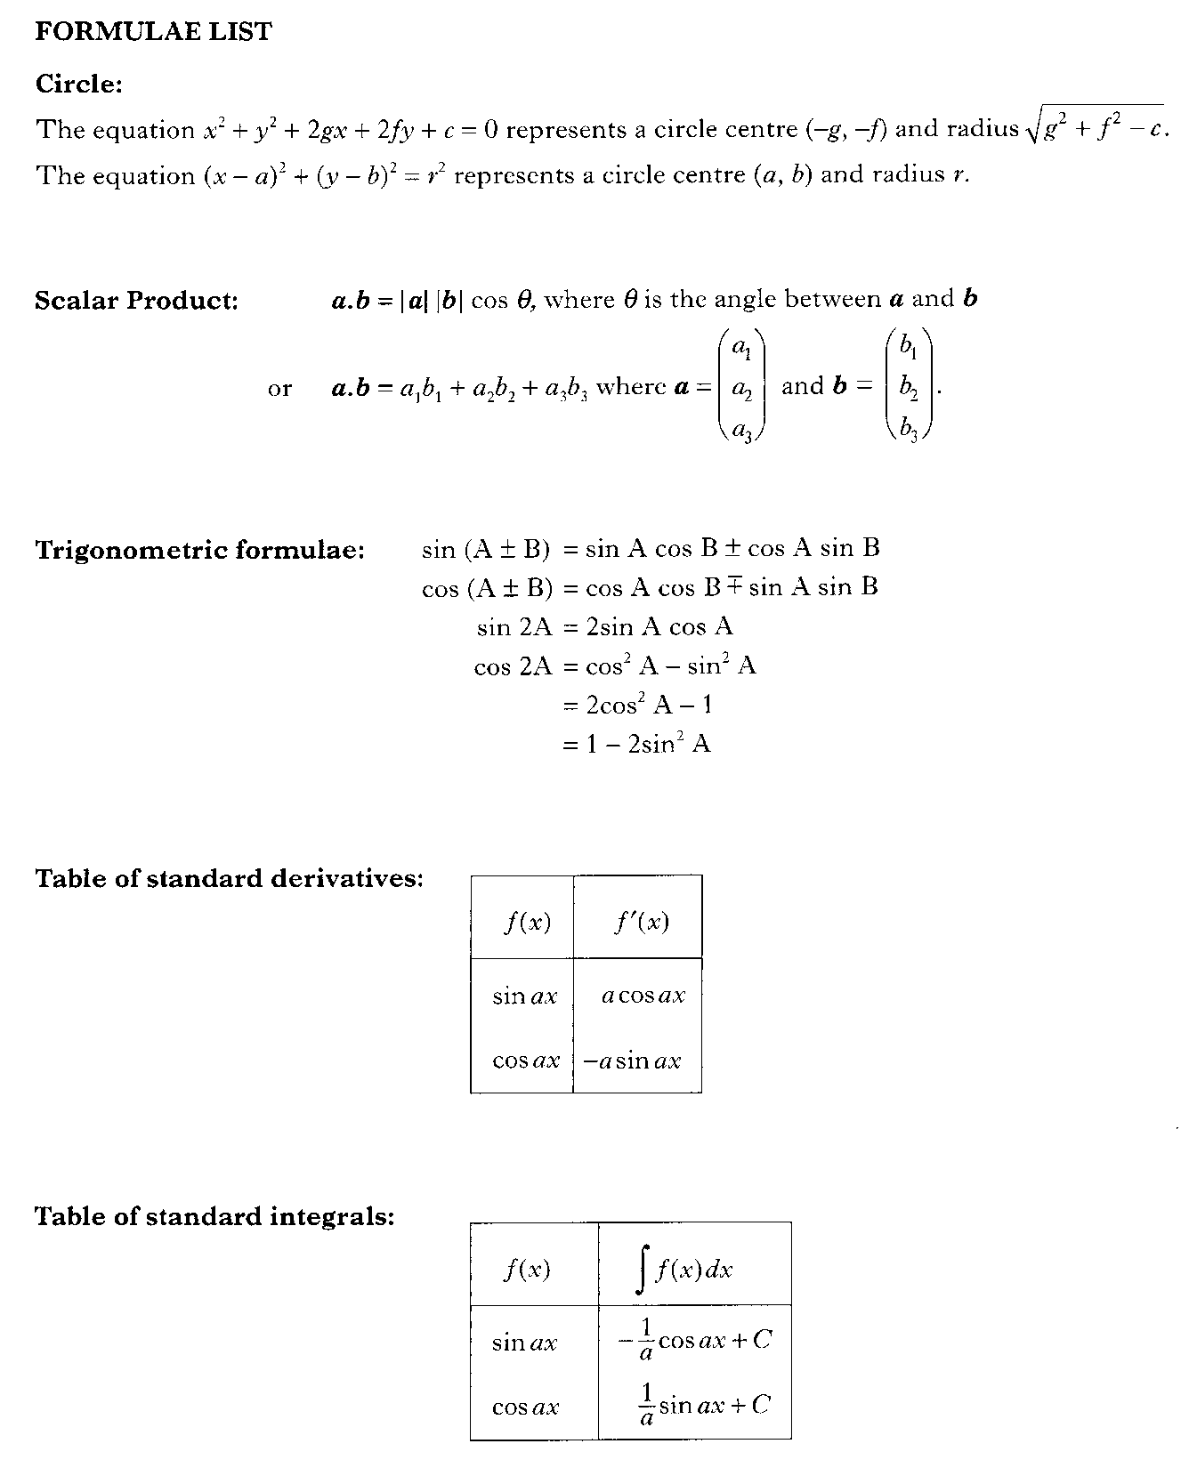
Return to Question

Slide 4
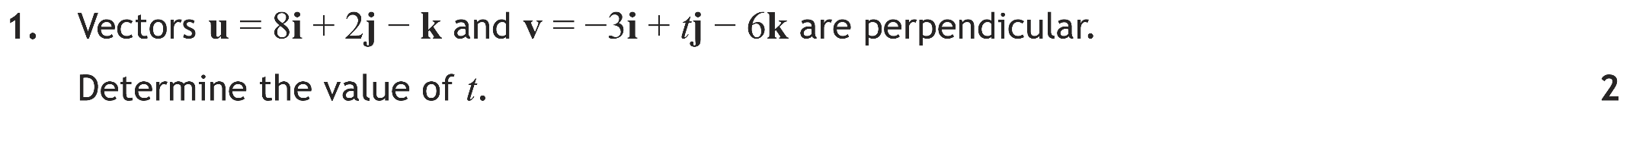
F
Solution
Main Grid

Slide 5
Q1
Main Grid

Slide 6
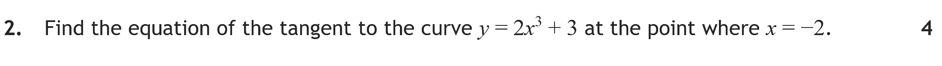
F
Solution
Main Grid

Slide 7
Q2
Main Grid

Slide 8
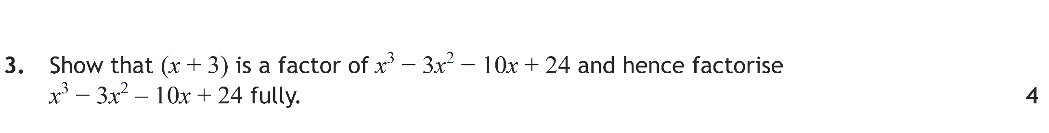
F
Solution
Main Grid

Slide 9
Q3
–3 | 1 | –3 | –10 | 24
 |  | –3 | 18 | –24
 | 1 | –6 | 8 | 0
Since remainder = 0, (x + 3) is a factor.
Main Grid

Slide 10

F
Solution
Main Grid

Slide 11
Q4
Main Grid

Slide 12

F
Solution
Main Grid

Slide 13
Q5a
Q5b
Main Grid

Slide 14

F
Solution
Main Grid

Slide 15
Q6
Main Grid

Slide 16
F
Solution
Main Grid

Slide 17
Q7
Main Grid

Slide 18
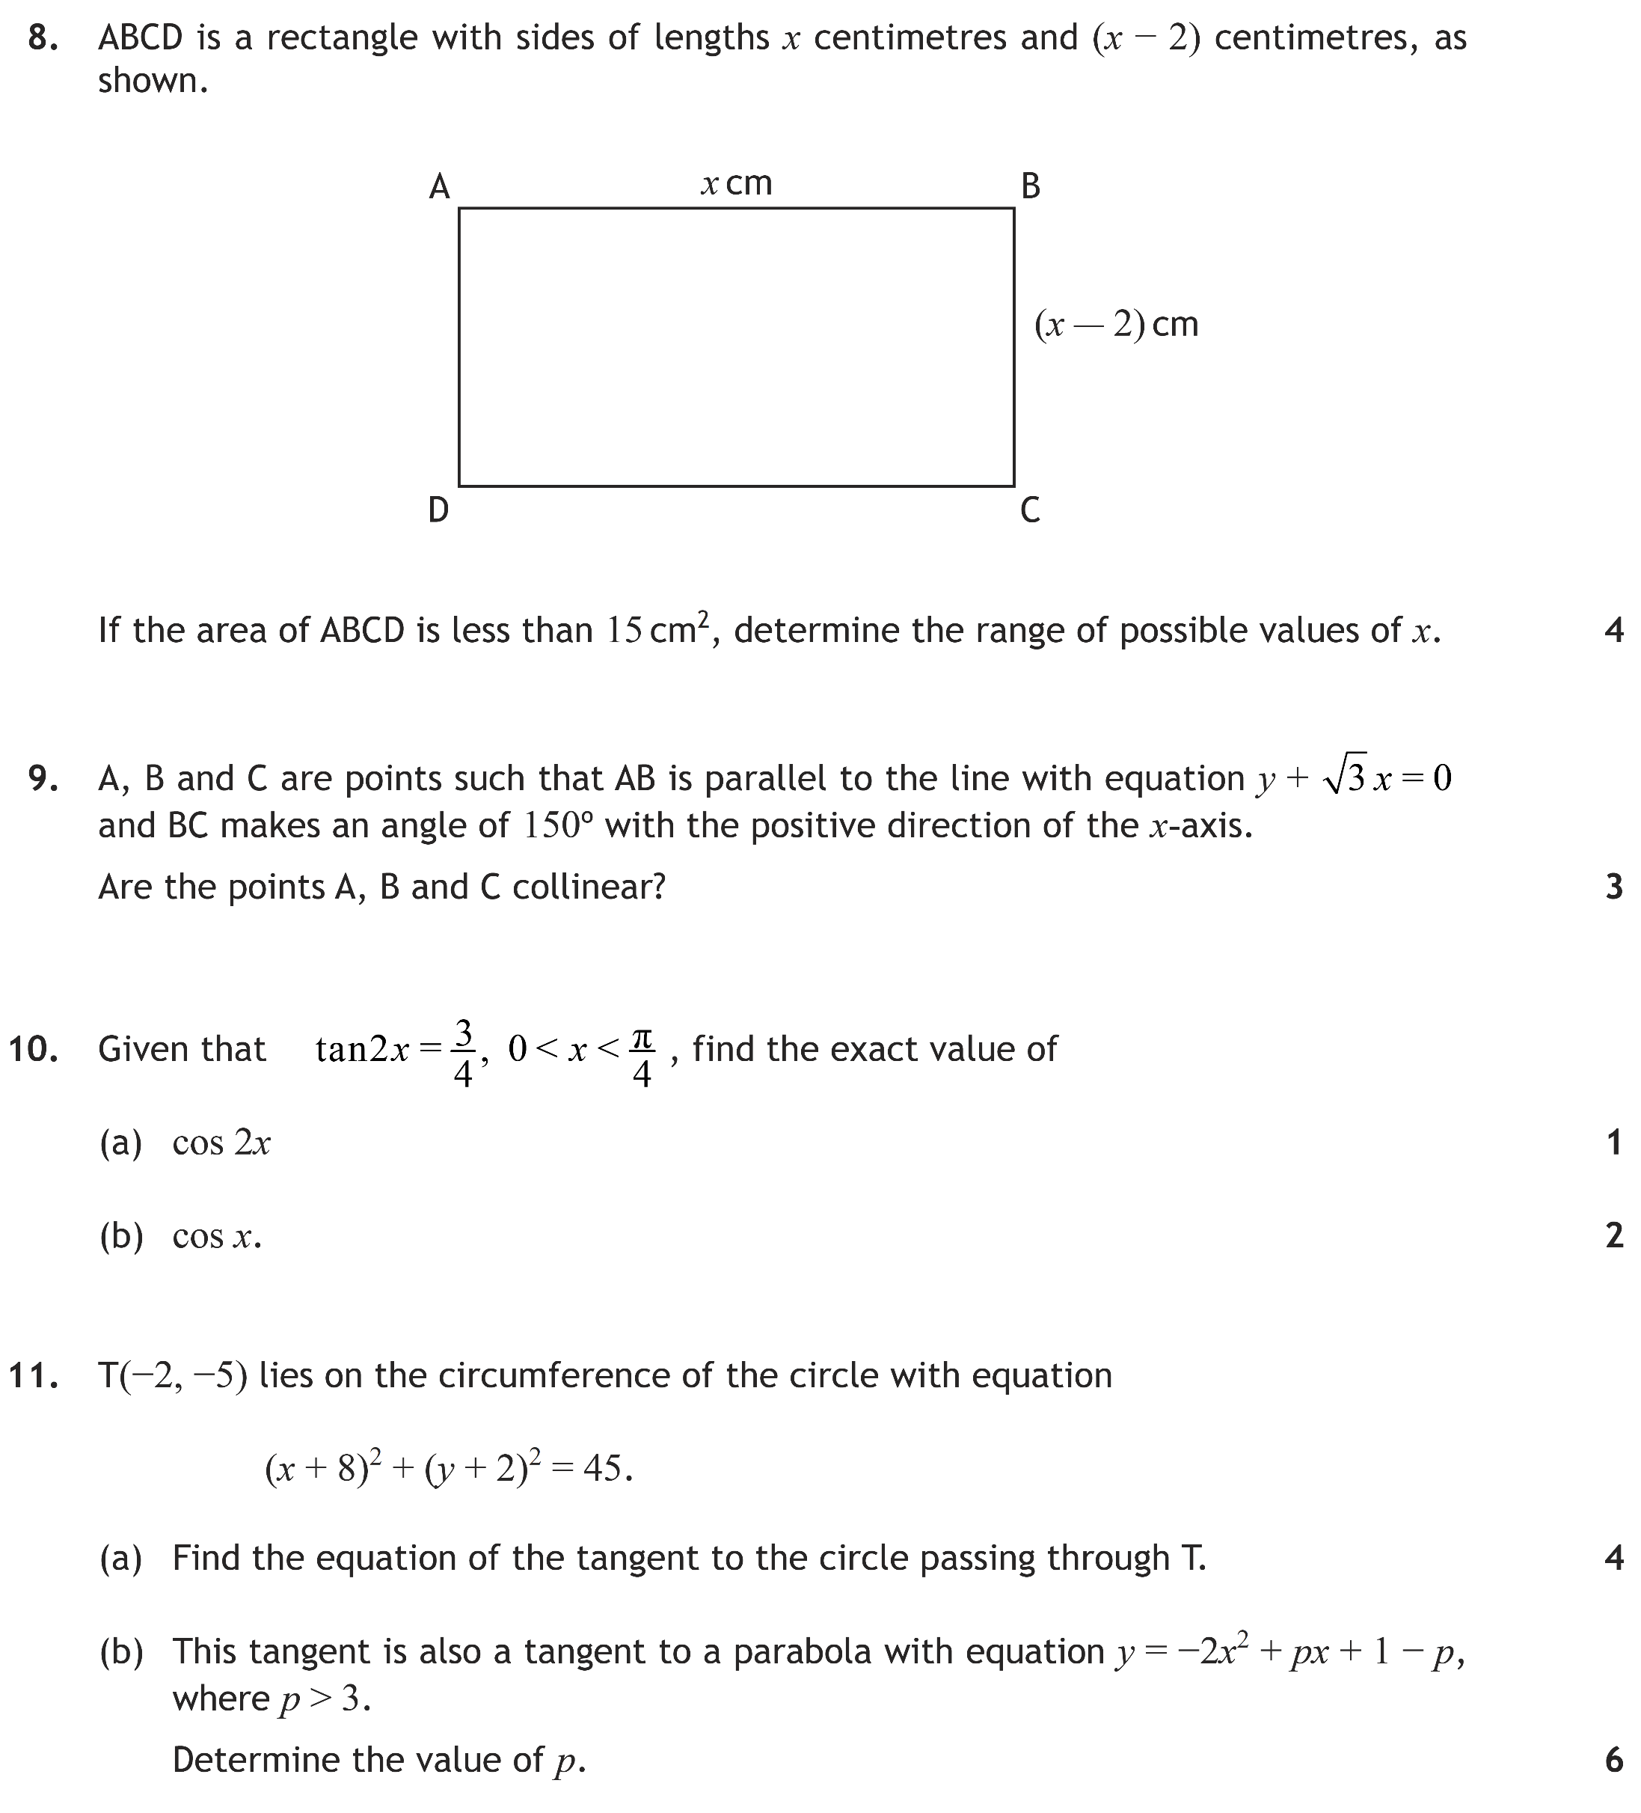
F
Solution
Main Grid

Slide 19
Q8
Main Grid

Slide 20

F
Solution
Main Grid

Slide 21
Q9
Related angle is 30º. Since 150º is in the sine quadrant the answer will be negative.
Main Grid

Slide 22

F
Solution
Main Grid

Slide 23
Q10a
3
2x
4
Q10b
Main Grid

Slide 24
F
Solution 11a
Solution 11b
Main Grid

Slide 25
Q11a
Solution 11b
Main Grid

Slide 26
Q11b
Main Grid

Slide 27
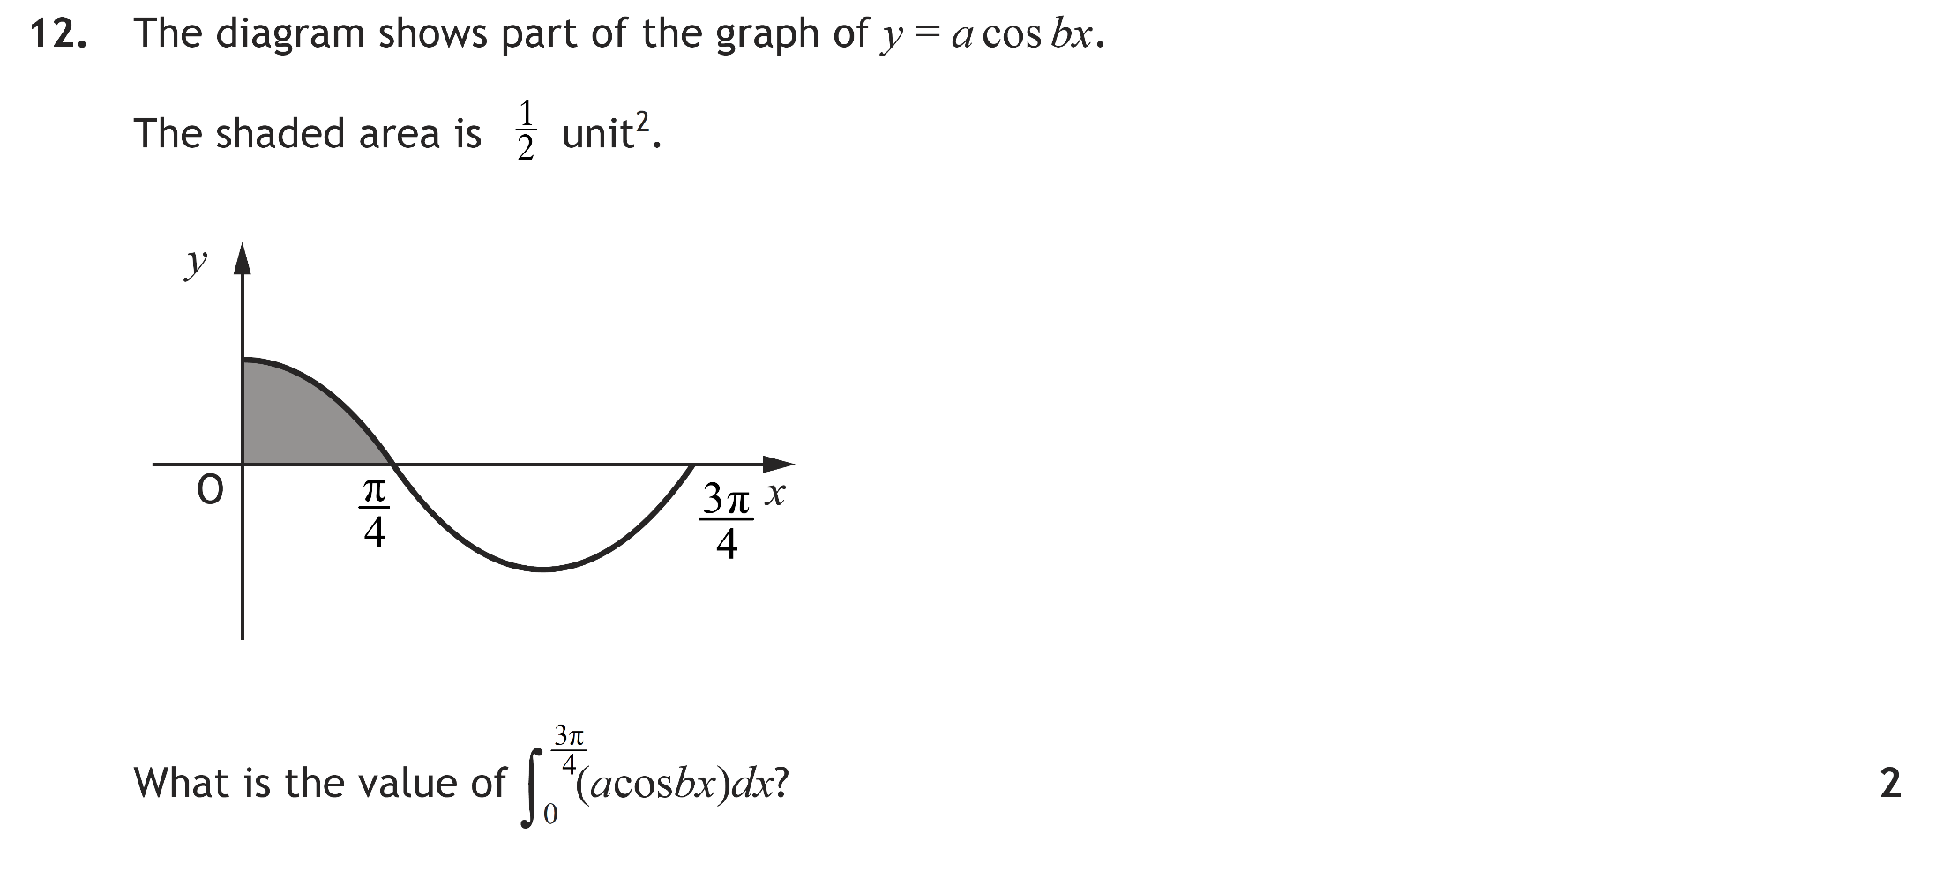
F
Solution
Main Grid

Slide 28
Q12
Main Grid

Slide 29
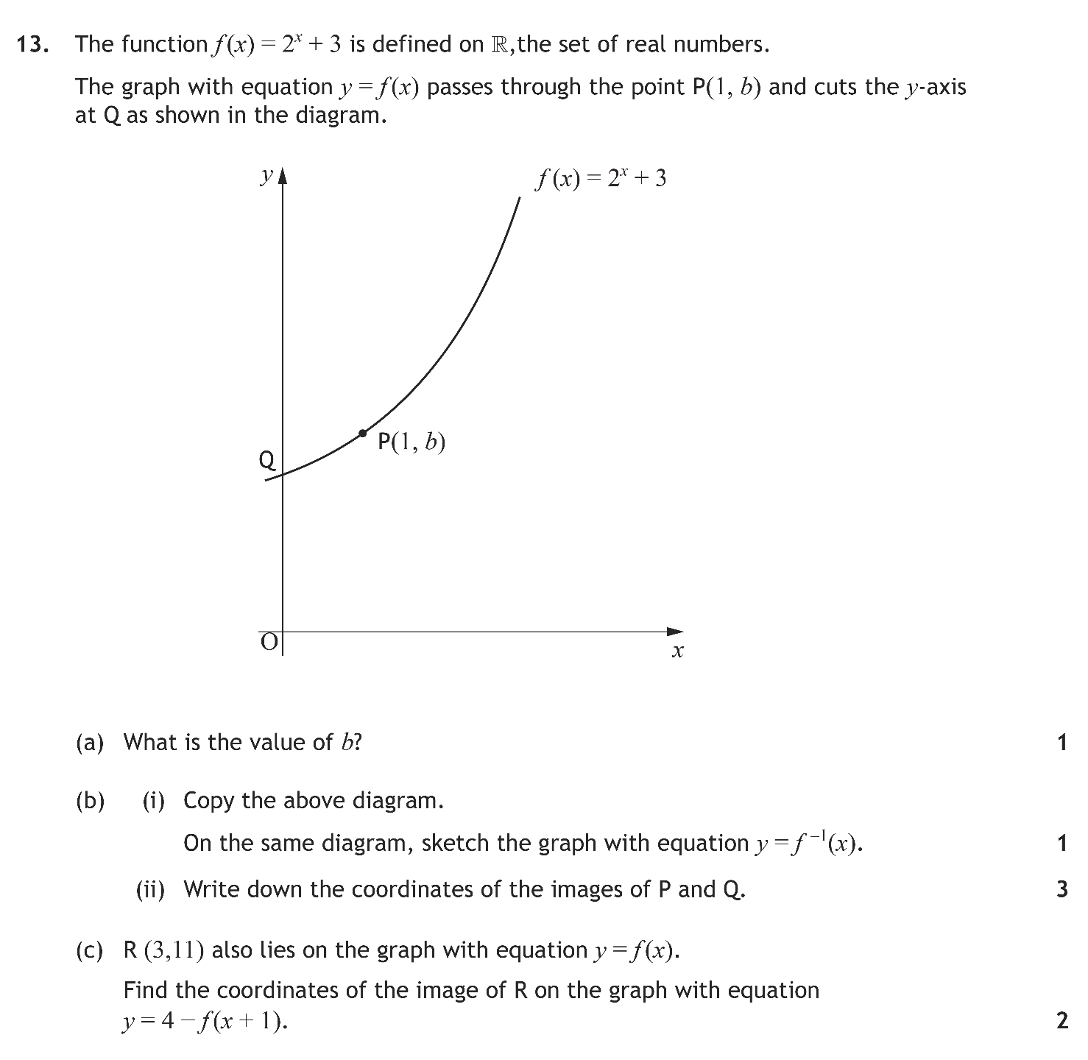
F
Solution
Main Grid

Slide 30
Q13a
Q13b
P’(5,1)
Q’(4,0)
Q13c
Main Grid

Slide 31
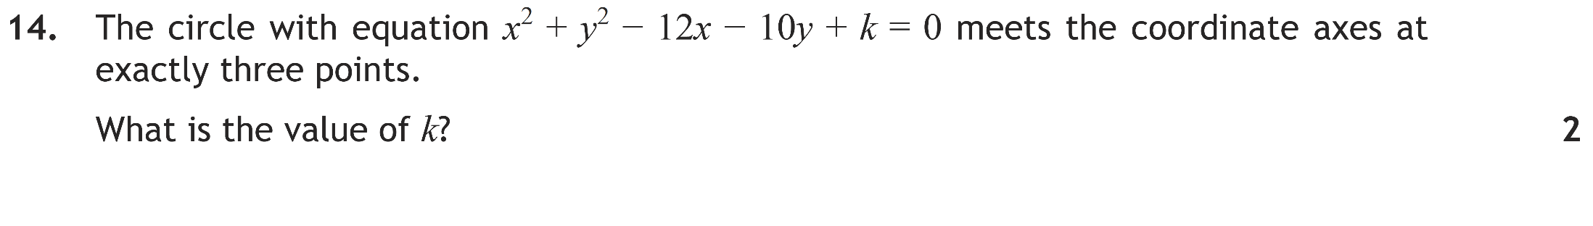
F
Solution
Main Grid

Slide 32
Q14
(6, 5)
r
Main Grid

Slide 33
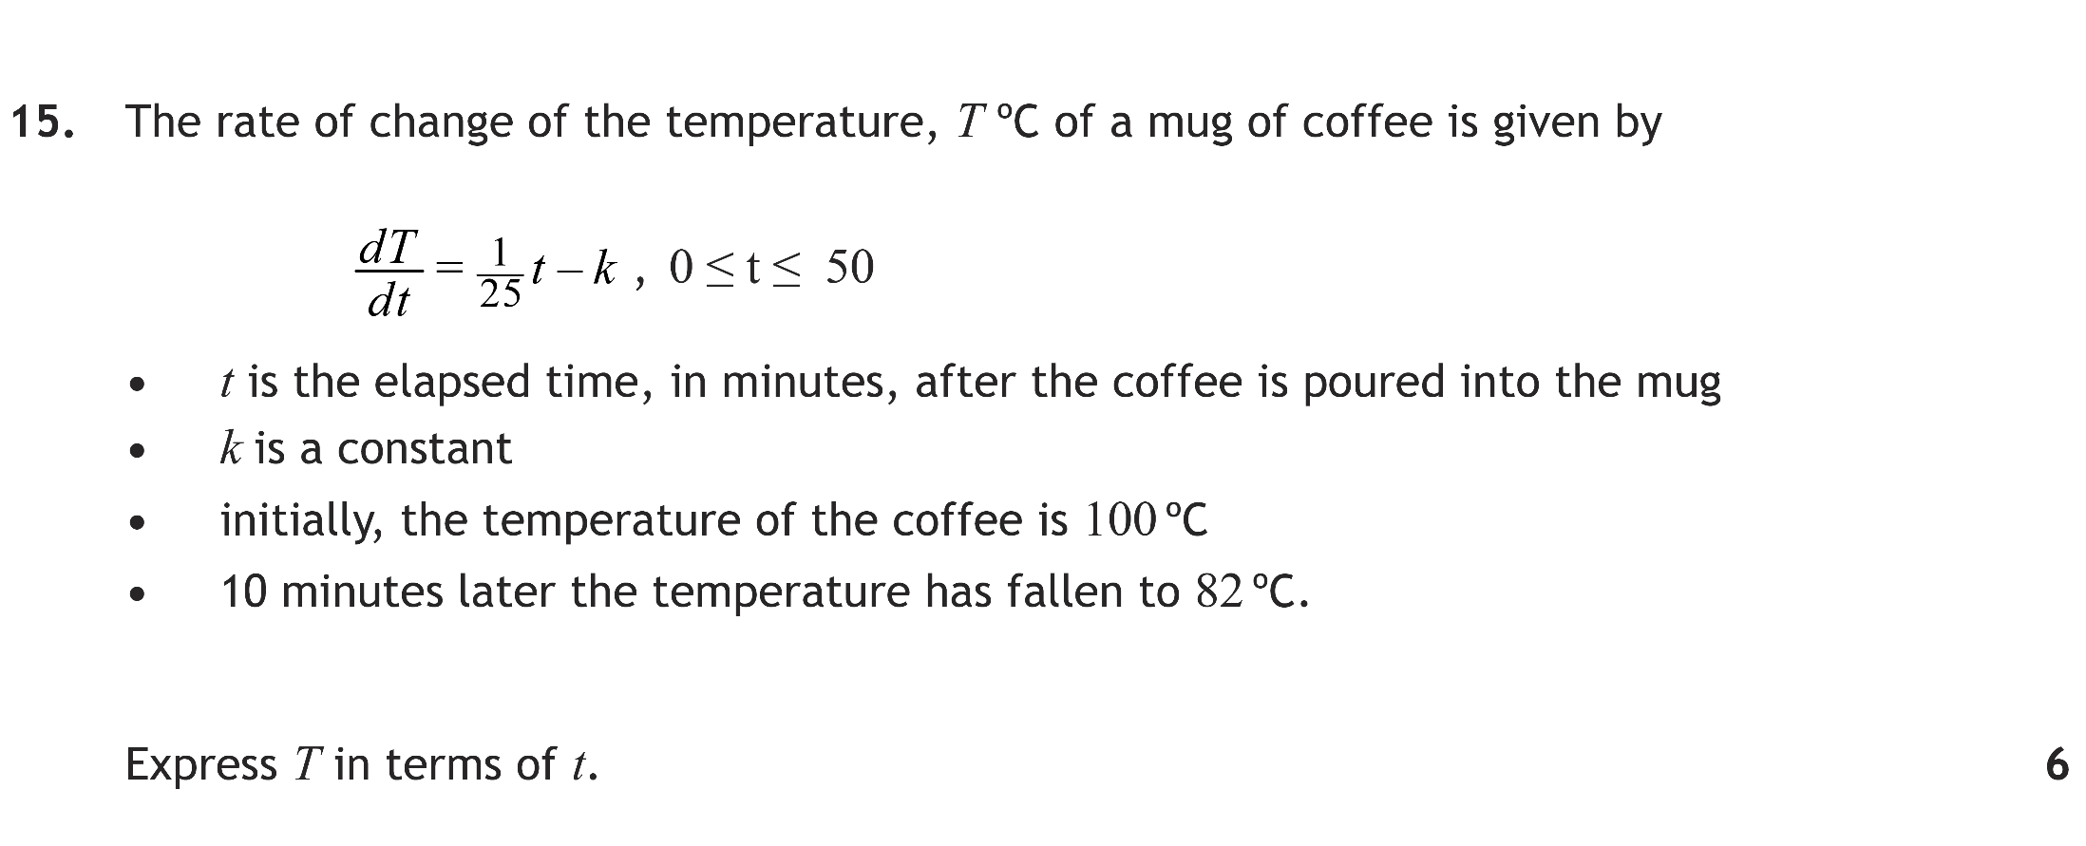
F
Solution
Main Grid

Slide 34
Q15
Main Grid

Slide 35
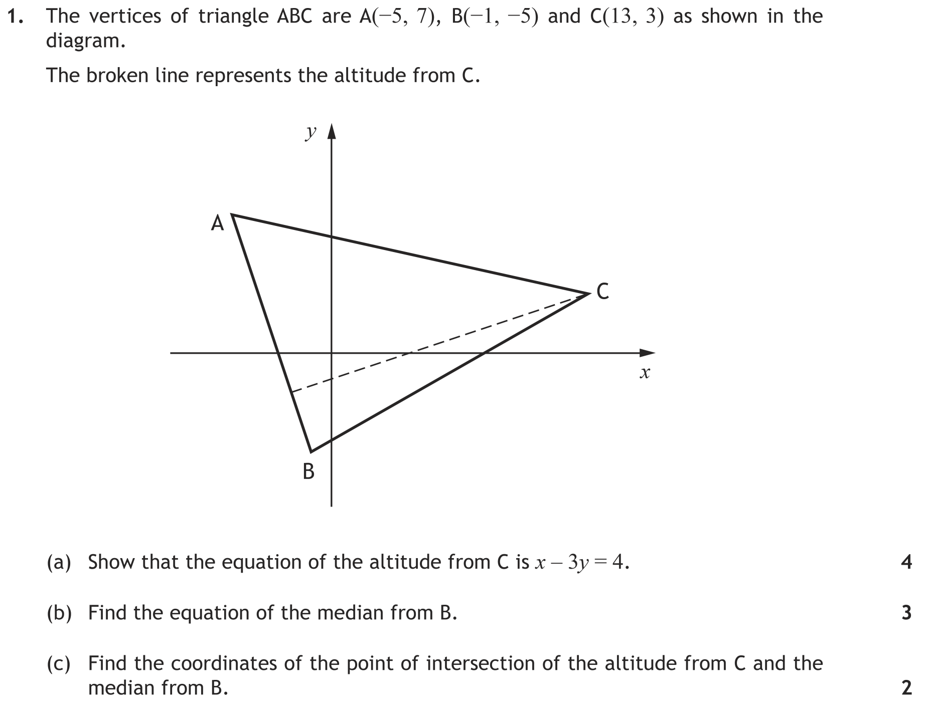
F
Solution 1a
Solution 1b
Solution 1c
Main Grid

Slide 36
Q1a
Solution 1b
Solution 1c
Main Grid

Slide 37
Q1b
Solution 1c
Main Grid

Slide 38
Q1c
Main Grid

Slide 39
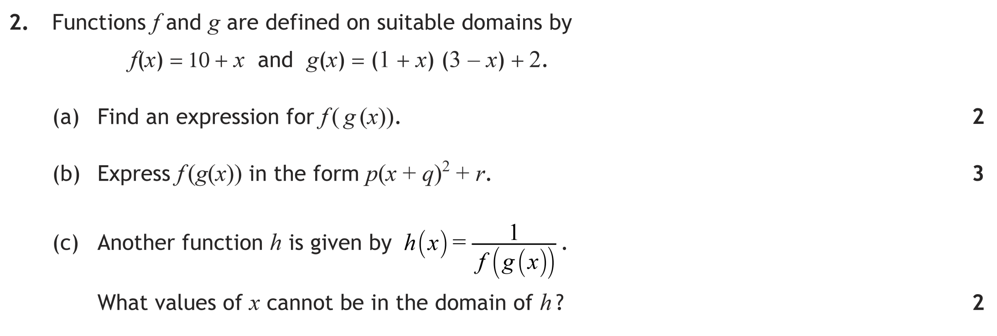
F
Solution 2ab
Solution 2c
Main Grid

Slide 40
Q2a
Q2b
Solution 2c
Main Grid

Slide 41
Q2c
Main Grid

Slide 42
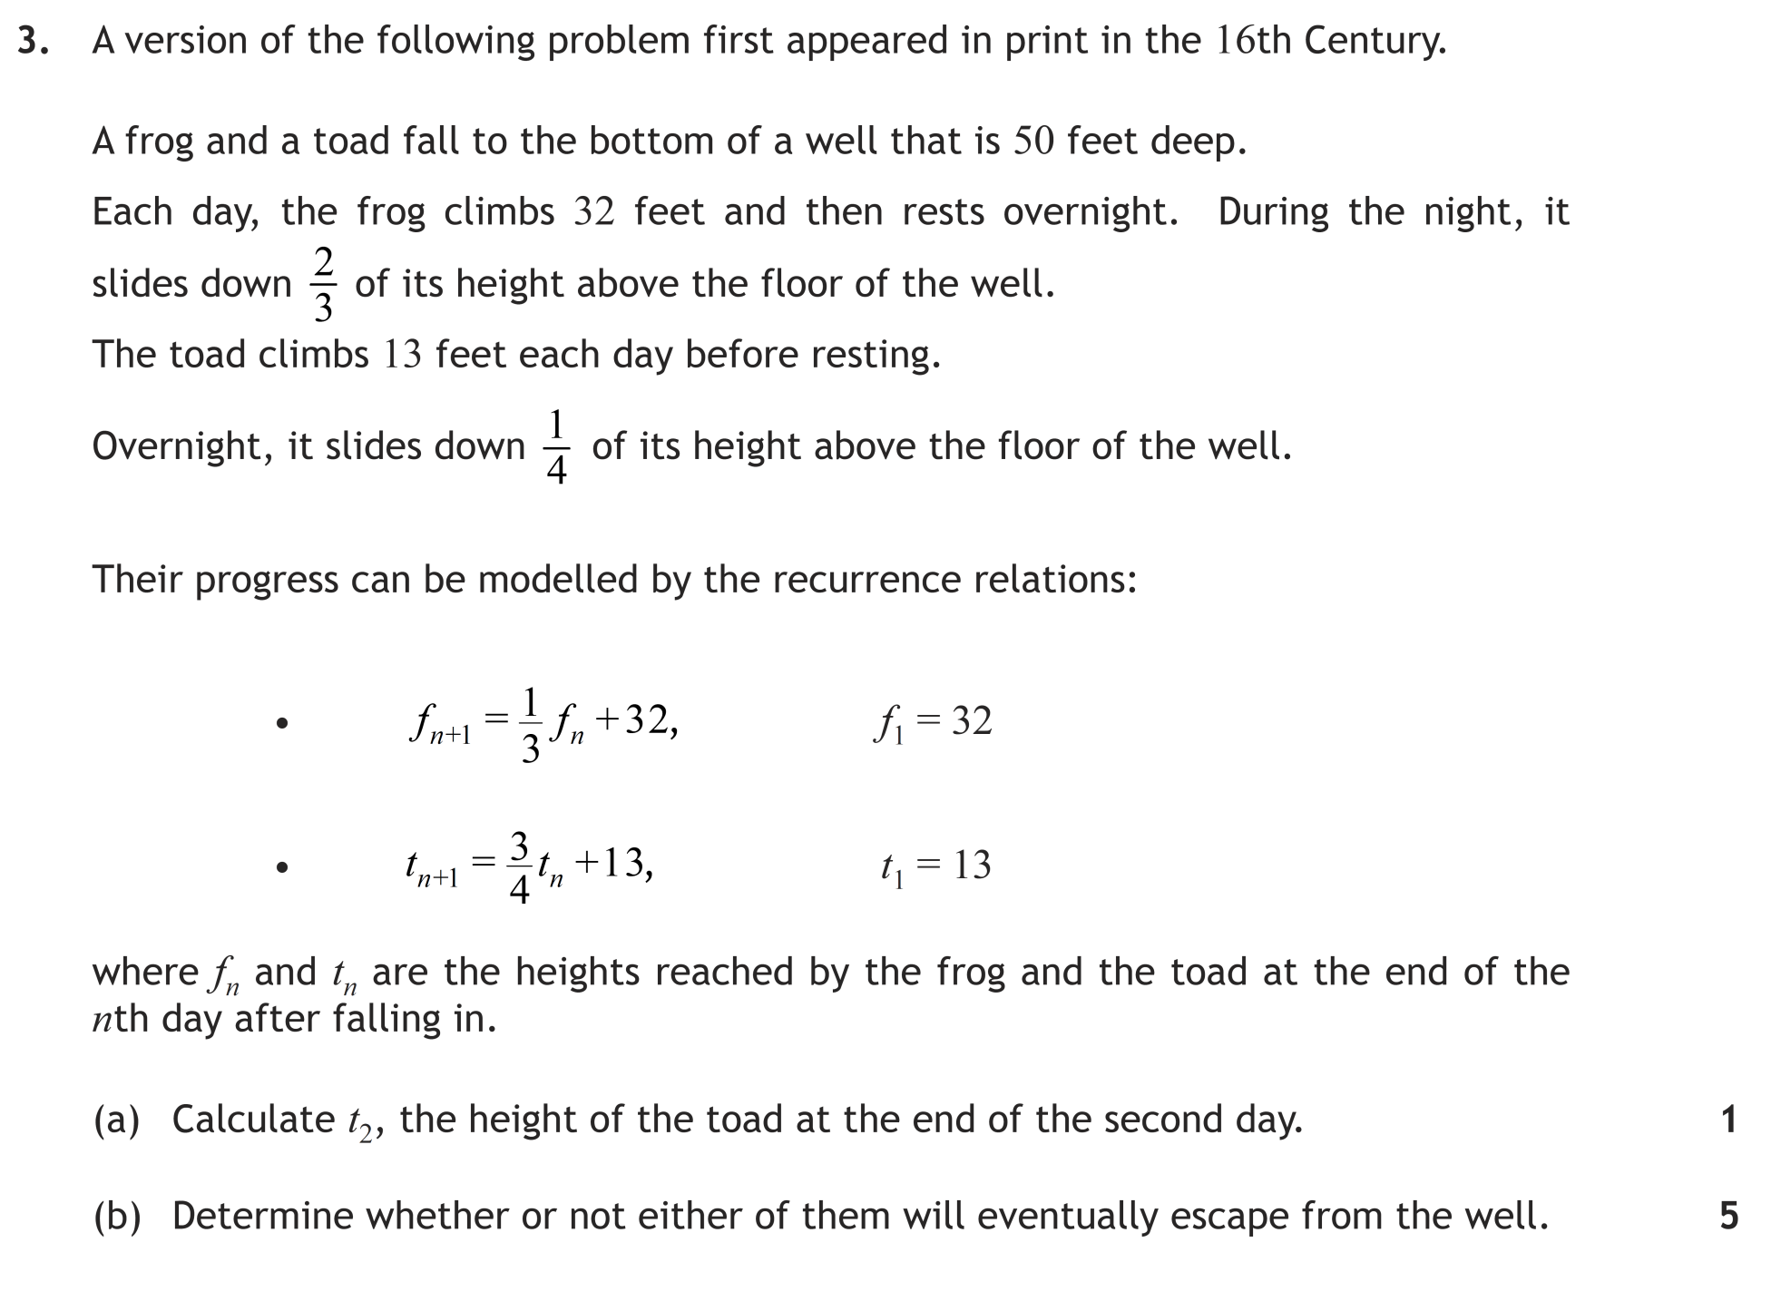
F
Solution
Main Grid

Slide 43
Q3a
Q3b
Main Grid

Slide 44
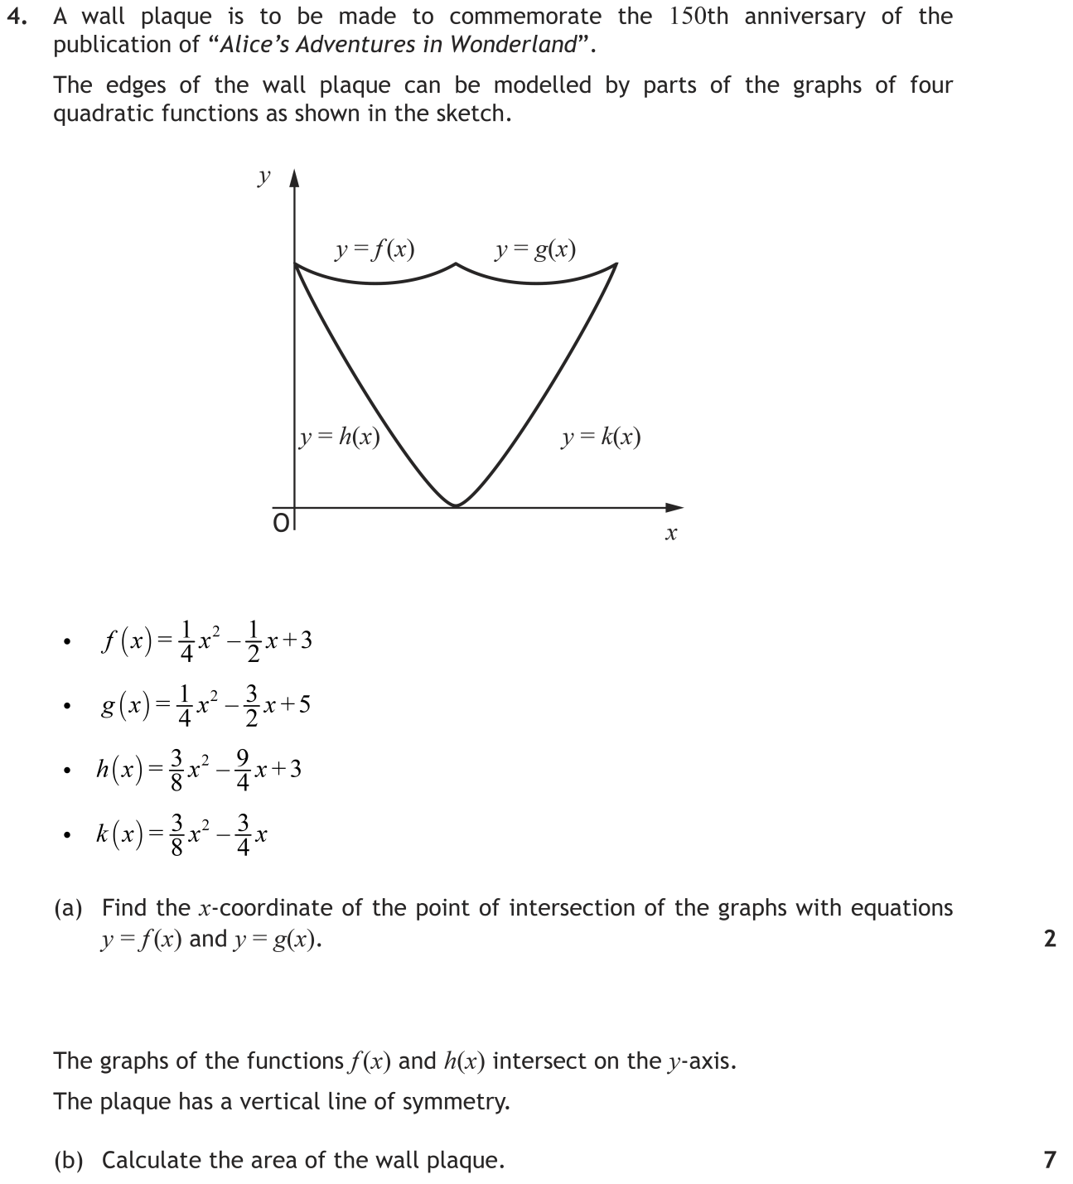
F
Solution
Main Grid

Slide 45
Q4a
Q4b
Main Grid

Slide 46
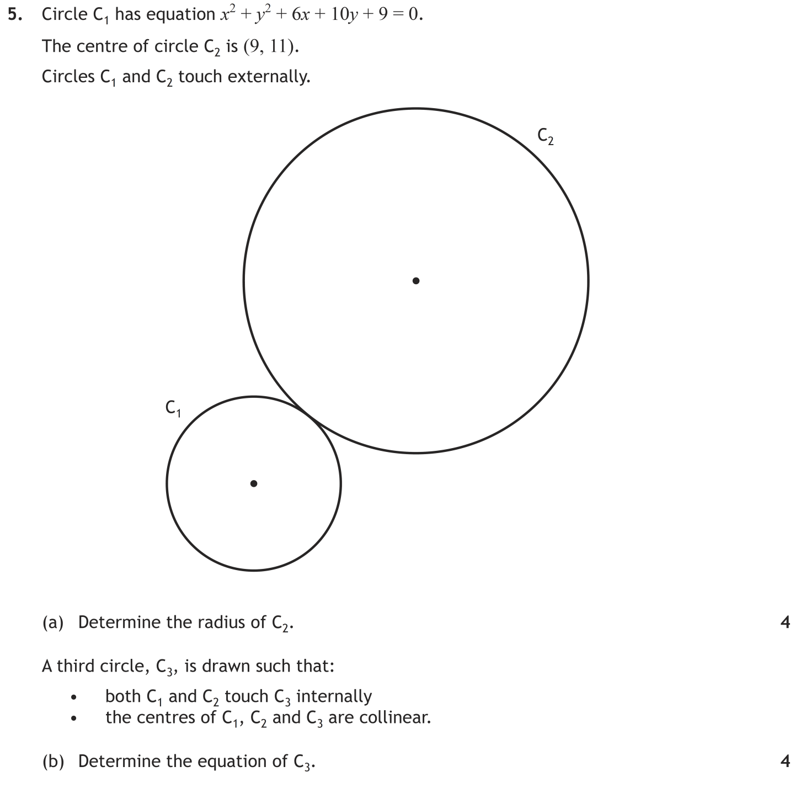
F
Solution
Main Grid

Slide 47
Q5a
Q5b
Main Grid

Slide 48
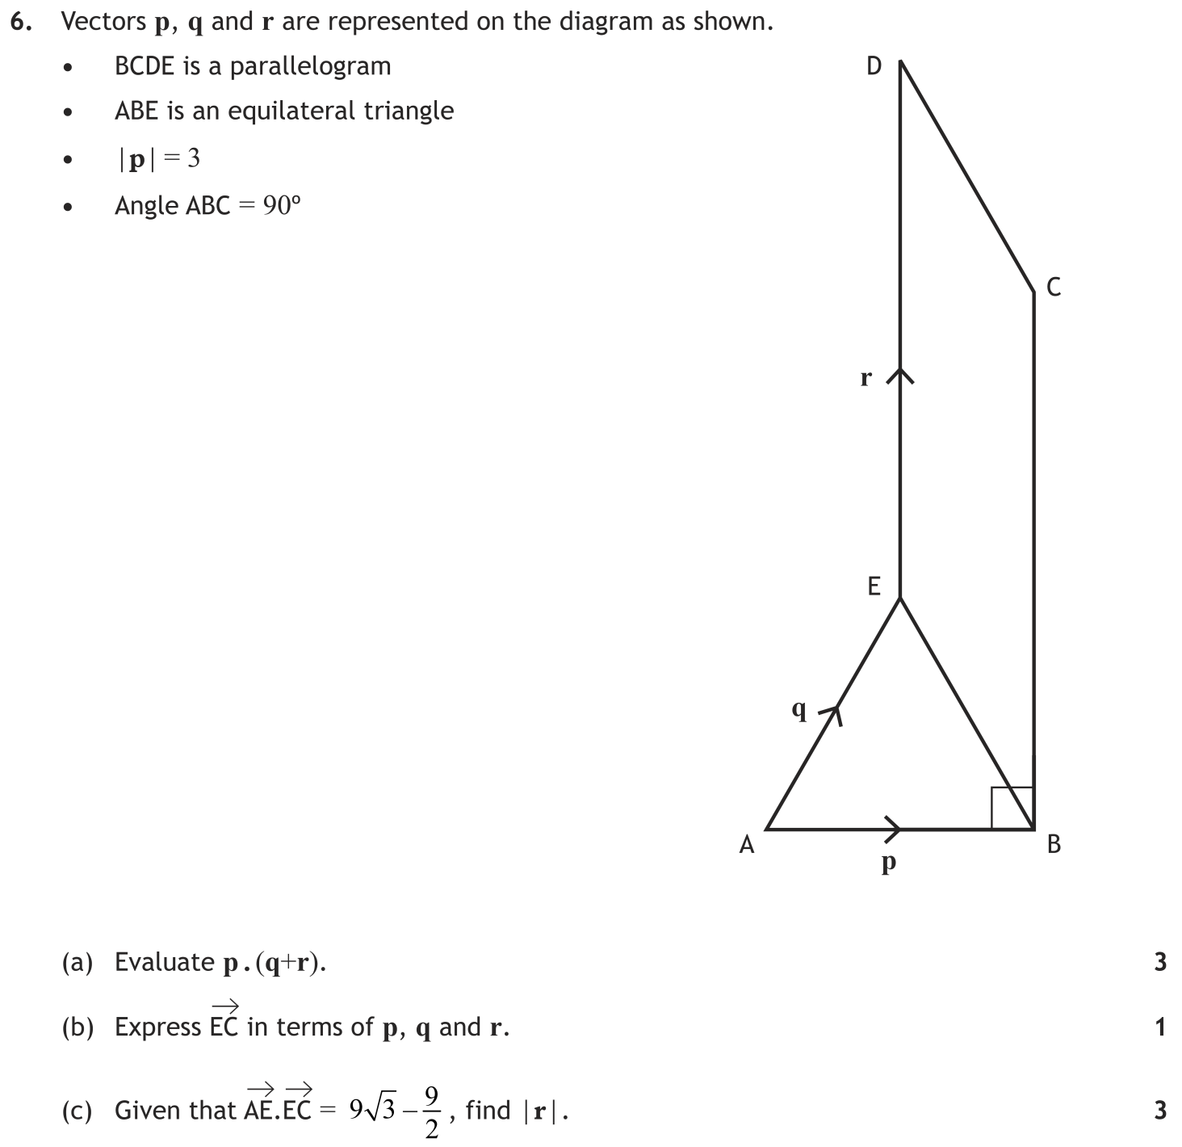
F
Solution
Main Grid

Slide 49
Q6a
Q6b
Q6c
Main Grid

Slide 50
F
Solution
Main Grid

Slide 51
Q7a
Q7b
Q7c
Main Grid

Slide 52
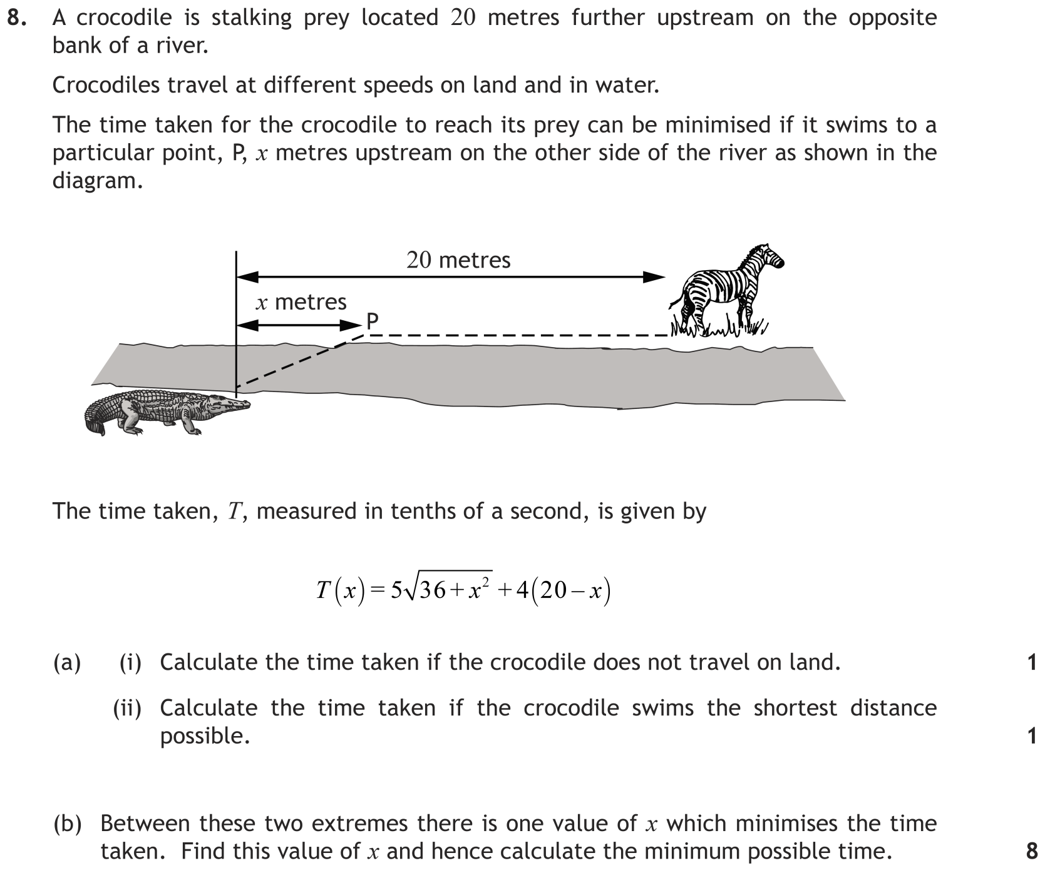
F
Solution
Main Grid

Slide 53
Q8a(i)
Q8a(ii)
Q8b
x | 7 | 8 | 9
T’(x) | - | 0 | +
Shape
 | Min at x = 8
Main Grid

Slide 54
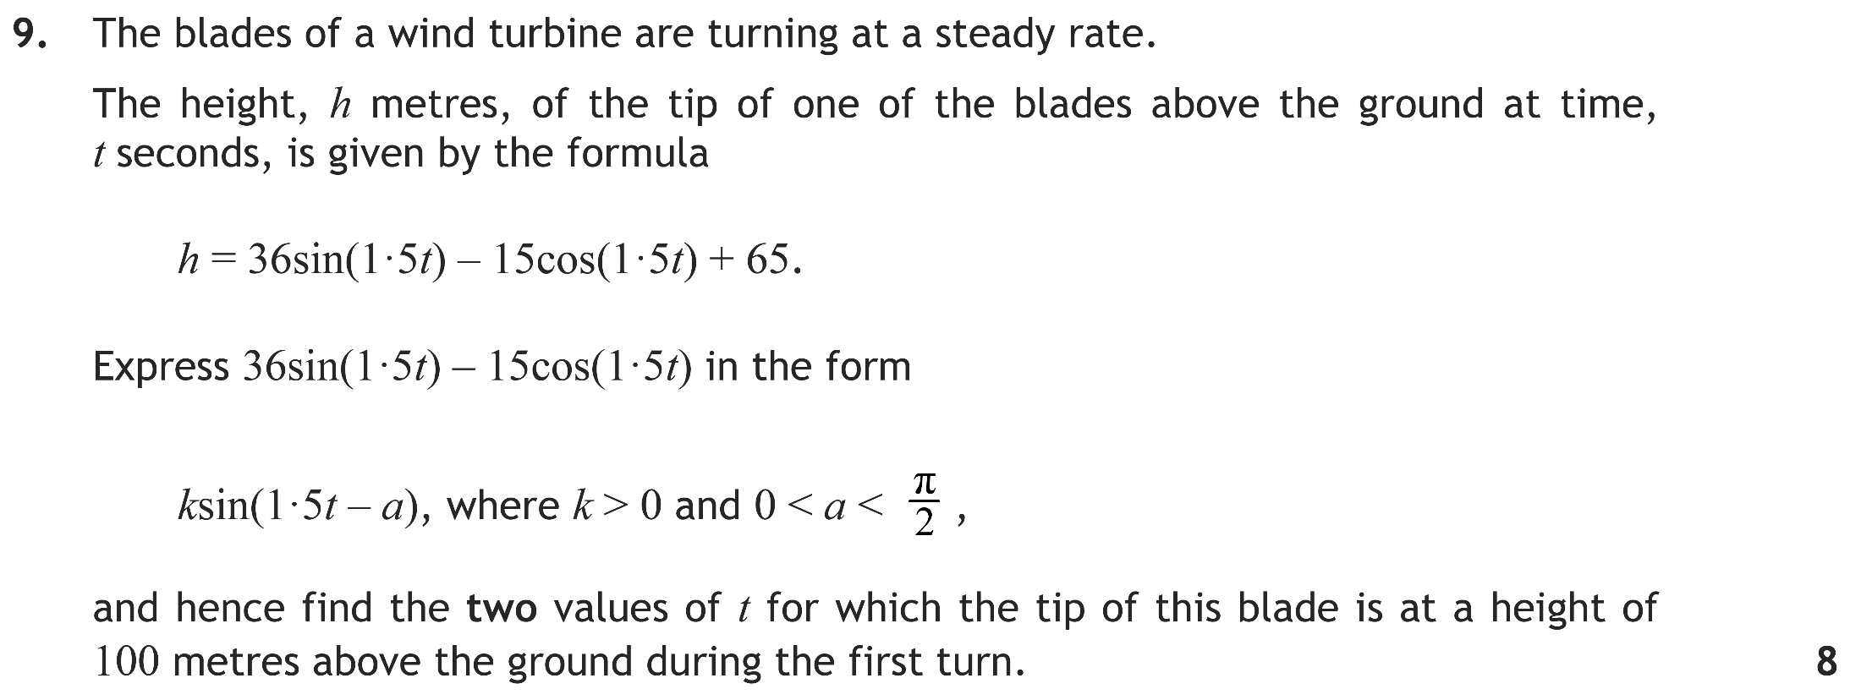
F
Solution
Main Grid

Slide 55
Q9
More Solution
Main Grid

Slide 56
Q9cont^{d}
Main Grid

Slide 57
F
Solution
Main Grid

Slide 58
Q1
Main Grid

Slide 59
F
Solution
Main Grid

Slide 60
Q2
Main Grid

Slide 61
F
Solution
Main Grid

Slide 62
Q3
Main Grid

Slide 63
F
Solution
Main Grid

Slide 64
Q4
Main Grid

Slide 65
F
Solution
Main Grid

Slide 66
Q5
Main Grid

Slide 67
F
Solution
Main Grid

Slide 68
Q6
Main Grid

Slide 69
F
Solution
Main Grid

Slide 70
Q7
Main Grid

Slide 71
F
Solution
Main Grid

Slide 72
Q8
At this point you could use b² – 4ac = 0, but because you are asked to find the point of contact you have to factorise anyway.
Main Grid

Slide 73
F
Solution
Main Grid

Slide 74
Q9a
Q9b
x | -5 | -4 | 0 | 0 | 2 | 3
dy/dx | + | 0 | – | – | 0 | +
Shape
Note: This could also be done by the method of quadratic inequalities with a quick sketch of the parabola.
Main Grid

Slide 75
F
Solution
Main Grid

Slide 76
Q10
Main Grid

Slide 77
F
Solution 11a
Solution 11b
Main Grid

Slide 78
Q11a
Solution 11b
Main Grid

Slide 79
Q11b
Main Grid

Slide 80
F
Solution
Main Grid

Slide 81
Q12a
Q12b
Main Grid

Slide 82
F
Solution
Main Grid

Slide 83
Q13
Main Grid

Slide 84
F
Solution
Main Grid

Slide 85
Q14a
Q14b
Main Grid

Slide 86
F
Solution
Main Grid

Slide 87
Q15a
Q15b
Main Grid

Slide 88
F
Solution 1a
Solution 1bc
Main Grid

Slide 89
Q1a(i)
Q1a(ii)
Solution 1bc
Main Grid

Slide 90
Q1b
Q1c
Main Grid

Slide 91
F
Solution
Main Grid

Slide 92
Q2
Main Grid

Slide 93
F
Solution 3a
Solution 3b
Main Grid

Slide 94
Q3a(i)
–1 | 2 | –9 | 3 | 14
 |  | –2 | 11 | –14
 | 2 | –11 | 14 | 0 | Remainder = 0, Therefore (x + 1) is a factor.
Q3a(ii)
Solution 3b
Main Grid

Slide 95
Q3b(i)
Q3b(ii)
Main Grid

Slide 96
F
Solution
Main Grid

Slide 97
Q4a
Q4b
Main Grid

Slide 98
F
Solution
Main Grid

Slide 99
Q5a
Q5b
Main Grid

Slide 100
F
Solution
Main Grid

Slide 101
Q6a
Q6b
Main Grid

Slide 102
F
Solution
Main Grid

Slide 103
Q7a
Q7b
Main Grid
x | 3 | 4 | 5
L’(x) | - | 0 | +
Shape
 | Min at x = 4m

Slide 104
F
Solution 8a
Solution 8b
Main Grid

Slide 105
Q8a
Solution 8b
Main Grid

Slide 106
Q8b
Main Grid

Slide 107
F
Solution
Main Grid

Slide 108
Q9
Main Grid

Slide 109
F
Solution
Main Grid

Slide 110
Q10a
Q10b
Main Grid

Slide 111
F
Solution
Main Grid

Slide 112
Q11a
Q11b
Main Grid

Slide 113
F
Solution
Main Grid

Slide 114
Q1a
Q1b
Main Grid

Slide 115
F
Solution
Main Grid

Slide 116
Q2
Main Grid

Slide 117
F
Solution
Main Grid

Slide 118
Q3
Main Grid

Slide 119
F
Solution
Main Grid

Slide 120
Q4
Main Grid

Slide 121
F
Solution
Main Grid

Slide 122
Q5a
Q5b
Main Grid

Slide 123
F
Solution
Main Grid

Slide 124
Q6
Main Grid

Slide 125
F
Solution
Main Grid

Slide 126
Q7
Main Grid

Slide 127
F
Solution
Main Grid

Slide 128
Q8
Main Grid

Slide 129
F
Solution
Main Grid

Slide 130
Q9a
Q9b(i)
Q9b(ii)
Main Grid

Slide 131
F
Solution 10a
Solution 10b
Main Grid

Slide 132
Q10a
Solution 10b
Main Grid

Slide 133
Q10b
Main Grid

Slide 134
F
Solution
Main Grid

Slide 135
Q11
Main Grid

Slide 136
F
Solution
Main Grid

Slide 137
Q12
Main Grid

Slide 138
F
Solution
Main Grid

Slide 139
Q13
Main Grid

Slide 140
F
Solution 14a
Solution 14b
Main Grid

Slide 141
Q14a
Solution 14b
Main Grid

Slide 142
Q14b
Main Grid

Slide 143
F
Solution
Main Grid

Slide 144
Q15a
Q15b
Q15c
Main Grid

Slide 145
F
Solution 1ab
Solution 1c
Main Grid

Slide 146
Q1a
Q1b
Solution 1c
Main Grid

Slide 147
Q1c
Main Grid

Slide 148
F
Solution
Main Grid

Slide 149
Q2a
1 | 2 | –5 | 1 | 2
 |  | 2 | –3 | –2
 | 2 | –3 | –2 | 0 | Remainder = 0, Therefore (x – 1) is a factor.
Q2b
Main Grid

Slide 150
F
Solution
Main Grid

Slide 151
Q3
Main Grid

Slide 152
F
Solution
Main Grid

Slide 153
Q4a
Q4b
Q4c
Main Grid

Slide 154
F
Solution
Main Grid

Slide 155
Q5a
Q5b
Q5c
Main Grid

Slide 156
F
Solution
Main Grid

Slide 157
Q6
Main Grid

Slide 158
F
Solution
Main Grid

Slide 159
Q7a
Q7b
Main Grid

Slide 160
F
Solution
Main Grid

Slide 161
Q8a
Main Grid
Q8b

Slide 162
F
Solution
Main Grid

Slide 163
Q9
Main Grid

Slide 164
F
Solution
Main Grid

Slide 165
Q10a
Q10b
Main Grid

Slide 166
F
Solution
Main Grid

Slide 167
Q11a
Q11b
Main Grid

Slide 168
F
Solution
Main Grid

Slide 169
Q1
Main Grid

Slide 170
F
Solution
Main Grid

Slide 171
Q2
Main Grid

Slide 172
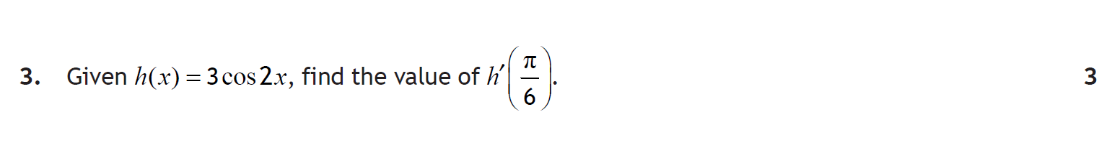
F
Solution
Main Grid

Slide 173
Q3
Main Grid

Slide 174
F
Solution
Main Grid

Slide 175
Q4
Main Grid

Slide 176
F
Solution
Main Grid

Slide 177
Q5a
Q5b
Main Grid

Slide 178
F
Solution
Main Grid

Slide 179
Q6
Main Grid

Slide 180
F
Solution
Main Grid

Slide 181
Q7a
Q7b
Q7c
Main Grid

Slide 182
F
Solution
Main Grid

Slide 183
Q8
Main Grid

Slide 184
F
Solution
Main Grid

Slide 185
Q9a
Q9b
Main Grid

Slide 186
F
Solution
Main Grid

Slide 187
Q10
Main Grid

Slide 188
F
Solution
Main Grid

Slide 189
Q11a
Q11b
Main Grid

Slide 190
F
Solution
Main Grid

Slide 191
Q12a
Q12b
Main Grid

Slide 192
F
Solution
Main Grid

Slide 193
Q13
Q13a(i)
Q13a(ii)
Q13b
Main Grid

Slide 194
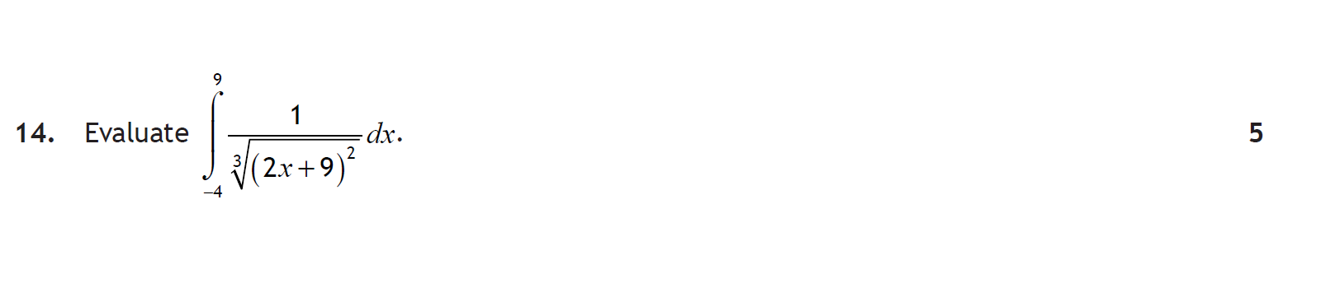
F
Solution
Main Grid

Slide 195
Q14
Main Grid

Slide 196
F
Solution
Main Grid

Slide 197
Q15
Main Grid

Slide 198
F
Solution
Main Grid

Slide 199
Q1
Main Grid

Slide 200
F
Solution
Main Grid

Slide 201
Q2a
Q2b
Main Grid

Slide 202
F
Solution
Main Grid

Slide 203
Q3
Main Grid

Slide 204
F
Solution
Main Grid

Slide 205
Q4
Main Grid

Slide 206
F
Solution 5ab
Solution 5c
Main Grid

Slide 207
Q5a
Q5b
Solution 5c
Main Grid

Slide 208
Q5c
Main Grid

Slide 209
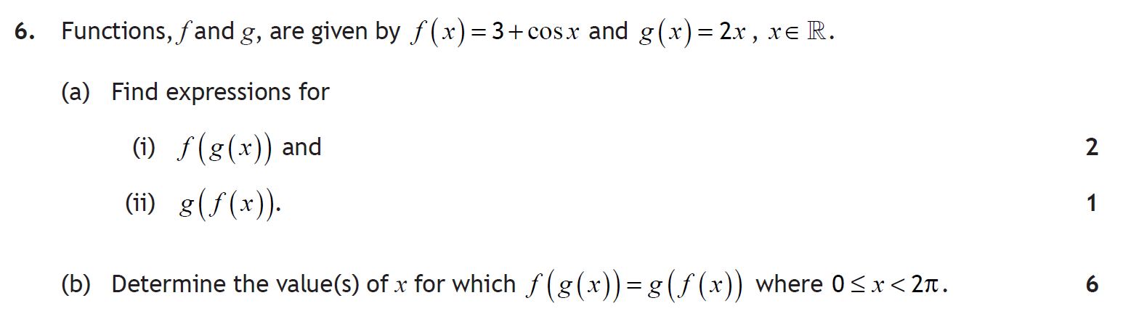
F
Solution
Main Grid

Slide 210
Q6a
Q6b
Main Grid

Slide 211
F
Solution 7a
Solution 7bc
Main Grid

Slide 212
Q7a(i)
2 | 2 | –3 | –3 | 2
 |  | 4 | 2 | –2
 | 2 | 1 | –1 | 0
Since remainder = 0, (x – 2) is a factor.
Q7a(ii)
Solution 7bc
Main Grid

Slide 213
Q7b
Q7c(i)
Q7c(ii)
Main Grid

Slide 214
F
Solution
Main Grid

Slide 215
Q8a
Q8b
More Solution
Main Grid

Slide 216
Q8b(i)
Q8b(ii)
Main Grid

Slide 217
F
Solution
Main Grid

Slide 218
Q9
x | 7 | 8 | 9
 | - | 0 | +
Shape
 | Min at x = 8
–8 would produce a negative value for P. Therefore, disregard.
Main Grid

Slide 219
F
Solution
Main Grid

Slide 220
Q10
Main Grid

Slide 221
F
Solution
Main Grid

Slide 222
Q11a
Q11b
Main Grid

Slide 223
F
Solution
Main Grid

Slide 224
Q12a(i)
Q12a(ii)
Q12b(i)
More Solution
Main Grid

Slide 225
Q12b(ii)
Q12c
Main Grid

Slide 226
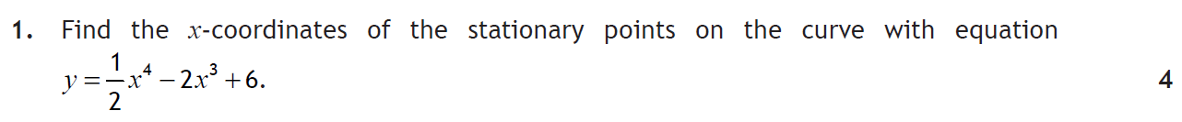
F
Solution
Main Grid

Slide 227
Q1
Main Grid

Slide 228
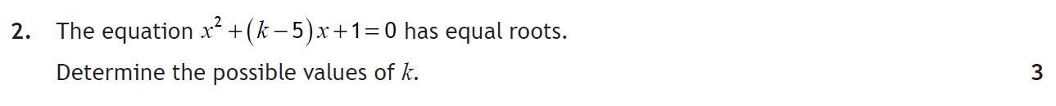
F
Solution
Main Grid

Slide 229
Q2
Main Grid

Slide 230
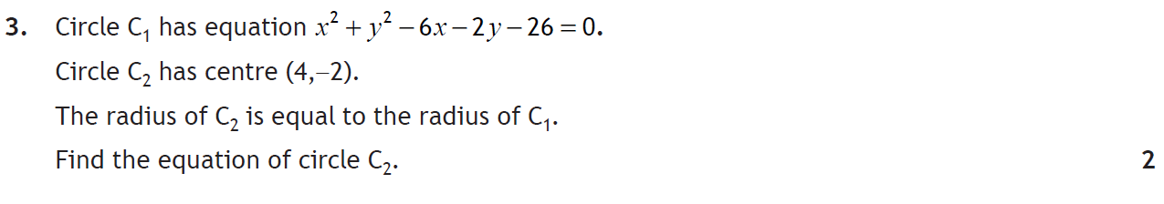
F
Solution
Main Grid

Slide 231
Q3
Main Grid

Slide 232
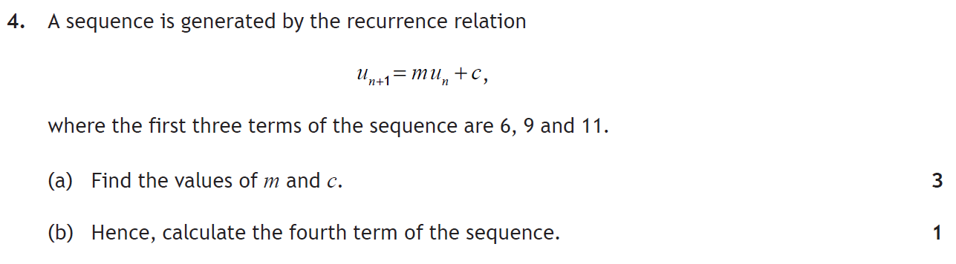
F
Solution
Main Grid

Slide 233
Q4a)
Q4b)
Main Grid

Slide 234
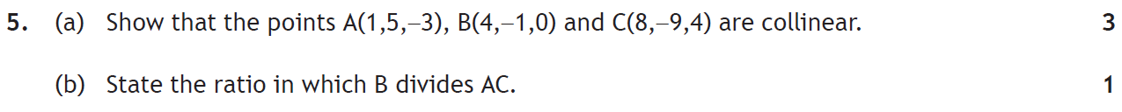
F
Solution
Main Grid

Slide 235
Q5a
Q5b
Main Grid

Slide 236
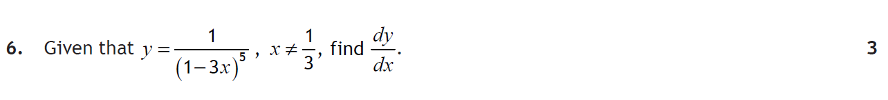
F
Solution
Main Grid

Slide 237
Q6
Main Grid

Slide 238
F
Solution
Main Grid

Slide 239
Q7
Main Grid

Slide 240
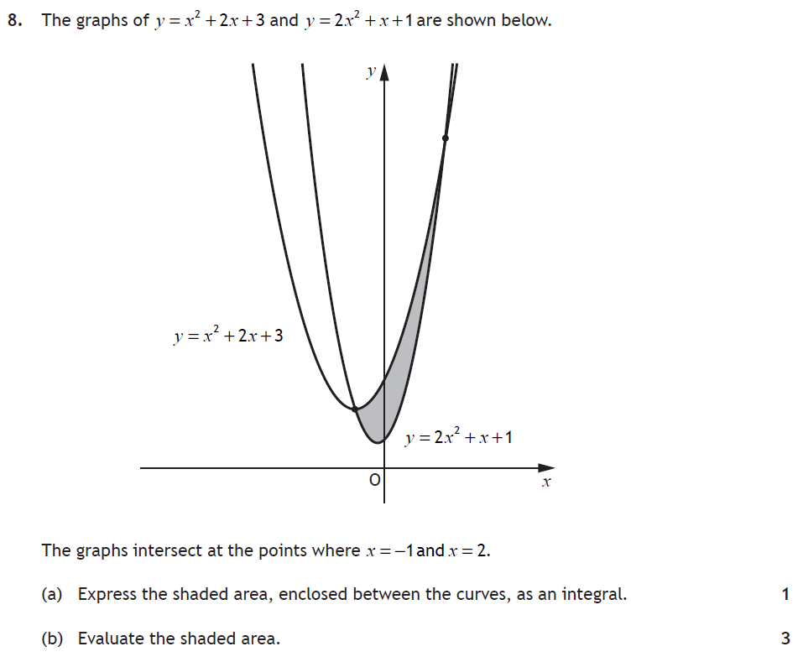
F
Solution
Main Grid

Slide 241
Q8a
Q8b
Main Grid

Slide 242
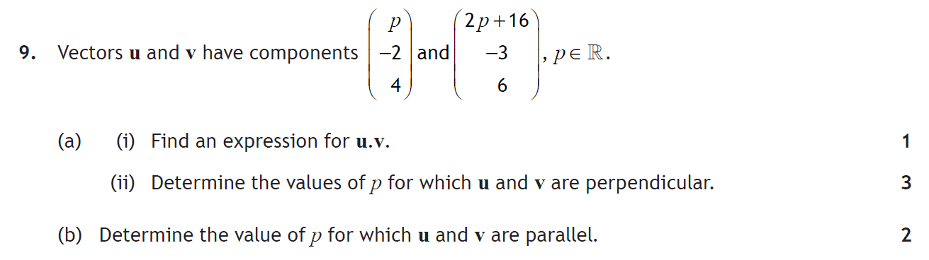
F
Solution
Main Grid

Slide 243
Q9ai)
Q9aii)
Q9b
Main Grid

Slide 244
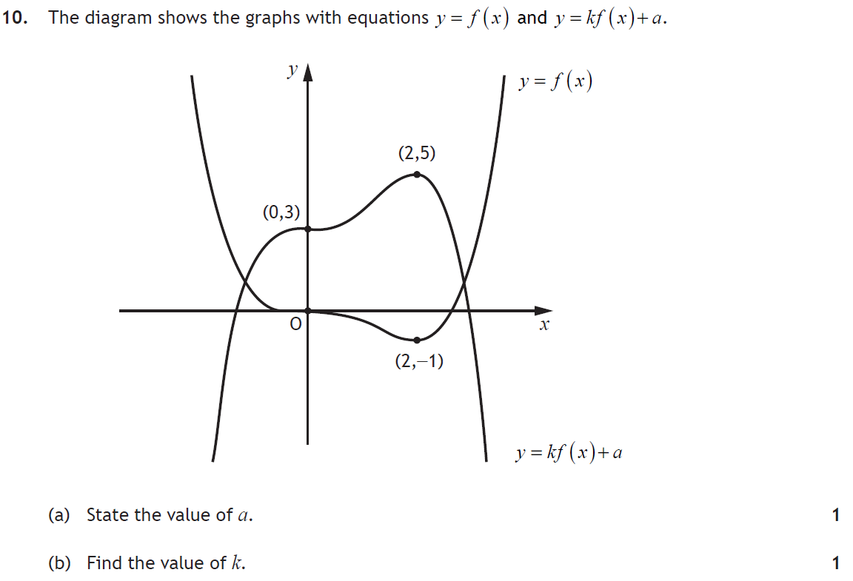
F
Solution
Main Grid

Slide 245
Q10
Main Grid

Slide 246
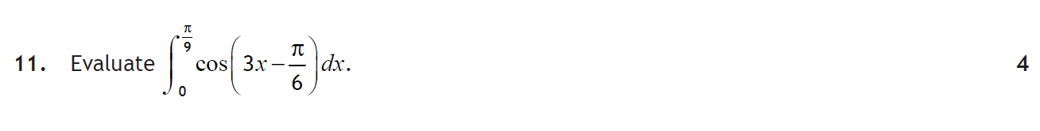
F
Solution
Main Grid

Slide 247
Q11
Main Grid

Slide 248
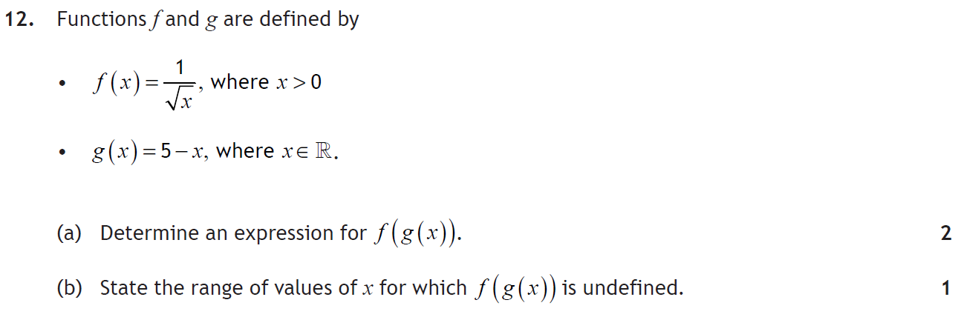
F
Solution
Main Grid

Slide 249
Q12a)
Q12b)
Main Grid

Slide 250
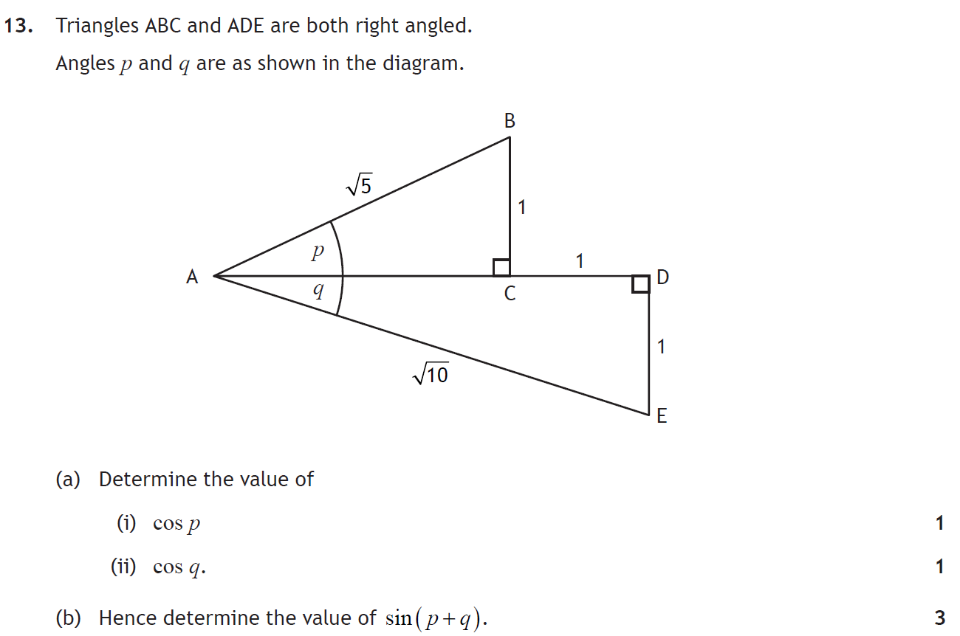
F
Solution
Main Grid

Slide 251
Q13
3
Q13a(i)
Q13a(ii)
Q13b)
Main Grid

Slide 252
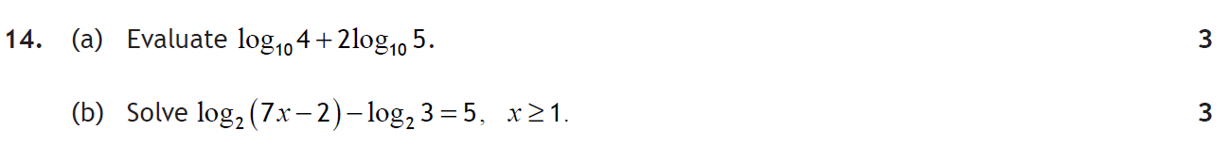
F
Solution
Main Grid

Slide 253
Q14a)
Q14b)
Main Grid

Slide 254
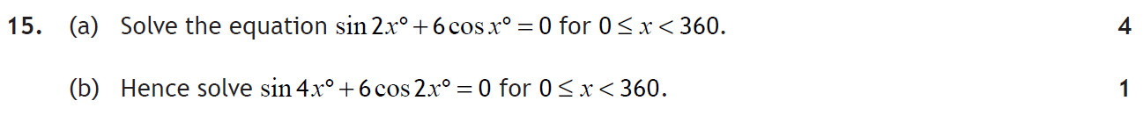
F
Solution
Main Grid

Slide 255
Q15a)
Q15b)
Main Grid

Slide 256
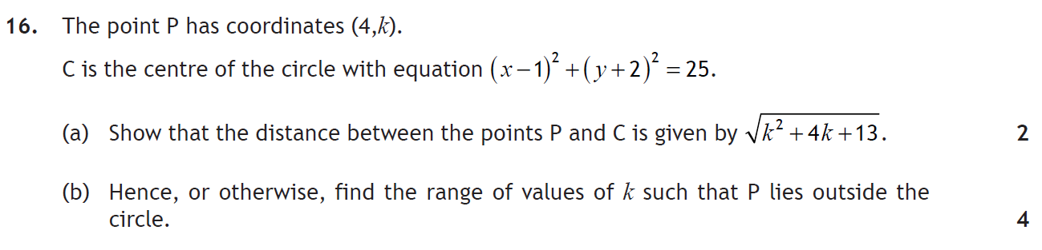
F
Solution
Main Grid

Slide 257
Q16a)
Main Grid
Q16b)

Slide 258
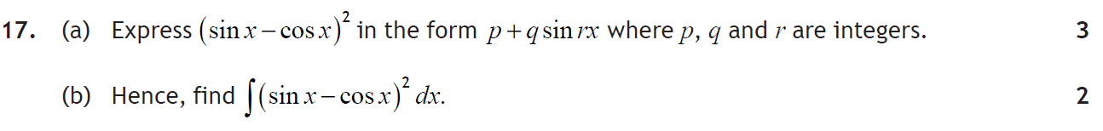
F
Solution
Main Grid

Slide 259
Q17a)
Main Grid
Q17b)

Slide 260
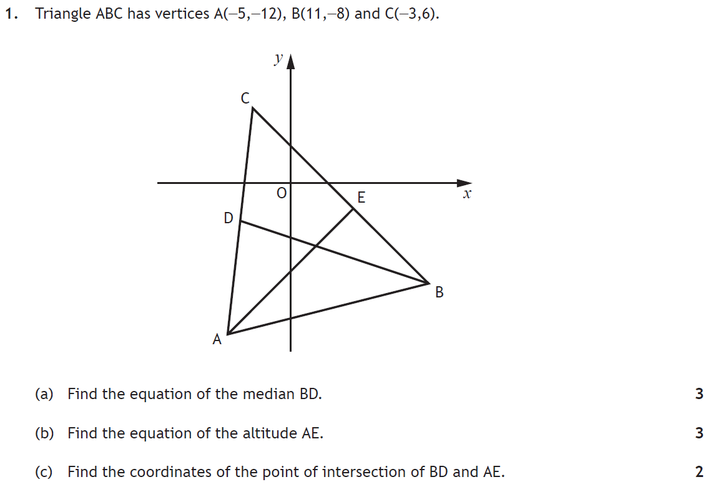
F
Solution
Main Grid

Slide 261
Q1a)
Main Grid
Q1b)
Q1c)

Slide 262
F
Solution
Main Grid

Slide 263
Q2
Main Grid

Slide 264
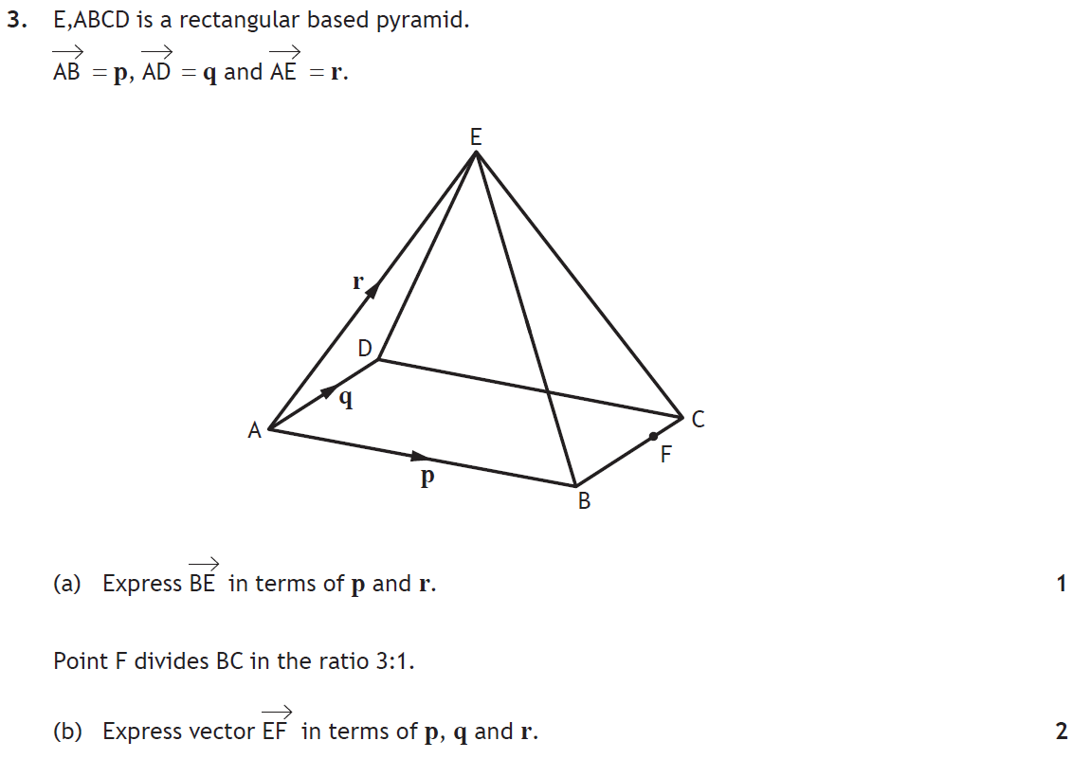
F
Solution
Main Grid

Slide 265
Q3a)
Q3b)
Main Grid

Slide 266
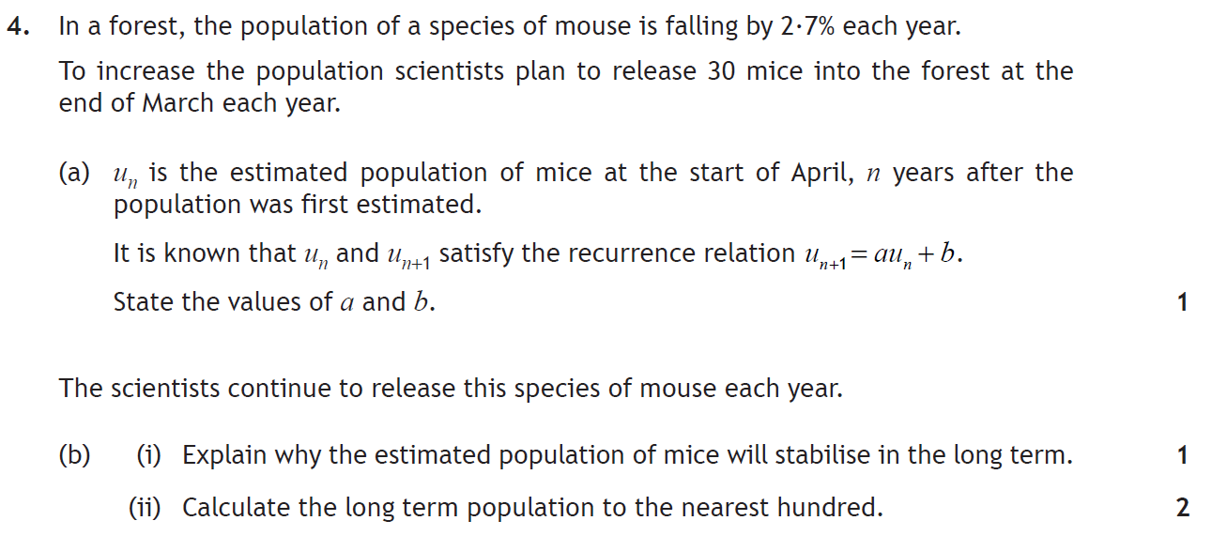
F
Solution
Main Grid

Slide 267
Q4a)
Q4b(i)
Q4b(ii)
Main Grid

Slide 268
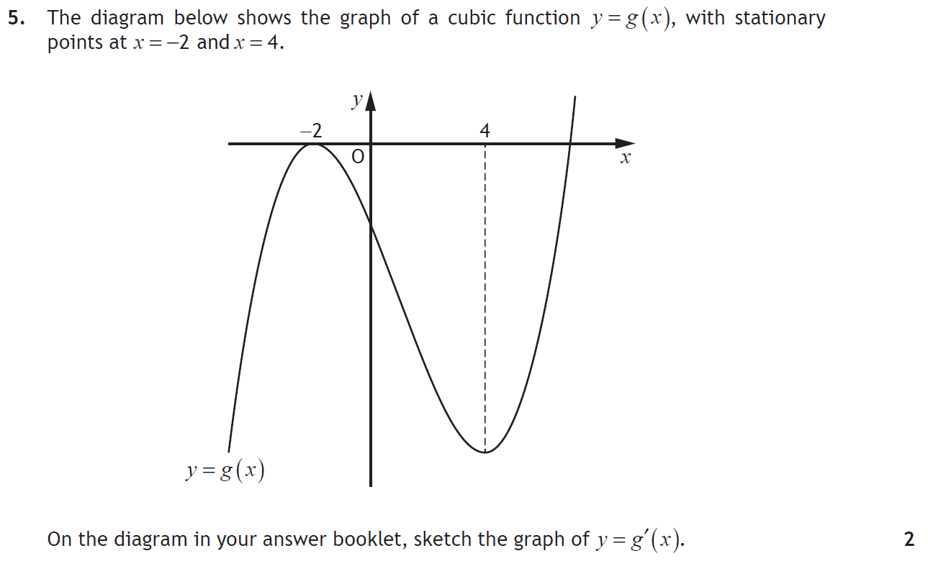
F
Solution
Main Grid

Slide 269
Q5
Main Grid

Slide 270
F
Solution 6a
Solution 6b
Main Grid

Slide 271
Q6a)
Solution 6b
Main Grid

Slide 272
Q6b)
Main Grid

Slide 273
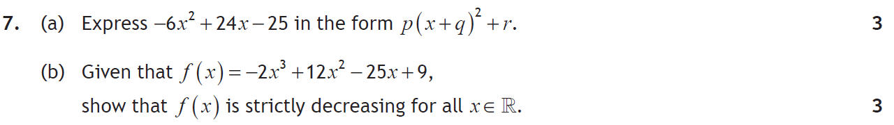
F
Solution
Main Grid

Slide 274
Q7a)
Q7b)
Main Grid

Slide 275
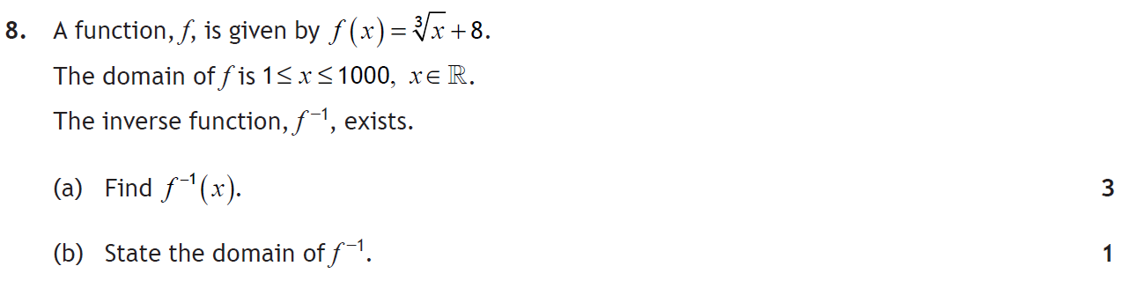
F
Solution
Main Grid

Slide 276
Q8a)
Q8b)
Main Grid

Slide 277
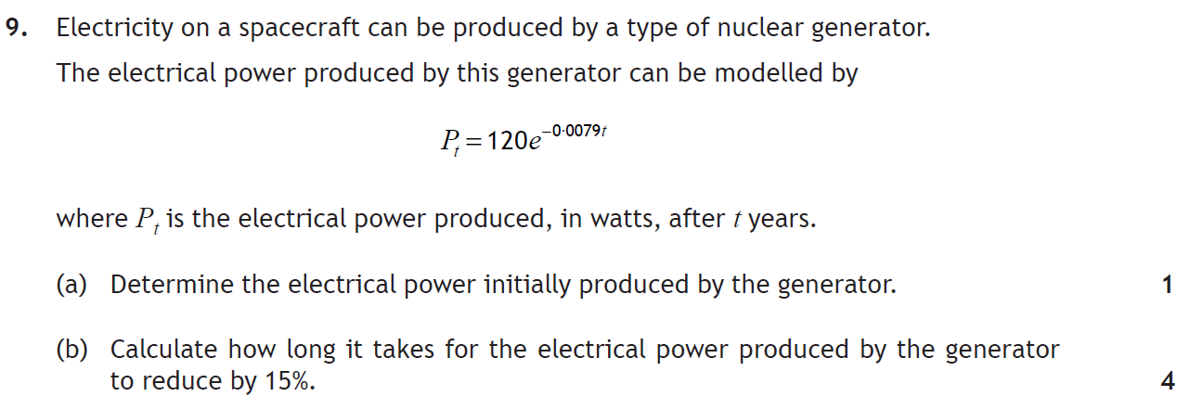
F
Solution
Main Grid

Slide 278
Q9a)
Q9b)
Main Grid

Slide 279
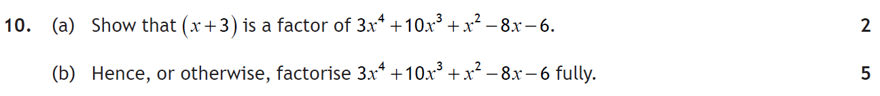
F
Solution
Main Grid

Slide 280
Q10a)
–3 | 3 | 10 | 1 | –8 | –6
 |  | –9 | –3 | 6 | 6
 | 3 | 1 | –2 | –2 | 0
Since remainder = 0, (x + 3) is a factor.
1 | 3 | 1 | –2 | –2
 |  | 3 | 4 | 2
 | 3 | 4 | 2 | 0
Q10b)
Since remainder = 0, (x – 1) is a factor.
Solution Cont^{d}
Main Grid

Slide 281
Q10b) contd.
Main Grid

Slide 282
F
Solution 11a
Solution 11b
Main Grid

Slide 283
Q11a)
Solution 11b
Main Grid

Slide 284
Q11b)
x | 4 | 5 | 6
 | - | 0 | +
Shape
 | Min at x = 5
Main Grid

Slide 285
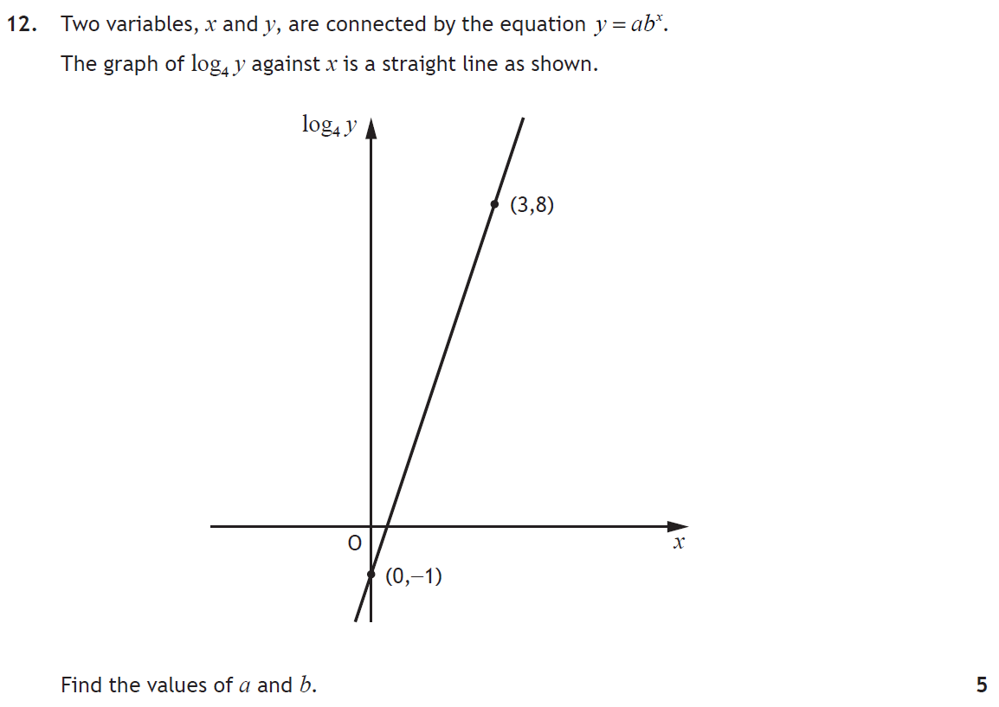
F
Solution
Main Grid

Slide 286
Q12
Main Grid

Slide 287
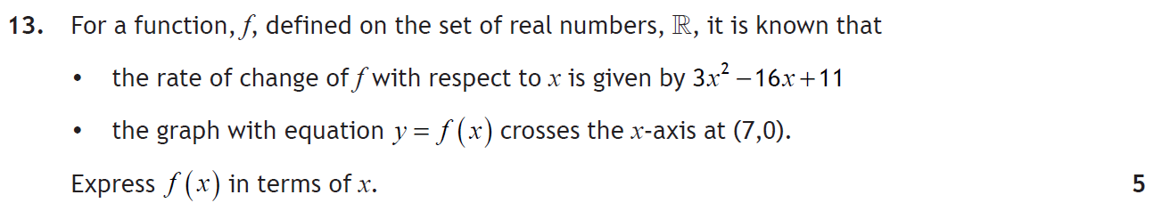
F
Solution
Main Grid

Slide 288
Q13
Main Grid

Slide 289
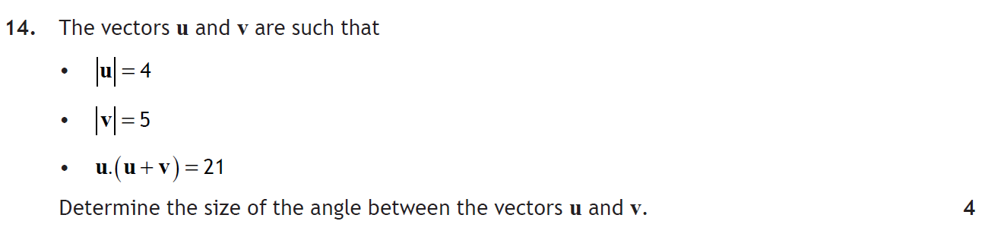
F
Solution
Main Grid

Slide 290
Q14
Main Grid

Slide 291
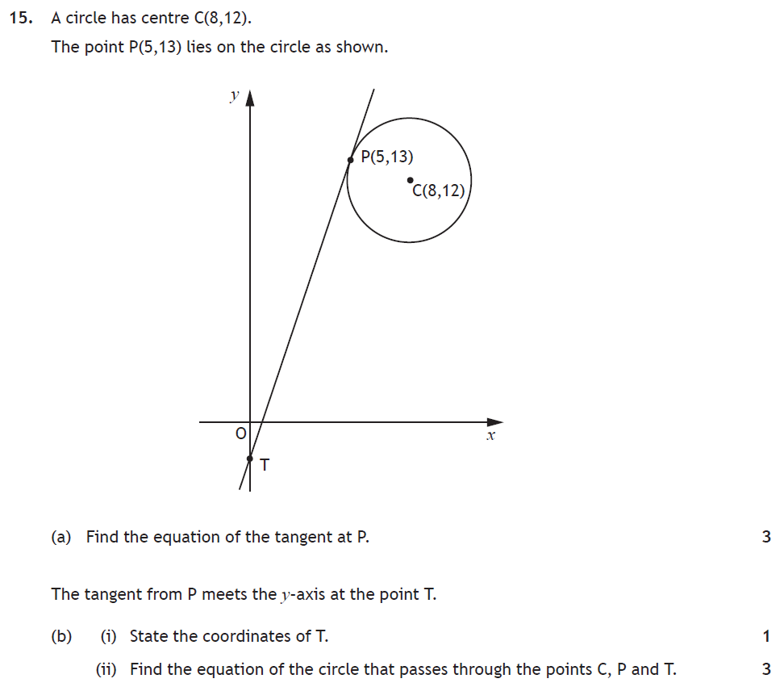
F
Solution
Main Grid

Slide 292
Q15a)
Q15b(i)
Solution Cont^{d}
Main Grid

Slide 293
Q15b(ii)
Main Grid

Slide 294
F
Solution
Main Grid

