Slide 1
30.01
Past Paper Questions – National 5 Mathematics
Topic: Trigonometry (Area)

Slide 2
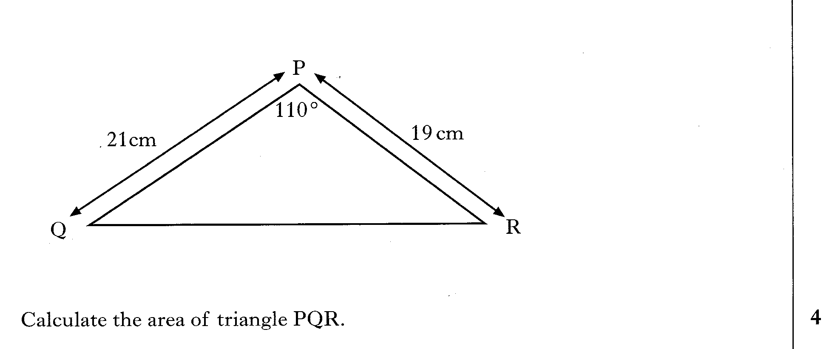
30.02
Past Paper Questions – National 5 Mathematics
Topic: Trigonometry (Area)

Slide 3
30.03
Past Paper Questions – National 5 Mathematics
Topic: Trigonometry (Area)

Slide 4
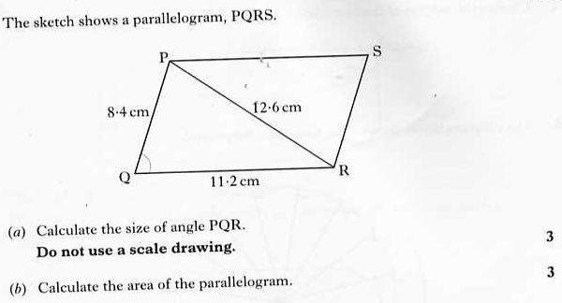
30.04
Past Paper Questions – National 5 Mathematics
Topic: Trigonometry (Area)

Slide 5
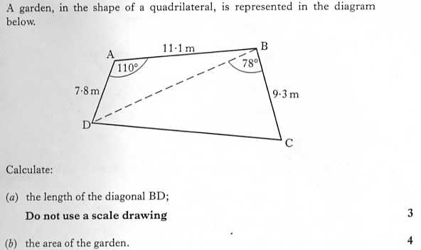
30.05
Past Paper Questions – National 5 Mathematics
Topic: Trigonometry (Area)

Slide 6
30.06
Past Paper Questions – National 5 Mathematics
Topic: Trigonometry (Area)

Slide 7
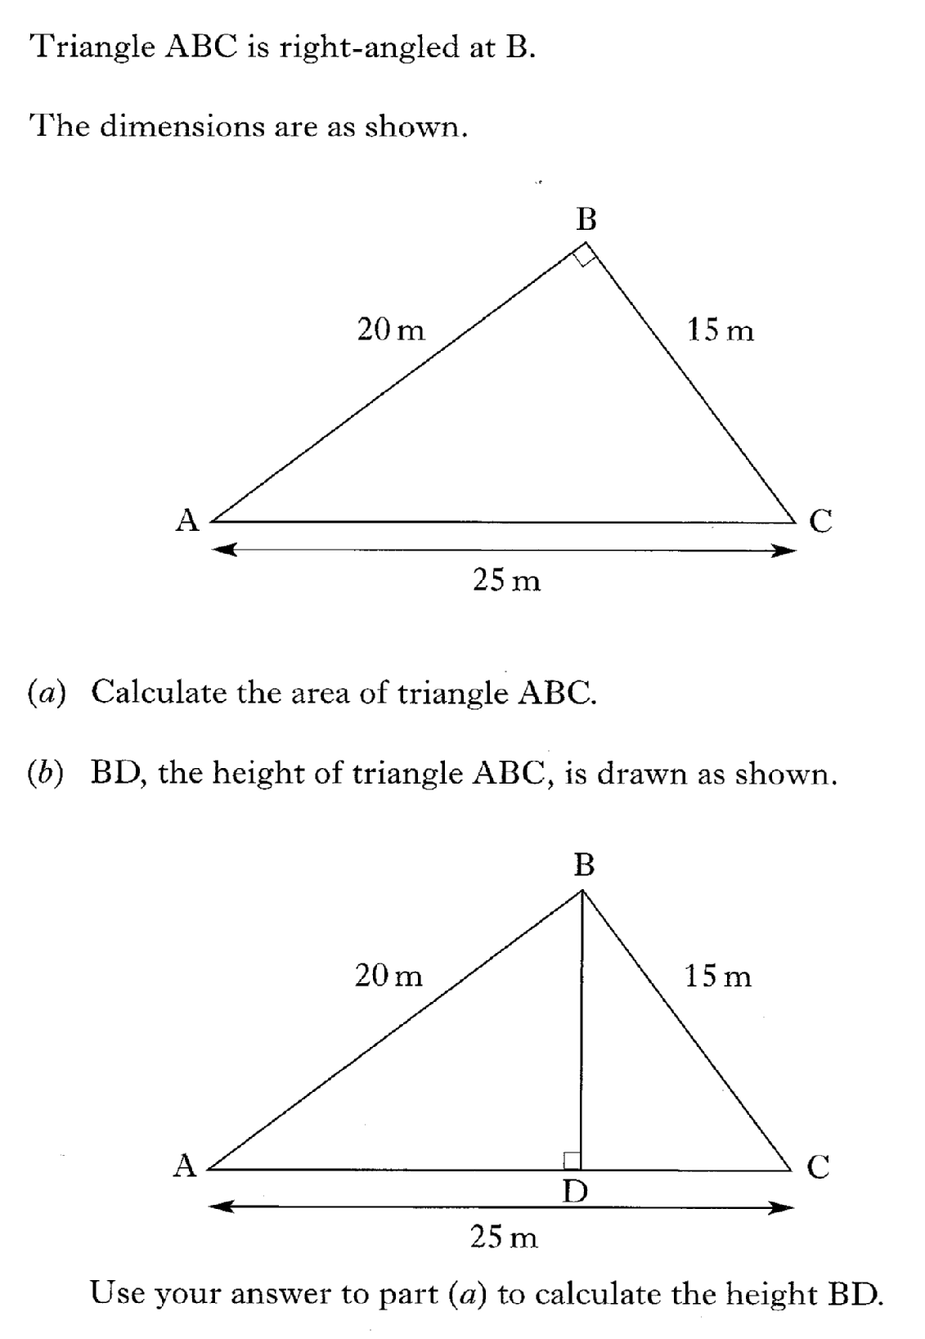
30.07
Past Paper Questions – National 5 Mathematics
Topic: Trigonometry (Area)

Slide 8
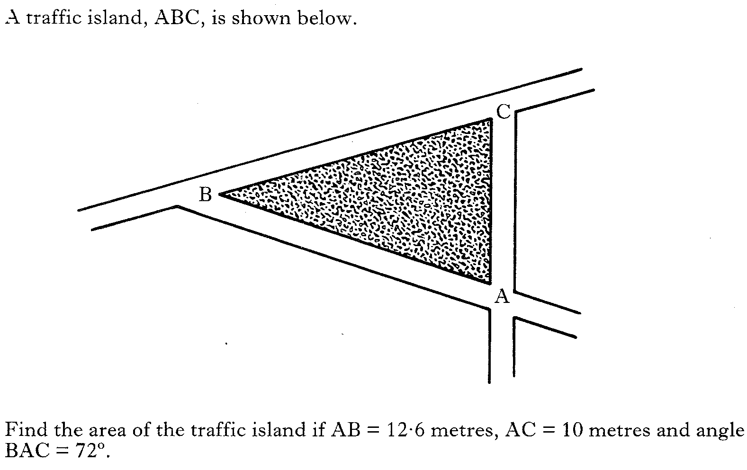
30.08
Past Paper Questions – National 5 Mathematics
Topic: Trigonometry (Area)

Slide 9
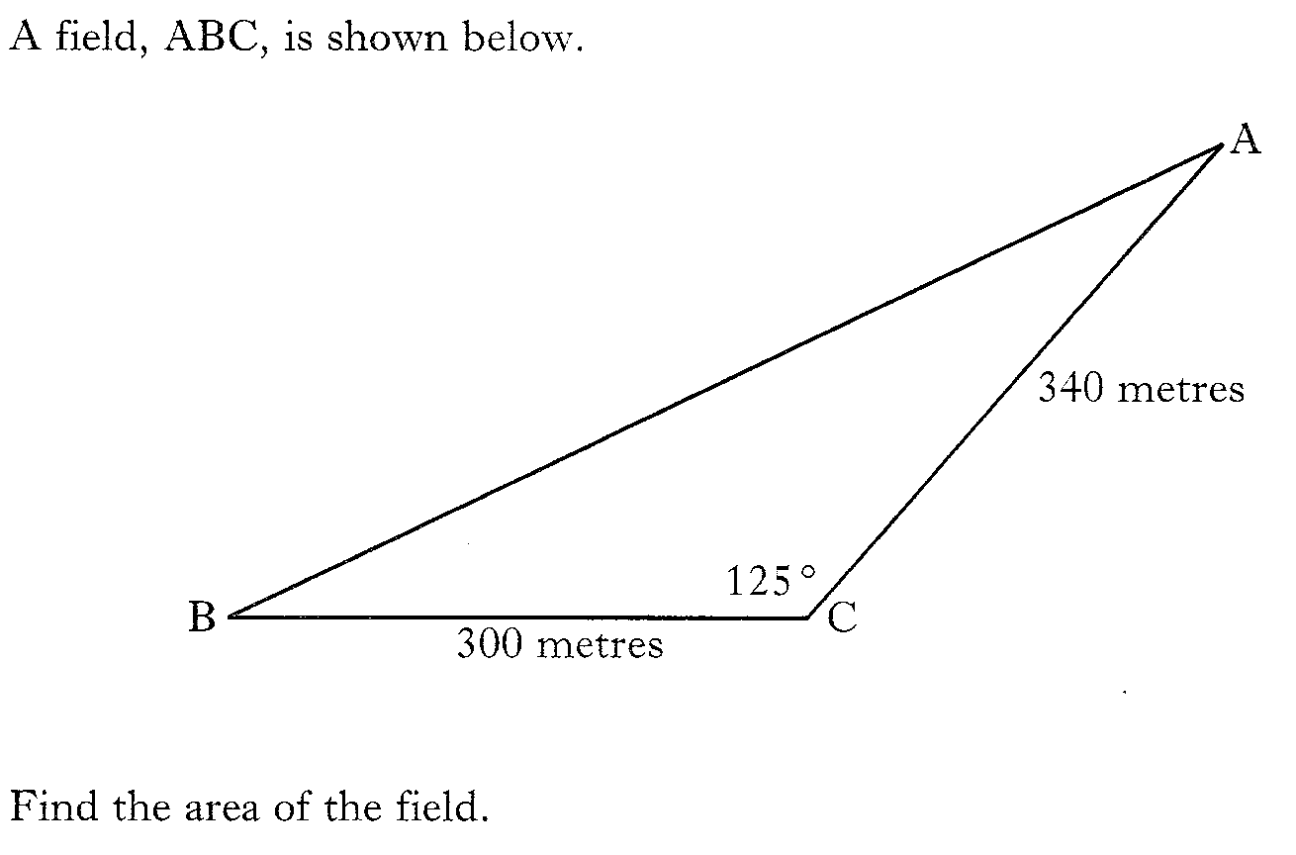
30.09
Past Paper Questions – National 5 Mathematics
Topic: Trigonometry (Area)

Slide 10
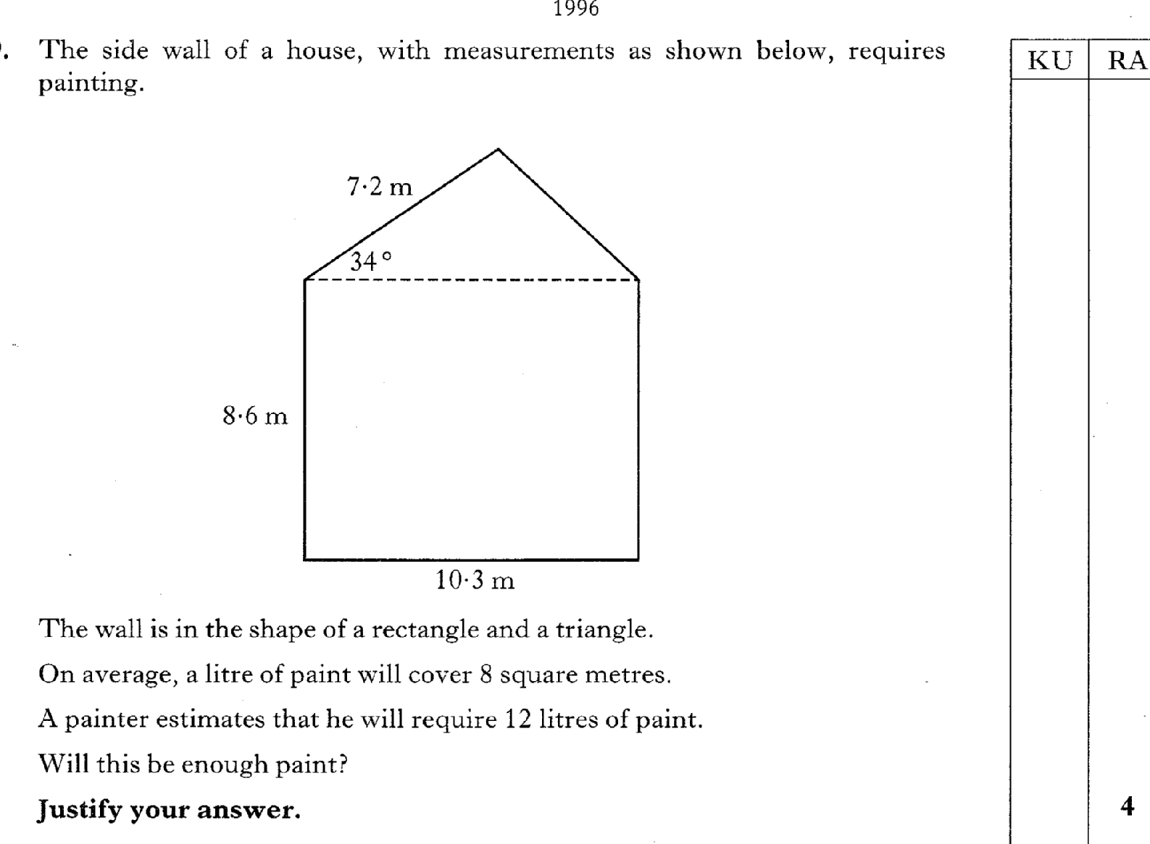
30.10
Past Paper Questions – National 5 Mathematics
Topic: Trigonometry (Area)

Slide 11
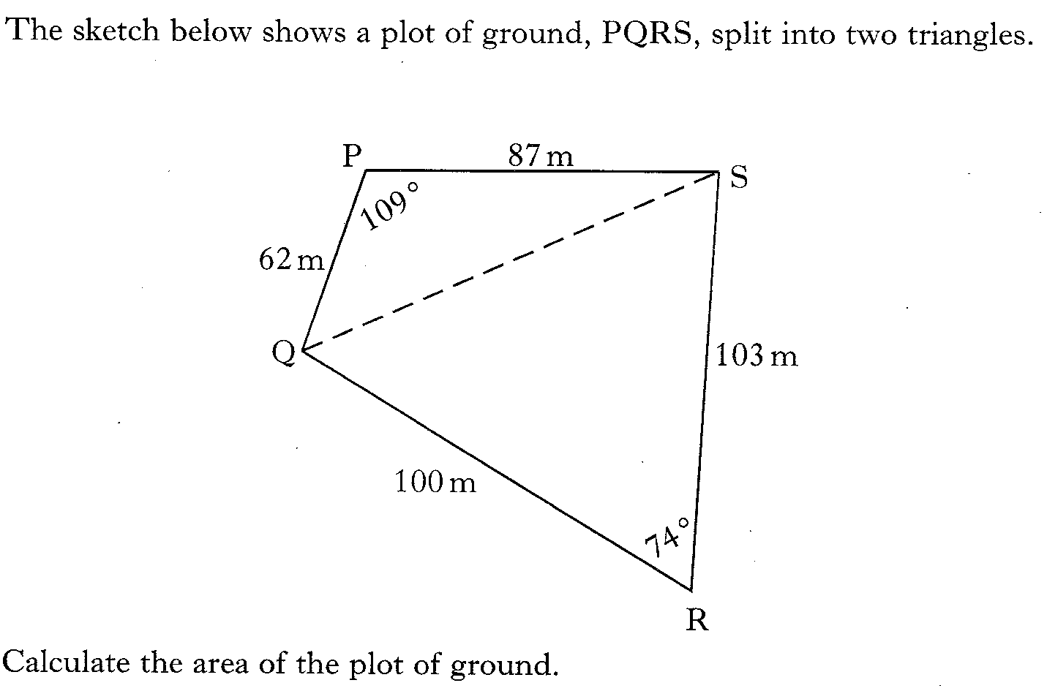
30.11
Past Paper Questions – National 5 Mathematics
Topic: Trigonometry (Area)

Slide 12
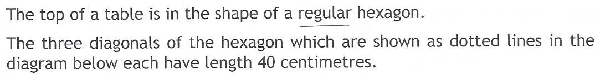
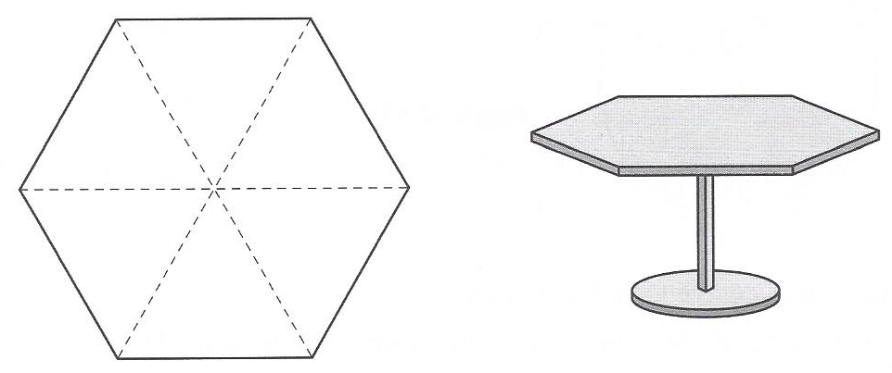
30.12
Past Paper Questions – National 5 Mathematics
Topic: Trigonometry (Area)

