Slide 1
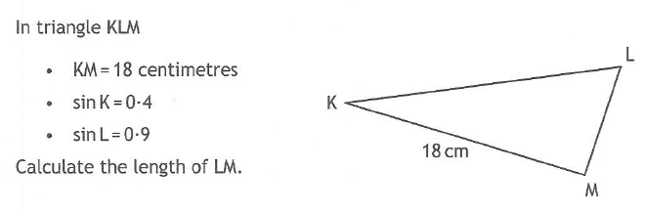
29.01
Past Paper Questions – National 5 Mathematics
Topic: Trigonometry (Side Length & Angle)

Slide 2
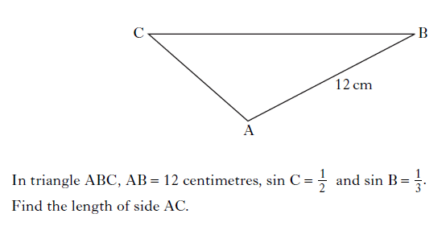
29.02
Past Paper Questions – National 5 Mathematics
Topic: Trigonometry (Side Length & Angle)
Notes:
2

Slide 3
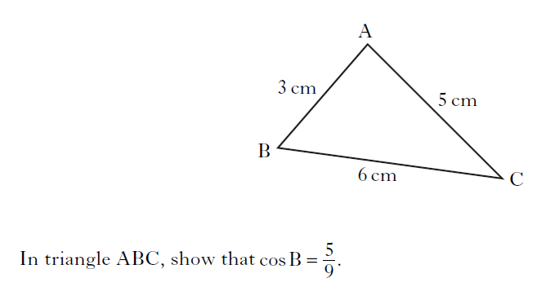
29.03
Past Paper Questions – National 5 Mathematics
Topic: Trigonometry (Side Length & Angle)
Notes:
3

Slide 4
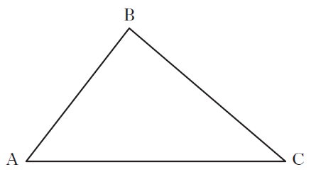
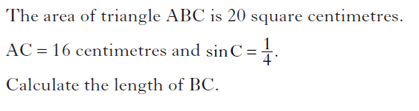
29.04
Past Paper Questions – National 5 Mathematics
Topic: Trigonometry (Side Length & Angle)
Notes:
4

Slide 5
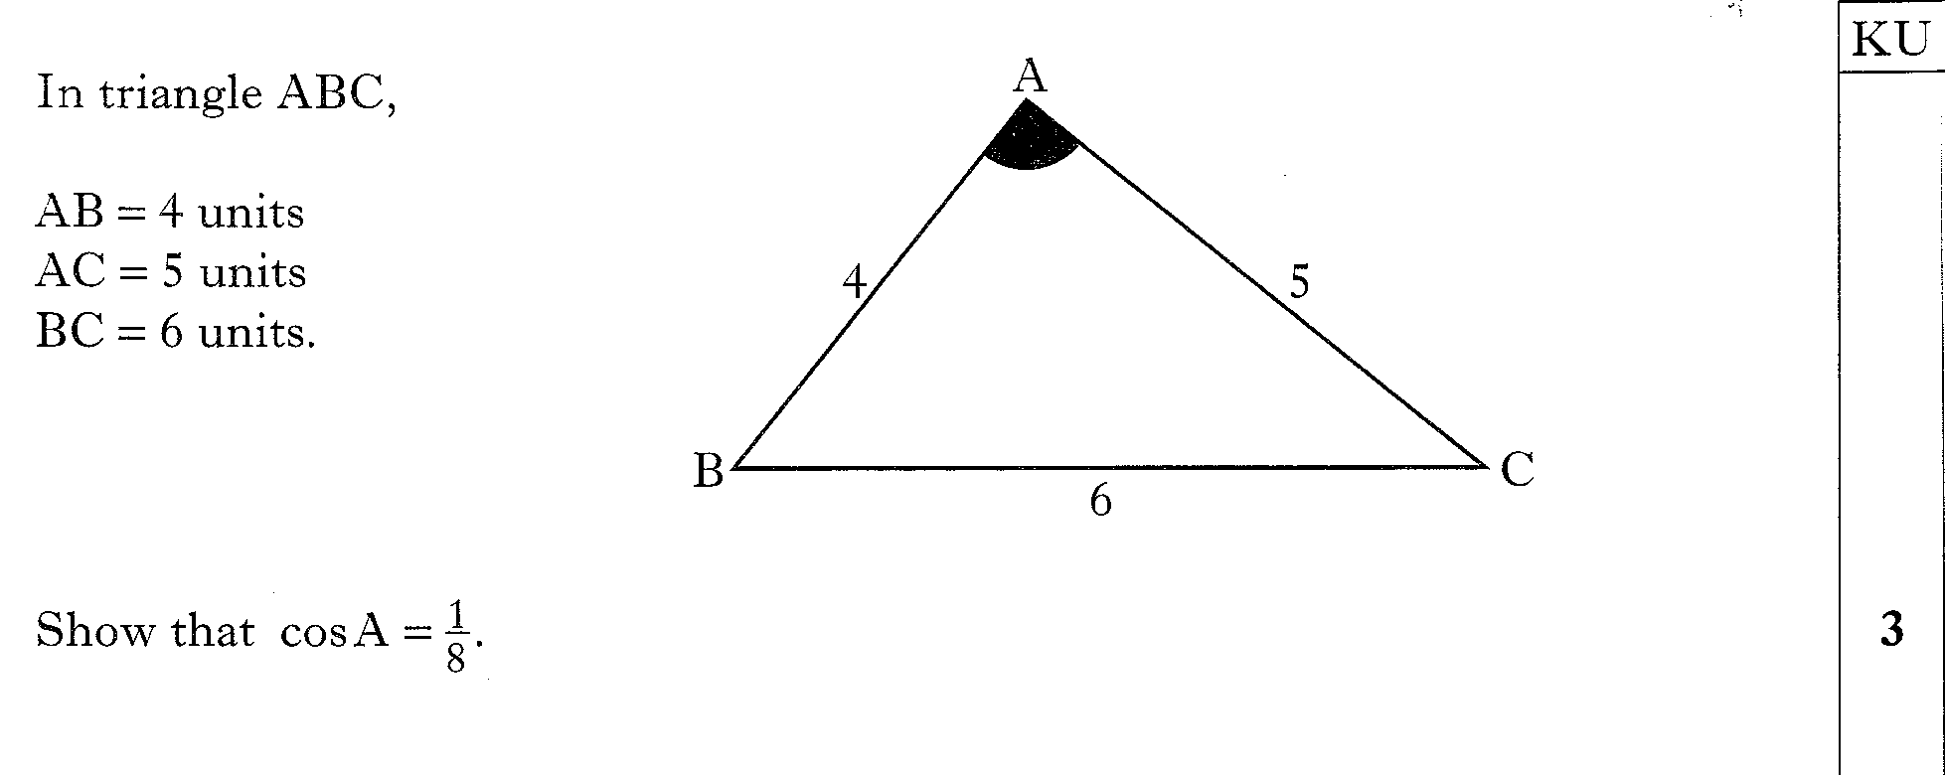
29.05
Past Paper Questions – National 5 Mathematics
Topic: Trigonometry (Side Length & Angle)

Slide 6
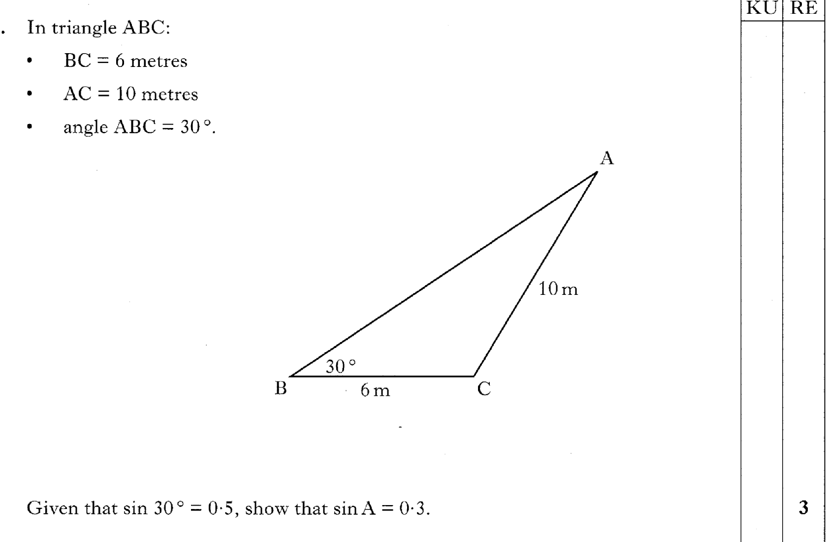
29.06
Past Paper Questions – National 5 Mathematics
Topic: Trigonometry (Side Length & Angle)

Slide 7
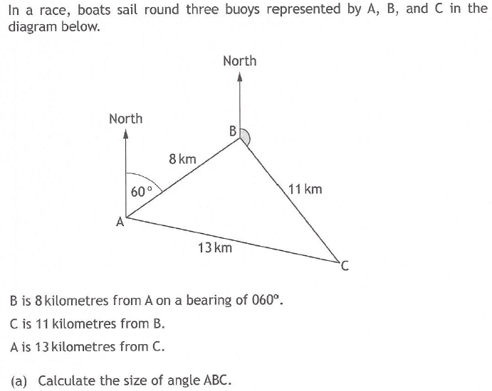
29.07
Past Paper Questions – National 5 Mathematics
Topic: Trigonometry (Side Length & Angle)

Slide 8
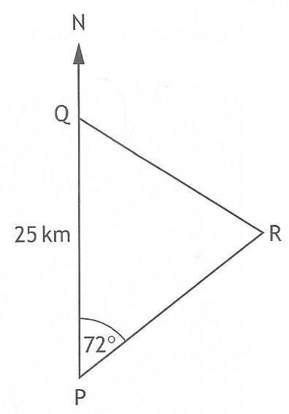
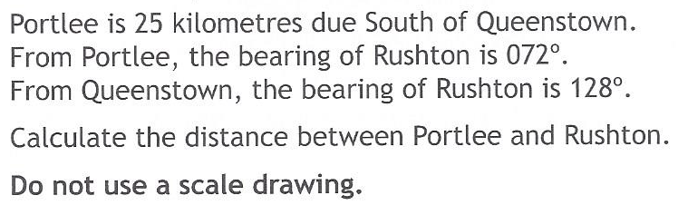
29.08
Past Paper Questions – National 5 Mathematics
Topic: Trigonometry (Side Length & Angle)

Slide 9
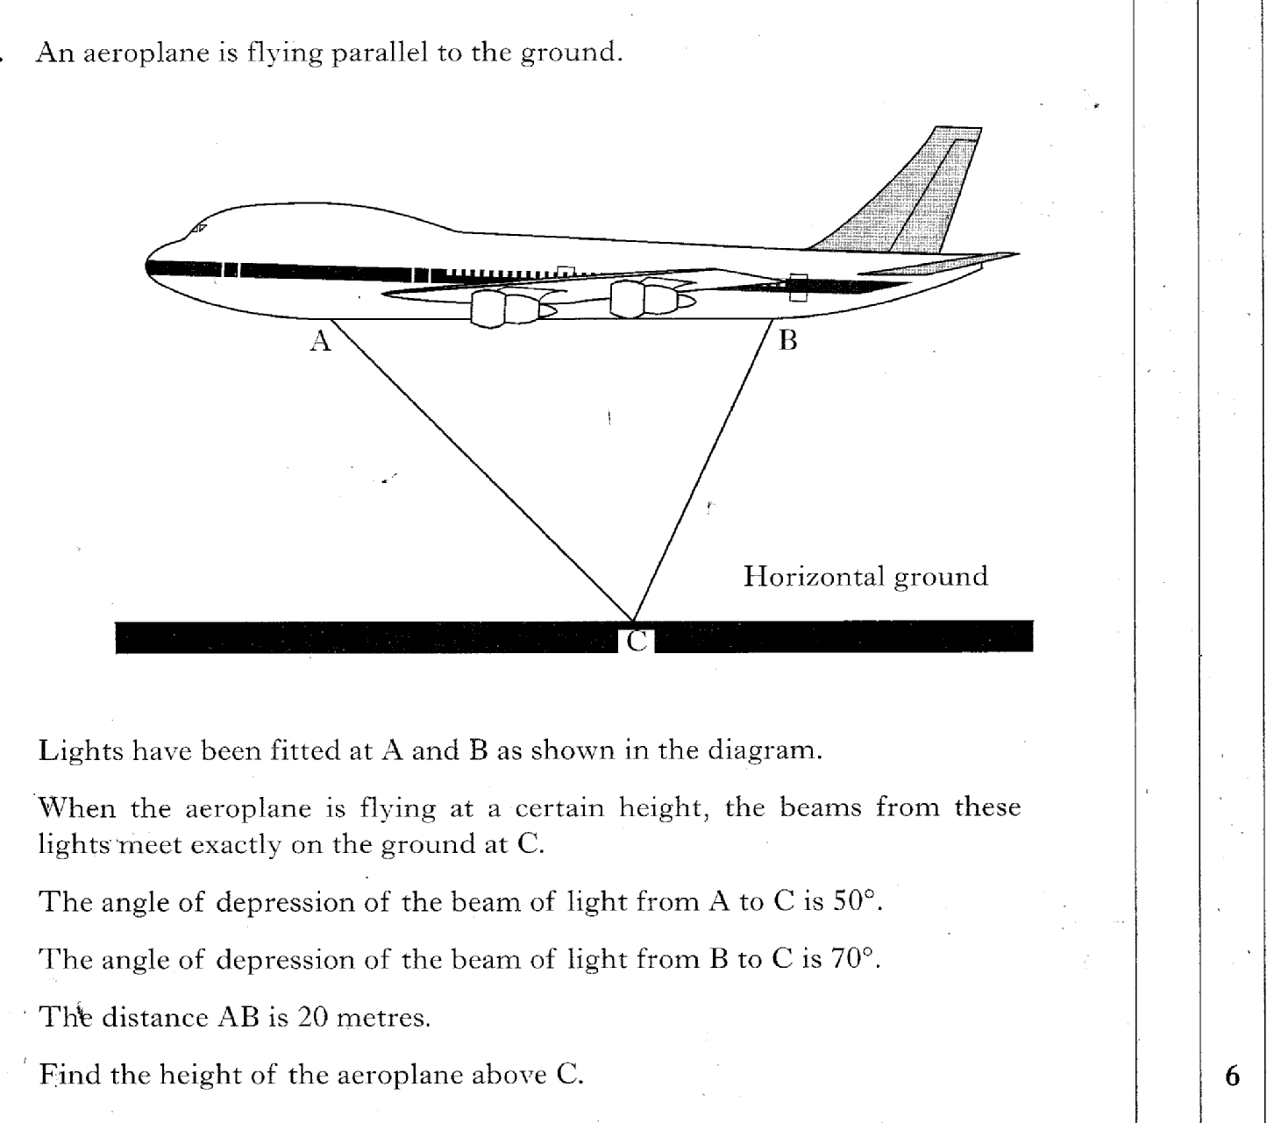
29.09
Past Paper Questions – National 5 Mathematics
Topic: Trigonometry (Side Length & Angle)

Slide 10
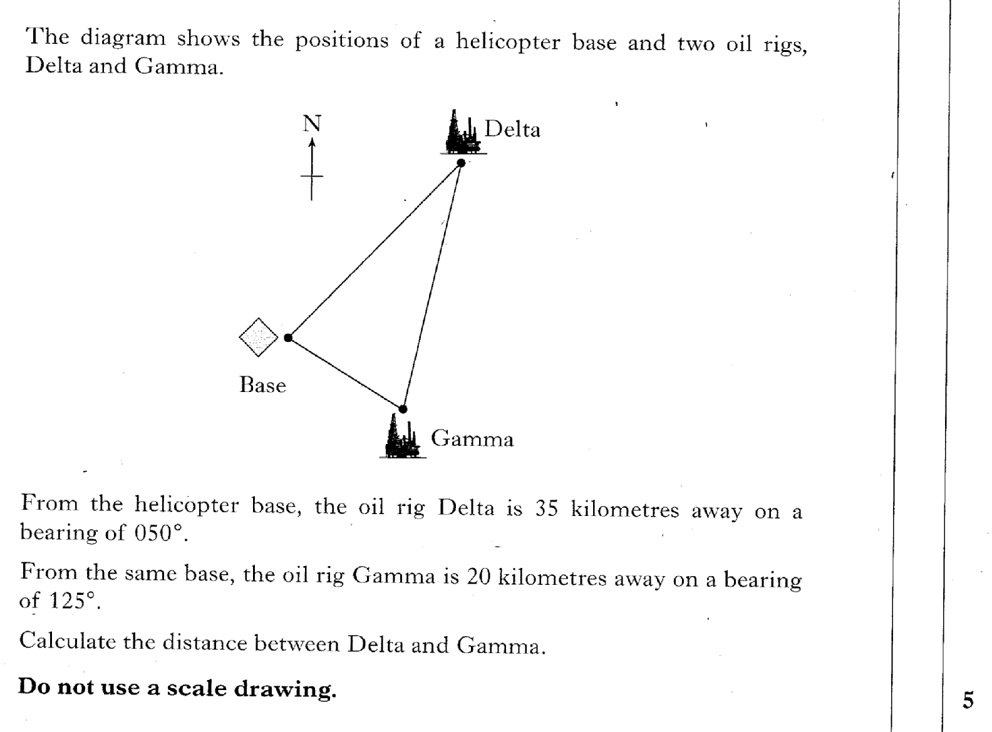
29.10
Past Paper Questions – National 5 Mathematics
Topic: Trigonometry (Side Length & Angle)

Slide 11
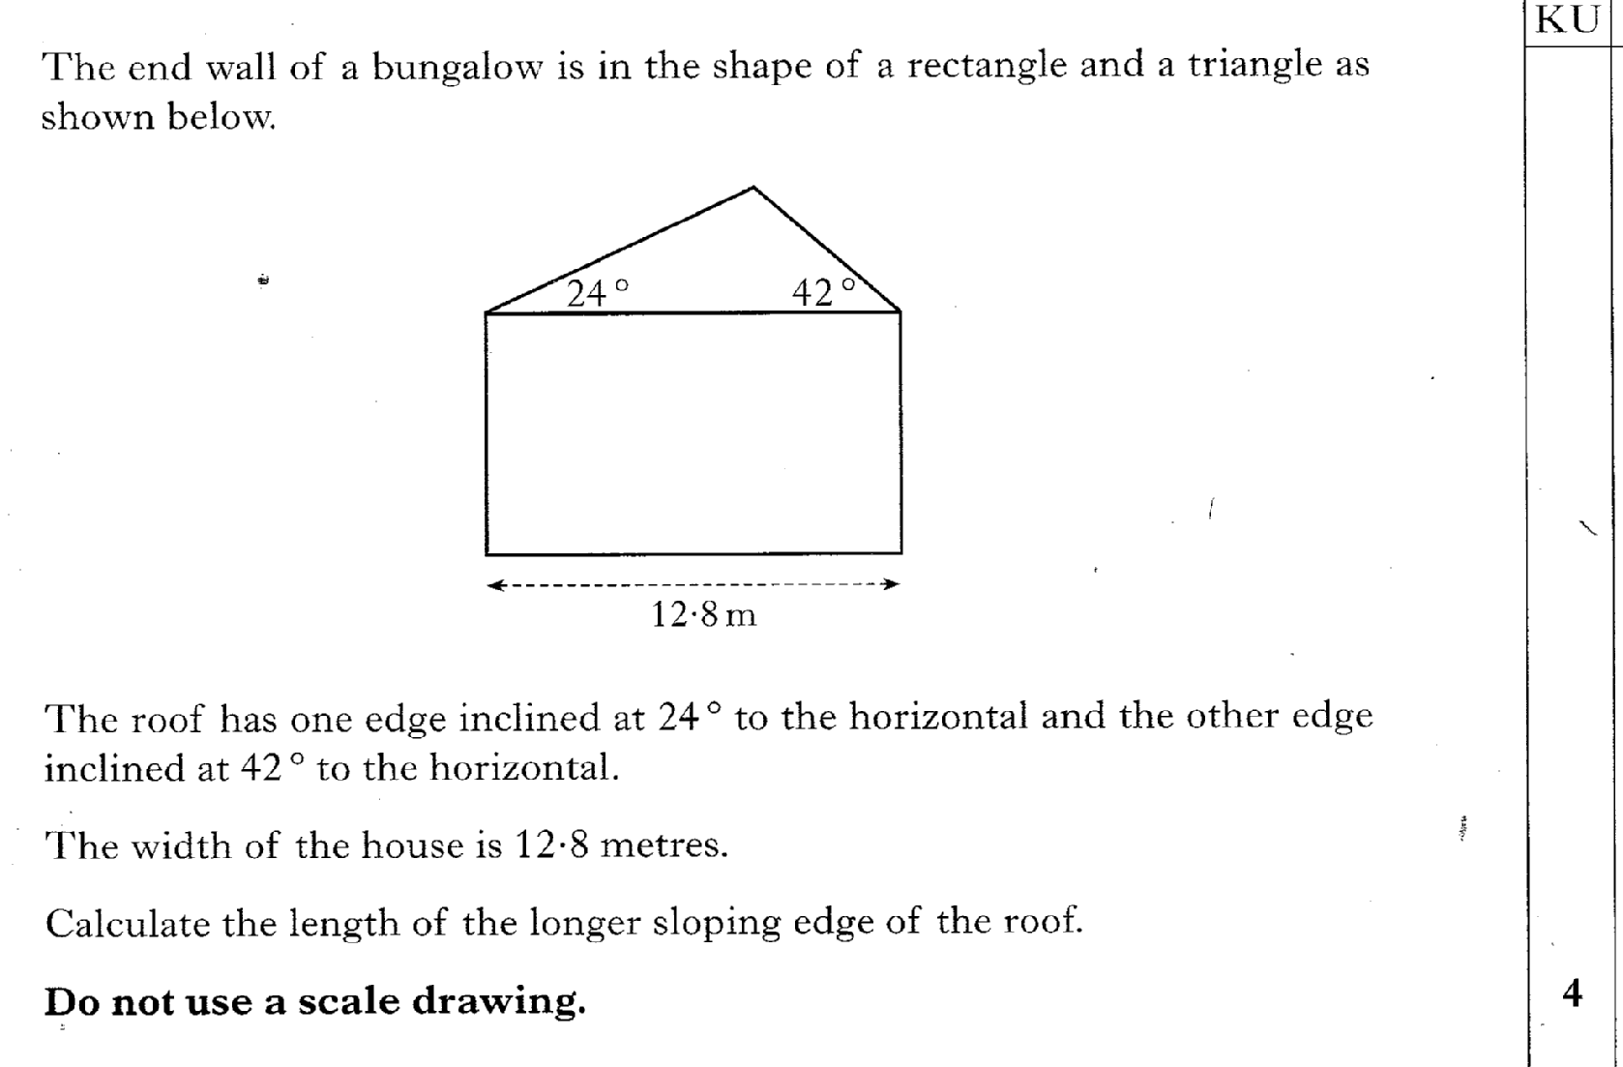
29.11
Past Paper Questions – National 5 Mathematics
Topic: Trigonometry (Side Length & Angle)

Slide 12
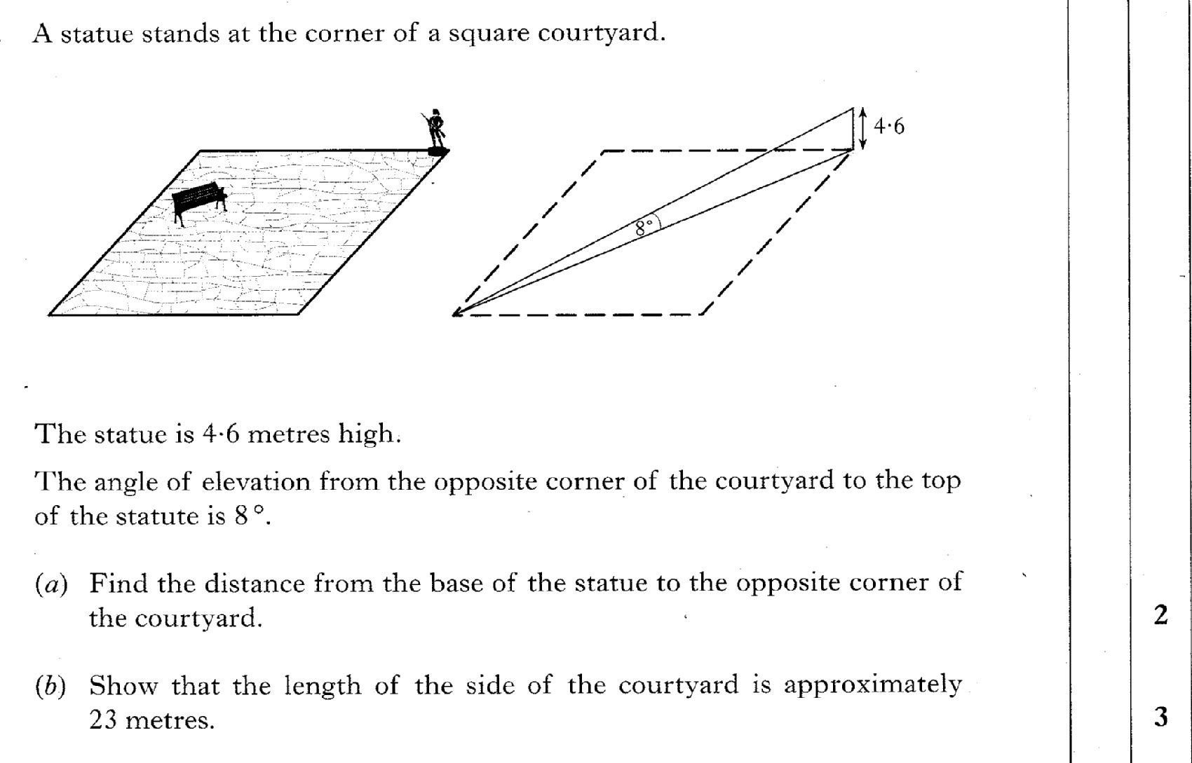
29.12
Past Paper Questions – National 5 Mathematics
Topic: Trigonometry (Side Length & Angle)

Slide 13
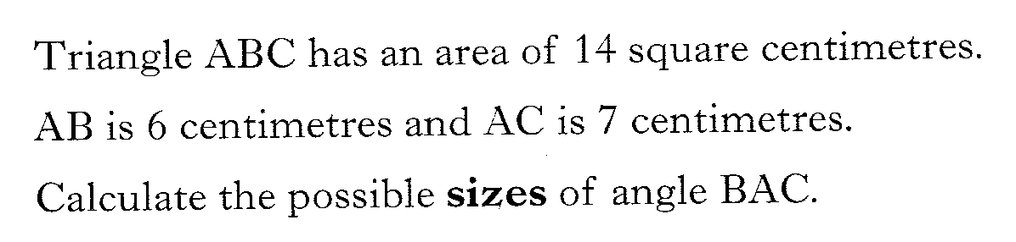
29.13
Past Paper Questions – National 5 Mathematics
Topic: Trigonometry (Side Length & Angle)

Slide 14
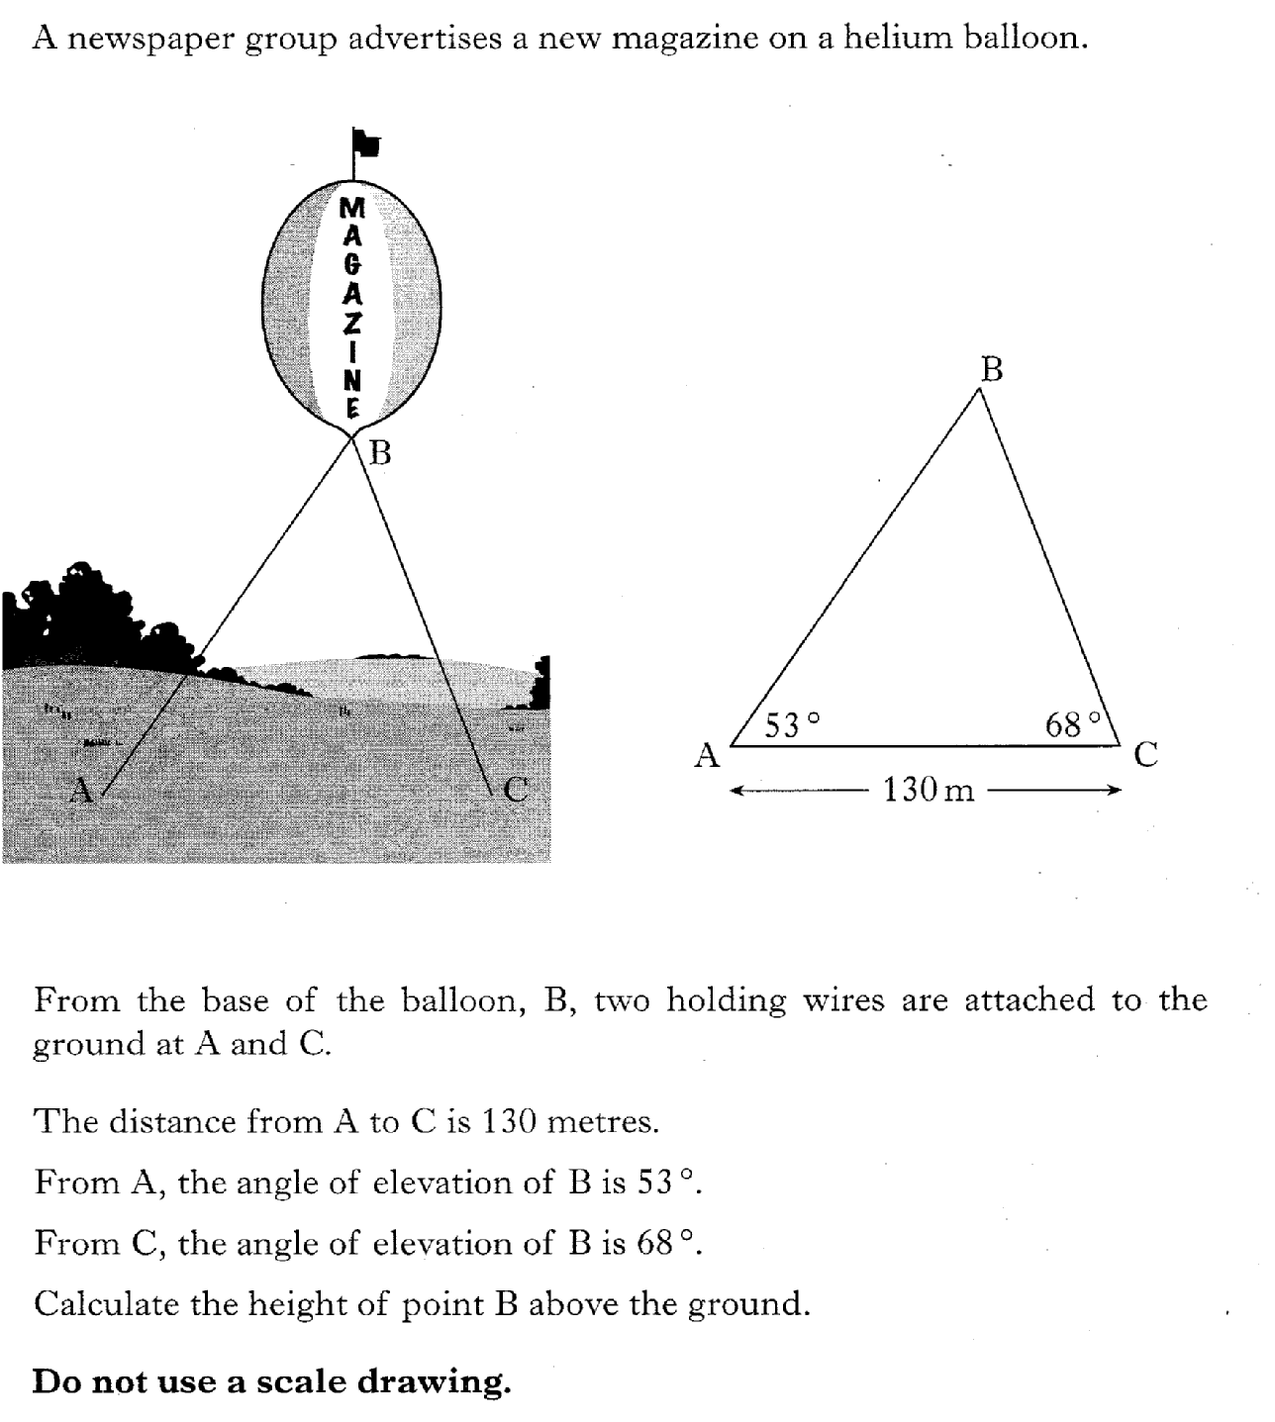
29.14
Past Paper Questions – National 5 Mathematics
Topic: Trigonometry (Side Length & Angle)

Slide 15
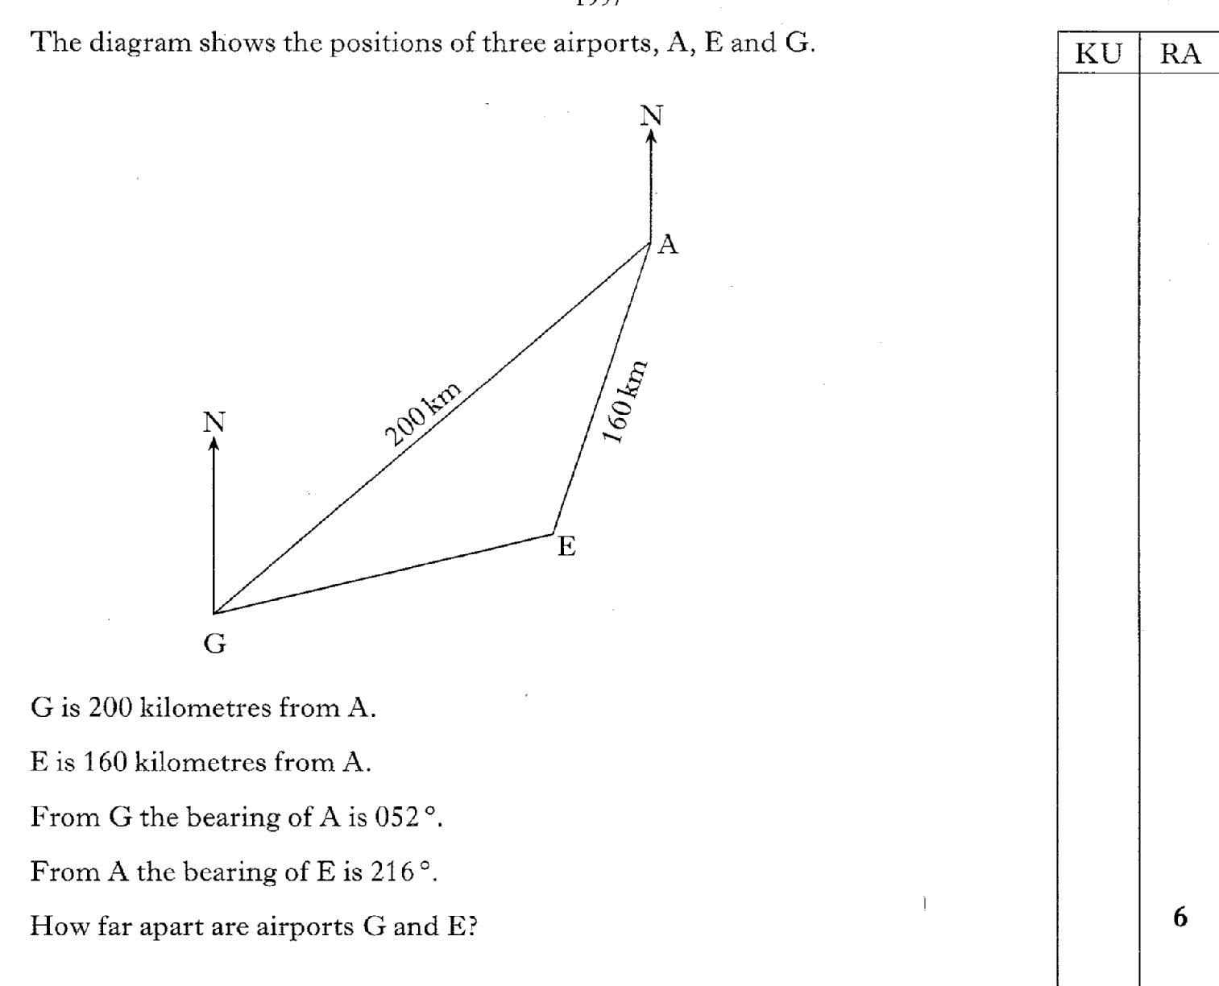
29.15
Past Paper Questions – National 5 Mathematics
Topic: Trigonometry (Side Length & Angle)

Slide 16
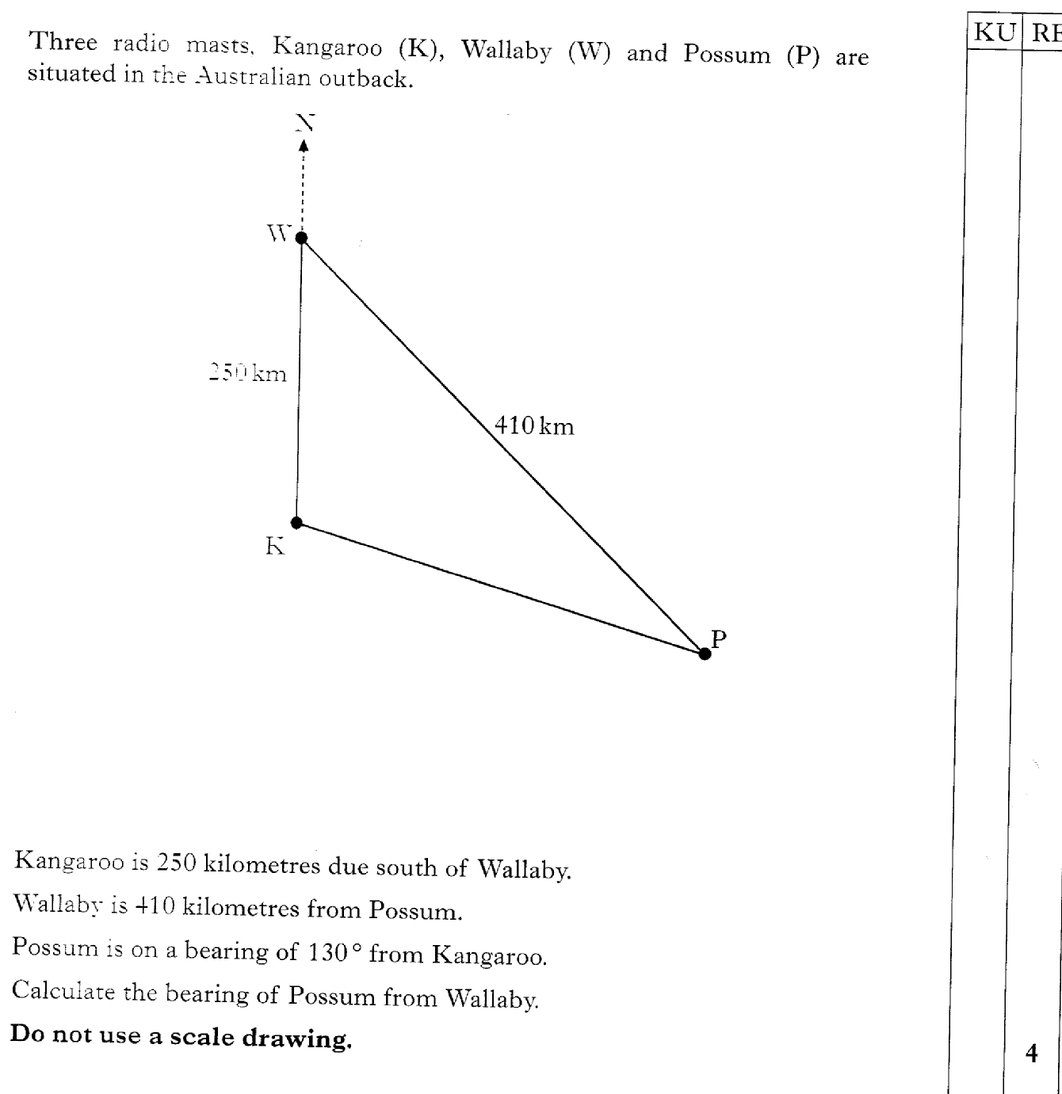
29.16
Past Paper Questions – National 5 Mathematics
Topic: Trigonometry (Side Length & Angle)

Slide 17
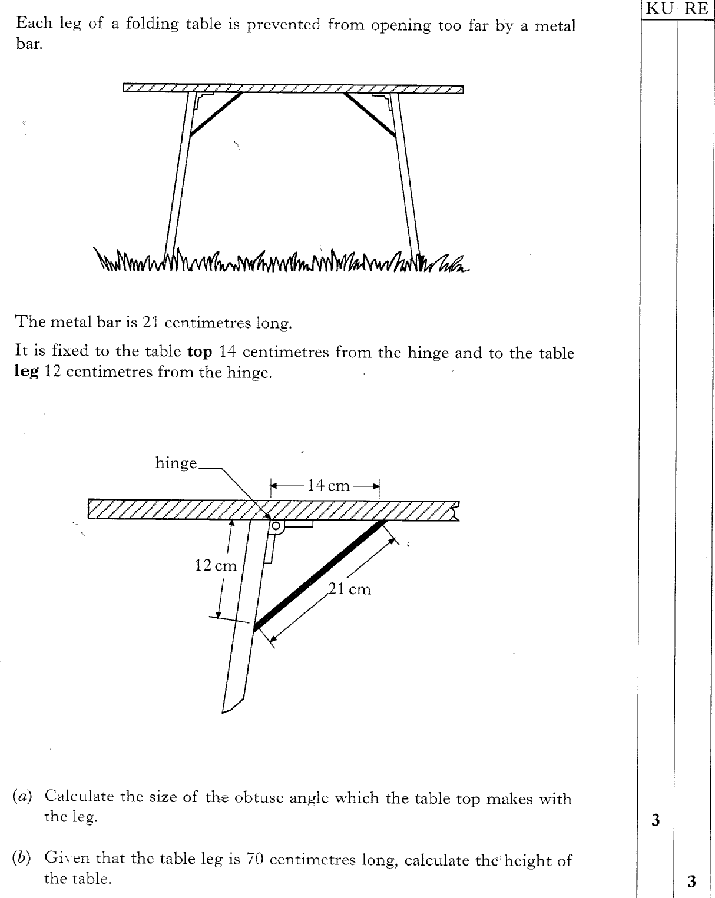
29.17
Past Paper Questions – National 5 Mathematics
Topic: Trigonometry (Side Length & Angle)

Slide 18
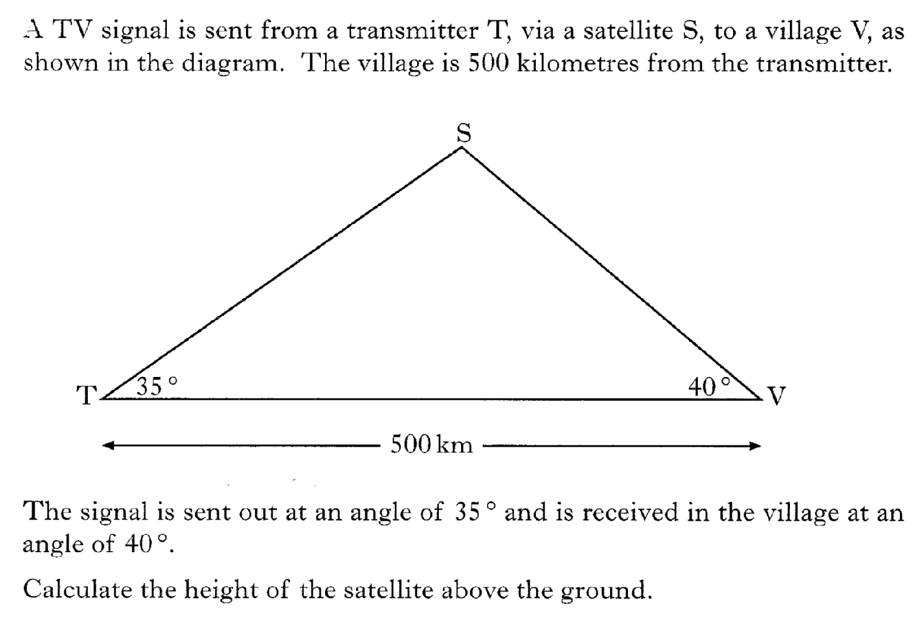
29.18
Past Paper Questions – National 5 Mathematics
Topic: Trigonometry (Side Length & Angle)

Slide 19
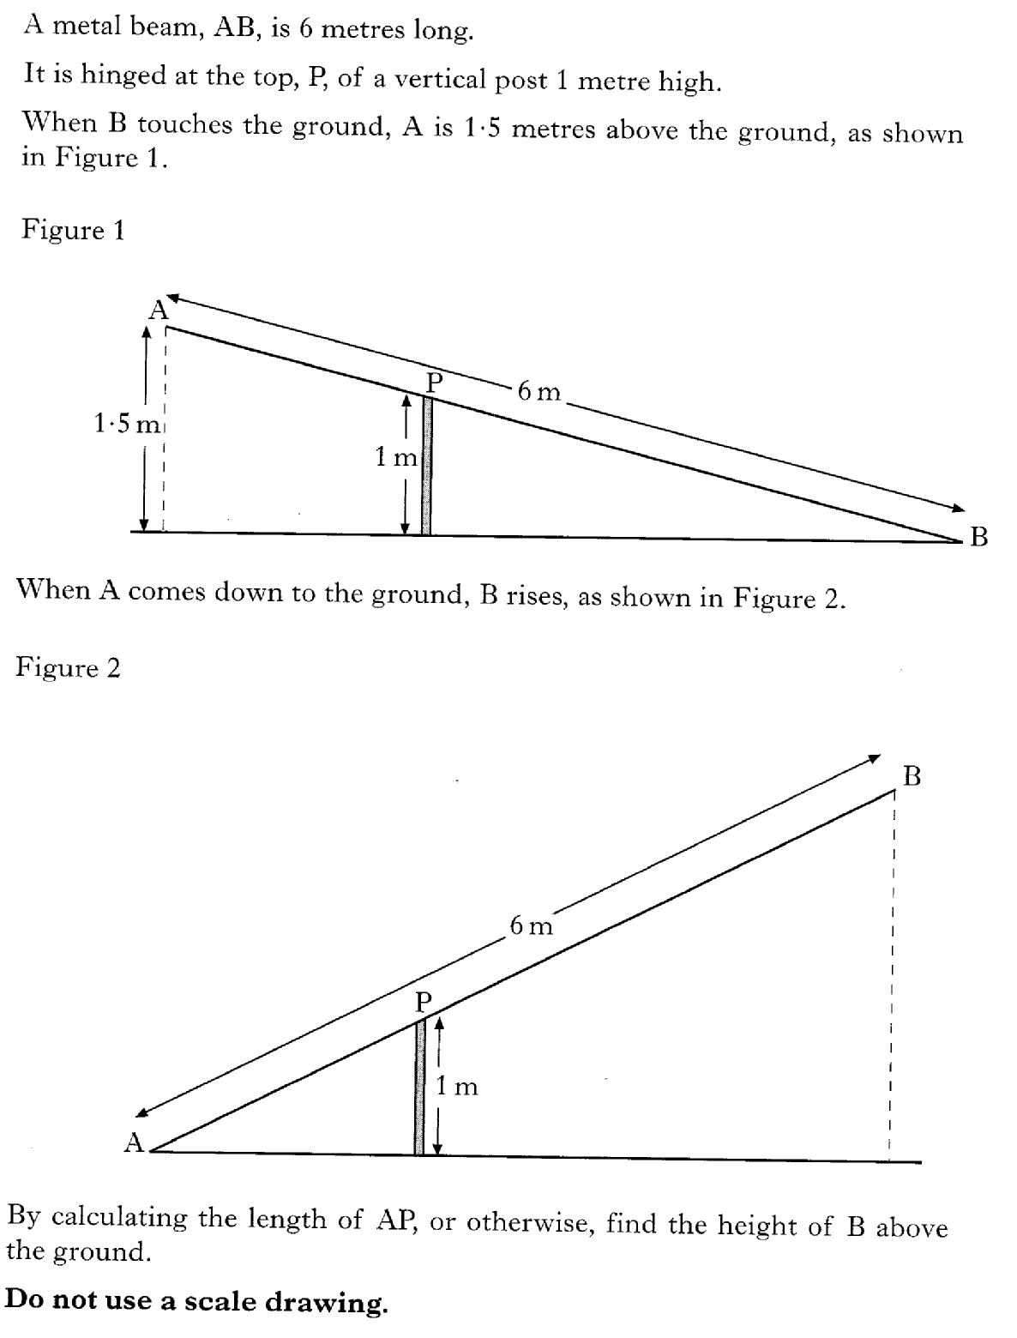
29.19
Past Paper Questions – National 5 Mathematics
Topic: Trigonometry (Side Length & Angle)

Slide 20
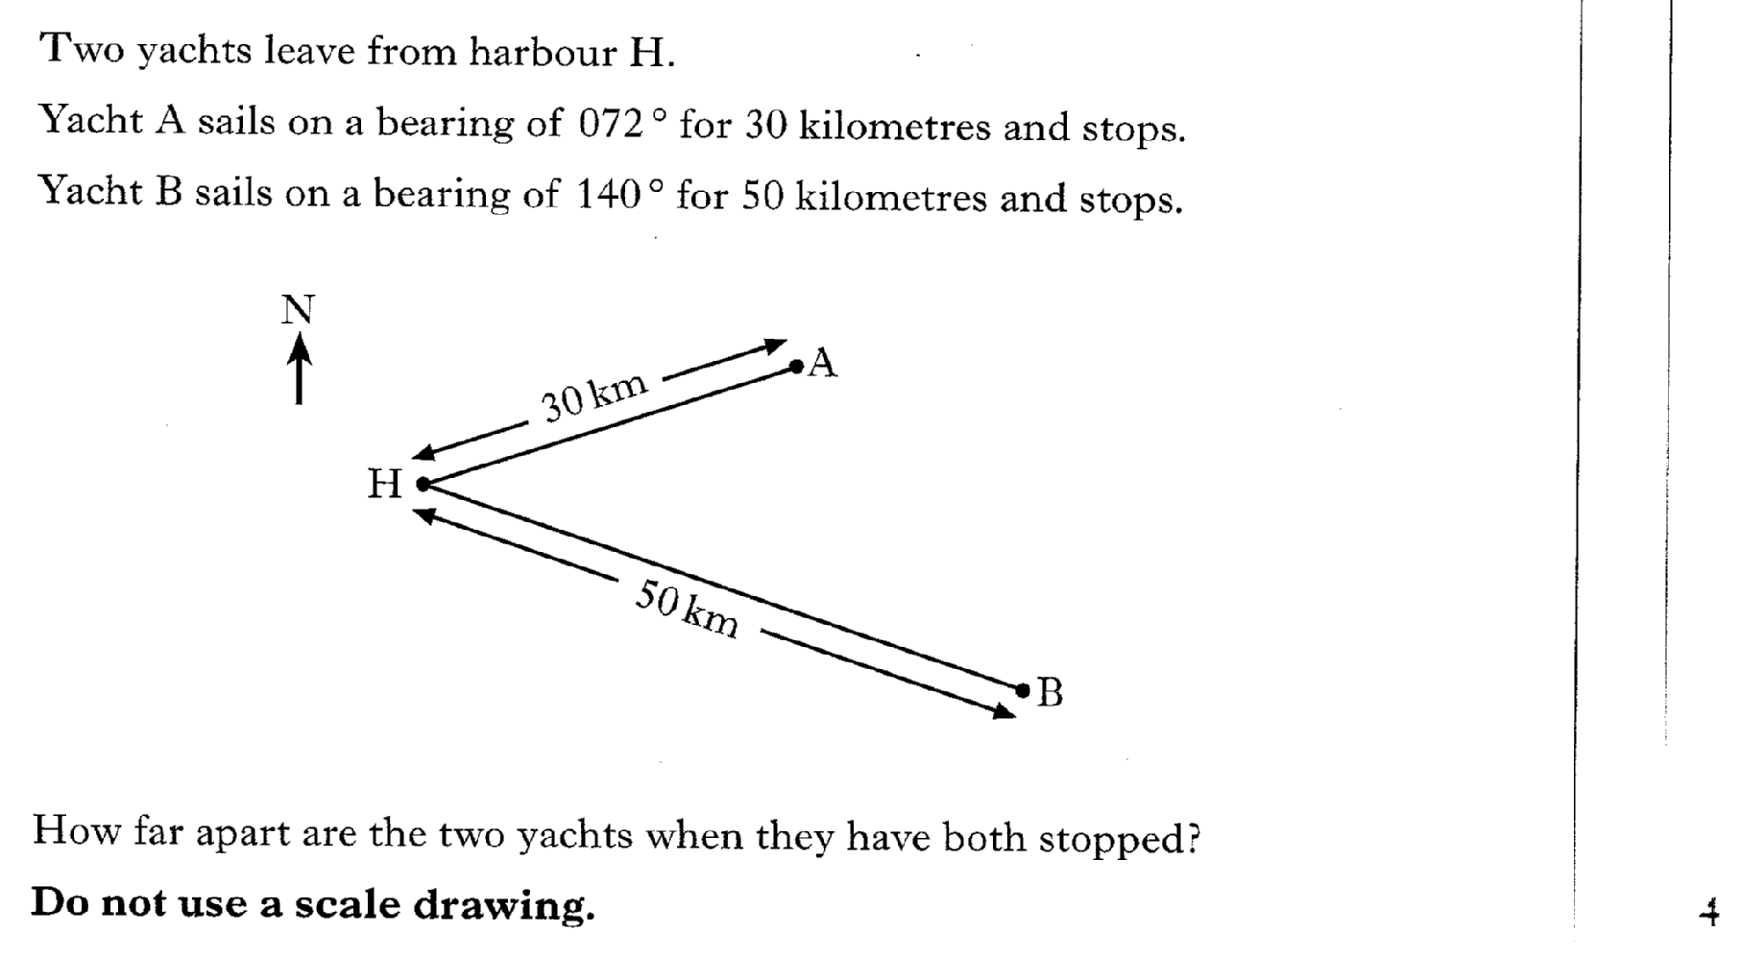
29.20
Past Paper Questions – National 5 Mathematics
Topic: Trigonometry (Side Length & Angle)

Slide 21
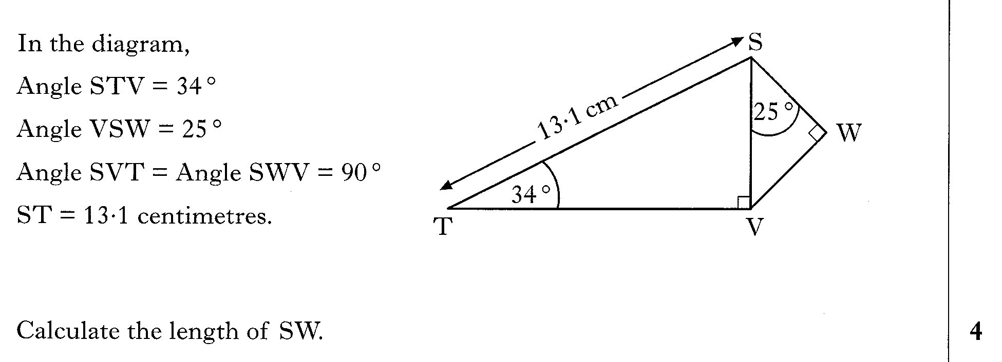
29.21
Past Paper Questions – National 5 Mathematics
Topic: Trigonometry (Side Length & Angle)

Slide 22
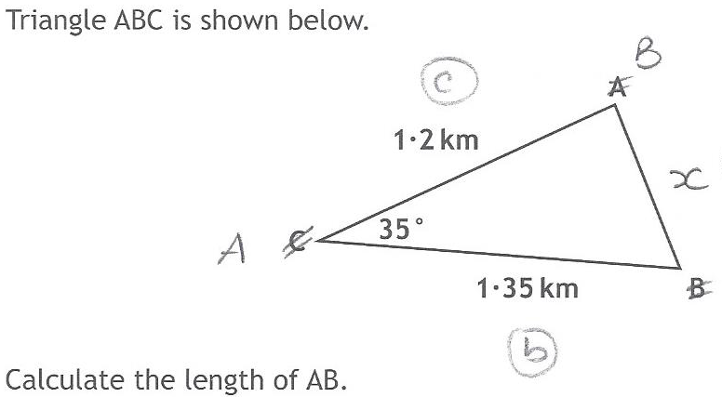
29.22
Past Paper Questions – National 5 Mathematics
Topic: Trigonometry (Side Length & Angle)

Slide 23
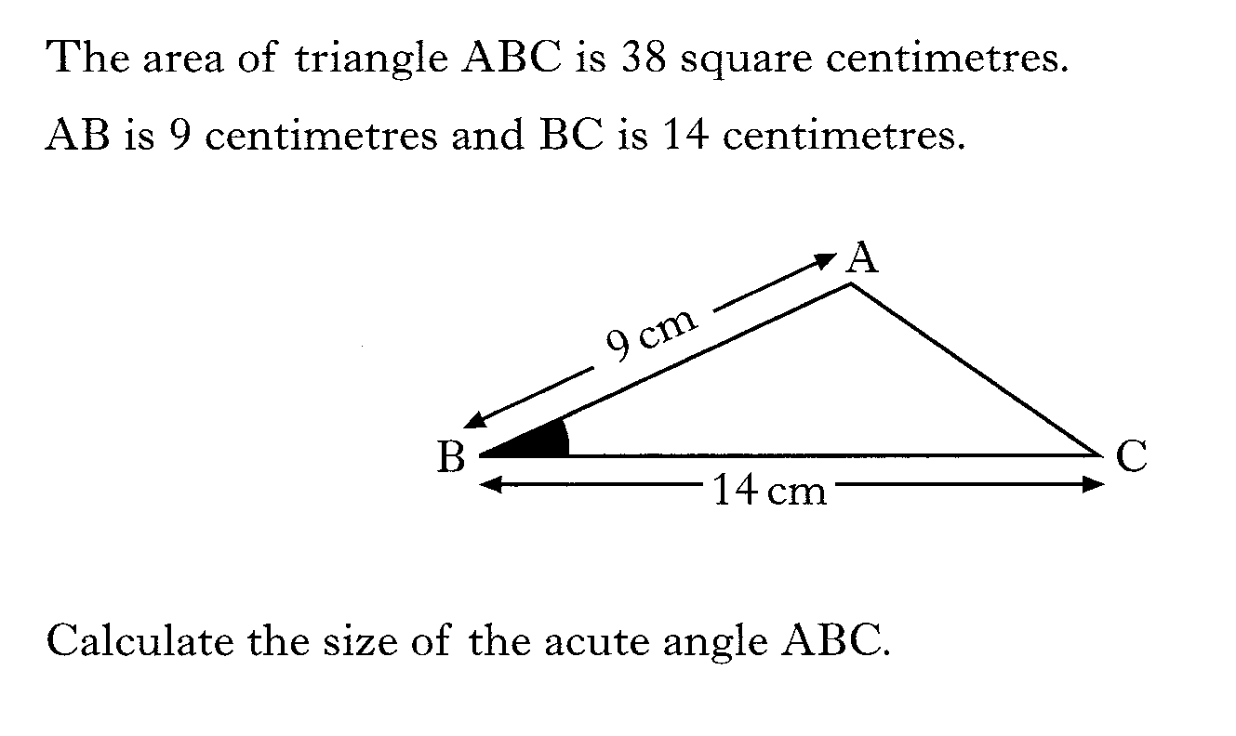
29.23
Past Paper Questions – National 5 Mathematics
Topic: Trigonometry (Side Length & Angle)

Slide 24
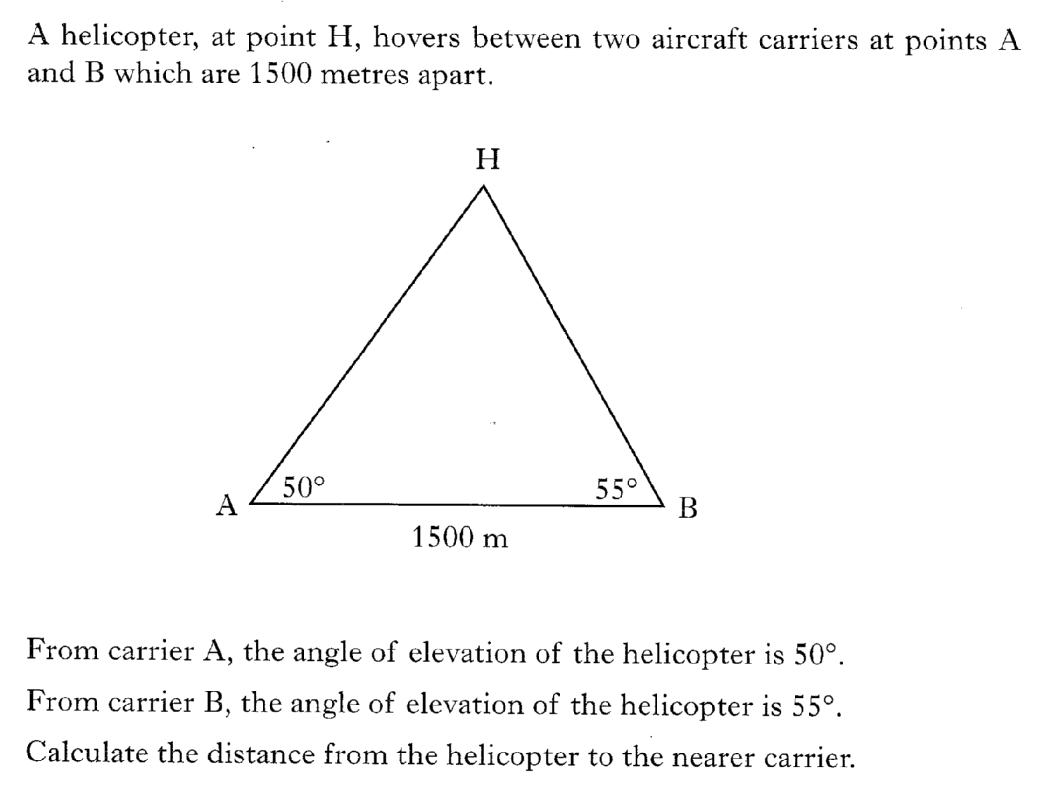
29.24
Past Paper Questions – National 5 Mathematics
Topic: Trigonometry (Side Length & Angle)

Slide 25
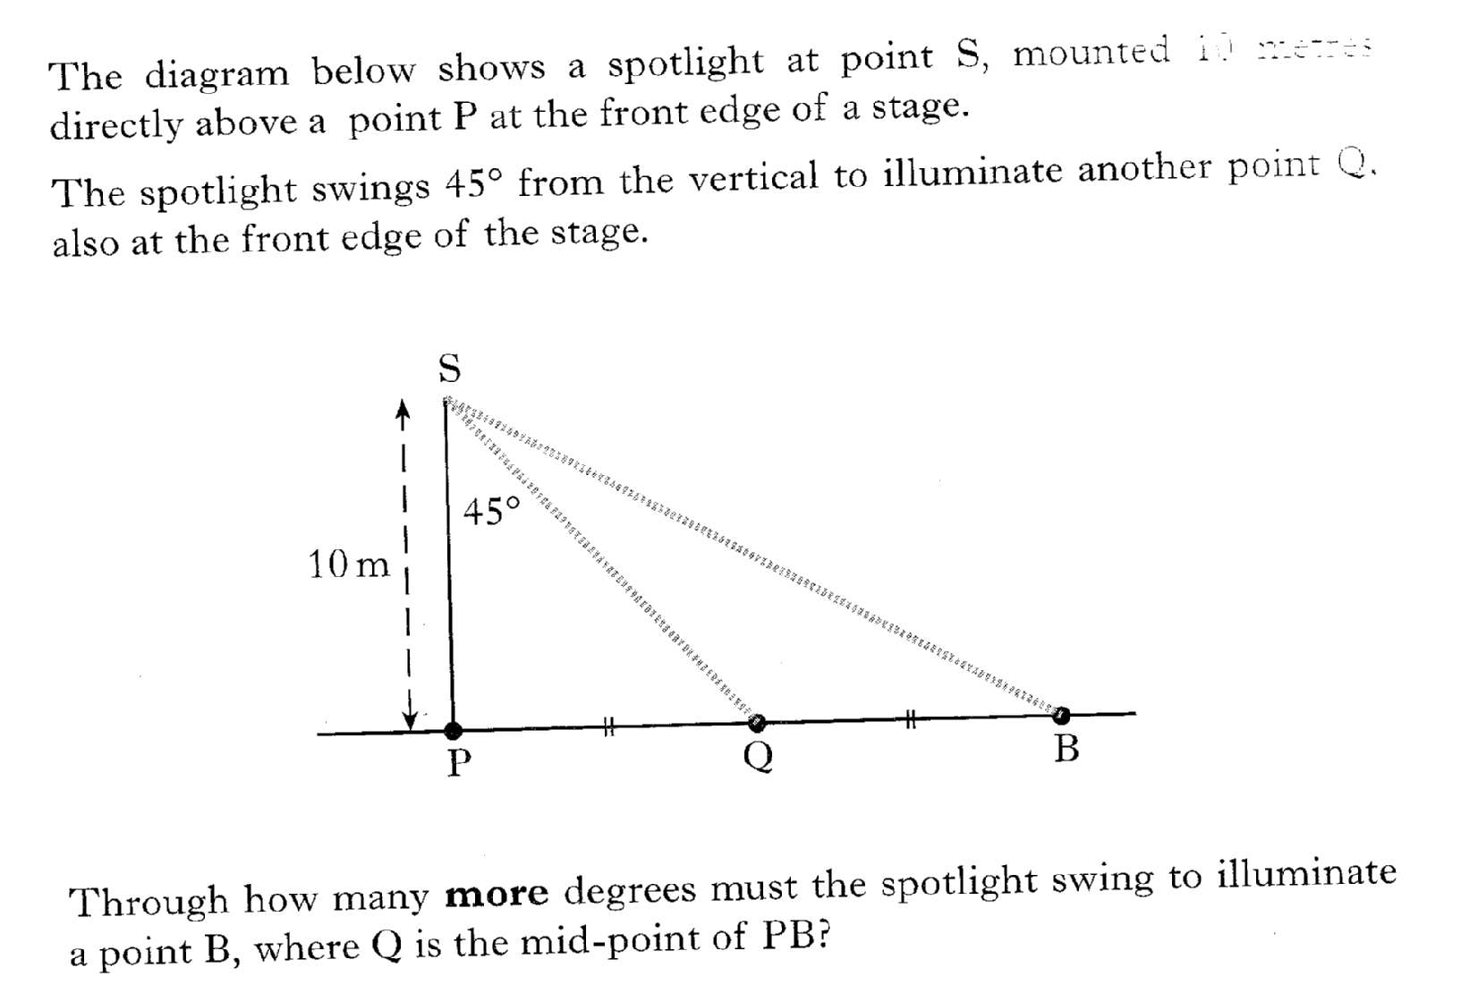
29.25
Past Paper Questions – National 5 Mathematics
Topic: Trigonometry (Side Length & Angle)
10 meters

Slide 26
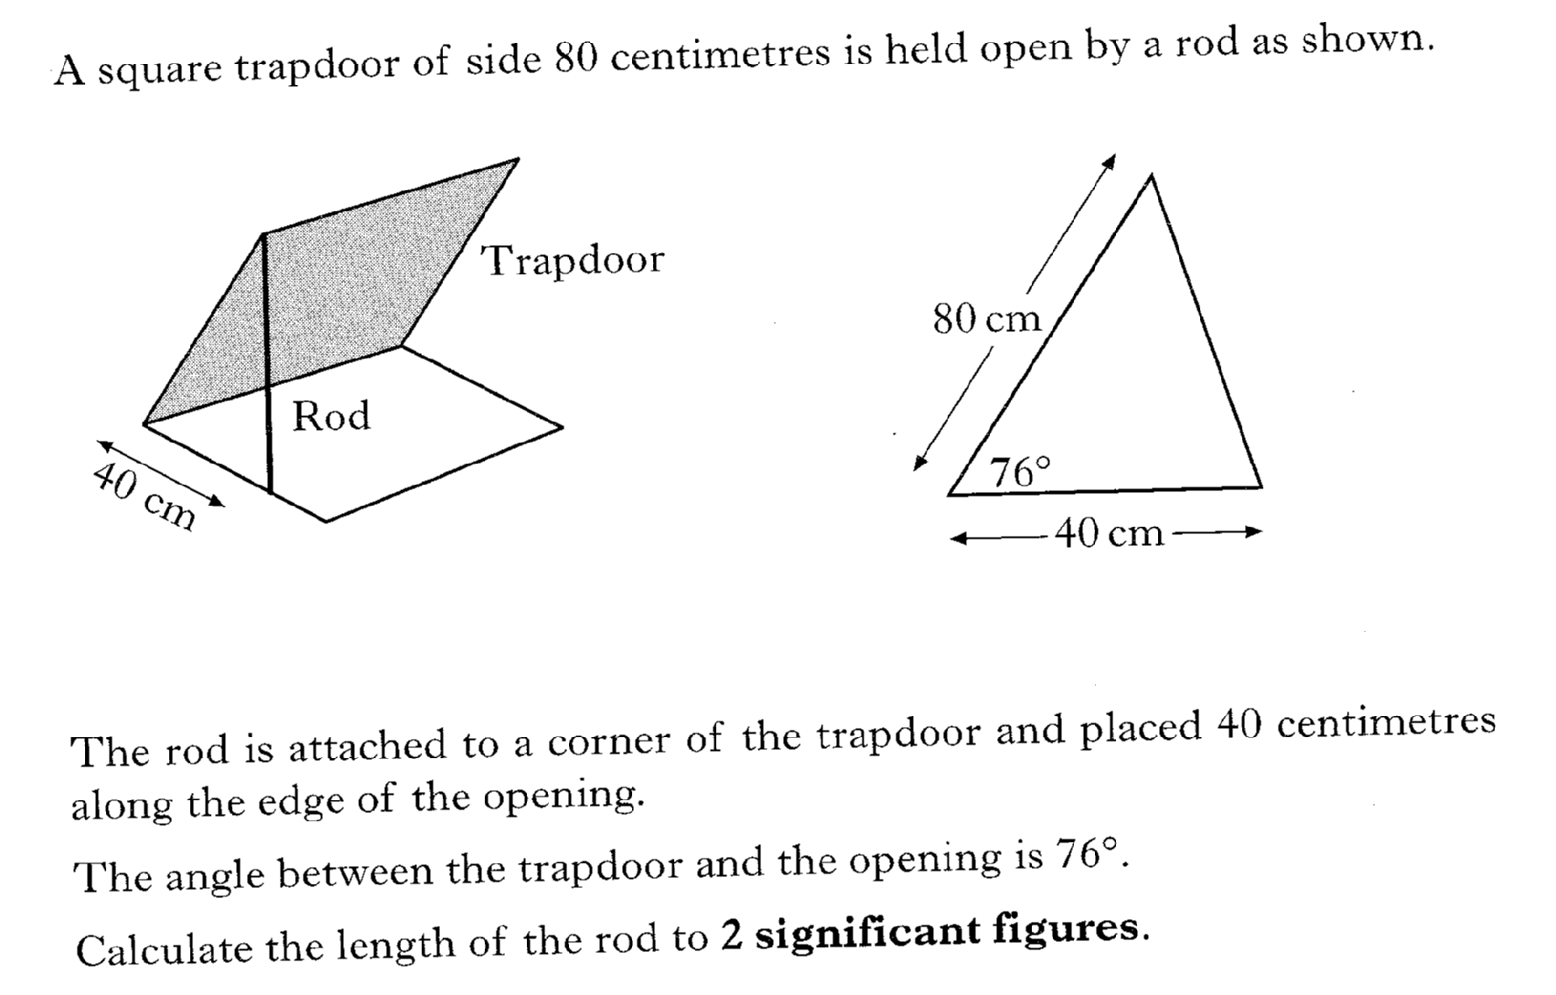
29.26
Past Paper Questions – National 5 Mathematics
Topic: Trigonometry (Side Length & Angle)

Slide 27
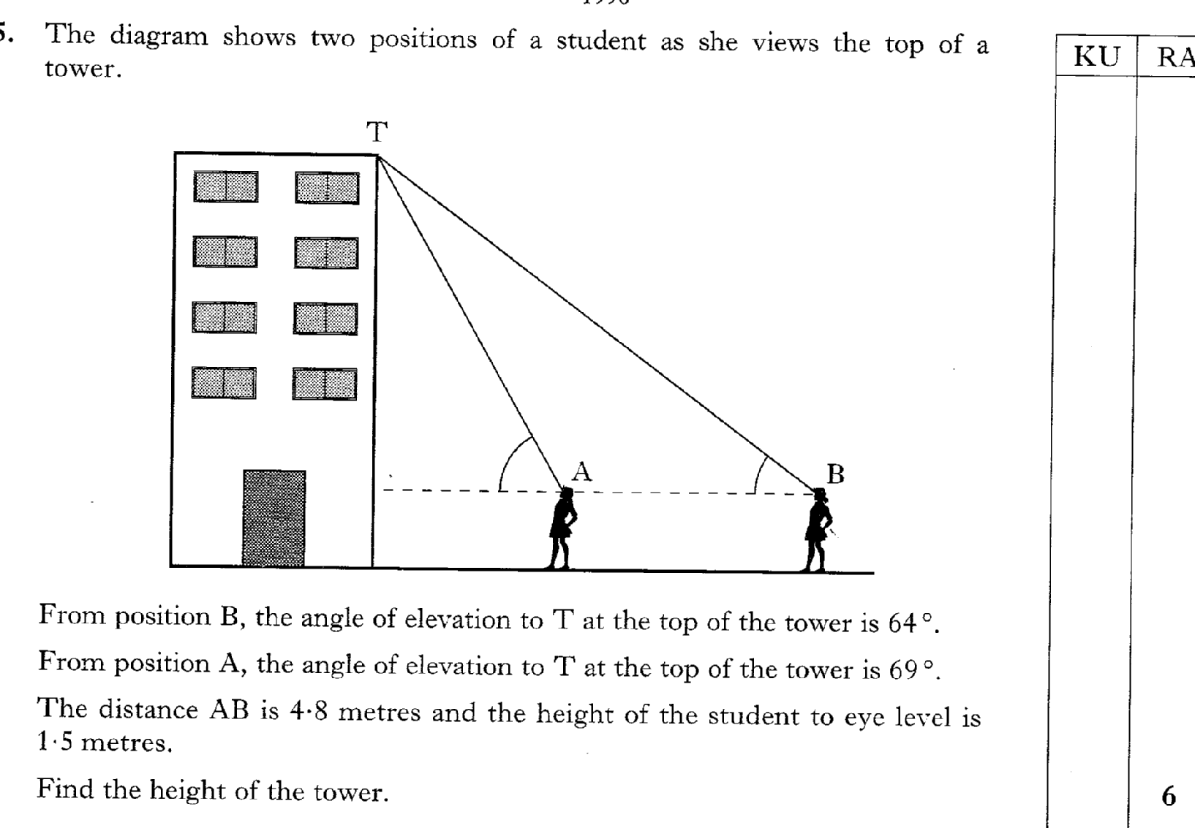
29.27
Past Paper Questions – National 5 Mathematics
Topic: Trigonometry (Side Length & Angle)

Slide 28
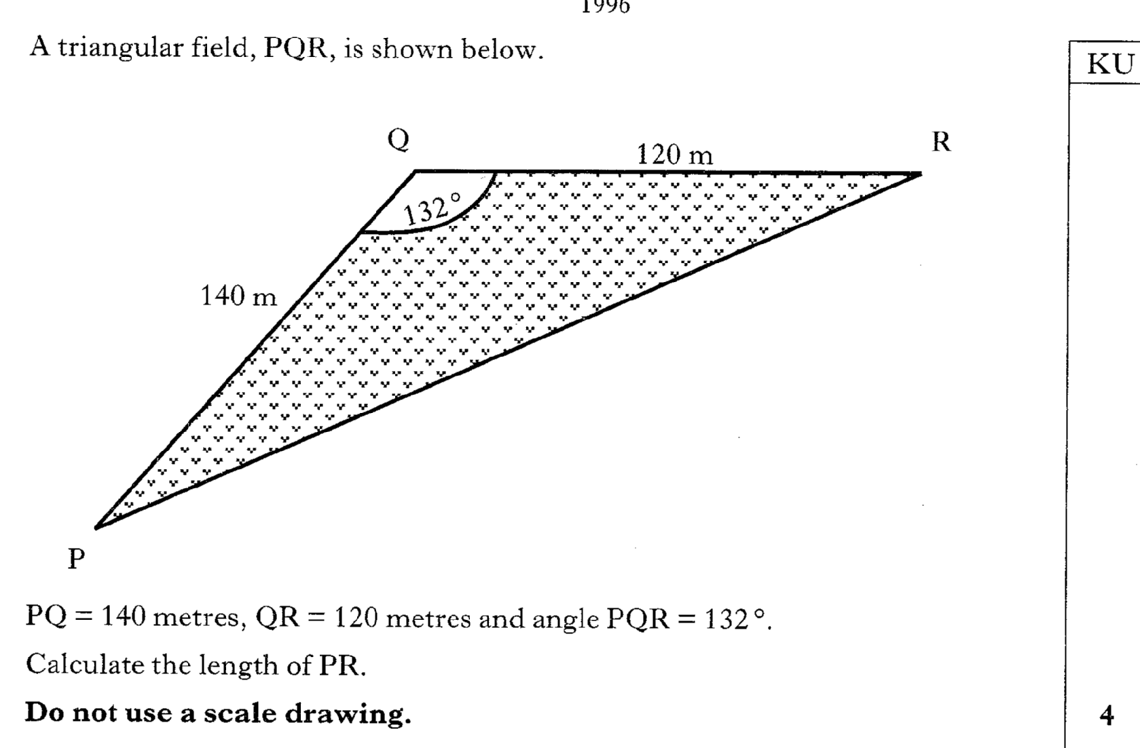
29.28
Past Paper Questions – National 5 Mathematics
Topic: Trigonometry (Side Length & Angle)

Slide 29
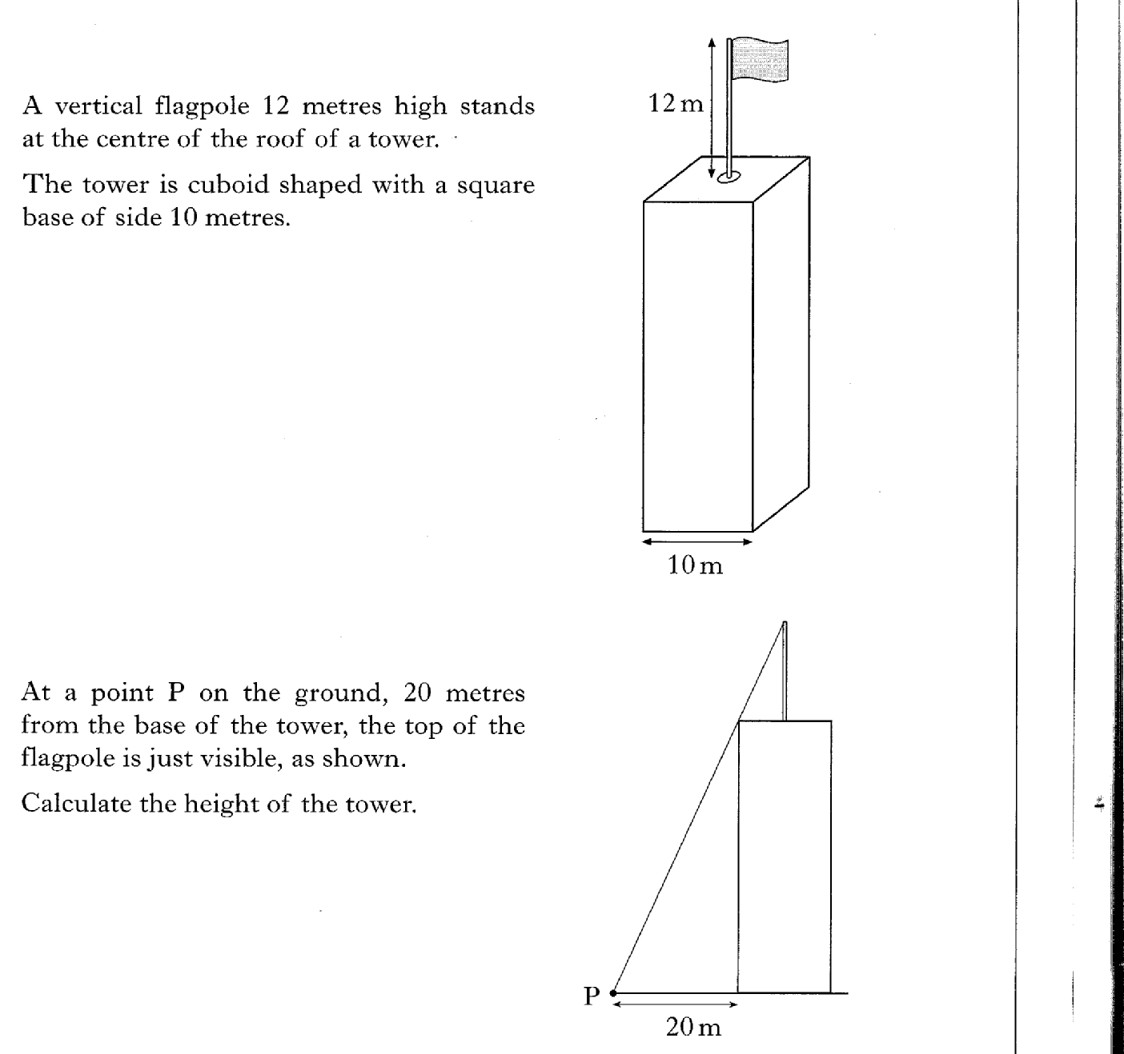
29.29
Past Paper Questions – National 5 Mathematics
Topic: Trigonometry (Side Length & Angle)

Slide 30
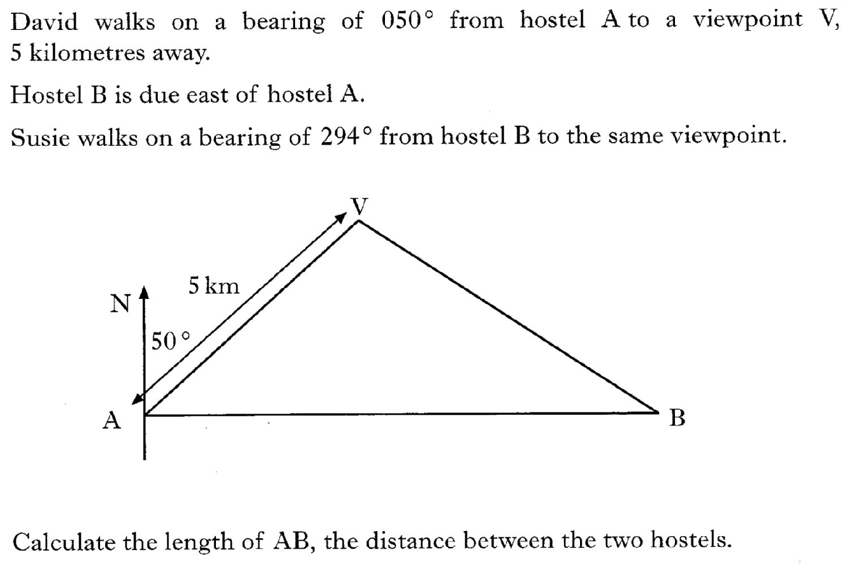
29.30
Past Paper Questions – National 5 Mathematics
Topic: Trigonometry (Side Length & Angle)

Slide 31
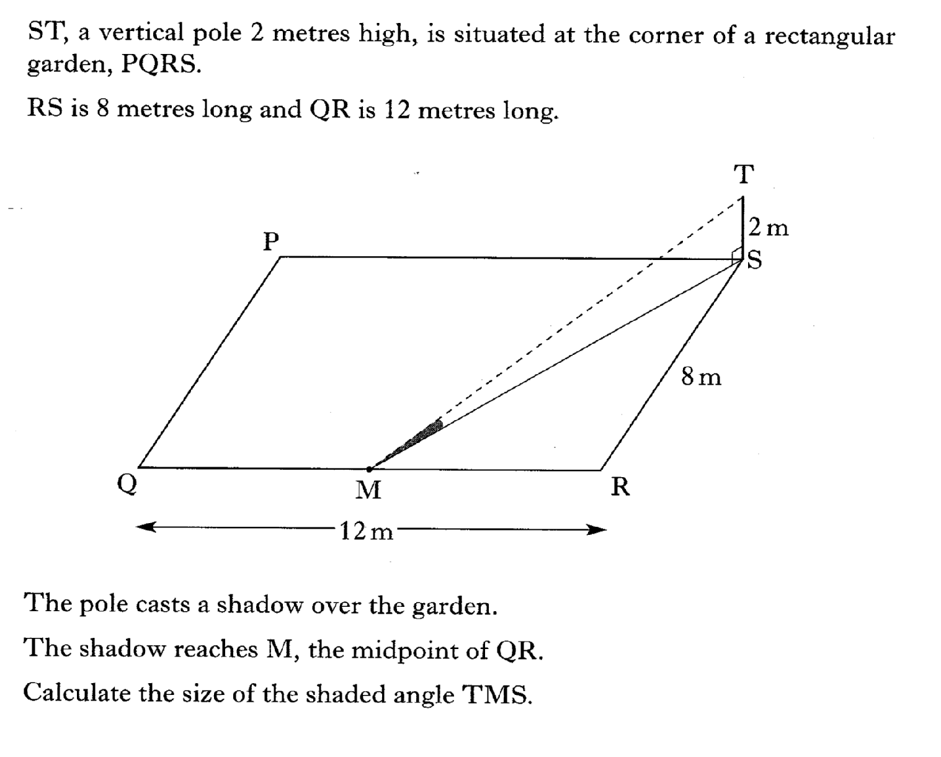
29.31
Past Paper Questions – National 5 Mathematics
Topic: Trigonometry (Side Length & Angle)

Slide 32
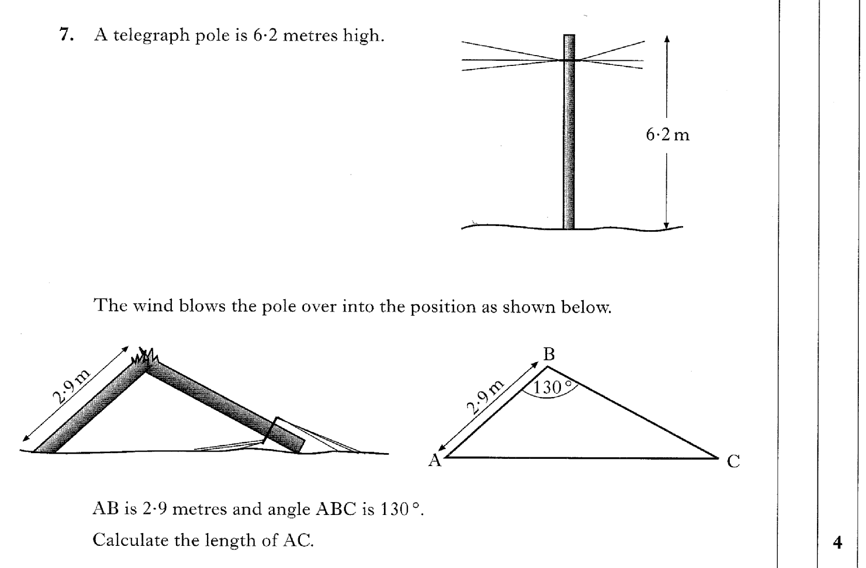
29.32
Past Paper Questions – National 5 Mathematics
Topic: Trigonometry (Side Length & Angle)

Slide 33
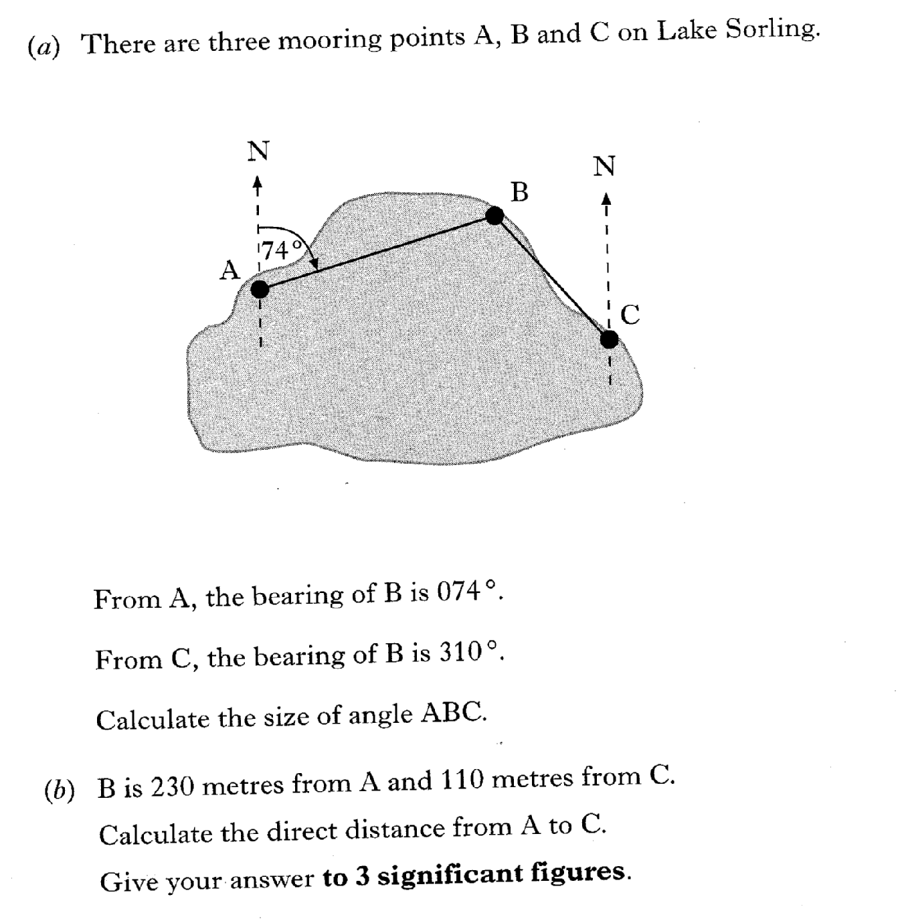
29.33
Past Paper Questions – National 5 Mathematics
Topic: Trigonometry (Side Length & Angle)

Slide 34
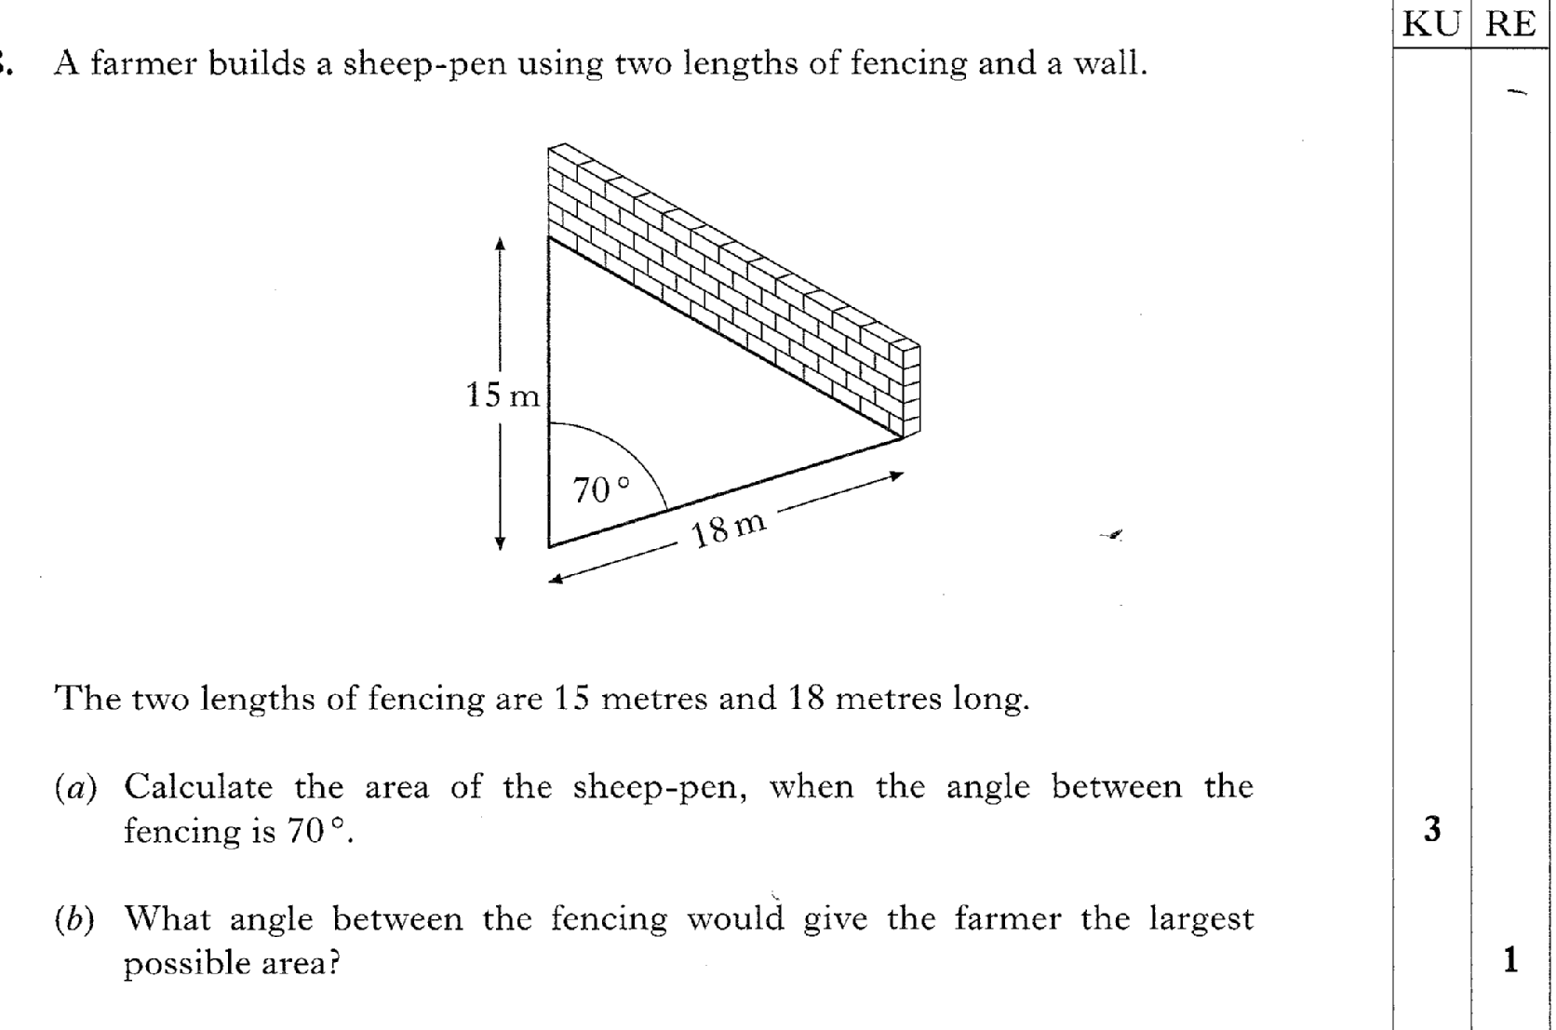
29.34
Past Paper Questions – National 5 Mathematics
Topic: Trigonometry (Side Length & Angle)

Slide 35
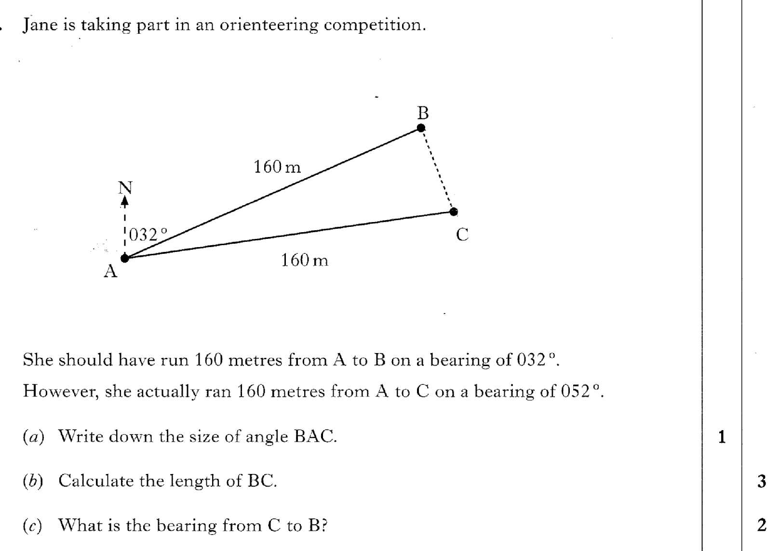
29.35
Past Paper Questions – National 5 Mathematics
Topic: Trigonometry (Side Length & Angle)

Slide 36
29.36
Past Paper Questions – National 5 Mathematics
Topic: Trigonometry (Side Length & Angle)

Slide 37
29.37
Past Paper Questions – National 5 Mathematics
Topic: Trigonometry (Side Length & Angle)

Slide 38
29.38
Past Paper Questions – National 5 Mathematics
Topic: Trigonometry (Side Length & Angle)

Slide 39
29.39
Past Paper Questions – National 5 Mathematics
Topic: Trigonometry (Side Length & Angle)

Slide 40
29.40
Past Paper Questions – National 5 Mathematics
Topic: Trigonometry (Side Length & Angle)

Slide 41
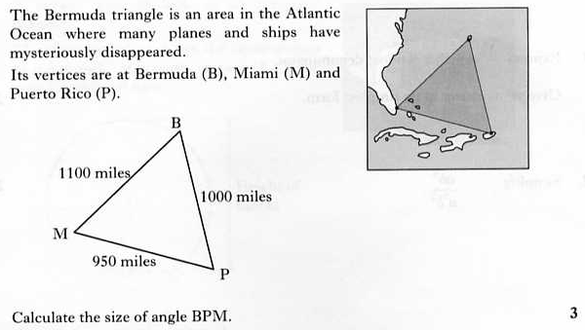
29.41
Past Paper Questions – National 5 Mathematics
Topic: Trigonometry (Side Length & Angle)
Notes:
41

Slide 42
29.42
Past Paper Questions – National 5 Mathematics
Topic: Trigonometry (Side Length & Angle)
Notes:
42

Slide 43
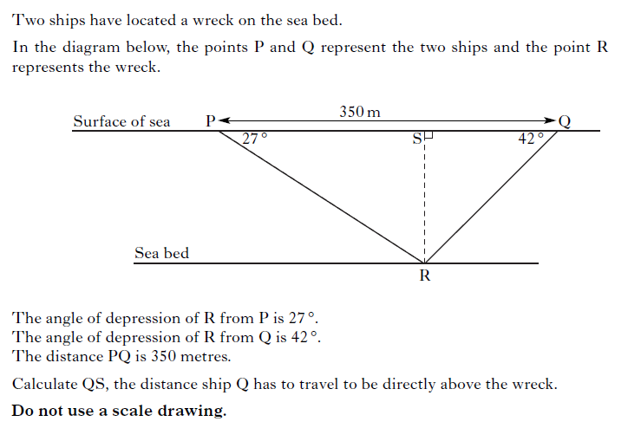
29.43
Past Paper Questions – National 5 Mathematics
Topic: Trigonometry (Side Length & Angle)
Notes:
43

Slide 44
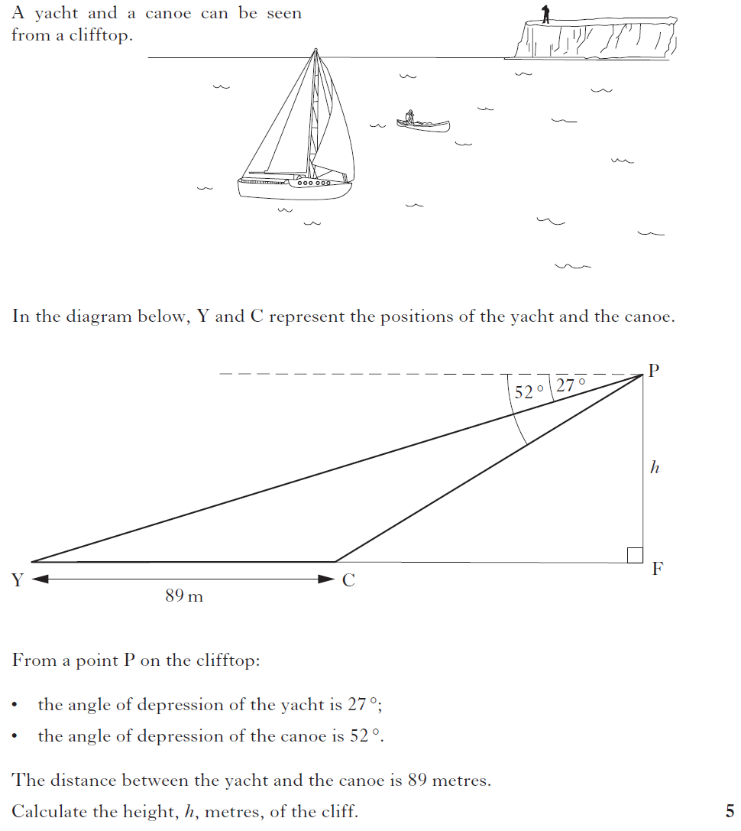
29.44
Past Paper Questions – National 5 Mathematics
Topic: Trigonometry (Side Length & Angle)
Notes:
44

Slide 45
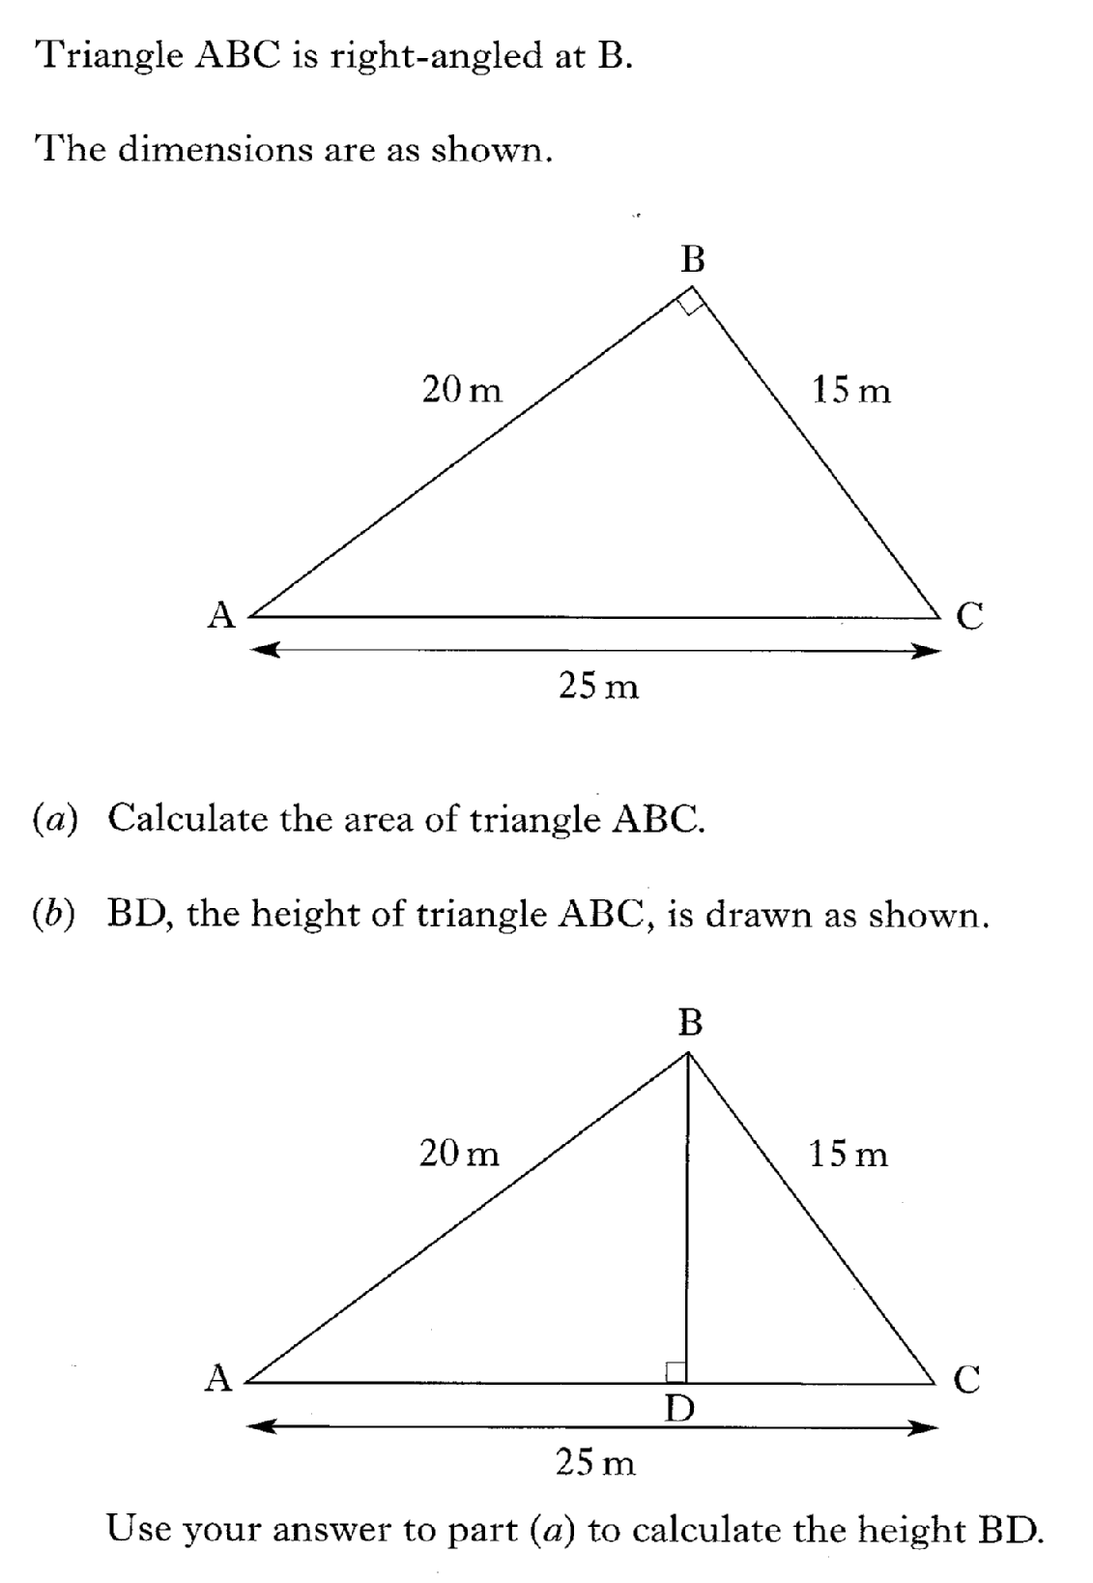
29.45
Past Paper Questions – National 5 Mathematics
Topic: Trigonometry (Side Length & Angle)

Slide 46
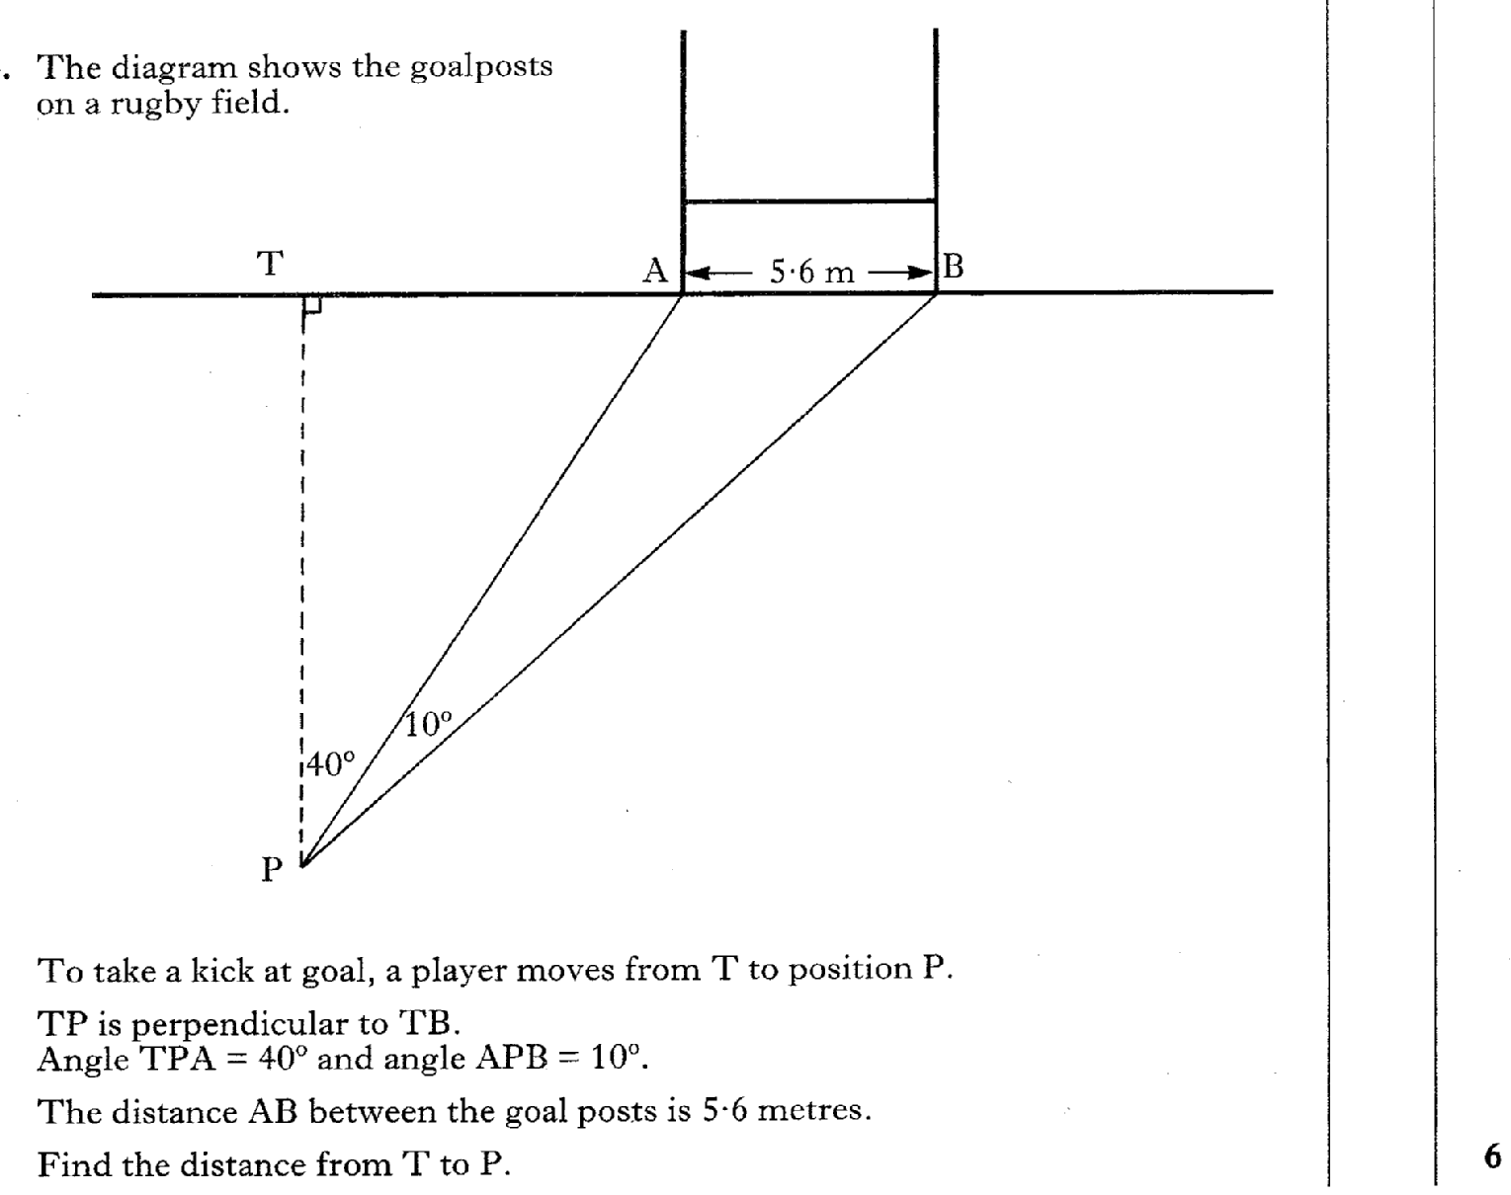
29.46
Past Paper Questions – National 5 Mathematics
Topic: Trigonometry (Side Length & Angle)

Slide 47
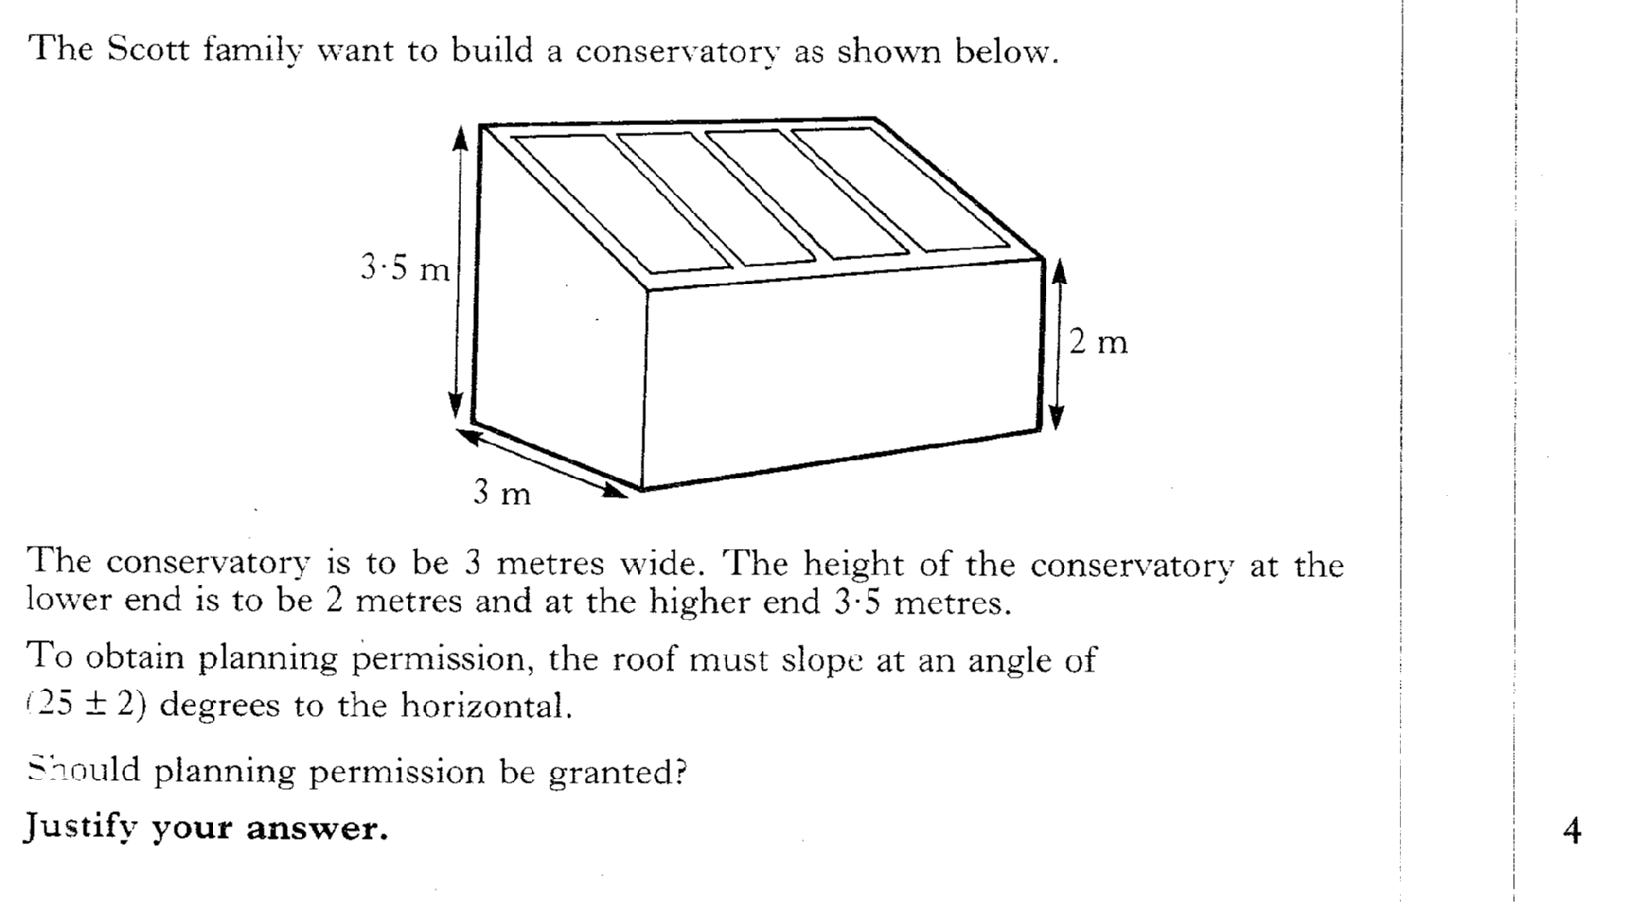
29.47
Past Paper Questions – National 5 Mathematics
Topic: Trigonometry (Side Length & Angle)

Slide 48
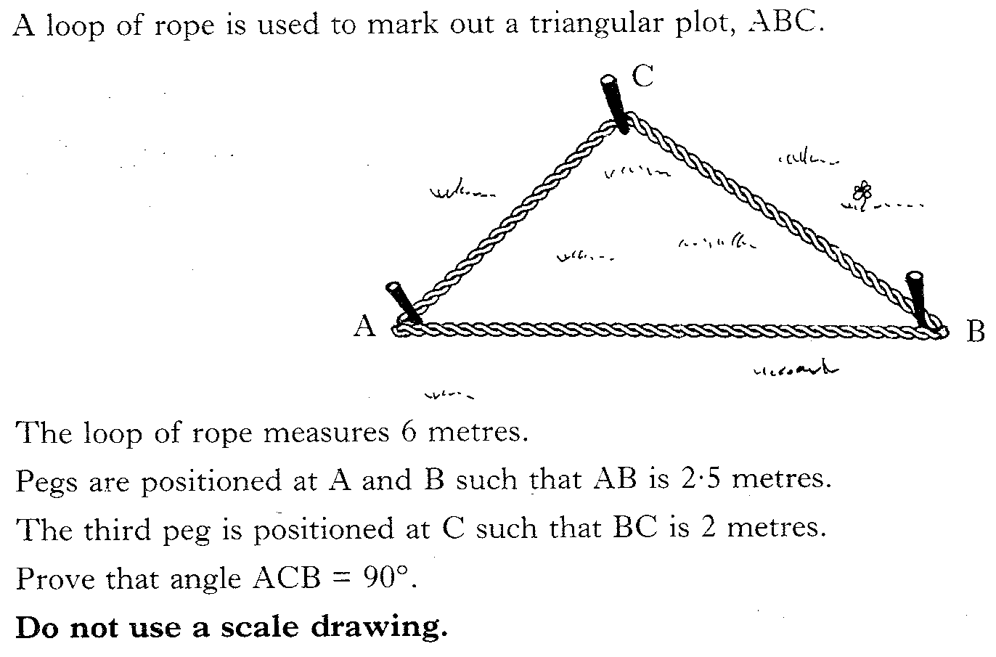
29.48
Past Paper Questions – National 5 Mathematics
Topic: Trigonometry (Side Length & Angle)

Slide 49
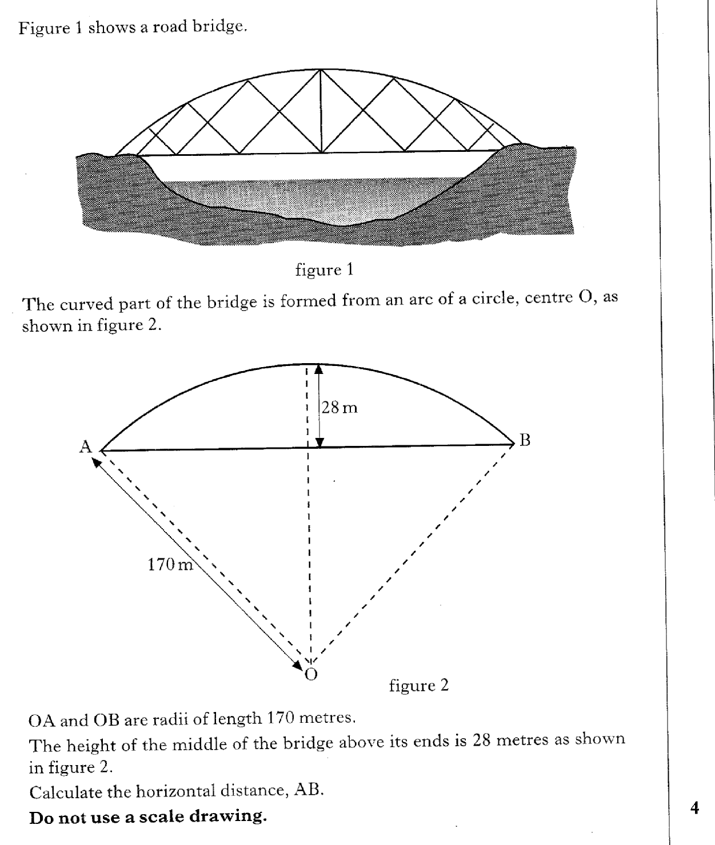
29.49
Past Paper Questions – National 5 Mathematics
Topic: Trigonometry (Side Length & Angle)

Slide 50
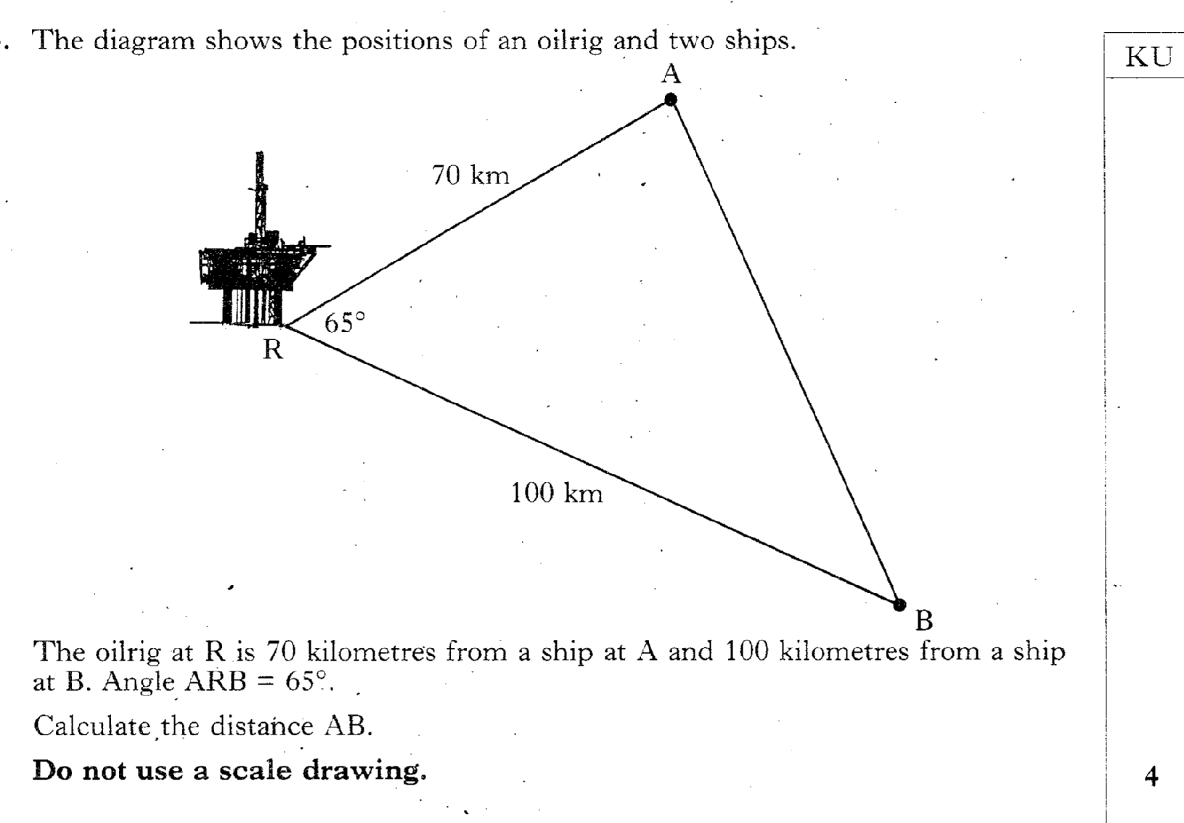
29.50
Past Paper Questions – National 5 Mathematics
Topic: Trigonometry (Side Length & Angle)

Slide 51
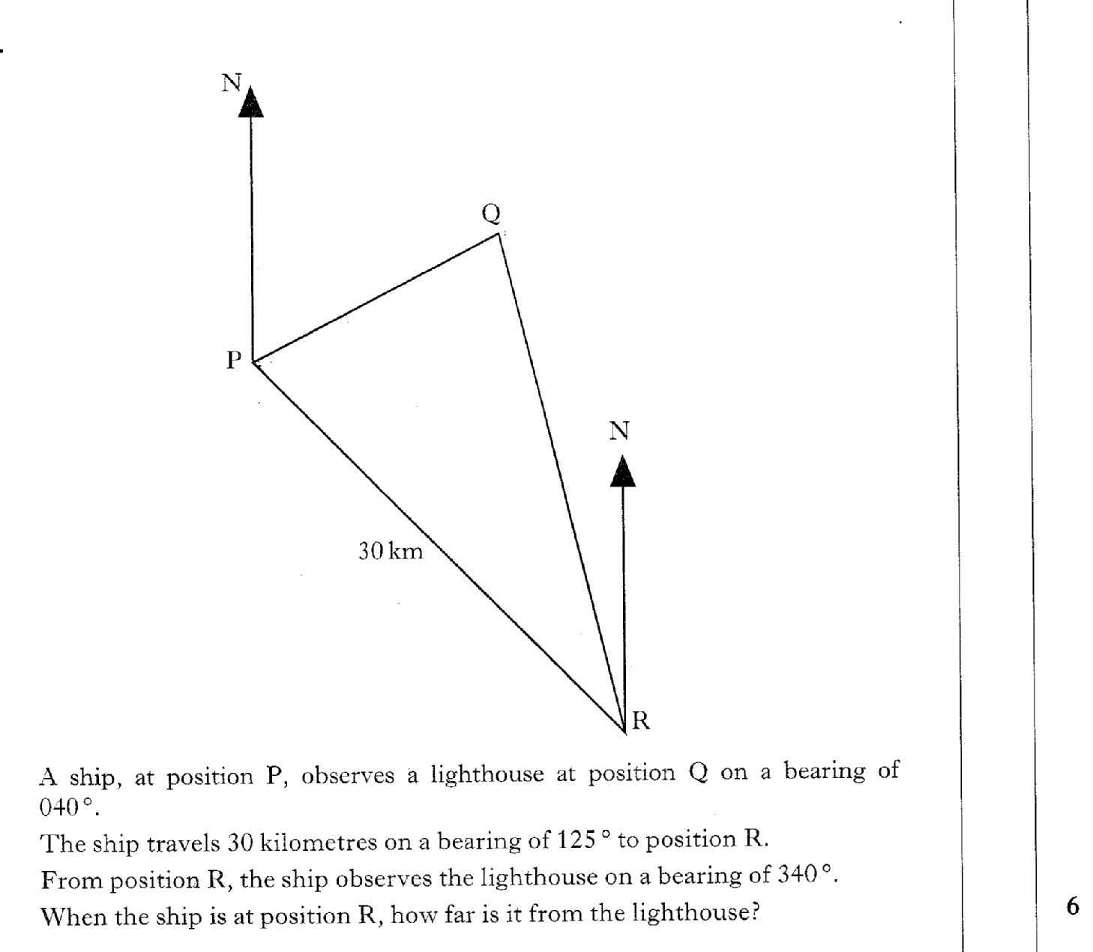
29.51
Past Paper Questions – National 5 Mathematics
Topic: Trigonometry (Side Length & Angle)

