Slide 1
Past Paper Questions – National 5 Mathematics
Topic: Vectors
26.01
26.02

Slide 2
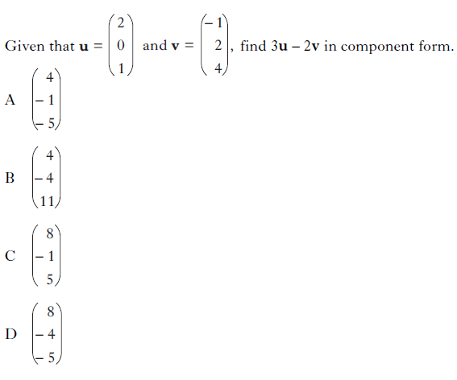
Past Paper Questions – National 5 Mathematics
Topic: Vectors
26.03

Slide 3
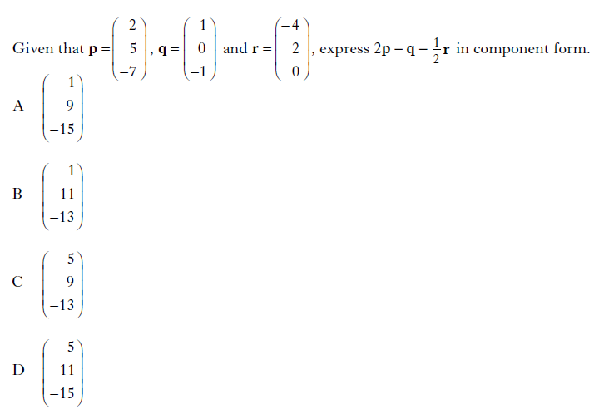
Past Paper Questions – National 5 Mathematics
Topic: Vectors
26.04

Slide 4
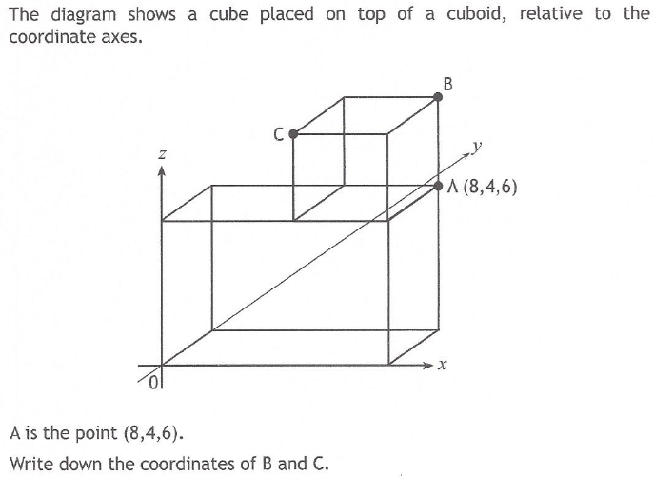
Past Paper Questions – National 5 Mathematics
Topic: Vectors
26.05

Slide 5
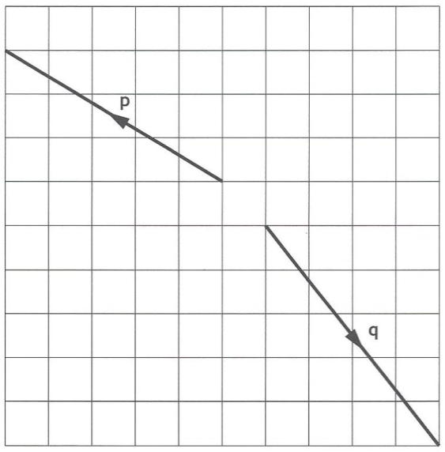
Past Paper Questions – National 5 Mathematics
Topic: Vectors
26.06

Slide 6
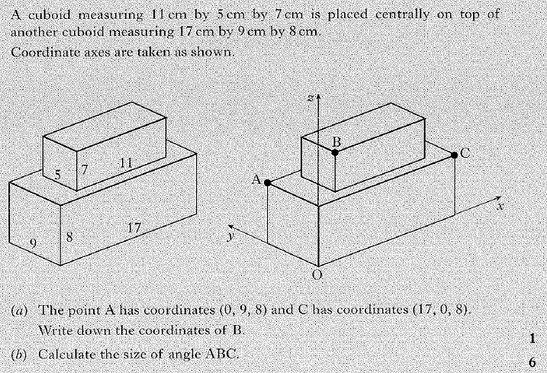
Past Paper Questions – National 5 Mathematics
Topic: Vectors
26.07

Slide 7
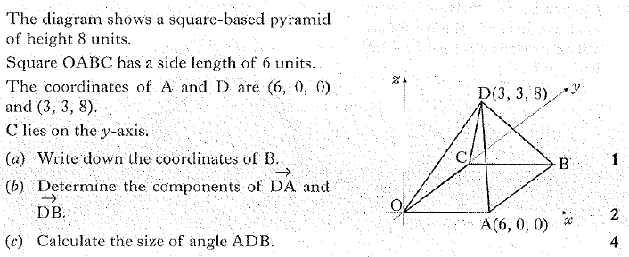
Past Paper Questions – National 5 Mathematics
Topic: Vectors
26.08

Slide 8
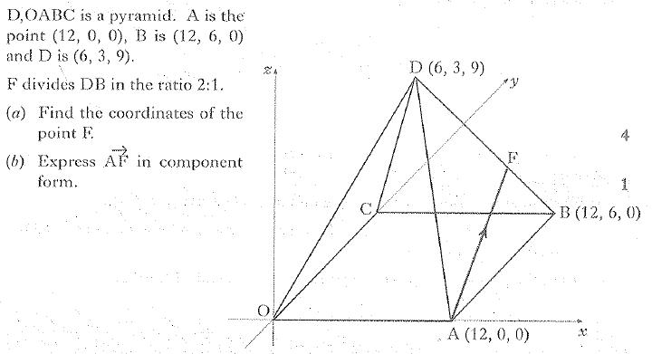
Past Paper Questions – National 5 Mathematics
Topic: Vectors
26.09

Slide 9
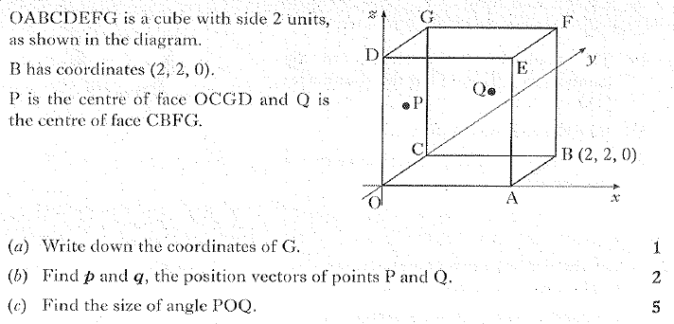
Past Paper Questions – National 5 Mathematics
Topic: Vectors
26.10

Slide 10
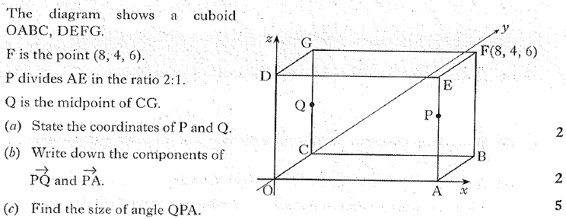
Past Paper Questions – National 5 Mathematics
Topic: Vectors
26.11

Slide 11
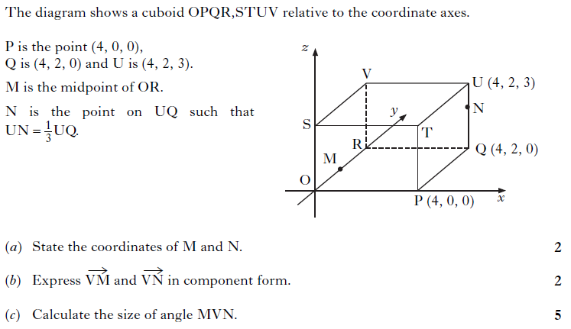
Past Paper Questions – National 5 Mathematics
Topic: Vectors
26.12

Slide 12
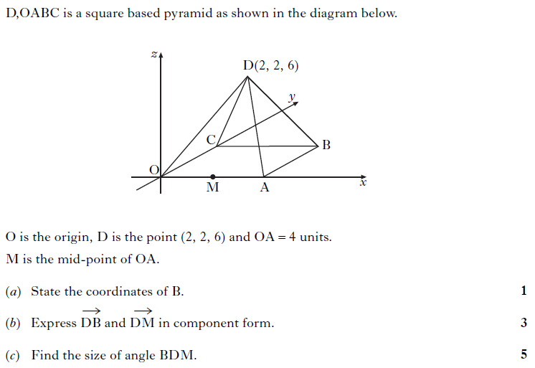
Past Paper Questions – National 5 Mathematics
Topic: Vectors
26.13

