Slide 1

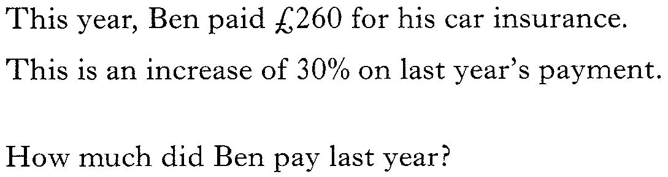
Past Paper Questions – National 5 Mathematics
Topic: Percentages
11.01
11.02

Slide 2

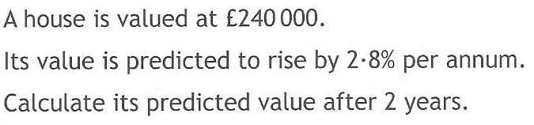
Past Paper Questions – National 5 Mathematics
Topic: Percentages
11.03
11.04

Slide 3
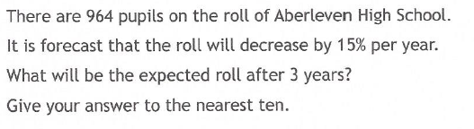
Past Paper Questions – National 5 Mathematics
Topic: Percentages
11.05
11.06

Slide 4

Past Paper Questions – National 5 Mathematics
Topic: Percentages
11.07
11.08

Slide 5
Past Paper Questions – National 5 Mathematics
Topic: Percentages
11.09
11.10

Slide 6
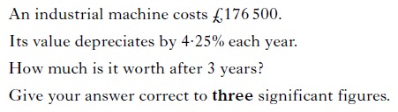
Past Paper Questions – National 5 Mathematics
Topic: Percentages
11.11
11.12

Slide 7
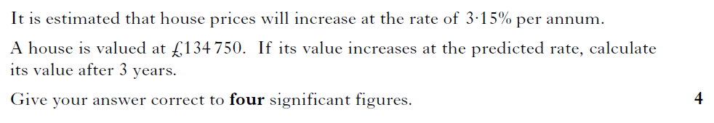
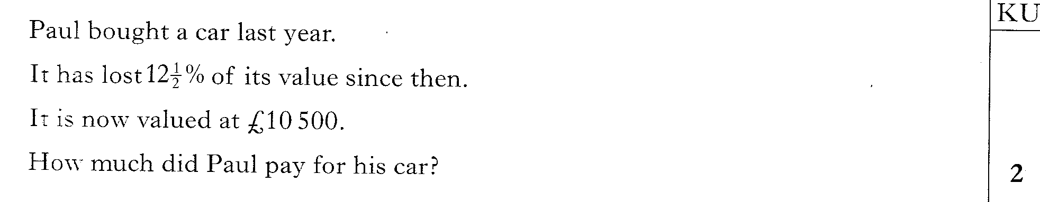
Past Paper Questions – National 5 Mathematics
Topic: Percentages
11.13
11.14
Notes:
7

Slide 8
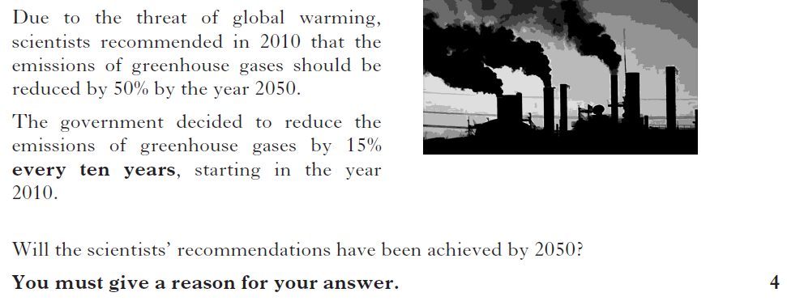
Past Paper Questions – National 5 Mathematics
Topic: Percentages
11.15
Notes:
8

Slide 9
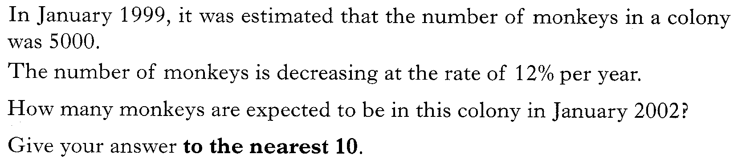
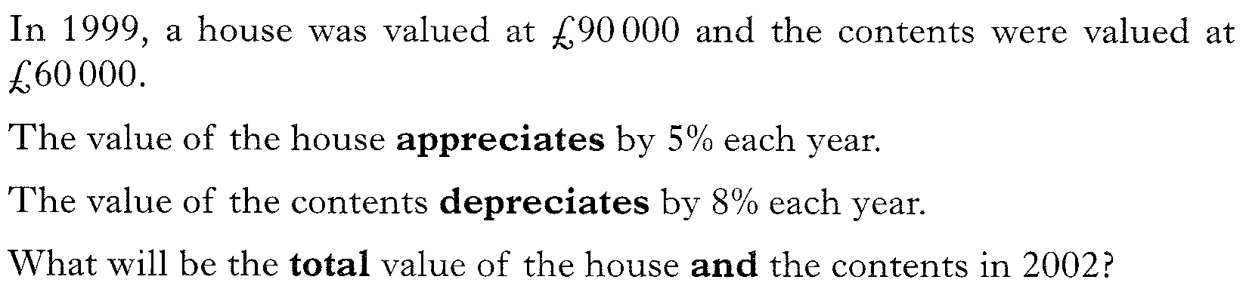
Past Paper Questions – National 5 Mathematics
Topic: Percentages
11.16
11.17

Slide 10
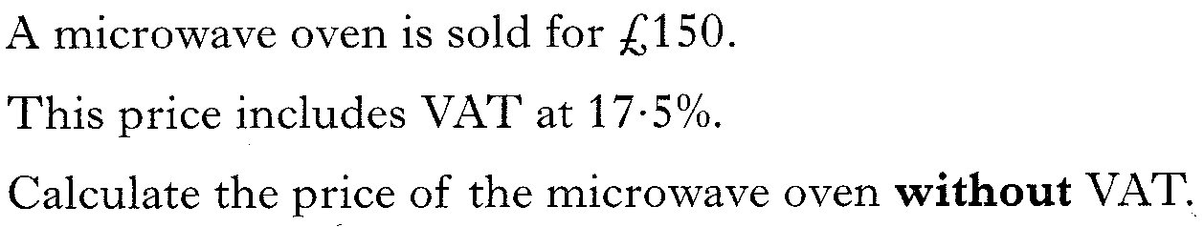
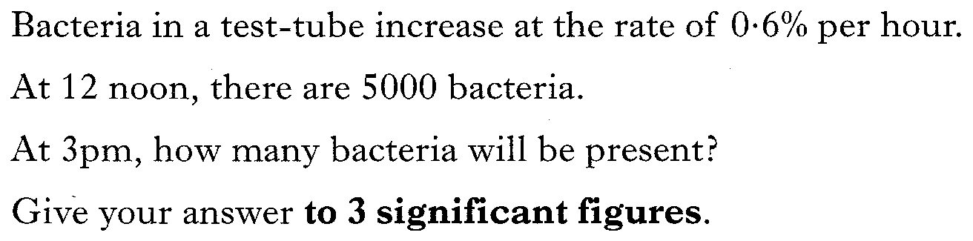
Past Paper Questions – National 5 Mathematics
Topic: Percentages
11.18
11.19

Slide 11
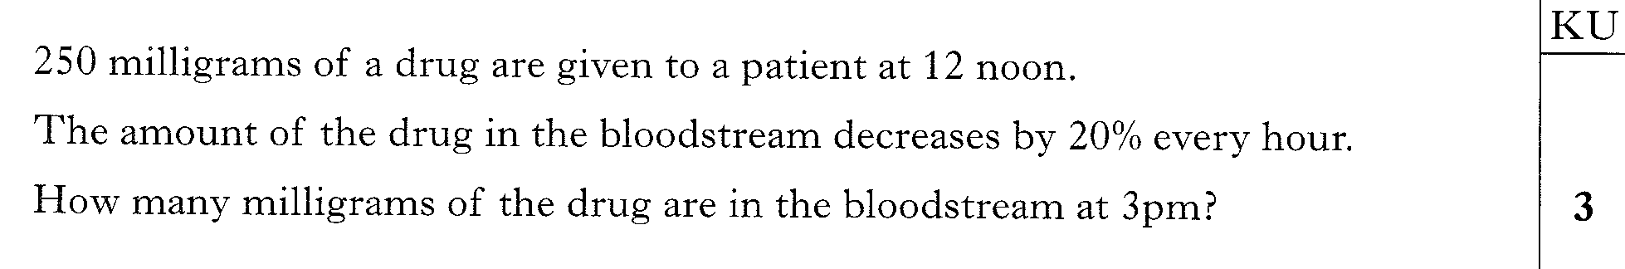
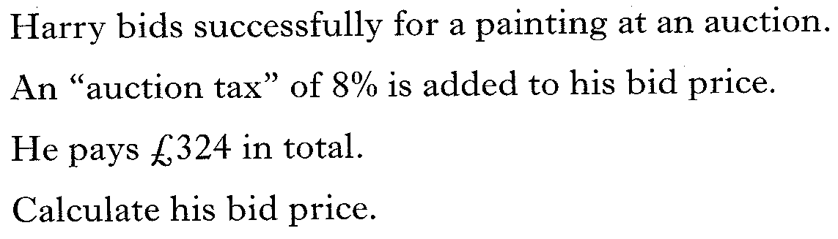
Past Paper Questions – National 5 Mathematics
Topic: Percentages
11.20
11.21

Slide 12
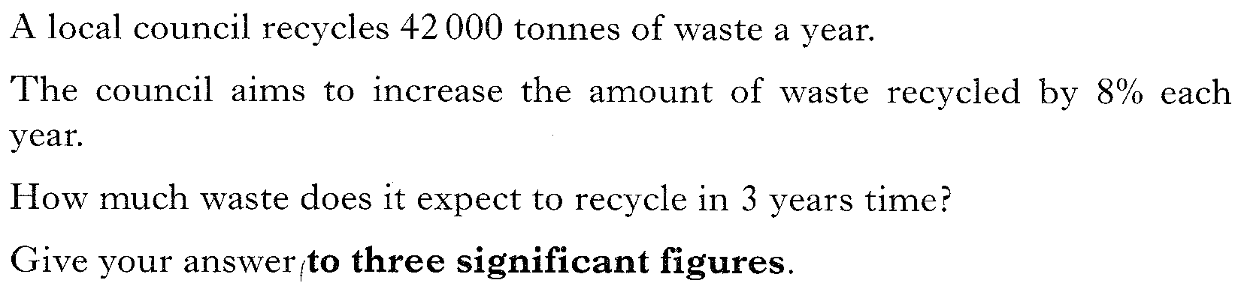
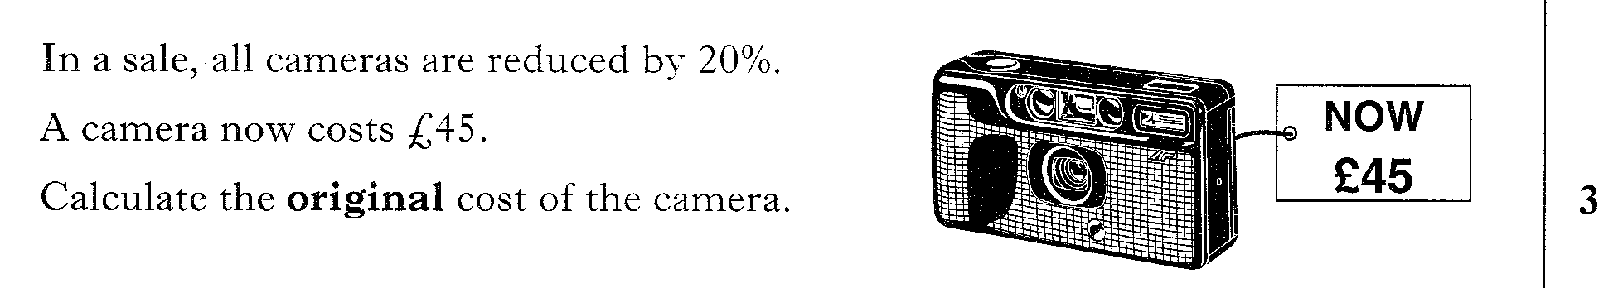
Past Paper Questions – National 5 Mathematics
Topic: Percentages
11.22
11.23

Slide 13
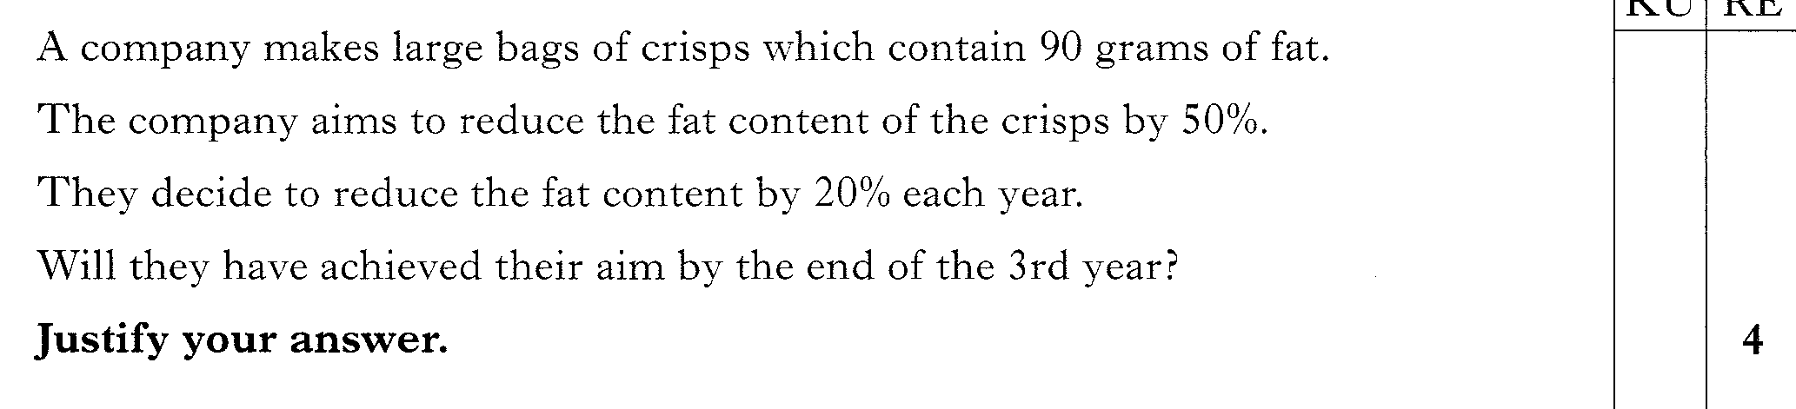
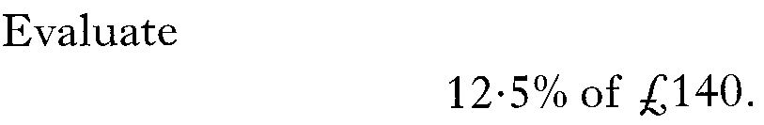
Past Paper Questions – National 5 Mathematics
Topic: Percentages
11.24
11.25

Slide 14
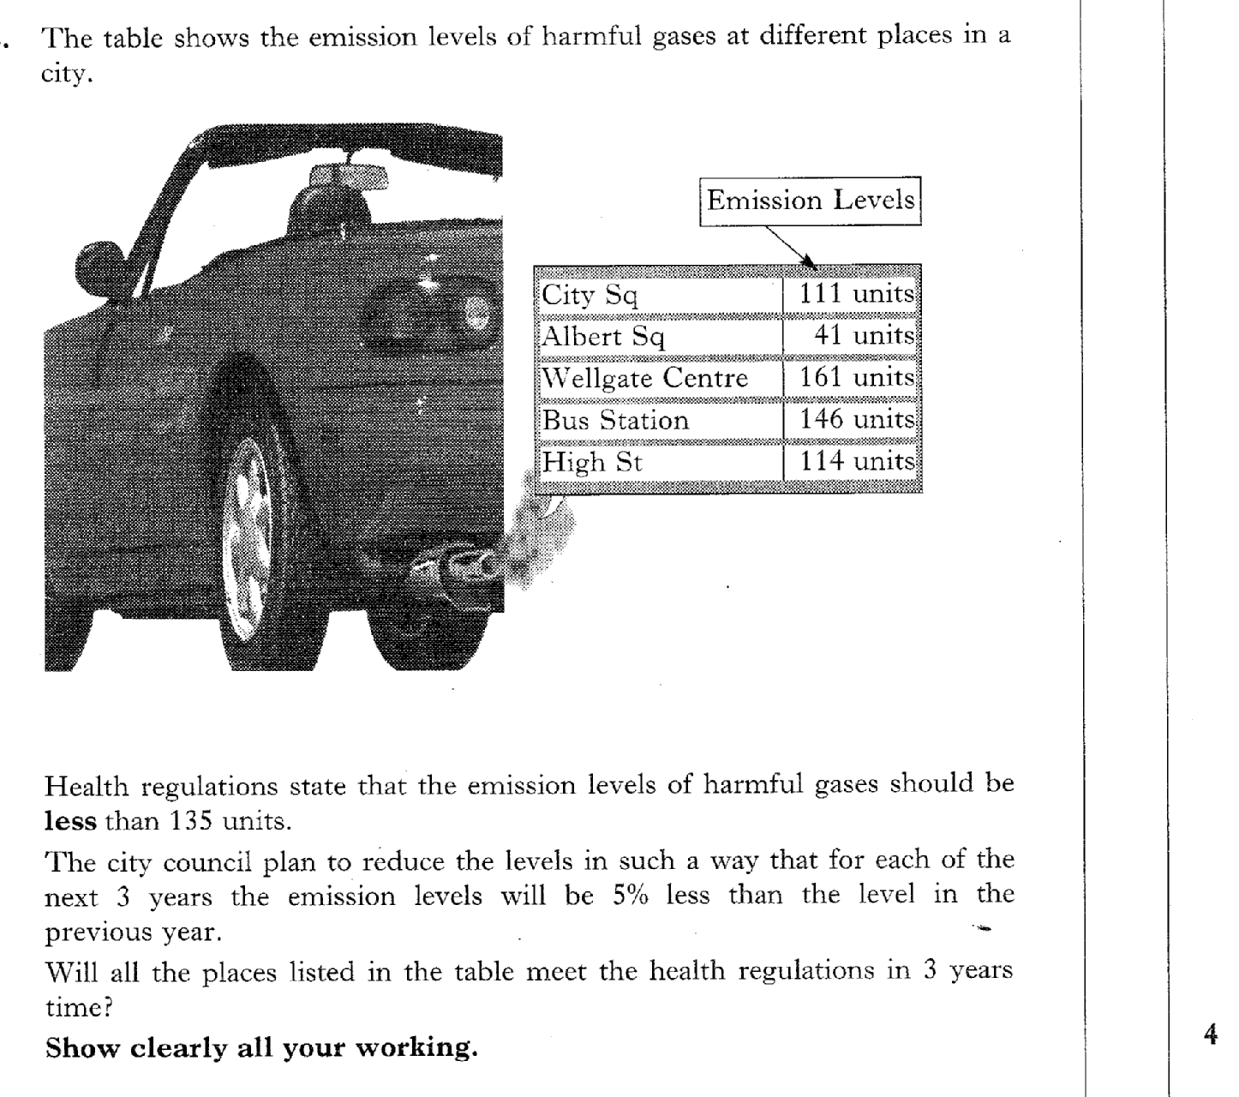
Past Paper Questions – National 5 Mathematics
Topic: Percentages
11.26

Slide 15
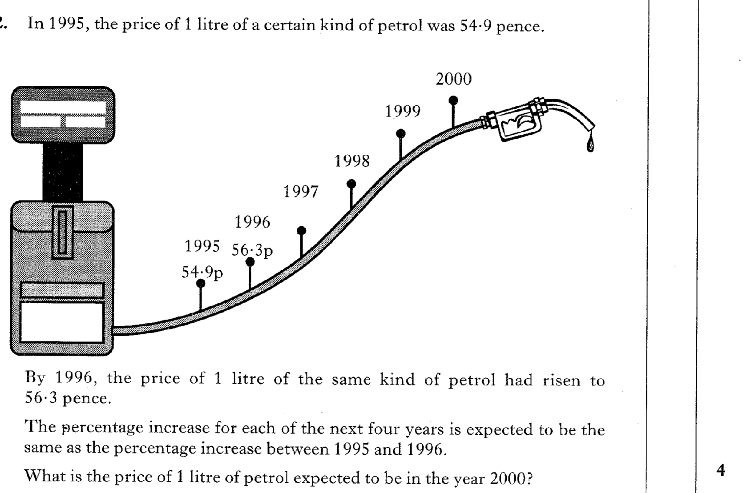
Past Paper Questions – National 5 Mathematics
Topic: Percentages
11.27

Slide 16
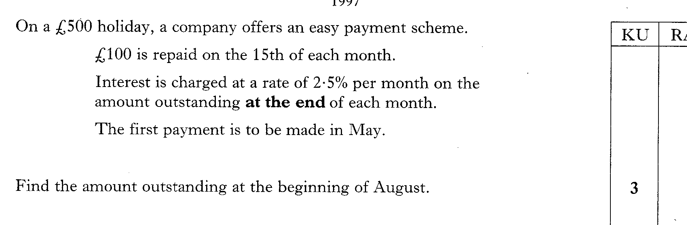
Past Paper Questions – National 5 Mathematics
Topic: Percentages
11.28

Slide 17
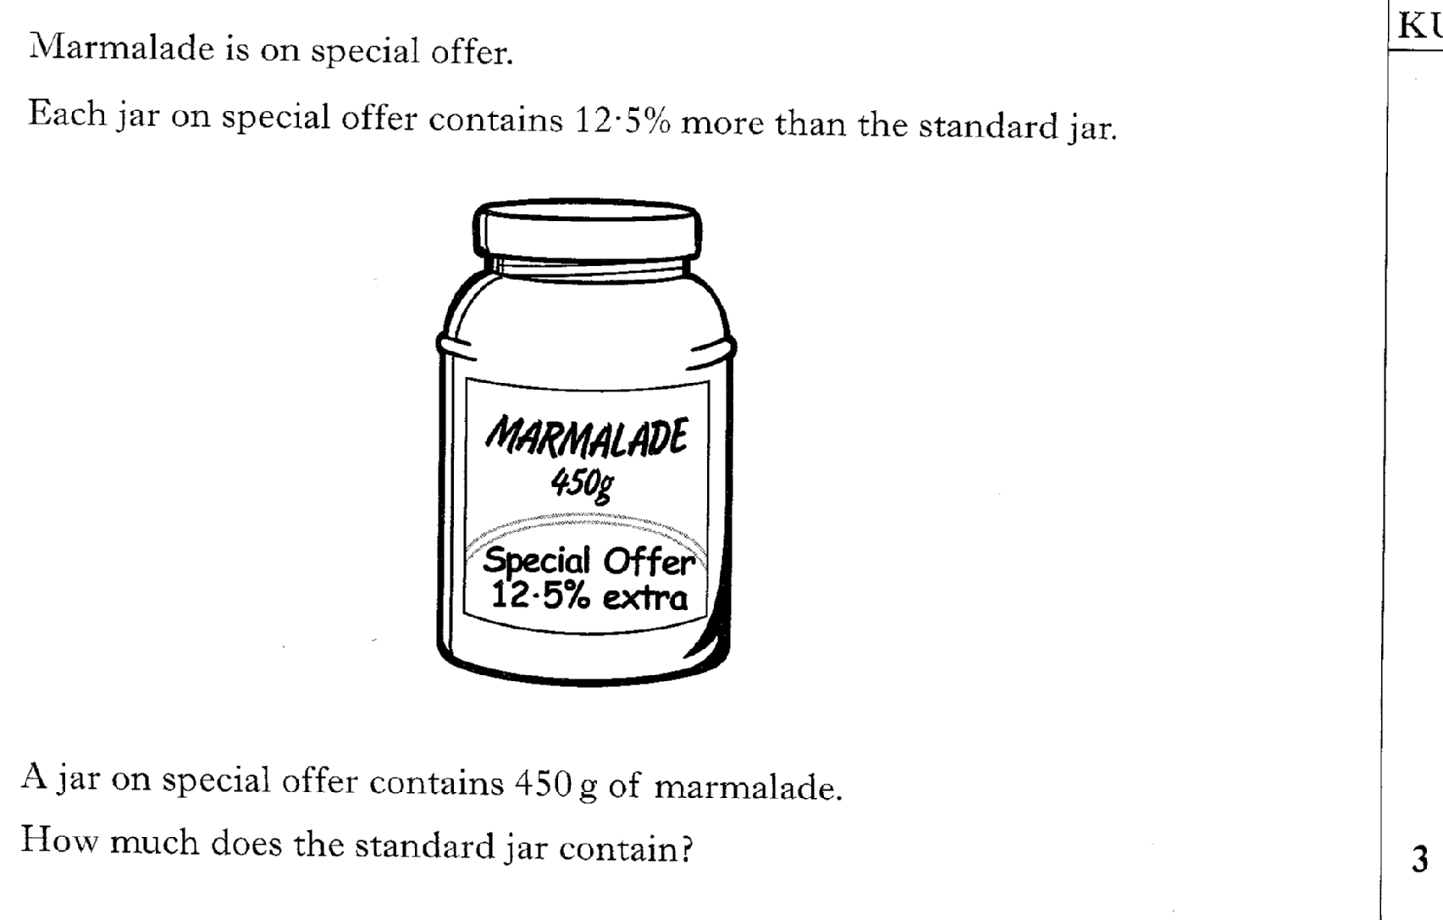
Past Paper Questions – National 5 Mathematics
Topic: Percentages
11.29

