Slide 1


Past Paper Questions – National 5 Mathematics
Topic: The Straight Line & Scattergraphs
24.01
24.02
24.03

Slide 2
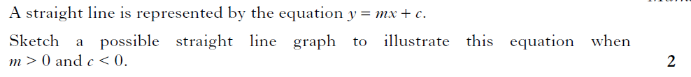
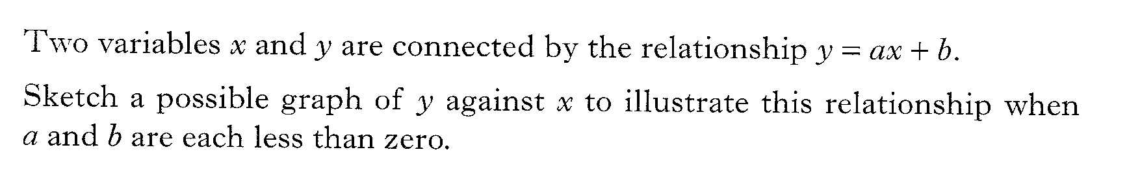
Past Paper Questions – National 5 Mathematics
Topic: The Straight Line & Scattergraphs
24.04
24.05
24.06

Slide 3
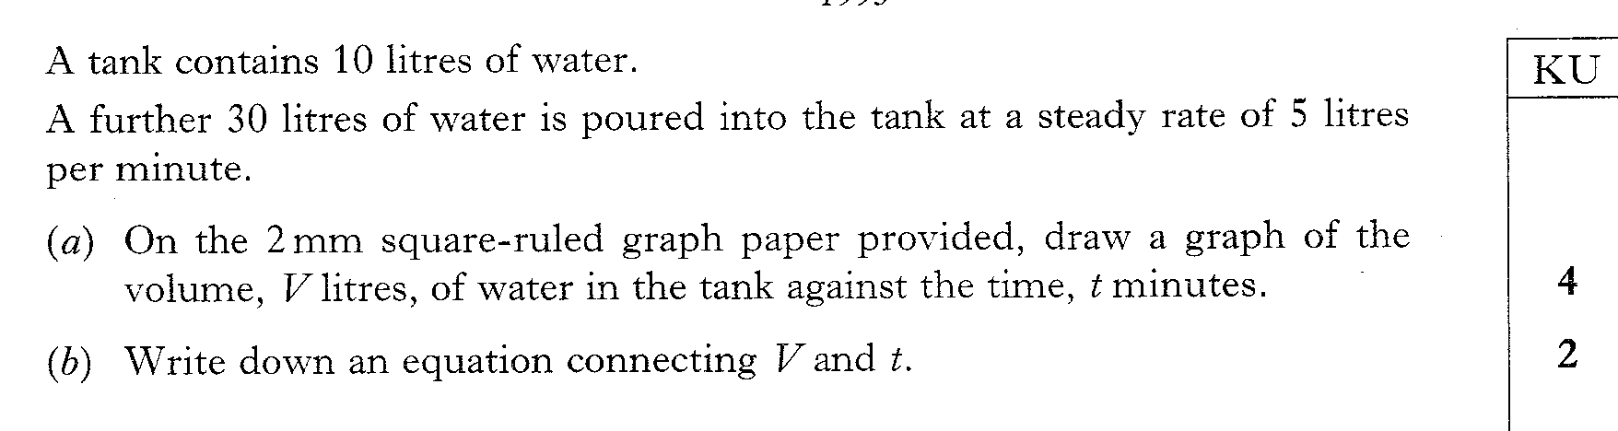
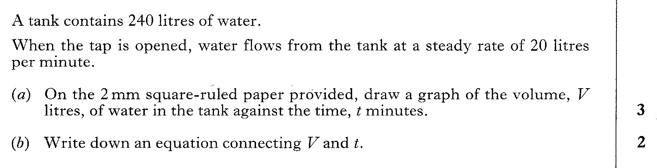
Past Paper Questions – National 5 Mathematics
Topic: The Straight Line & Scattergraphs
24.07
24.08

Slide 4
Past Paper Questions – National 5 Mathematics
Topic: The Straight Line & Scattergraphs
24.09
24.10
24.11

Slide 5
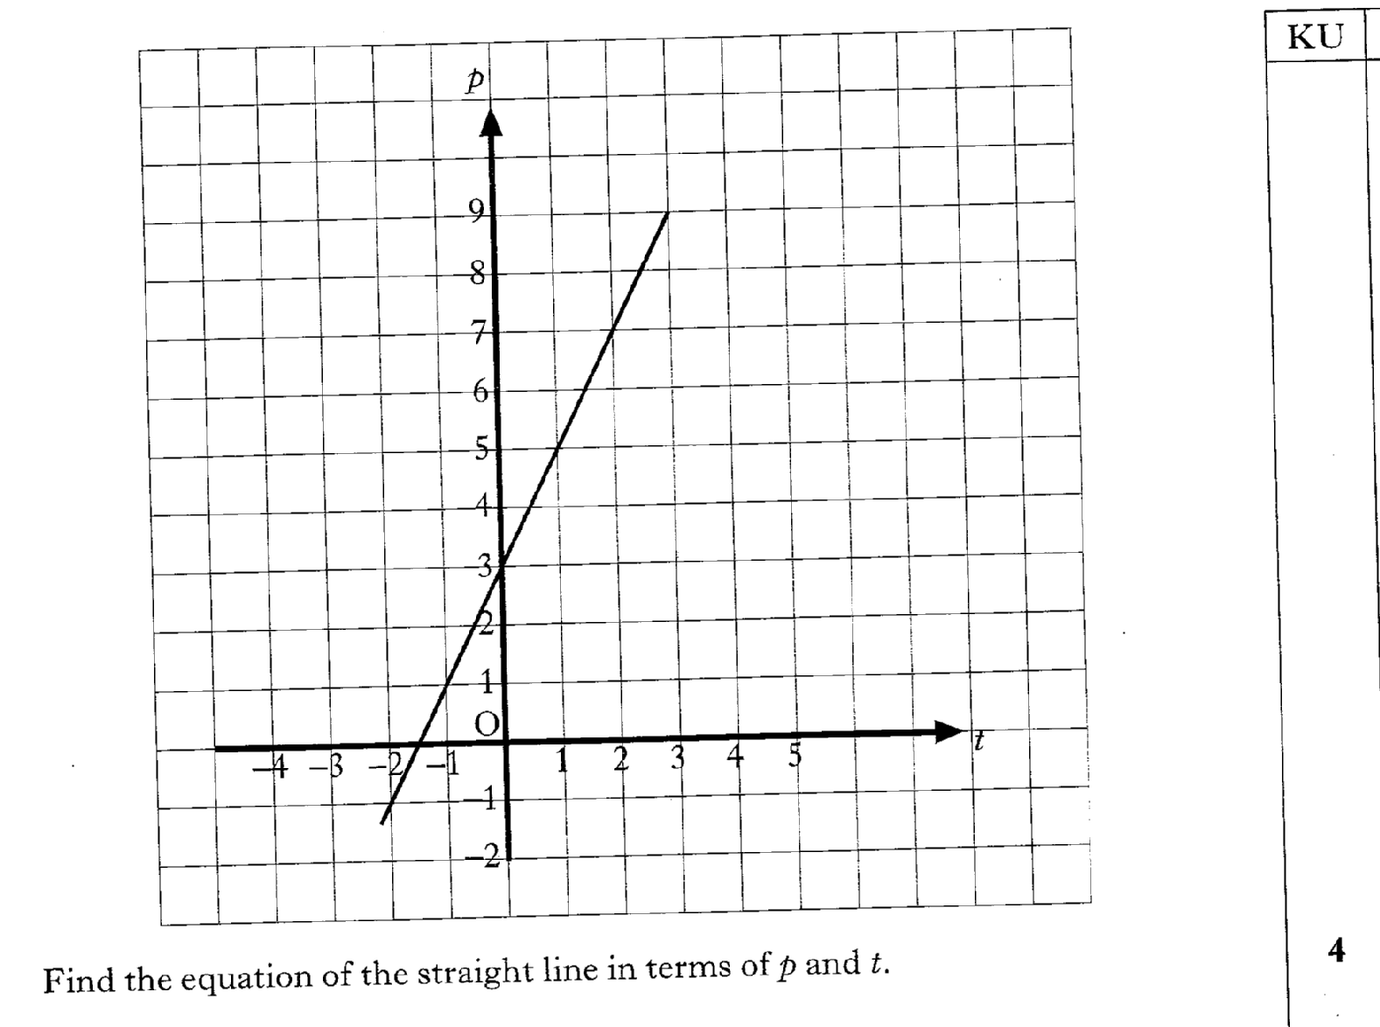
24.12
Past Paper Questions – National 5 Mathematics
Topic: The Straight Line & Scattergraphs

Slide 6
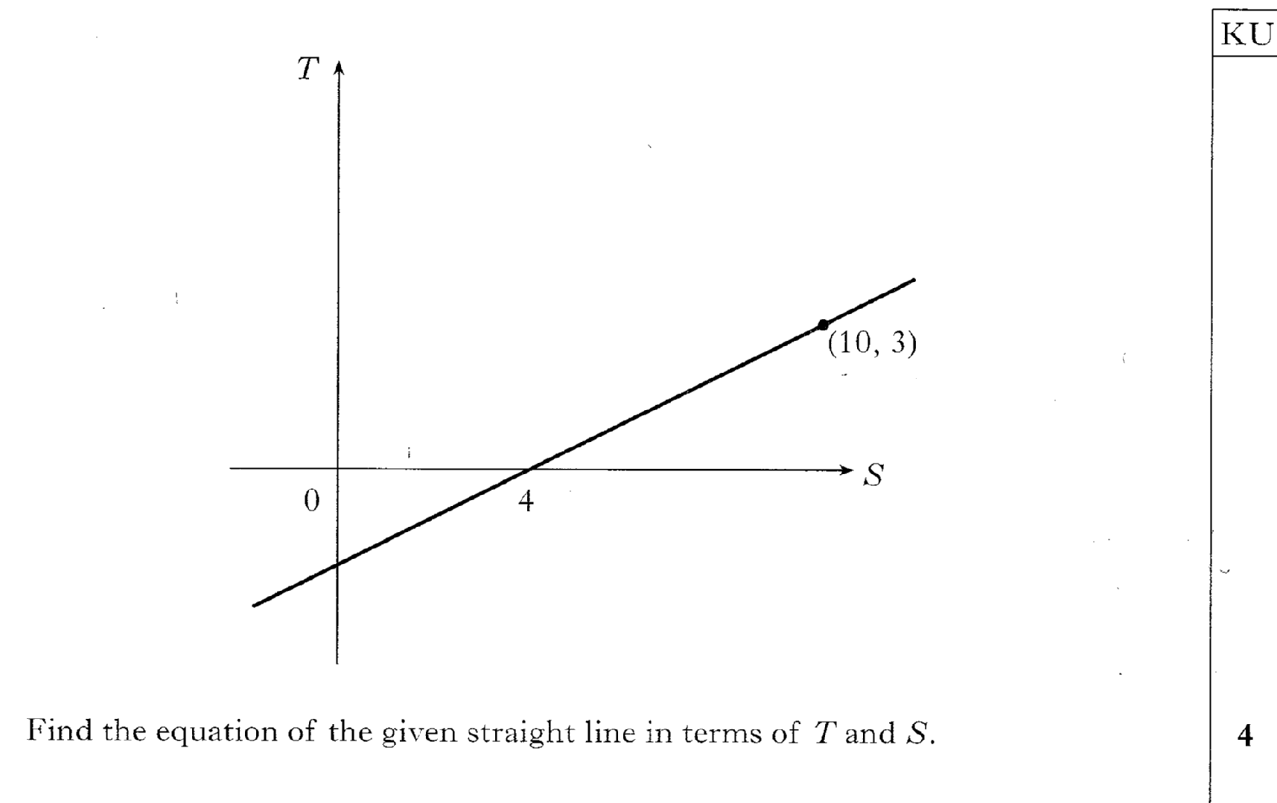
Past Paper Questions – National 5 Mathematics
Topic: The Straight Line & Scattergraphs
24.13

Slide 7
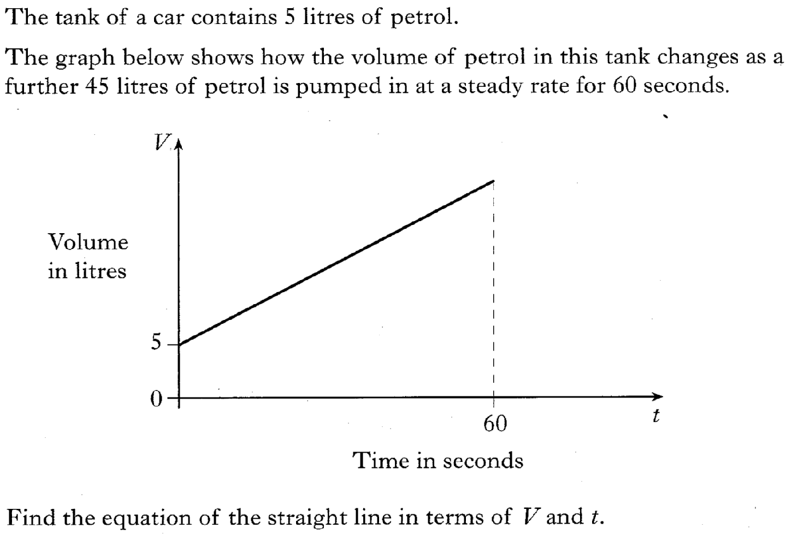
24.14
Past Paper Questions – National 5 Mathematics
Topic: The Straight Line & Scattergraphs

Slide 8
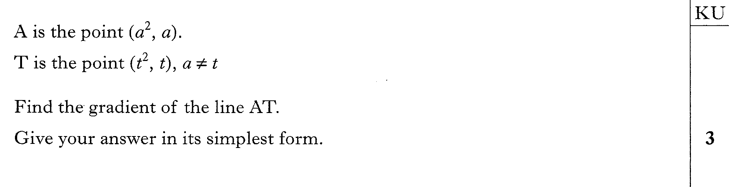
Past Paper Questions – National 5 Mathematics
Topic: The Straight Line & Scattergraphs
24.15

Slide 9
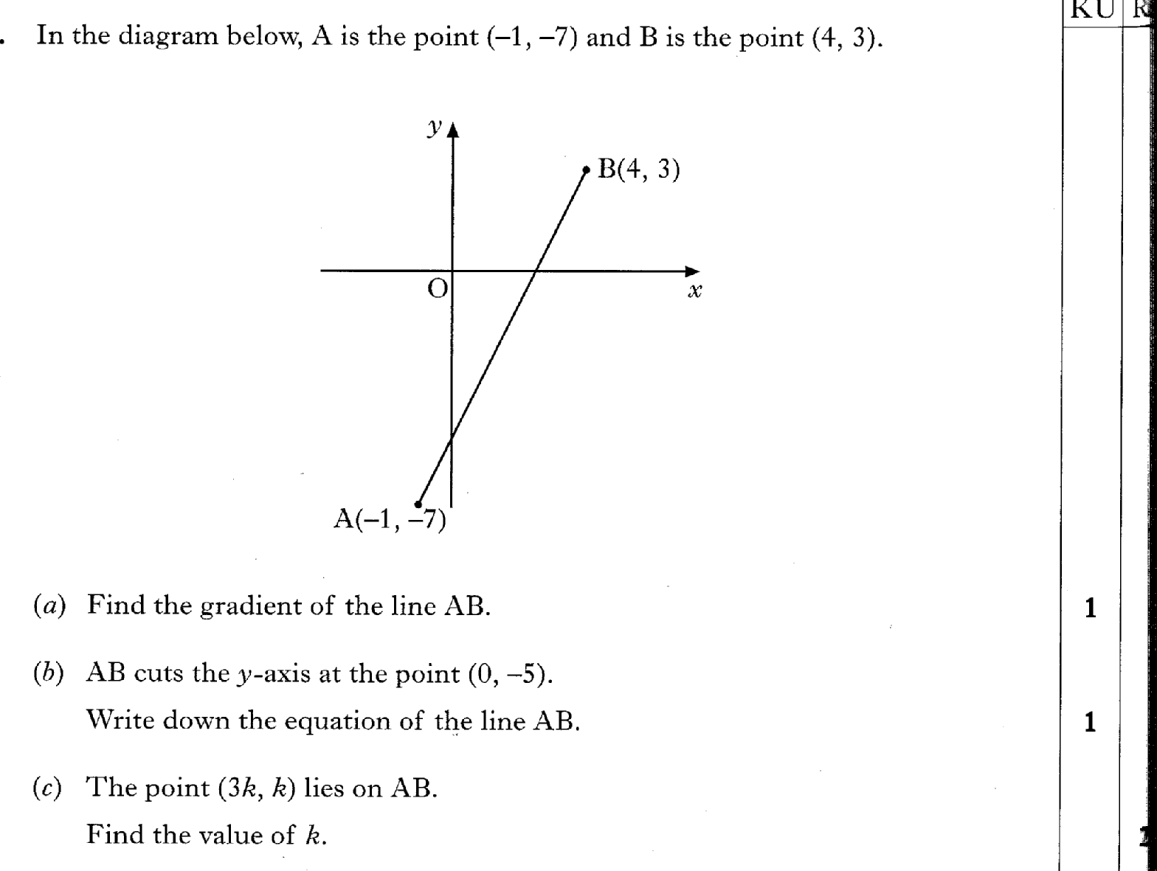
24.16
Past Paper Questions – National 5 Mathematics
Topic: The Straight Line & Scattergraphs

Slide 10
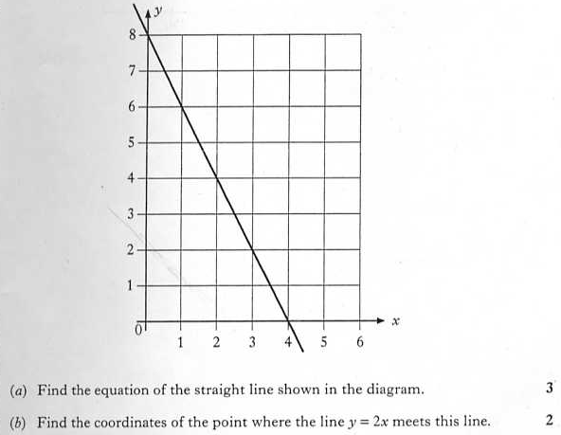
24.17
Past Paper Questions – National 5 Mathematics
Topic: The Straight Line & Scattergraphs

Slide 11
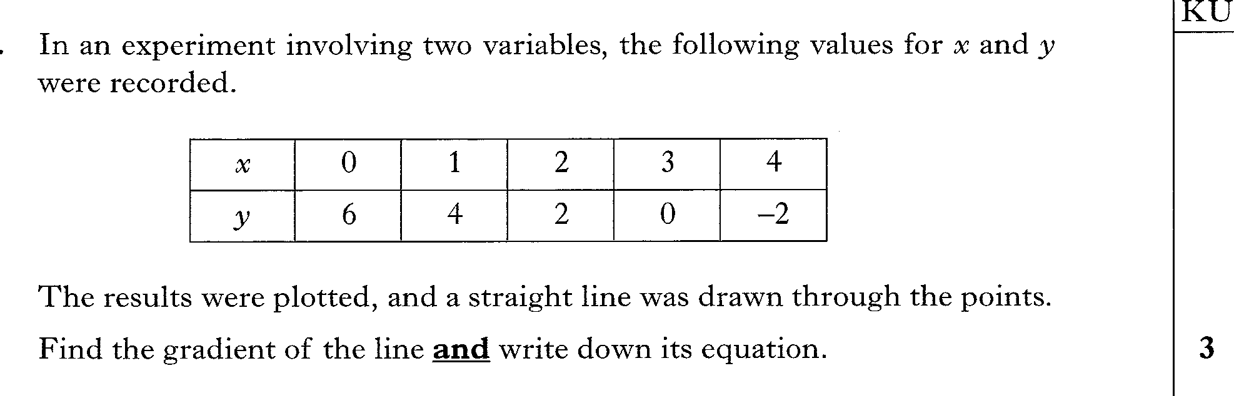
24.18
Past Paper Questions – National 5 Mathematics
Topic: The Straight Line & Scattergraphs

Slide 12
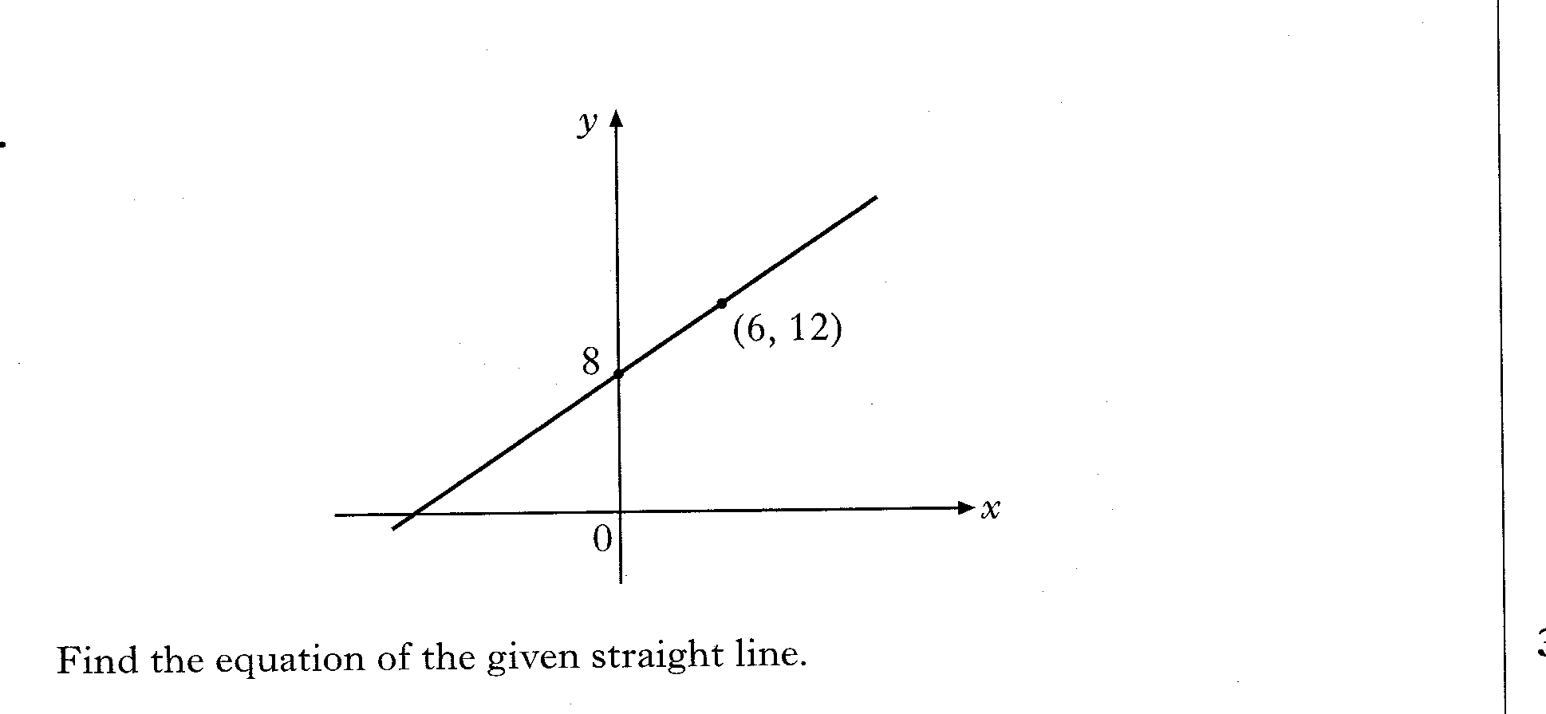
24.19
Past Paper Questions – National 5 Mathematics
Topic: The Straight Line & Scattergraphs

Slide 13
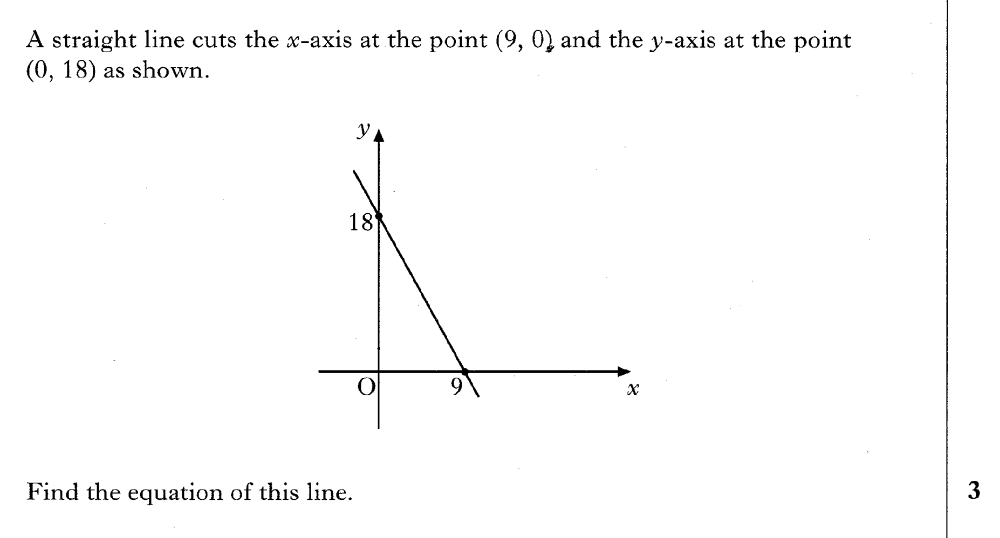
24.20
Past Paper Questions – National 5 Mathematics
Topic: The Straight Line & Scattergraphs

Slide 14
24.21
Past Paper Questions – National 5 Mathematics
Topic: The Straight Line & Scattergraphs

Slide 15
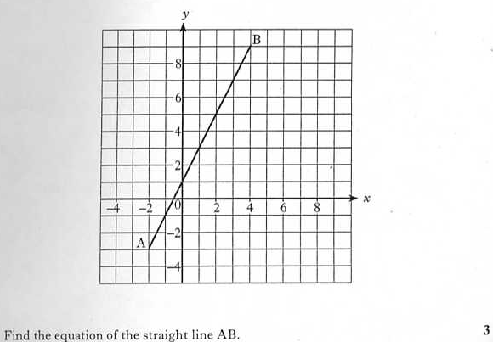
24.22
Past Paper Questions – National 5 Mathematics
Topic: The Straight Line & Scattergraphs

Slide 16
24.23
Past Paper Questions – National 5 Mathematics
Topic: The Straight Line & Scattergraphs

Slide 17
24.24
Past Paper Questions – National 5 Mathematics
Topic: The Straight Line & Scattergraphs

Slide 18
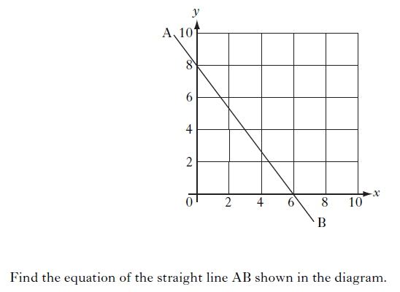
24.25
Past Paper Questions – National 5 Mathematics
Topic: The Straight Line & Scattergraphs
Notes:
18

Slide 19
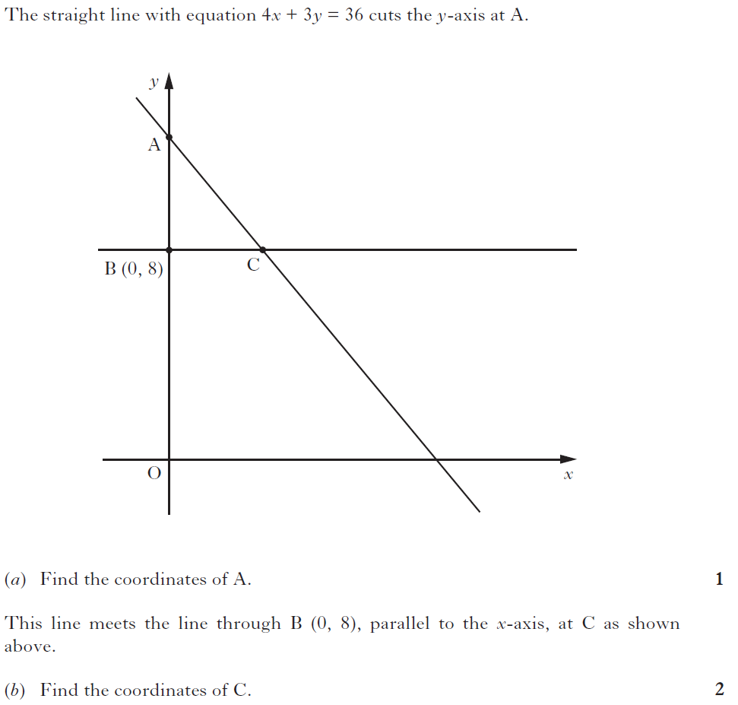
24.26
Past Paper Questions – National 5 Mathematics
Topic: The Straight Line & Scattergraphs
Notes:
19

Slide 20
24.27
Past Paper Questions – National 5 Mathematics
Topic: The Straight Line & Scattergraphs

Slide 21
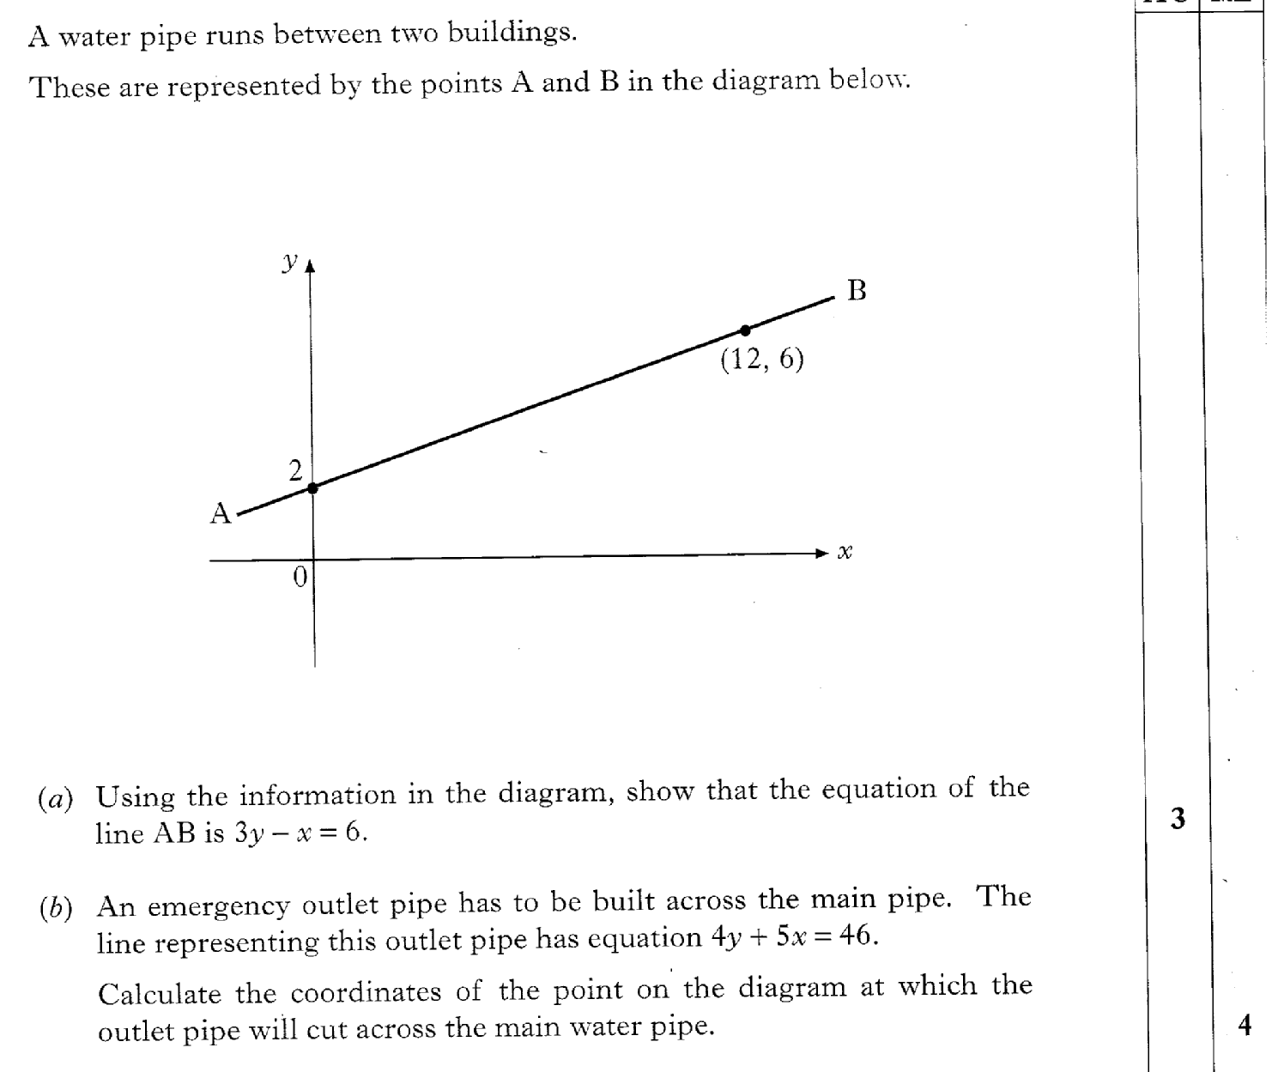
24.28
Past Paper Questions – National 5 Mathematics
Topic: The Straight Line & Scattergraphs

Slide 22
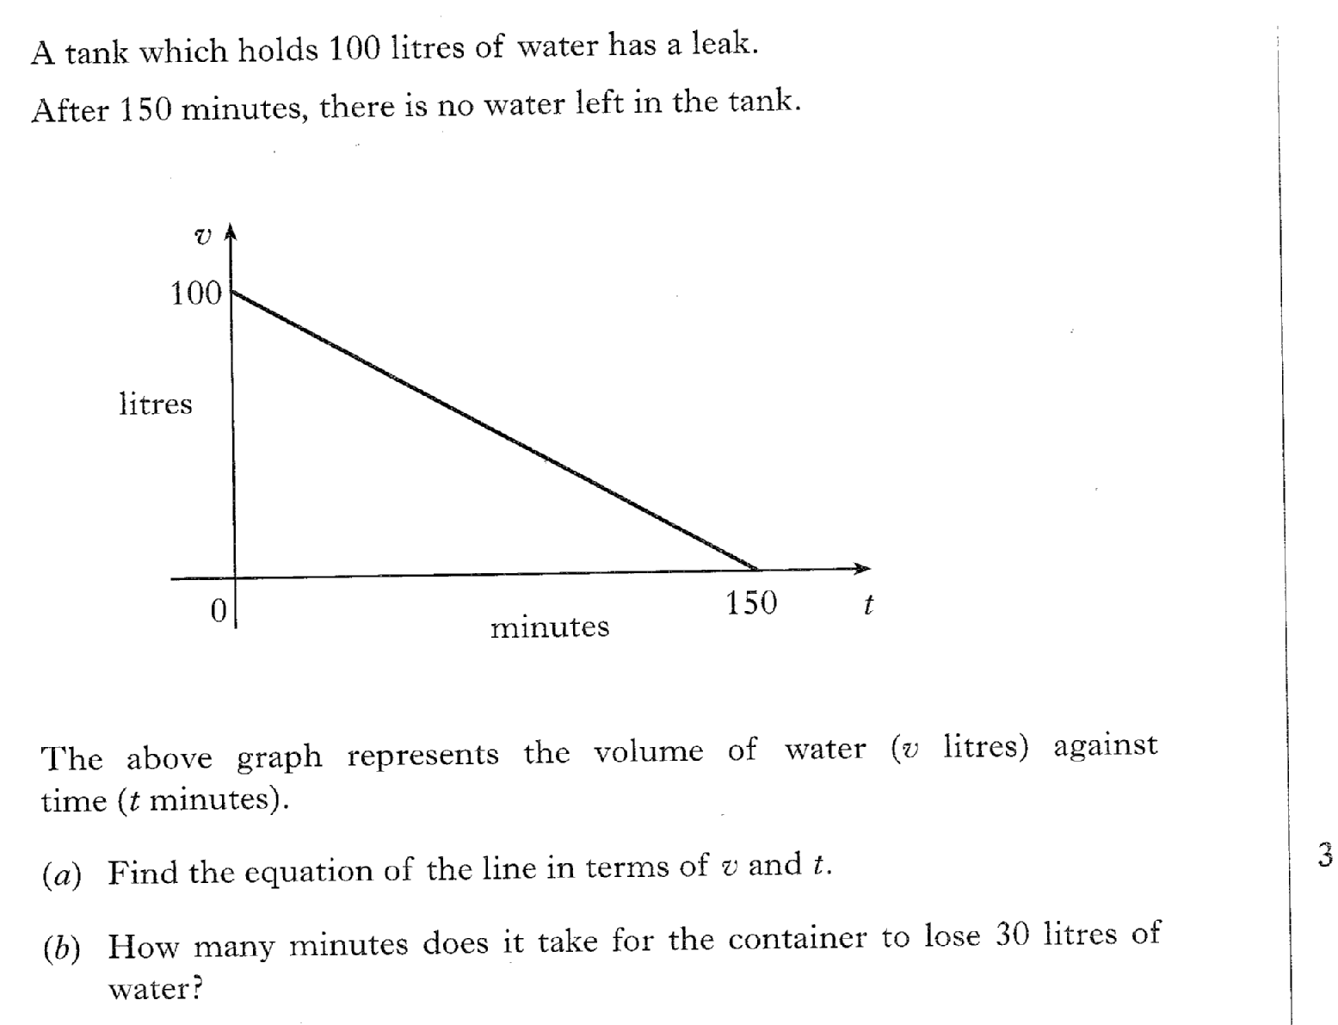
24.29
Past Paper Questions – National 5 Mathematics
Topic: The Straight Line & Scattergraphs

Slide 23
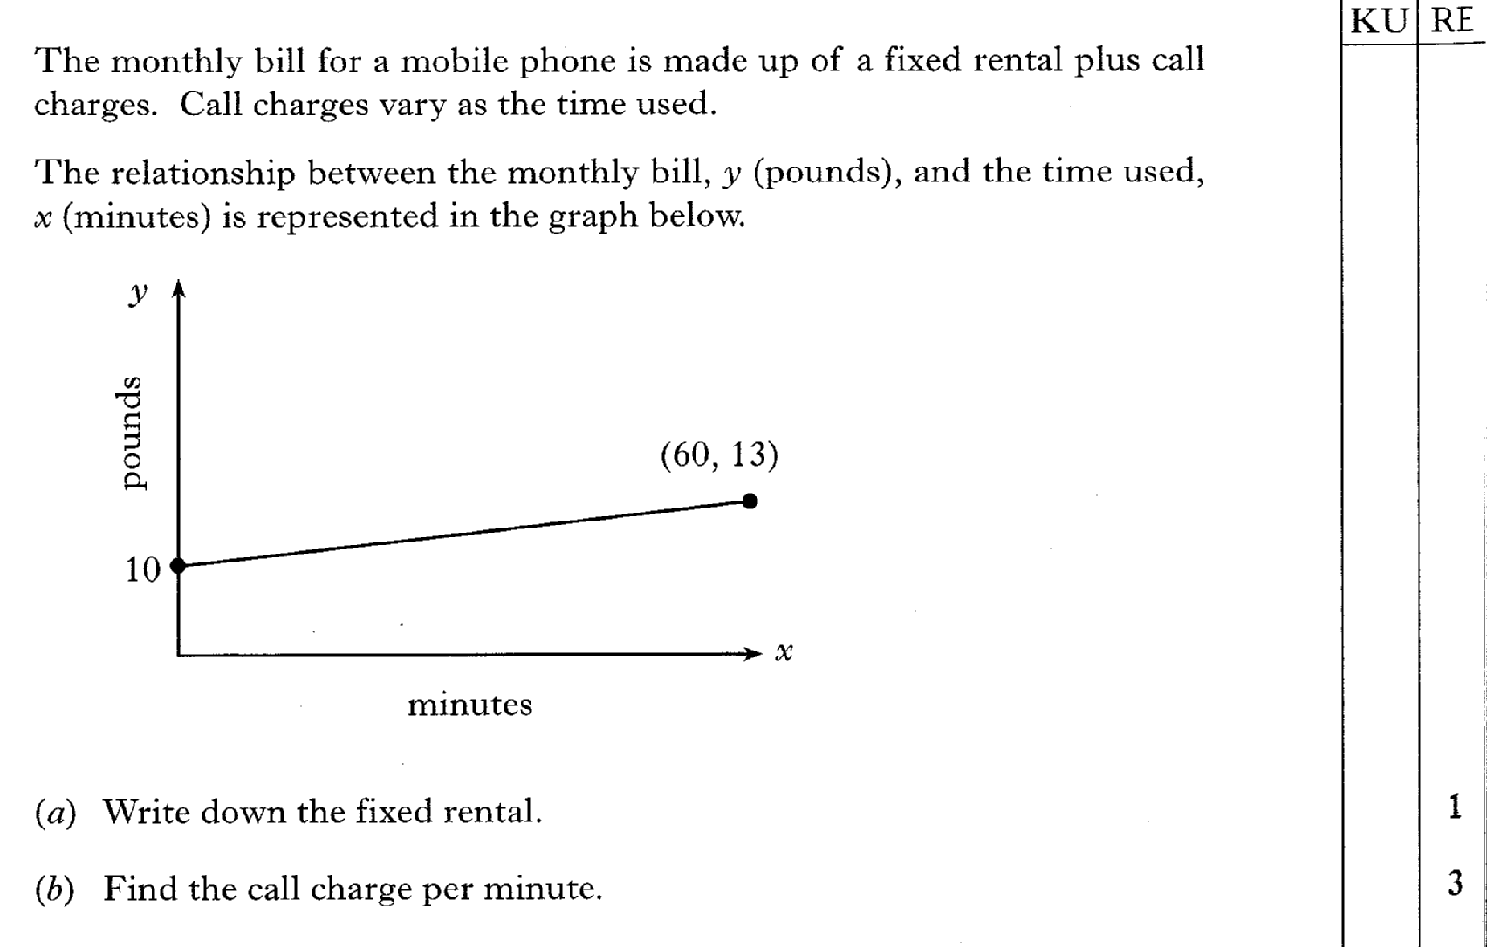
24.30
Past Paper Questions – National 5 Mathematics
Topic: The Straight Line & Scattergraphs

Slide 24
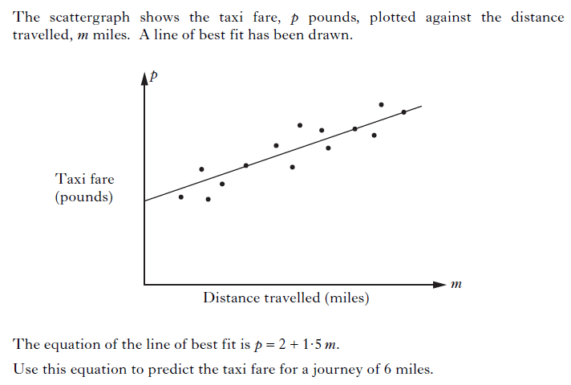
24.31
Past Paper Questions – National 5 Mathematics
Topic: The Straight Line & Scattergraphs
Notes:
24

Slide 25
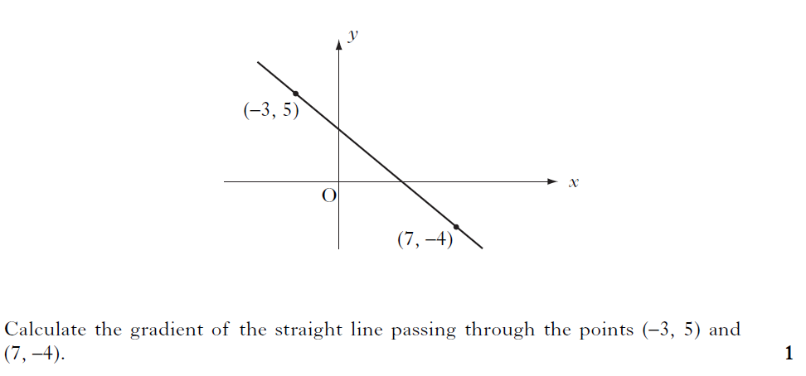
24.32
Past Paper Questions – National 5 Mathematics
Topic: The Straight Line & Scattergraphs
Notes:
25

Slide 26

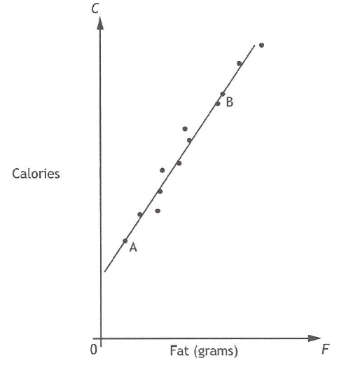

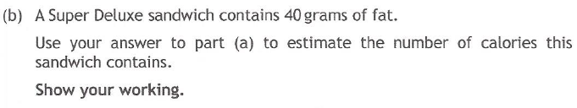
24.33
Past Paper Questions – National 5 Mathematics
Topic: The Straight Line & Scattergraphs

Slide 27
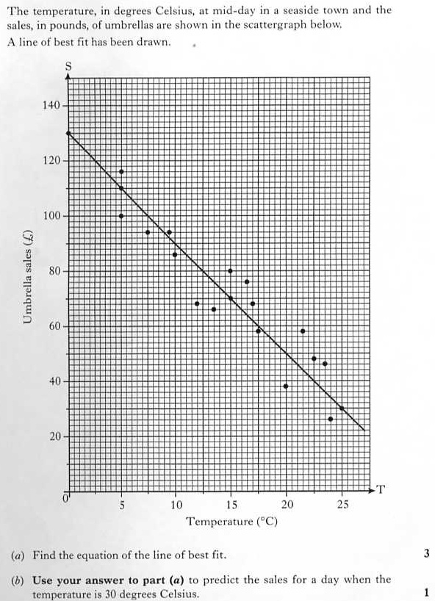
24.34
Past Paper Questions – National 5 Mathematics
Topic: The Straight Line & Scattergraphs

Slide 28
24.35
Past Paper Questions – National 5 Mathematics
Topic: The Straight Line & Scattergraphs

Slide 29
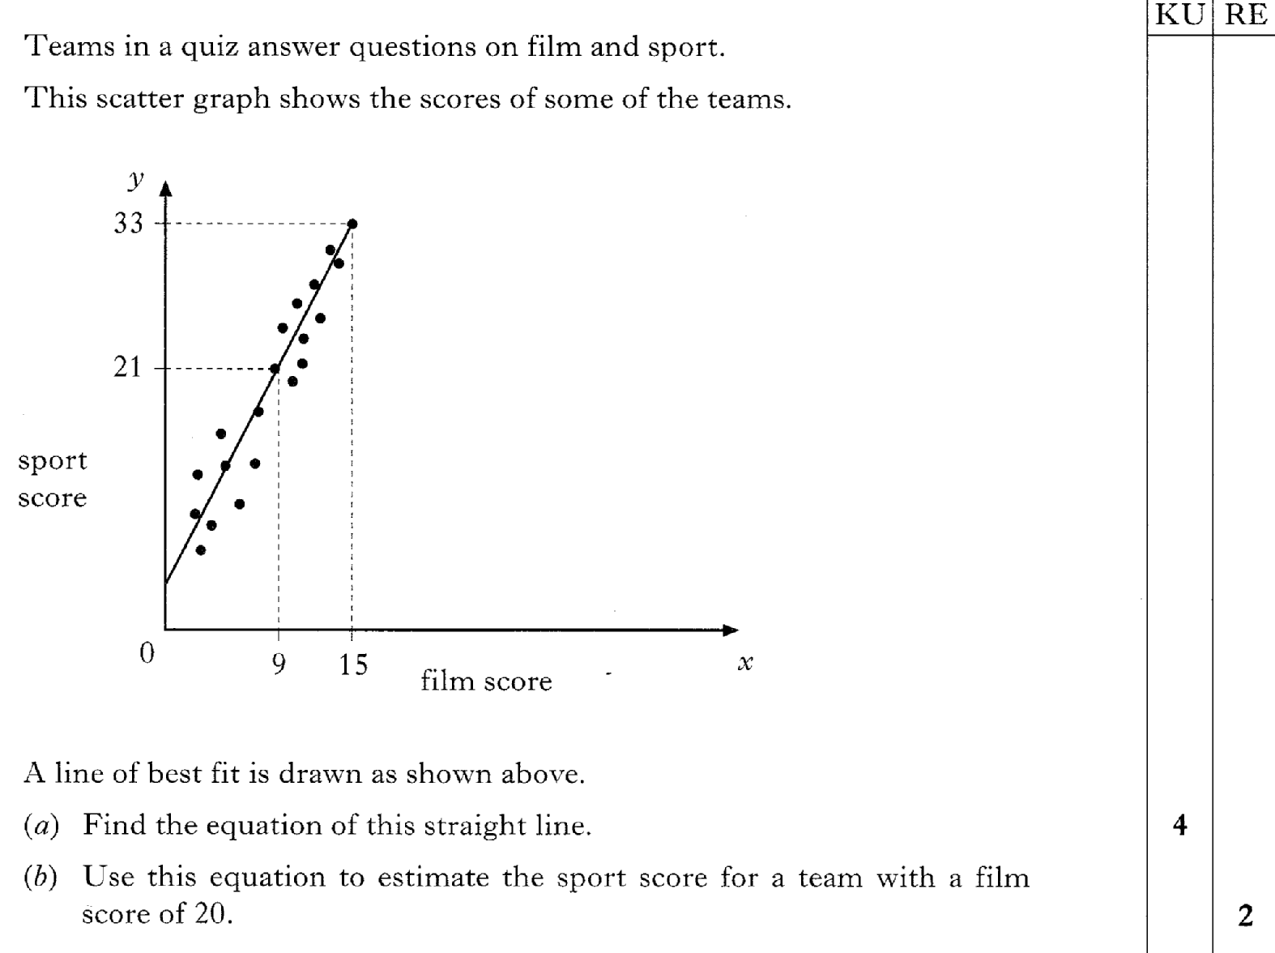
24.36
Past Paper Questions – National 5 Mathematics
Topic: The Straight Line & Scattergraphs

Slide 30
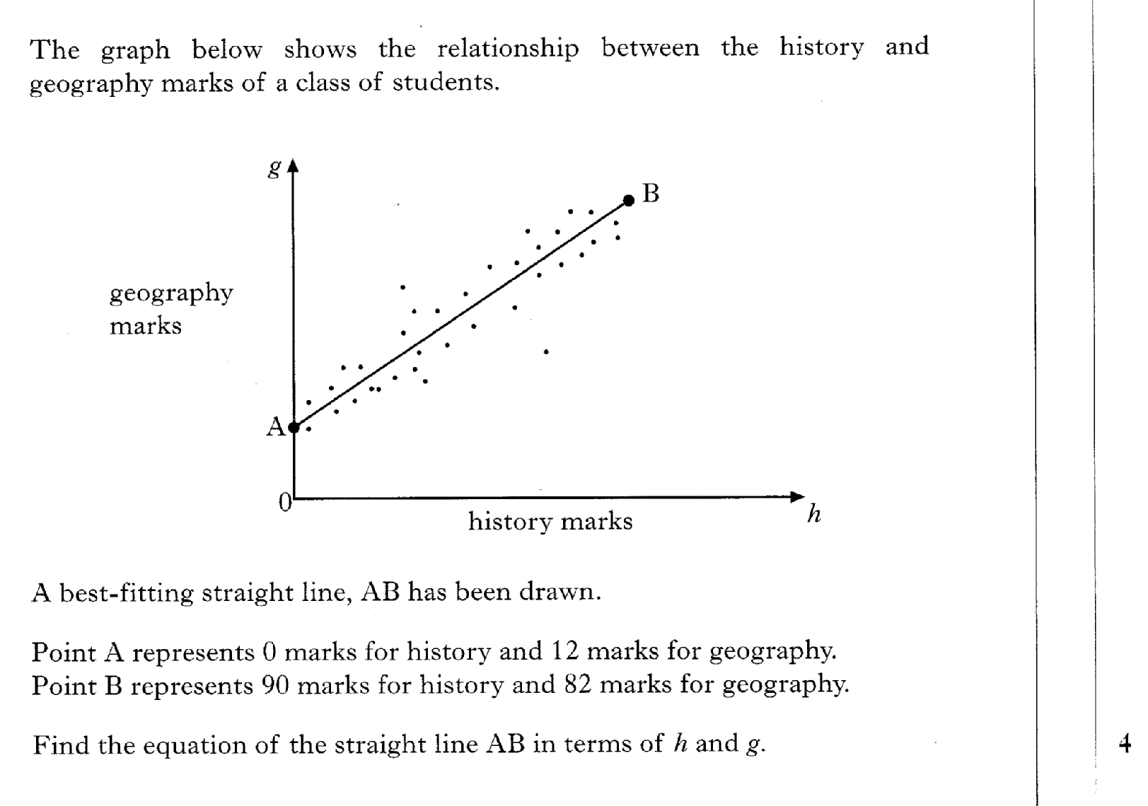
24.37
Past Paper Questions – National 5 Mathematics
Topic: The Straight Line & Scattergraphs

