Slide 1
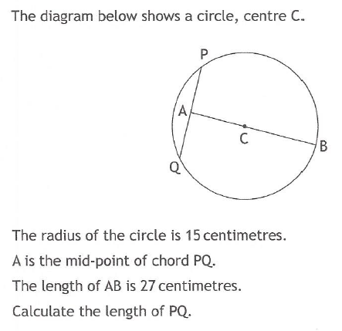
Past Paper Questions – National 5 Mathematics
Topic: Pythagoras
21.01

Slide 2
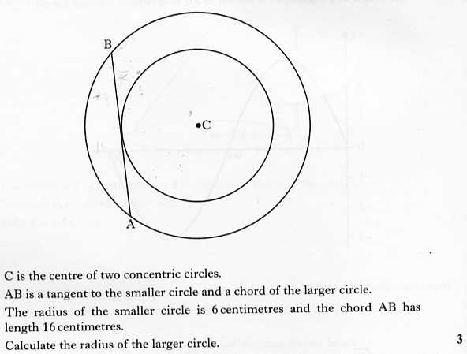
Past Paper Questions – National 5 Mathematics
Topic: Pythagoras
21.02

Slide 3
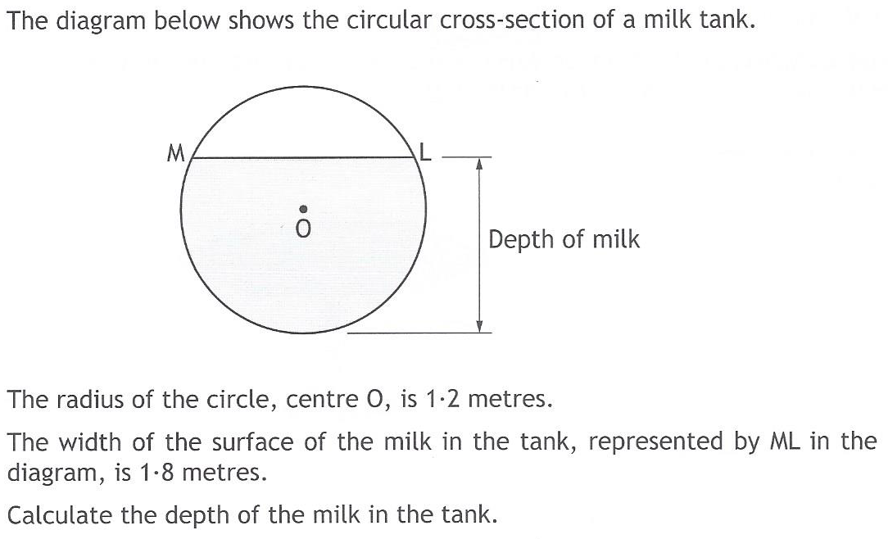
Past Paper Questions – National 5 Mathematics
Topic: Pythagoras
21.03

Slide 4
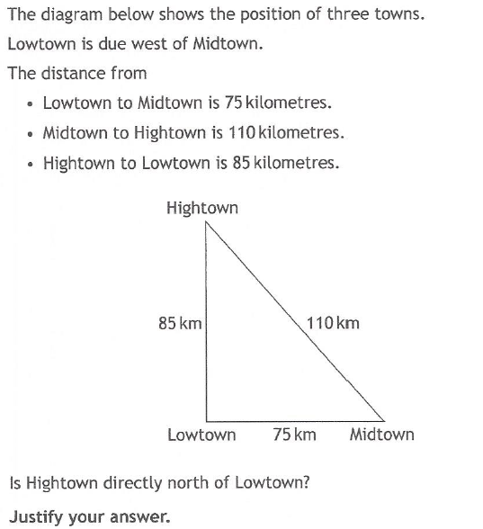
Past Paper Questions – National 5 Mathematics
Topic: Pythagoras
21.04

Slide 5
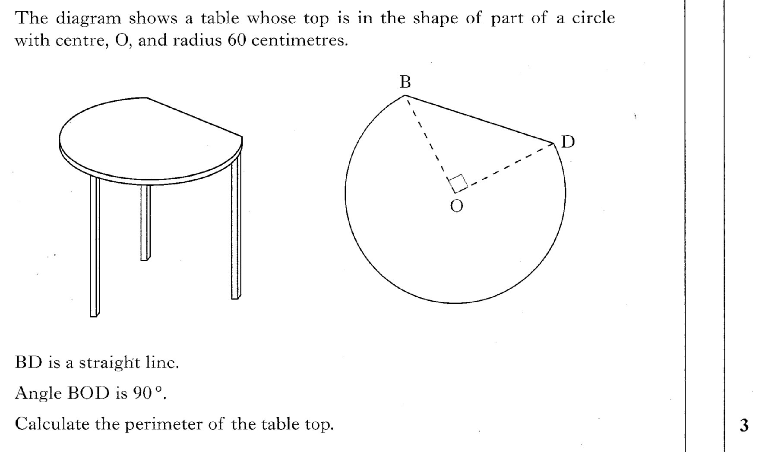
Past Paper Questions – National 5 Mathematics
Topic: Pythagoras
21.05

Slide 6
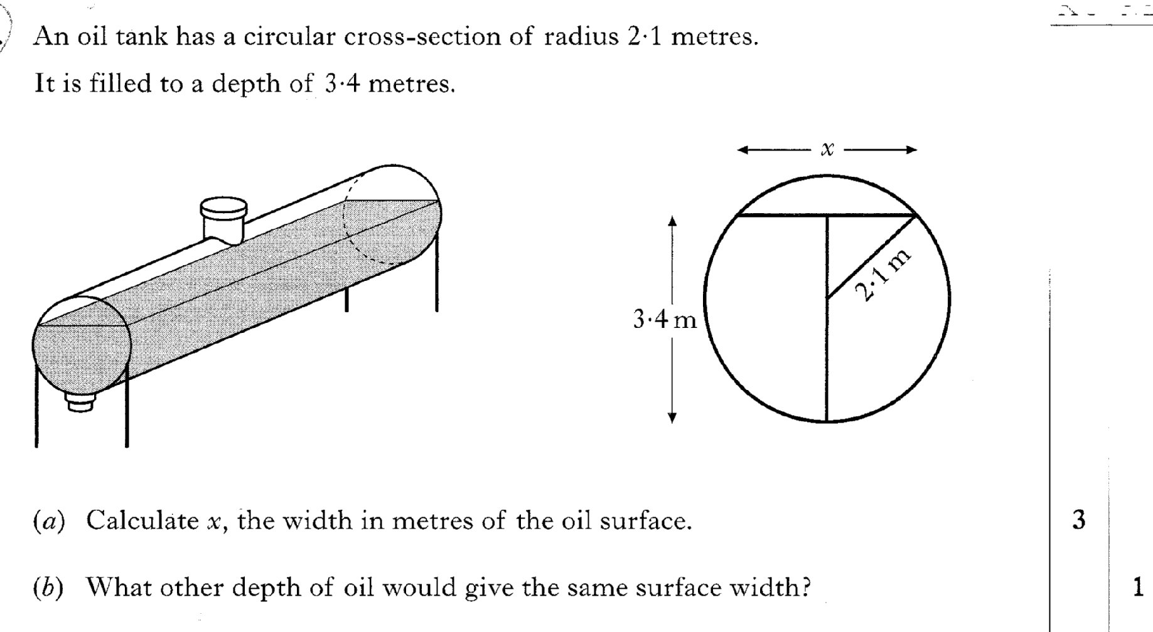
Past Paper Questions – National 5 Mathematics
Topic: Pythagoras
21.06

Slide 7
Past Paper Questions – National 5 Mathematics
Topic: Pythagoras
21.07

Slide 8
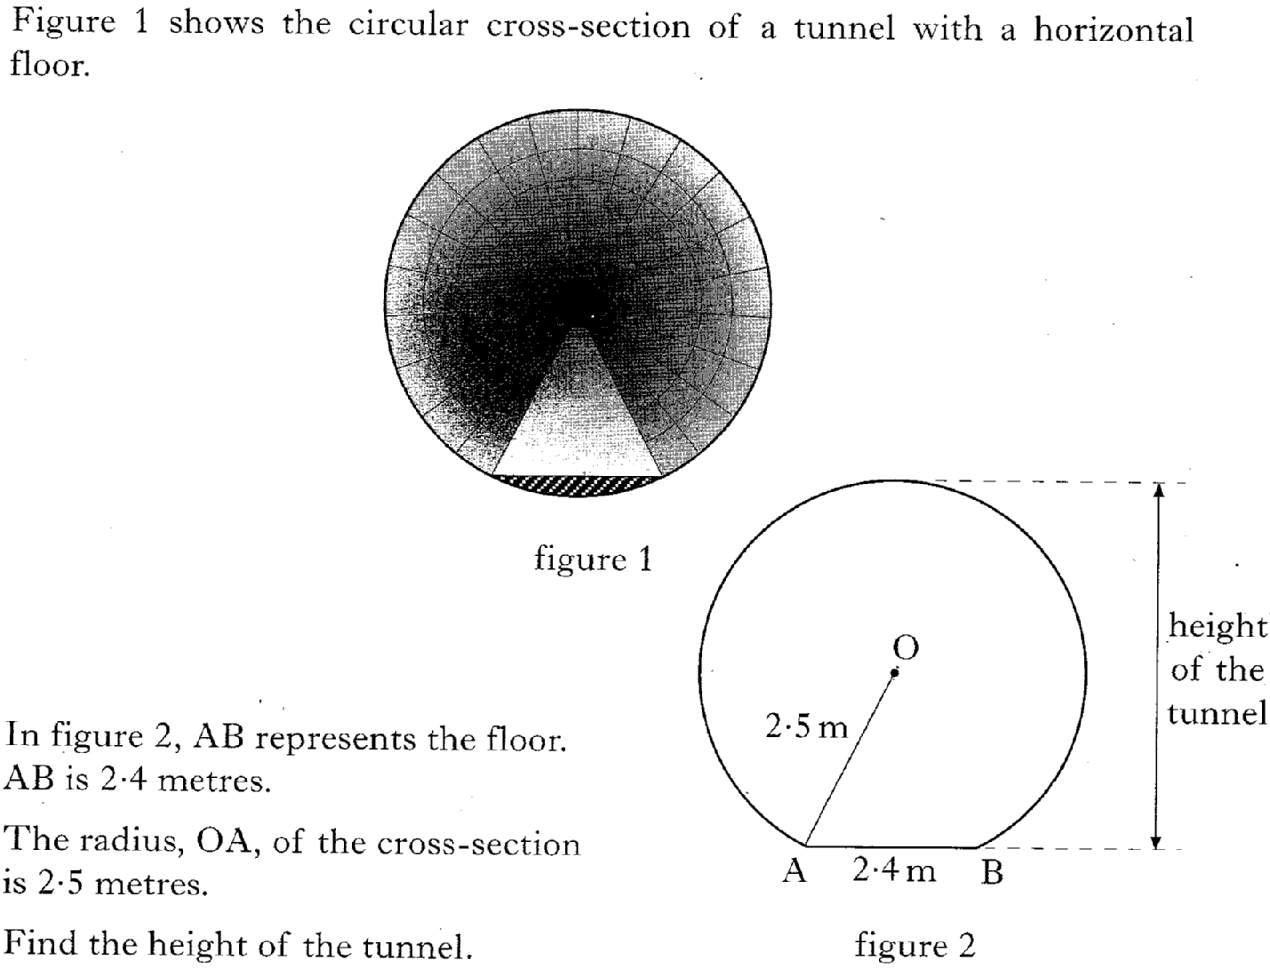
Past Paper Questions – National 5 Mathematics
Topic: Pythagoras
21.08

Slide 9
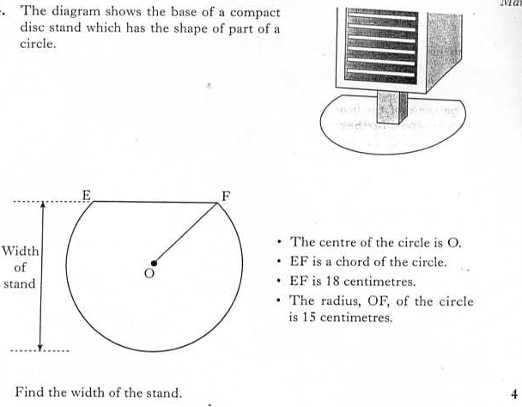
Past Paper Questions – National 5 Mathematics
Topic: Pythagoras
21.09

Slide 10
Past Paper Questions – National 5 Mathematics
Topic: Pythagoras
21.10

Slide 11
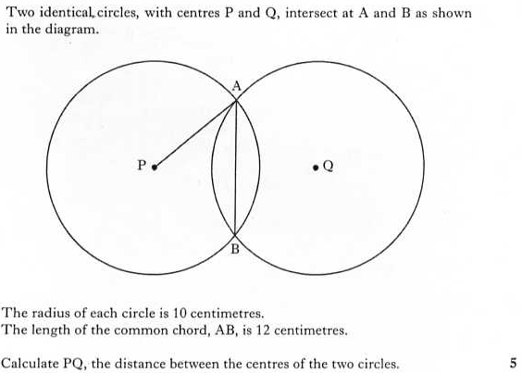
Past Paper Questions – National 5 Mathematics
Topic: Pythagoras
21.11

Slide 12
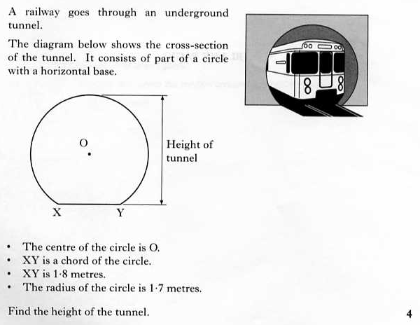
Past Paper Questions – National 5 Mathematics
Topic: Pythagoras
21.12
Notes:
12

Slide 13
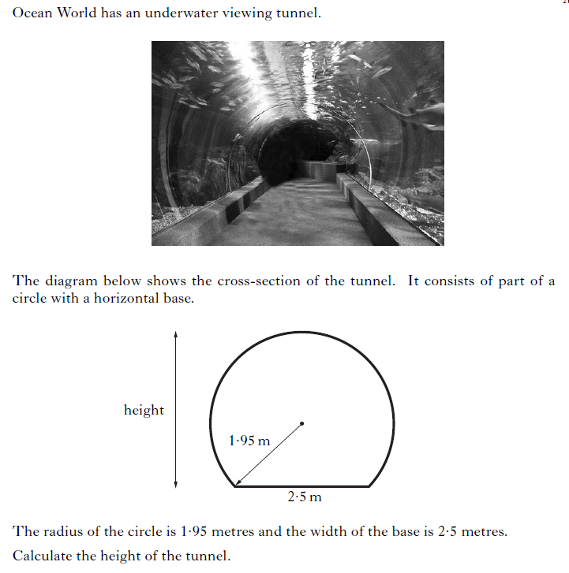
Past Paper Questions – National 5 Mathematics
Topic: Pythagoras
21.13
Notes:
13

Slide 14
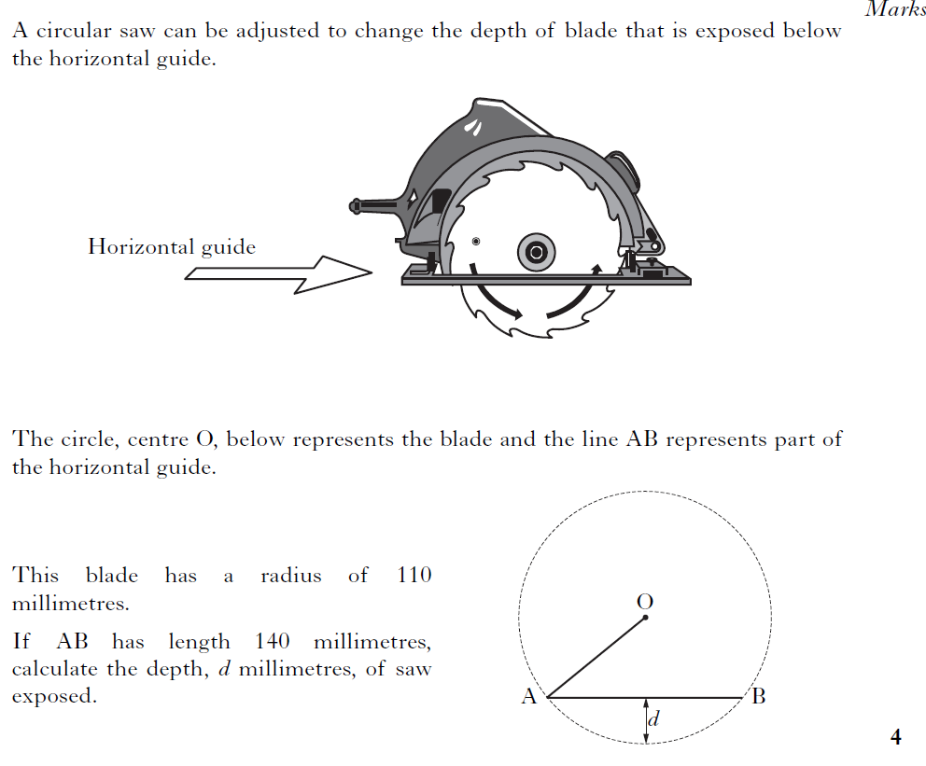
Past Paper Questions – National 5 Mathematics
Topic: Pythagoras
21.14
Notes:
14

Slide 15
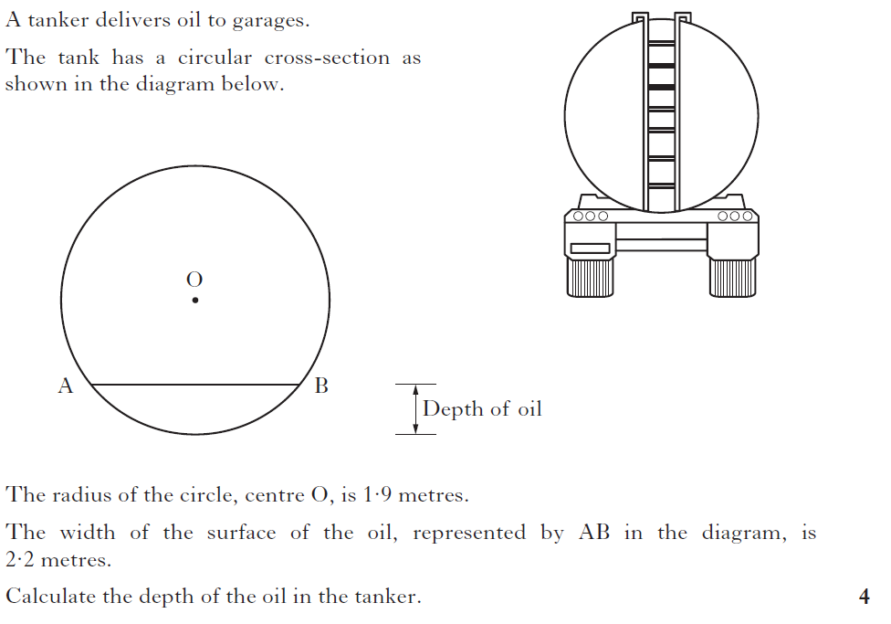
Past Paper Questions – National 5 Mathematics
Topic: Pythagoras
21.15
Notes:
15

Slide 16
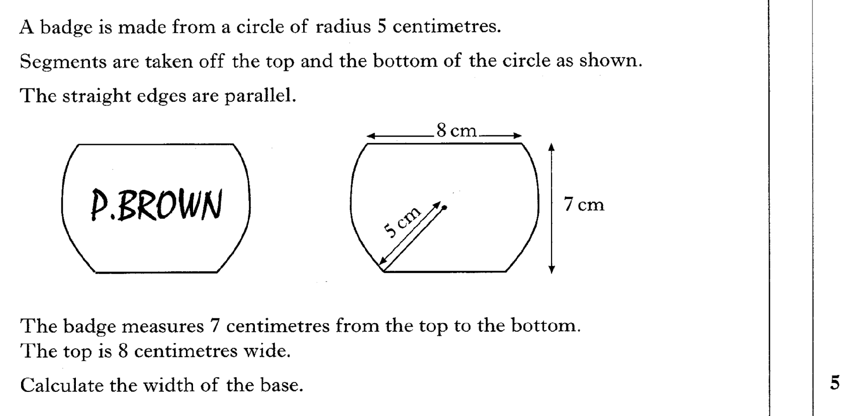
Past Paper Questions – National 5 Mathematics
Topic: Pythagoras
21.16

Slide 17
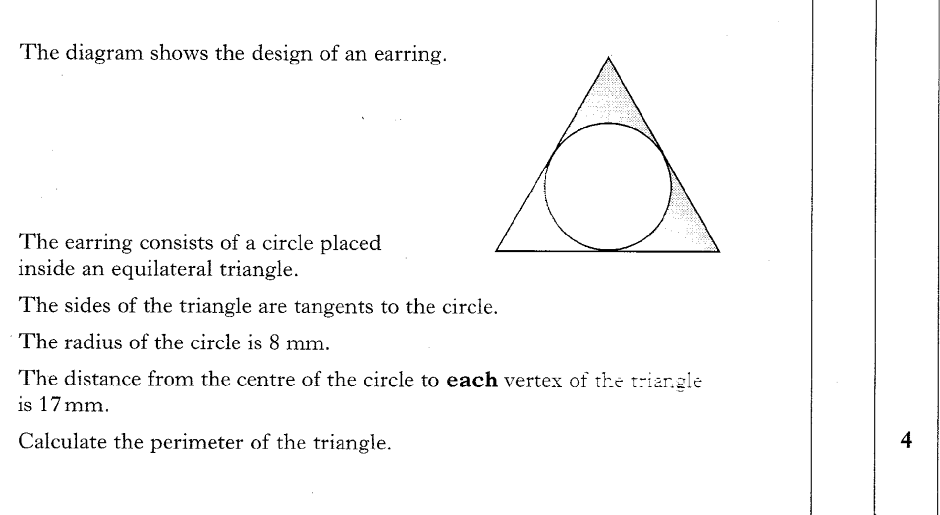
21.17
Past Paper Questions – National 5 Mathematics
Topic: Pythagoras

Slide 18
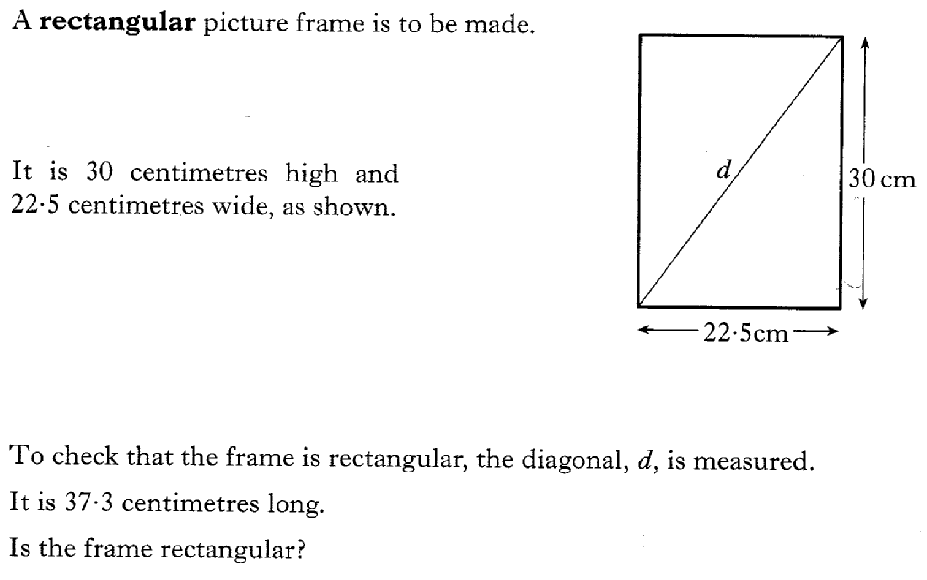
21.18
Past Paper Questions – National 5 Mathematics
Topic: Pythagoras

Slide 19
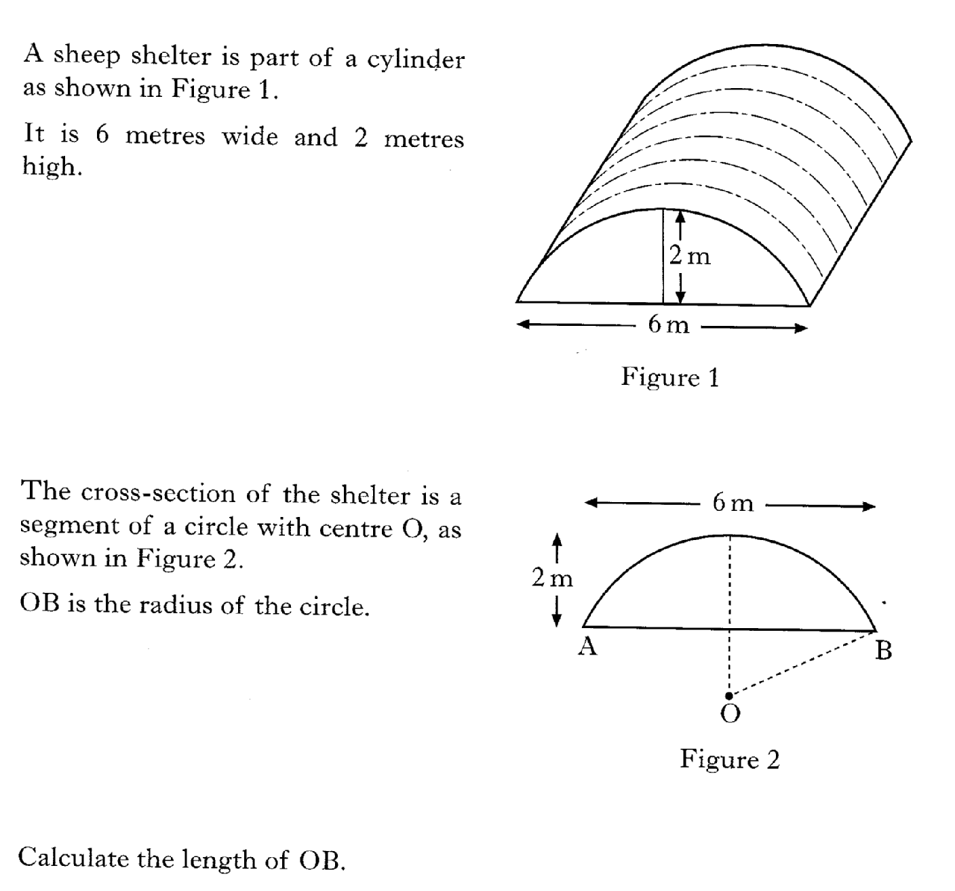
21.19
Past Paper Questions – National 5 Mathematics
Topic: Pythagoras

Slide 20
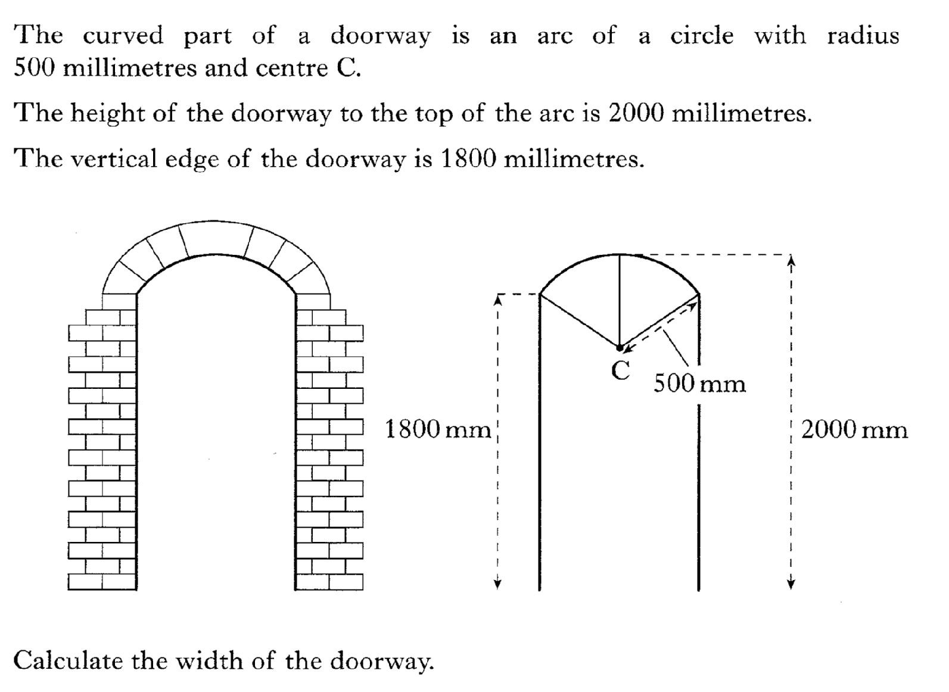
21.20
Past Paper Questions – National 5 Mathematics
Topic: Pythagoras

Slide 21
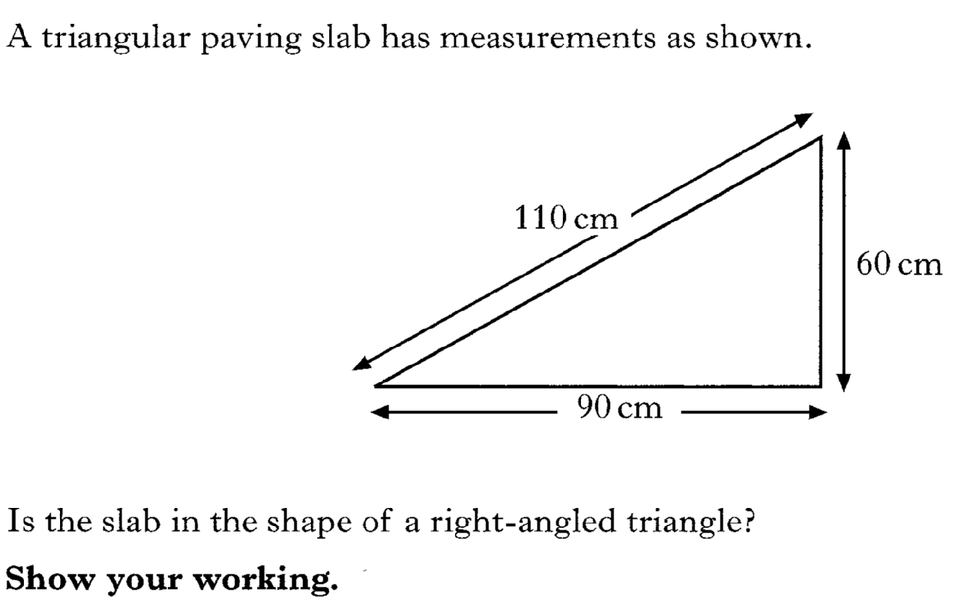
21.21
Past Paper Questions – National 5 Mathematics
Topic: Pythagoras

Slide 22
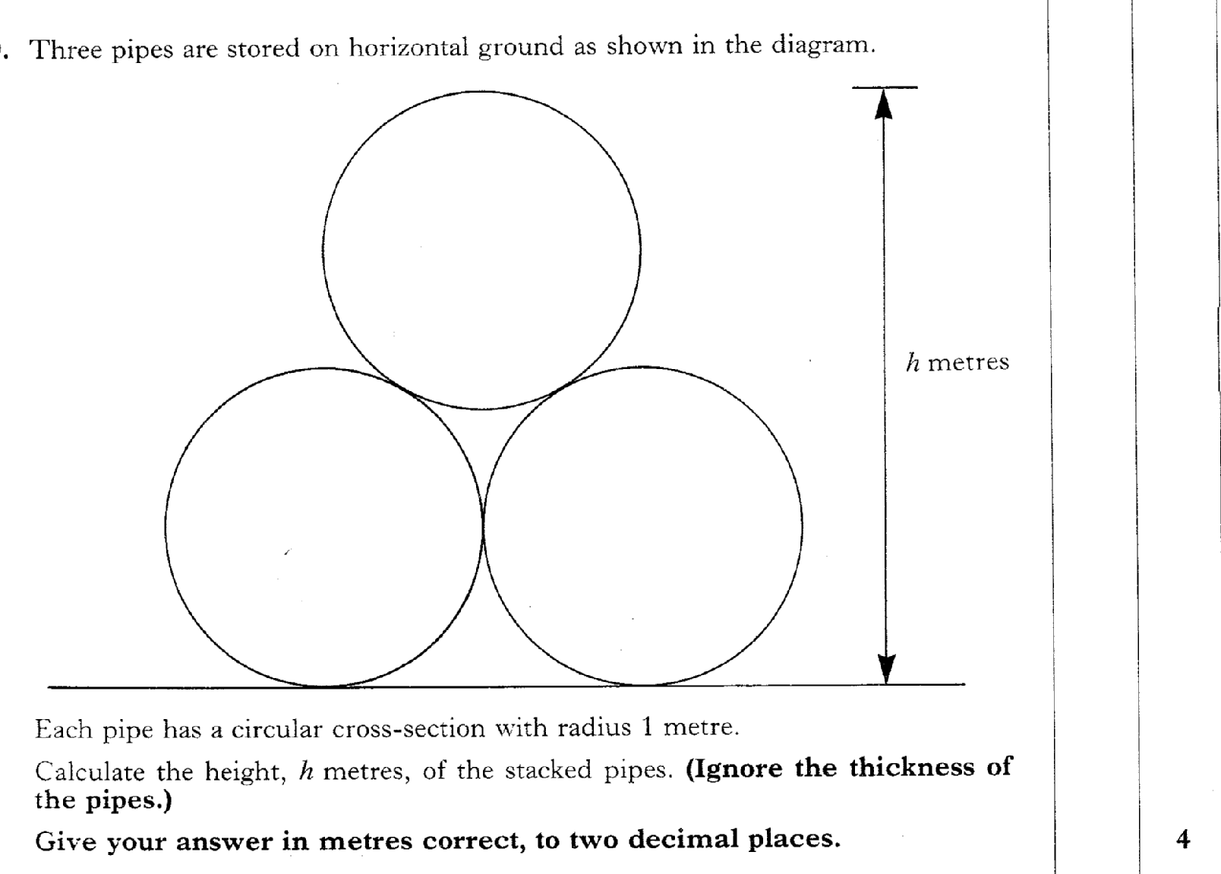
21.22
Past Paper Questions – National 5 Mathematics
Topic: Pythagoras

