Slide 1
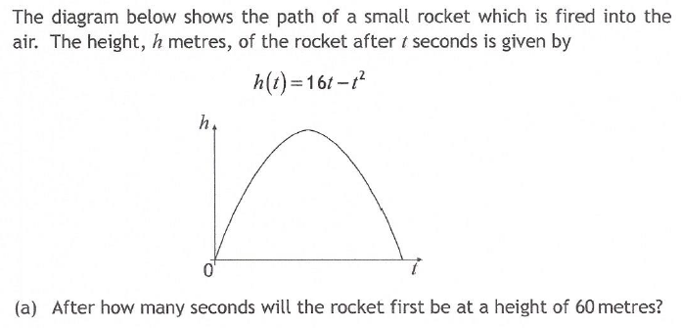

Past Paper Questions – National 5 Mathematics
Topic: Quadratic Function & Parabolas
18.01

Slide 2
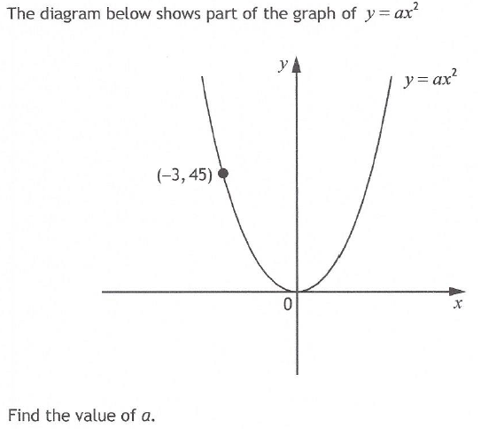
Past Paper Questions – National 5 Mathematics
Topic: Quadratic Function & Parabolas
18.02

Slide 3
Past Paper Questions – National 5 Mathematics
Topic: Quadratic Function & Parabolas
18.03

Slide 4
Past Paper Questions – National 5 Mathematics
Topic: Quadratic Function & Parabolas
18.04

Slide 5
Past Paper Questions – National 5 Mathematics
Topic: Quadratic Function & Parabolas
18.05

Slide 6
Past Paper Questions – National 5 Mathematics
Topic: Quadratic Function & Parabolas
18.06

Slide 7
Past Paper Questions – National 5 Mathematics
Topic: Quadratic Function & Parabolas
18.07

Slide 8
Past Paper Questions – National 5 Mathematics
Topic: Quadratic Function & Parabolas
18.08

Slide 9
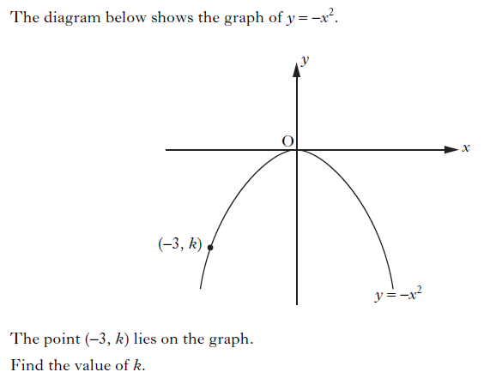
Past Paper Questions – National 5 Mathematics
Topic: Quadratic Function & Parabolas
18.09
Notes:
9

Slide 10
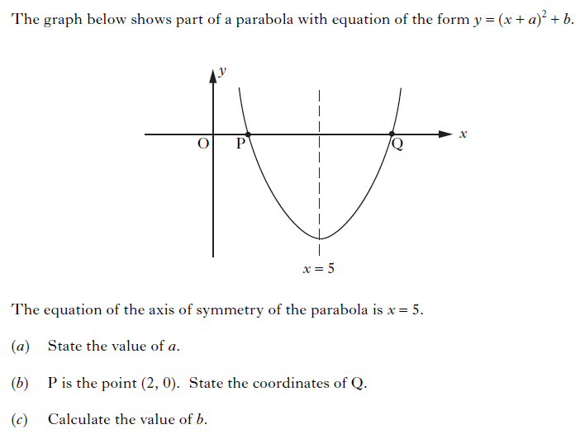
Past Paper Questions – National 5 Mathematics
Topic: Quadratic Function & Parabolas
18.10
Notes:
10

Slide 11
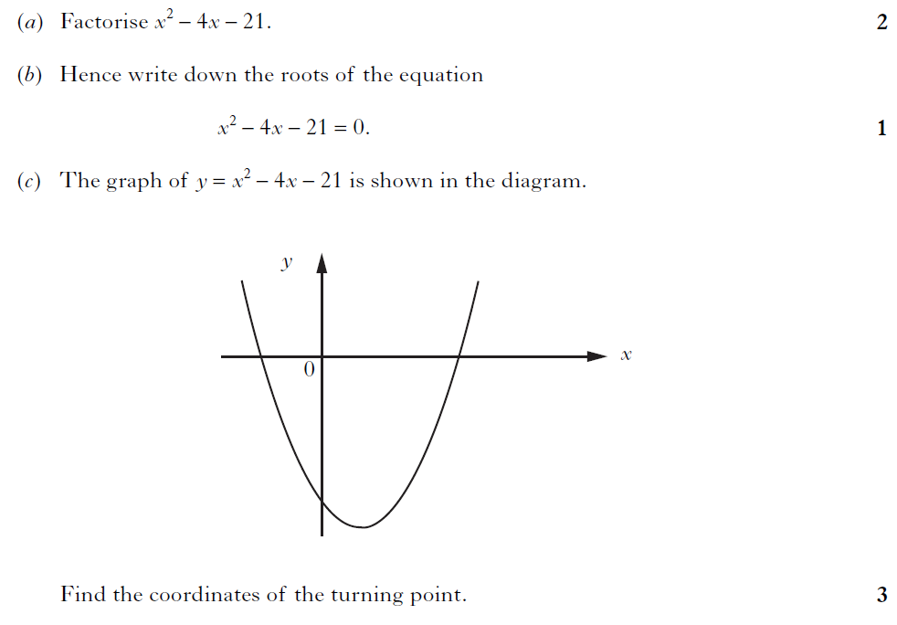
Past Paper Questions – National 5 Mathematics
Topic: Quadratic Function & Parabolas
18.11
Notes:
11

Slide 12
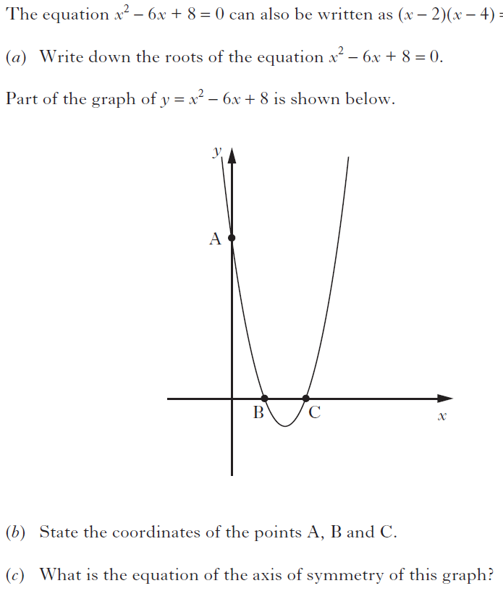
Past Paper Questions – National 5 Mathematics
Topic: Quadratic Function & Parabolas
18.12
Notes:
12

Slide 13
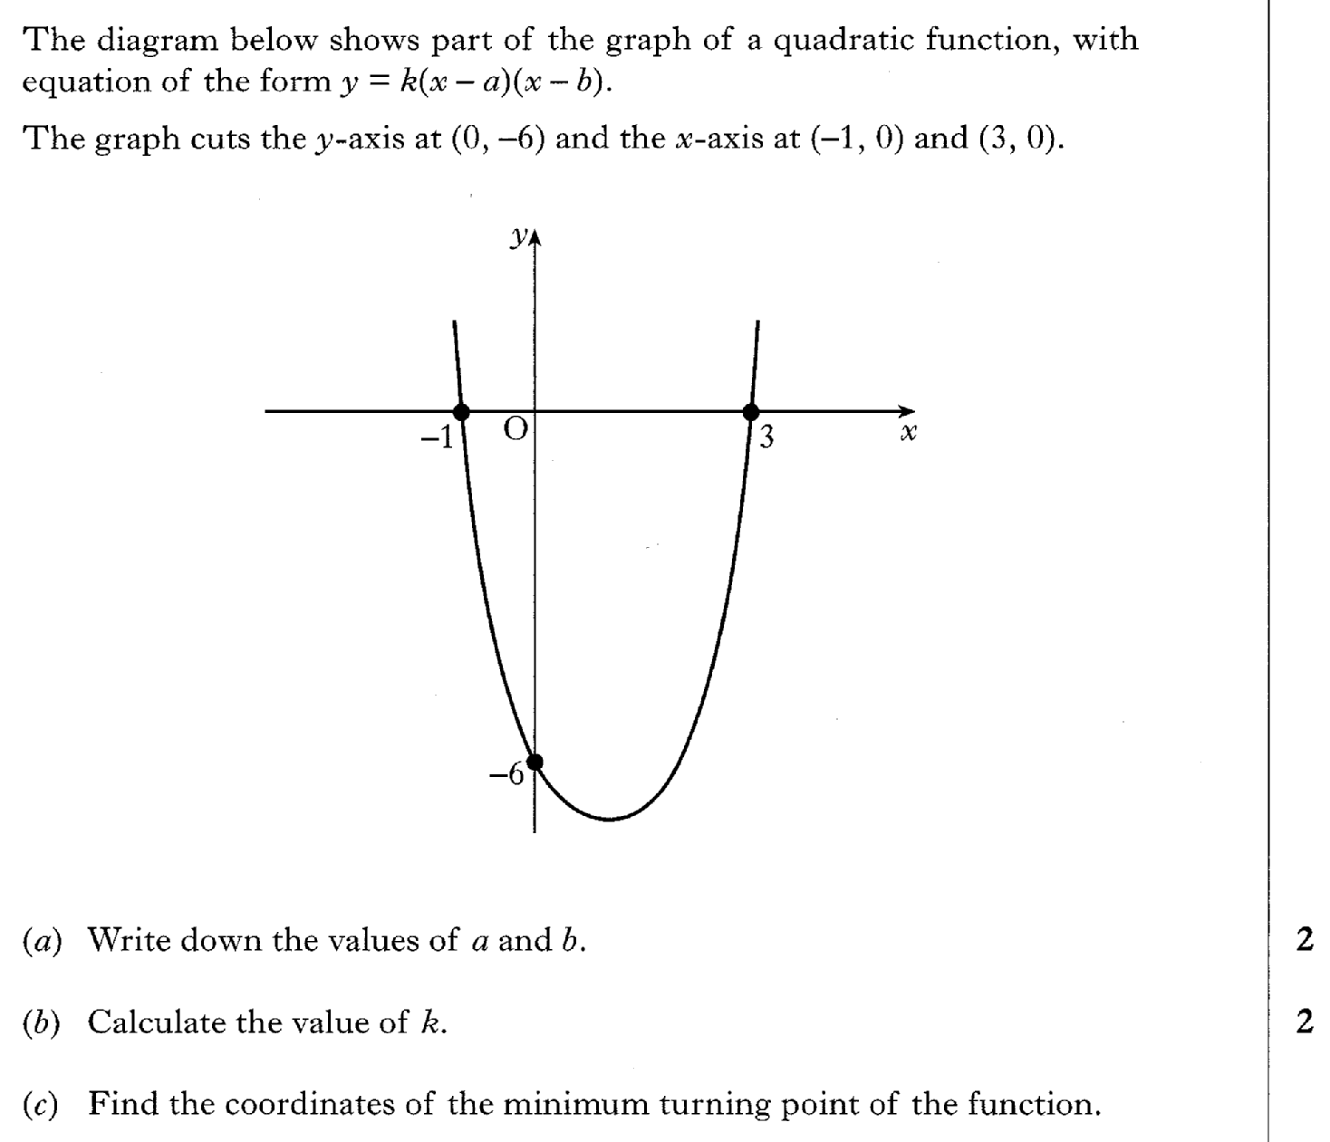
Past Paper Questions – National 5 Mathematics
Topic: Quadratic Function & Parabolas
18.13

Slide 14
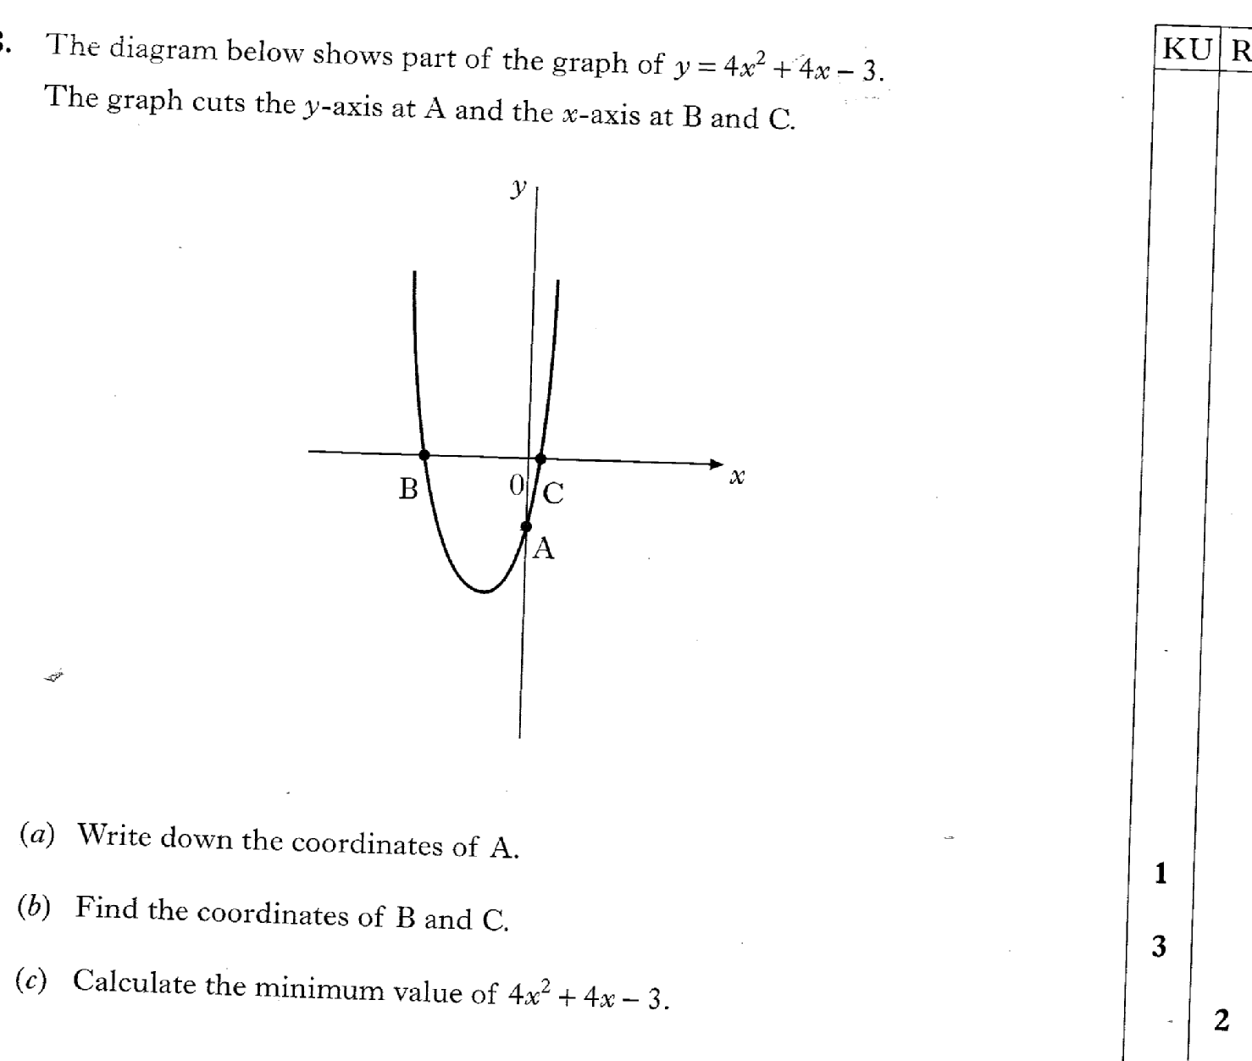
Past Paper Questions – National 5 Mathematics
Topic: Quadratic Function & Parabolas
18.14

Slide 15
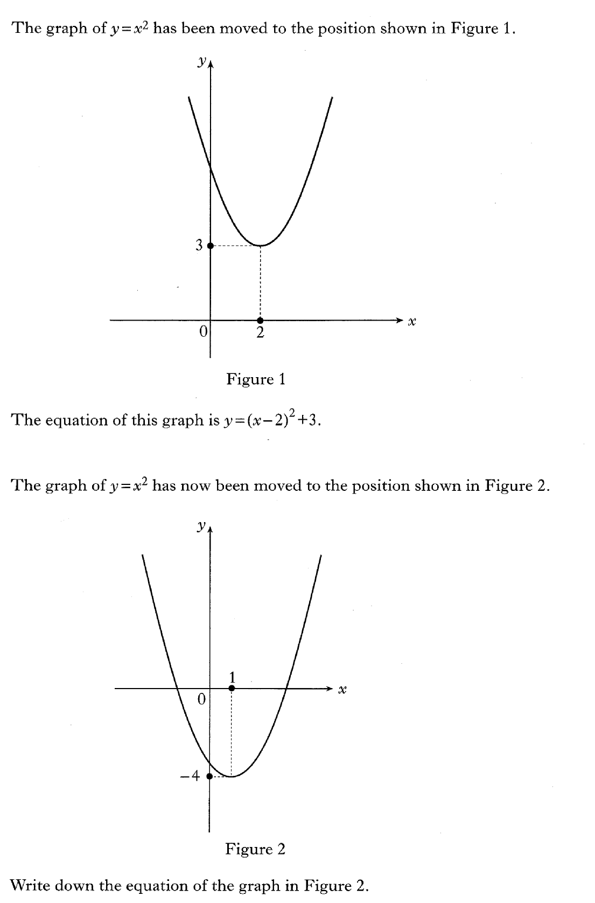
Past Paper Questions – National 5 Mathematics
Topic: Quadratic Function & Parabolas
18.15

Slide 16
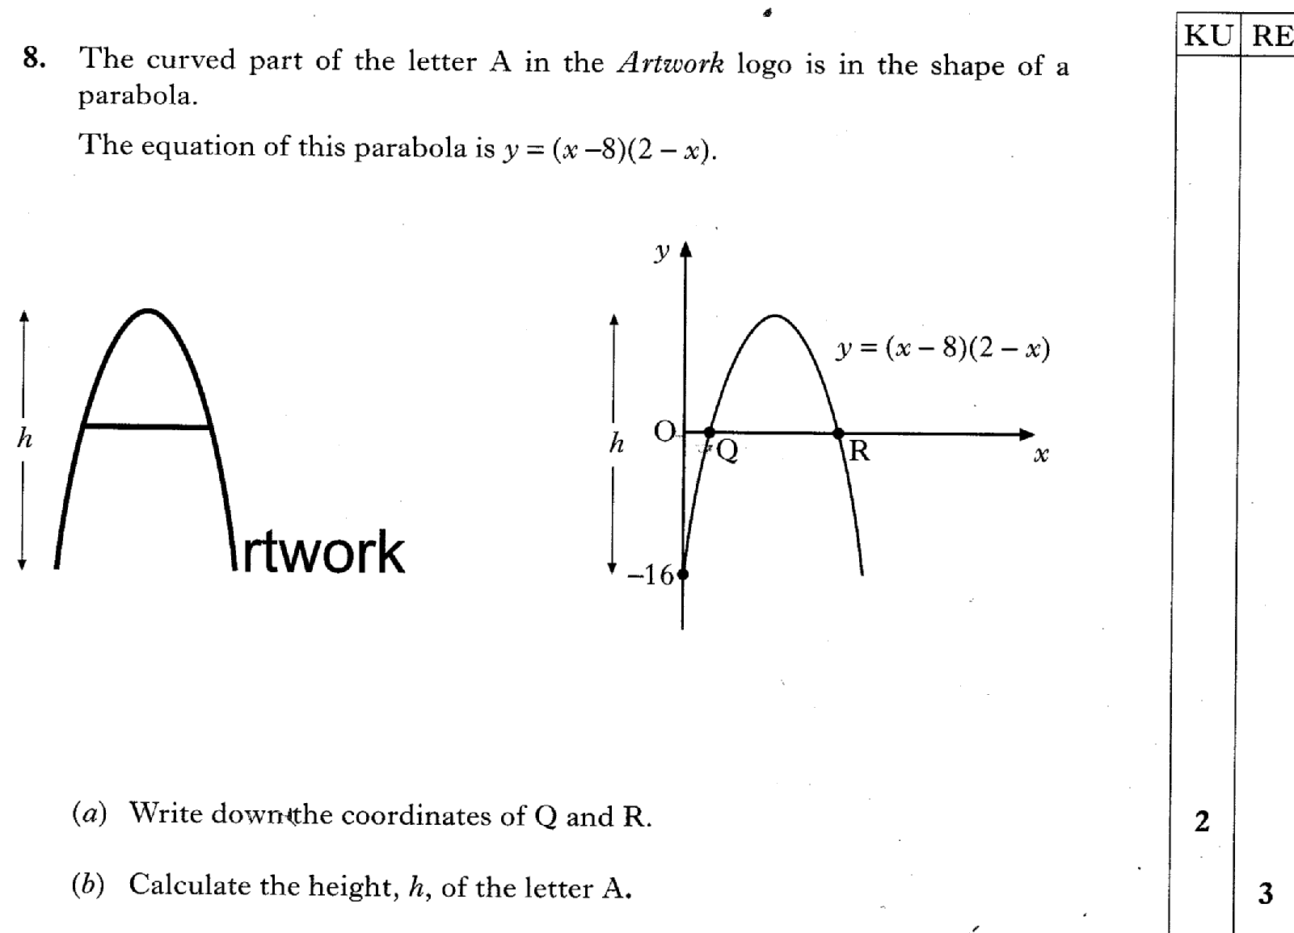
Past Paper Questions – National 5 Mathematics
Topic: Quadratic Function & Parabolas
18.16

Slide 17
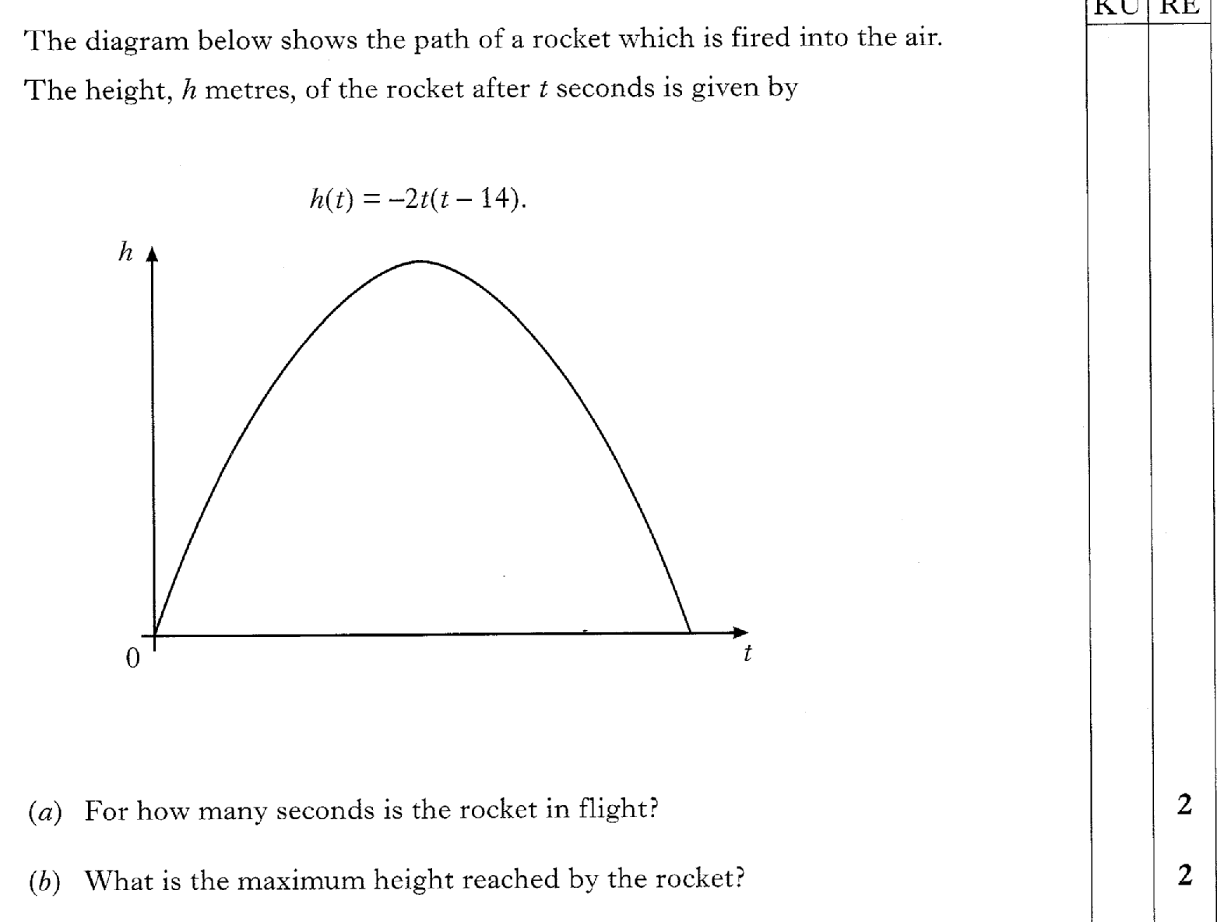
Past Paper Questions – National 5 Mathematics
Topic: Quadratic Function & Parabolas
18.17

Slide 18
Past Paper Questions – National 5 Mathematics
Topic: Quadratic Function & Parabolas
18.18

Slide 19

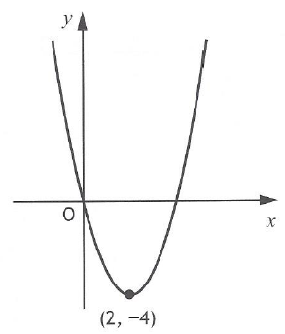
Past Paper Questions – National 5 Mathematics
Topic: Quadratic Function & Parabolas
18.19

