Slide 1
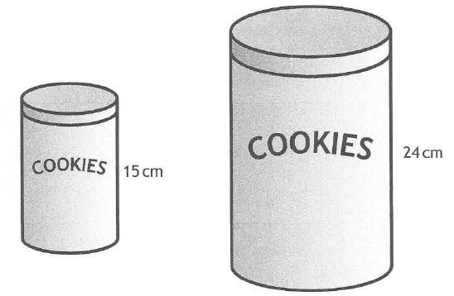
Past Paper Questions – National 5 Mathematics
Topic: Similar Figures
14.01

Slide 2
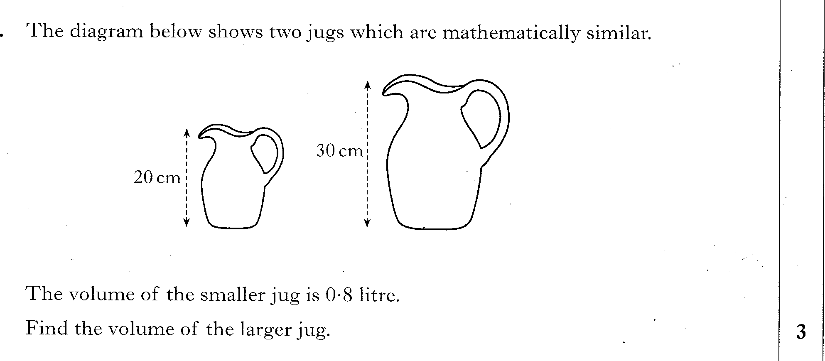
Past Paper Questions – National 5 Mathematics
Topic: Similar Figures
14.02

Slide 3
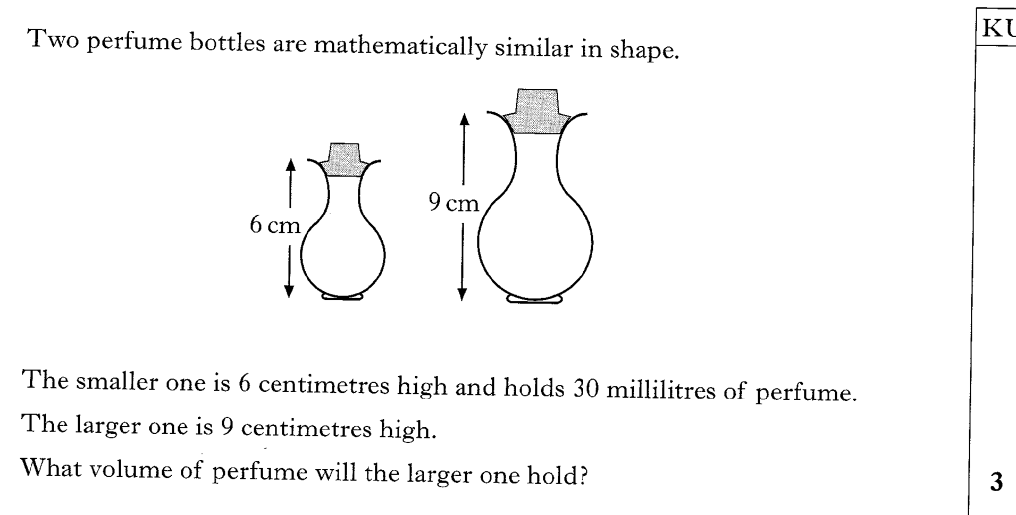
Past Paper Questions – National 5 Mathematics
Topic: Similar Figures
14.03

Slide 4
Past Paper Questions – National 5 Mathematics
Topic: Similar Figures
14.04

Slide 5
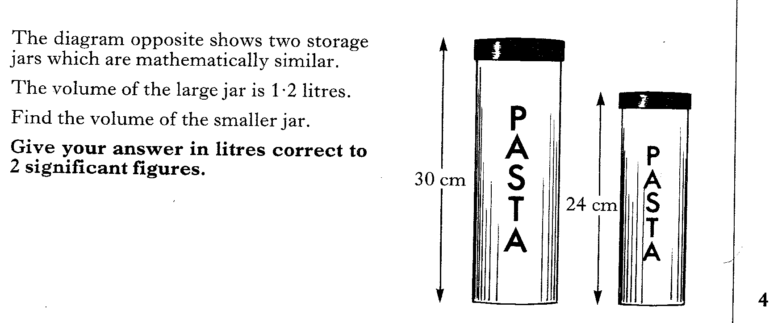
Past Paper Questions – National 5 Mathematics
Topic: Similar Figures
14.05

Slide 6
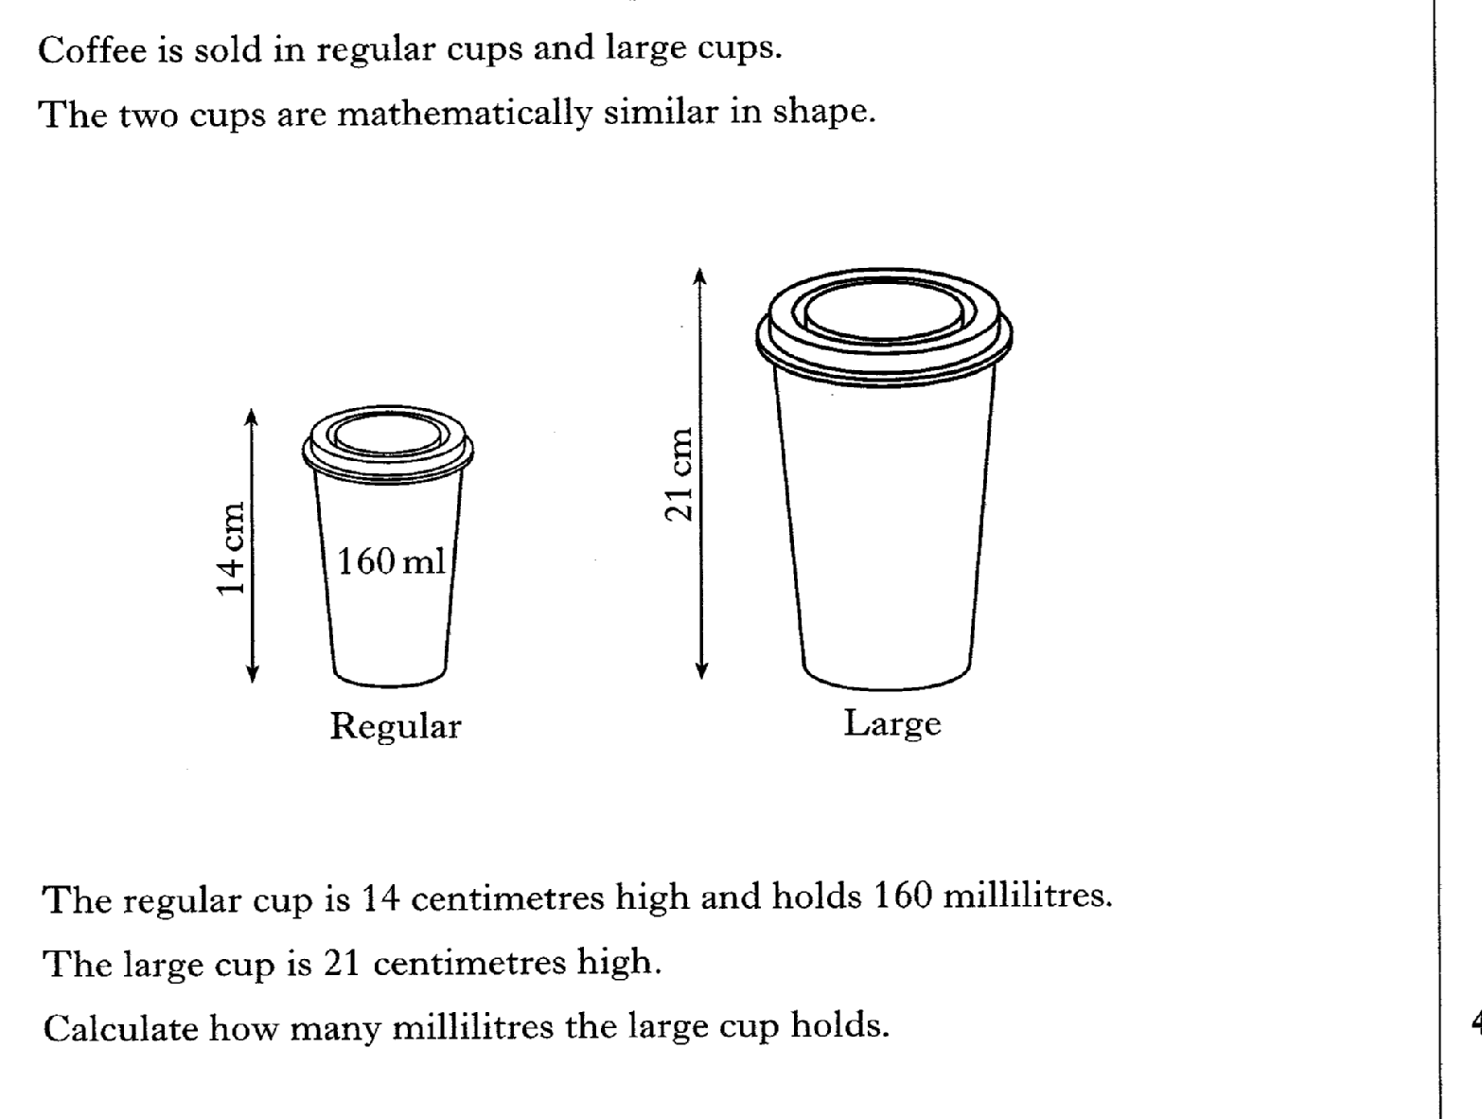
Past Paper Questions – National 5 Mathematics
Topic: Similar Figures
14.06

Slide 7
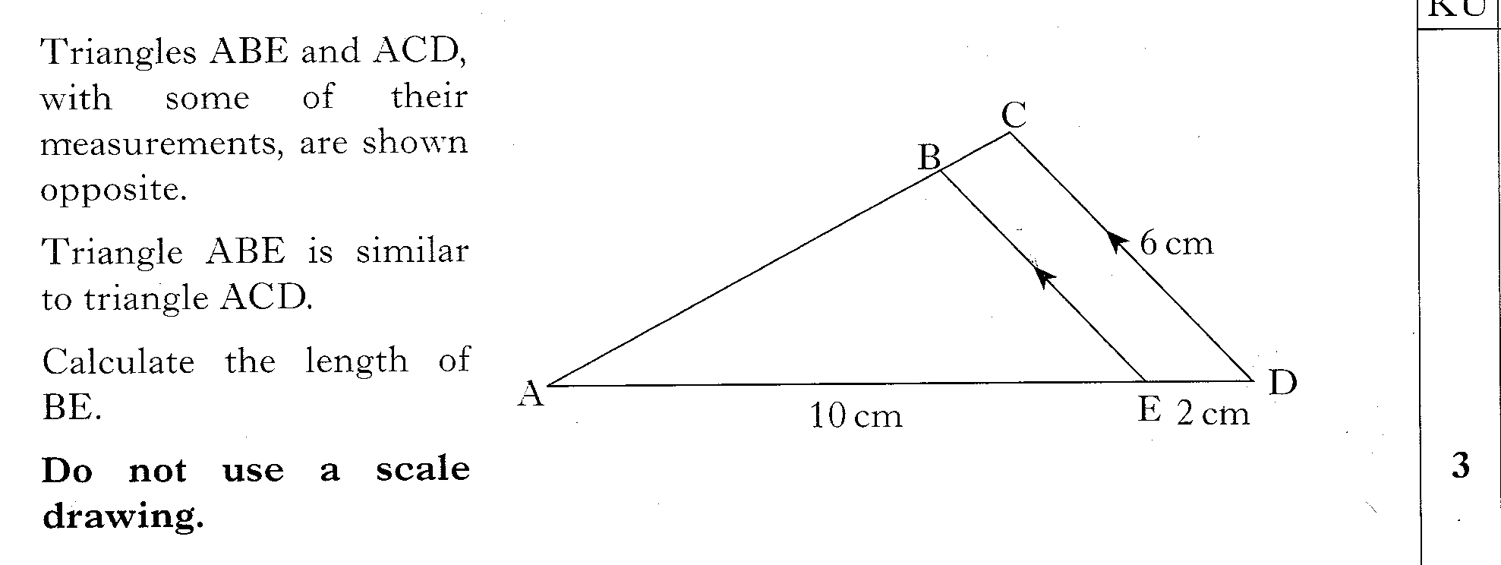
Past Paper Questions – National 5 Mathematics
Topic: Similar Figures
14.07

Slide 8
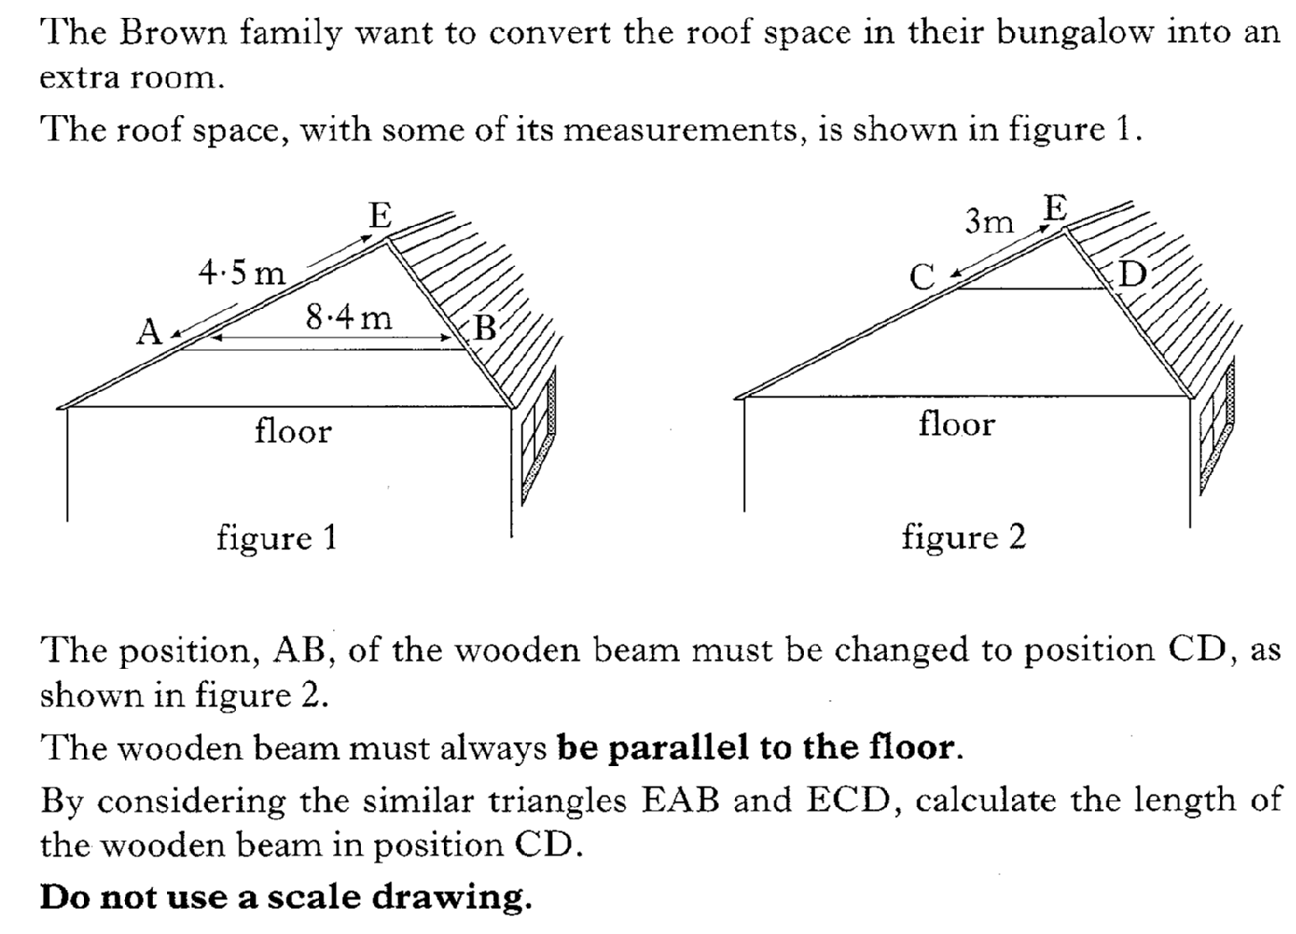
Past Paper Questions – National 5 Mathematics
Topic: Similar Figures
14.08

Slide 9
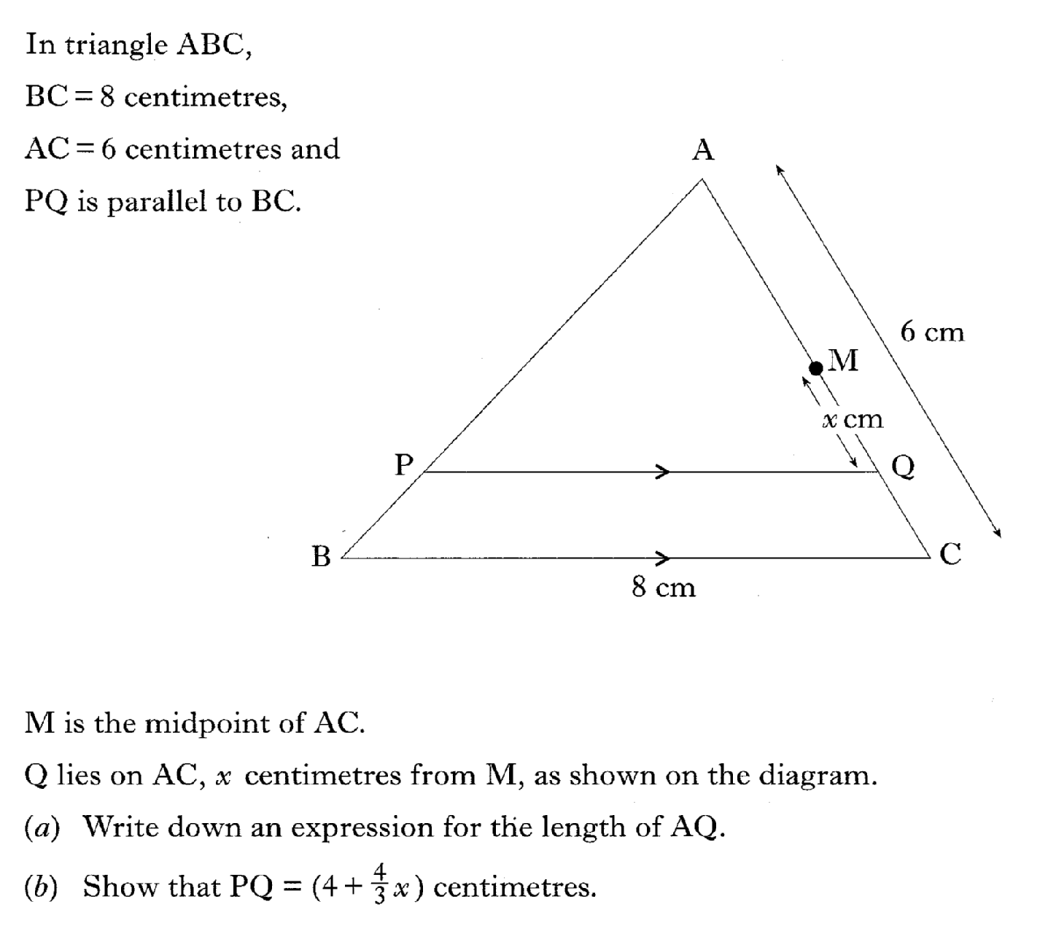
Past Paper Questions – National 5 Mathematics
Topic: Similar Figures
14.09

Slide 10
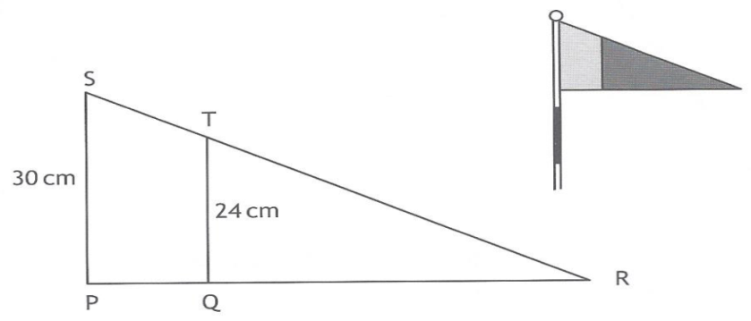
Past Paper Questions – National 5 Mathematics
Topic: Similar Figures
14.10

