Slide 1
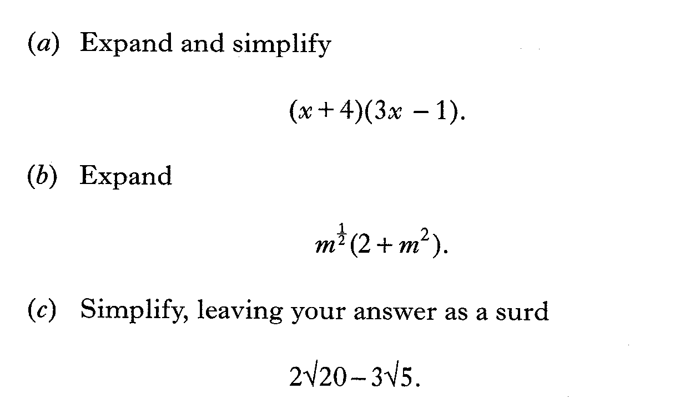
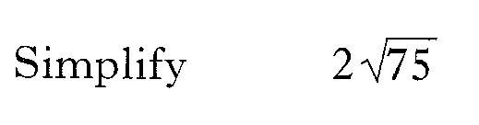
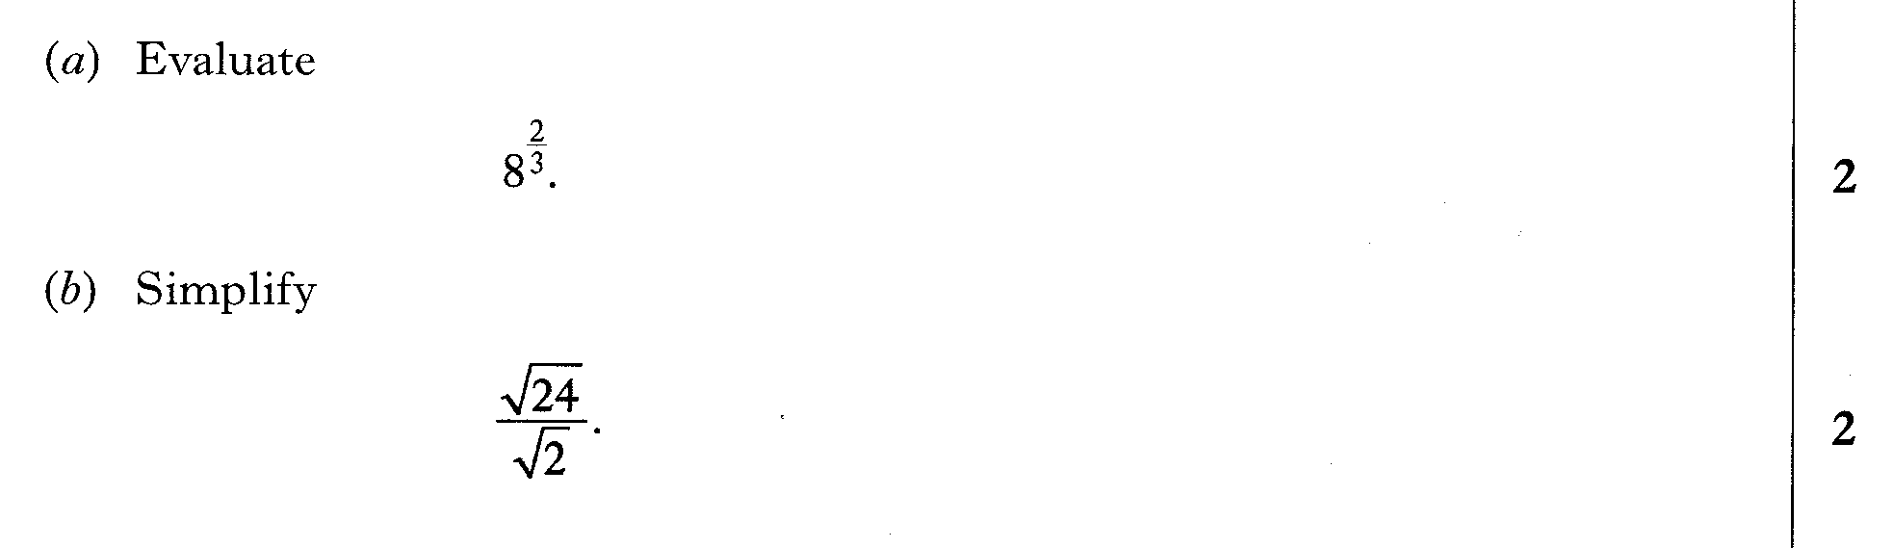
Past Paper Questions – National 5 Mathematics
Topic: Surds
08.01
08.02
08.03
08.04

Slide 2

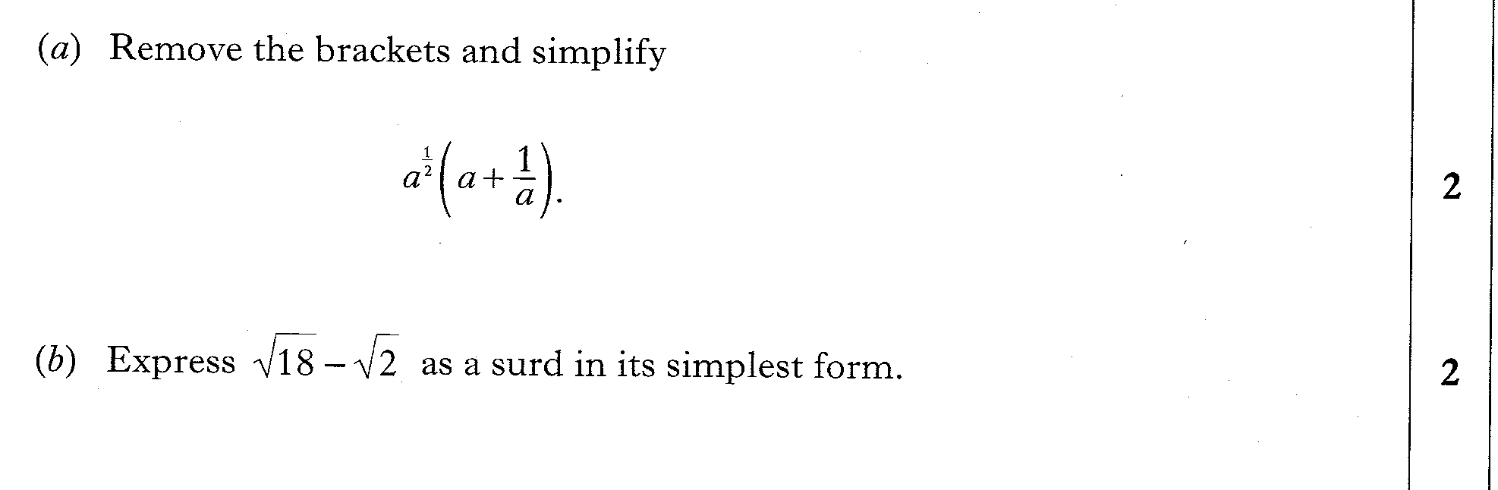
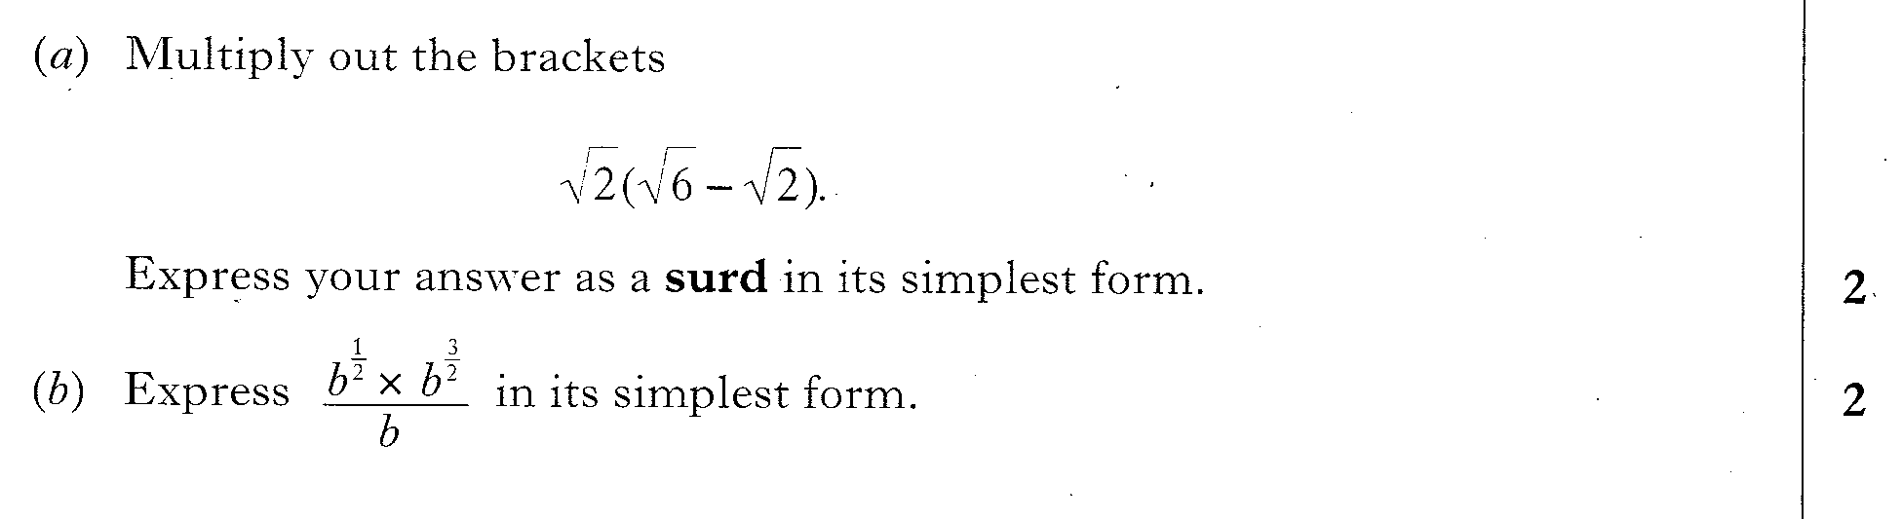
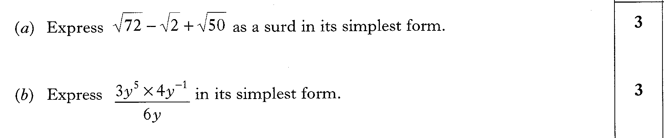
Past Paper Questions – National 5 Mathematics
Topic: Surds
08.05
08.06
08.07
08.08

Slide 3
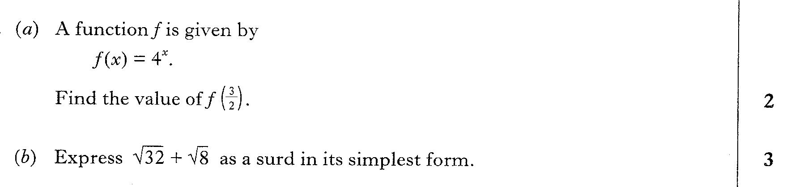
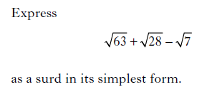
Past Paper Questions – National 5 Mathematics
Topic: Surds
08.09
08.10
08.11

Slide 4

Past Paper Questions – National 5 Mathematics
Topic: Surds
08.12
08.13
08.14
08.15

Slide 5
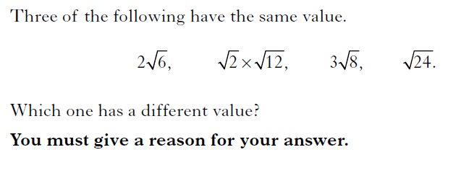
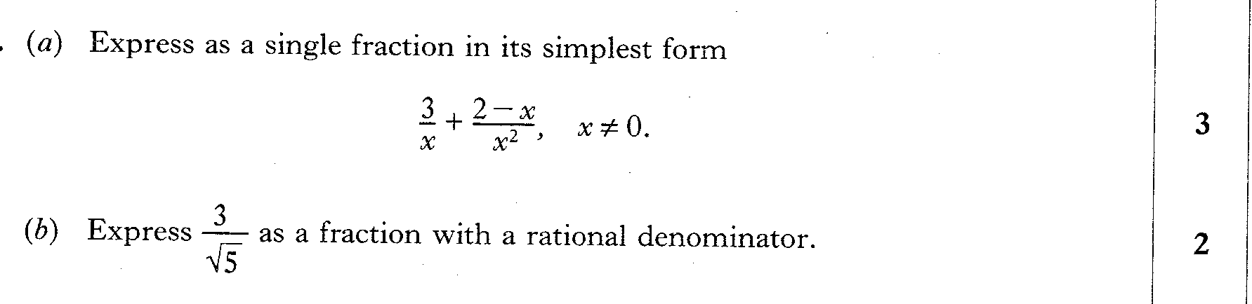

Past Paper Questions – National 5 Mathematics
Topic: Surds
08.16
08.17
08.18
Notes:
5

Slide 6
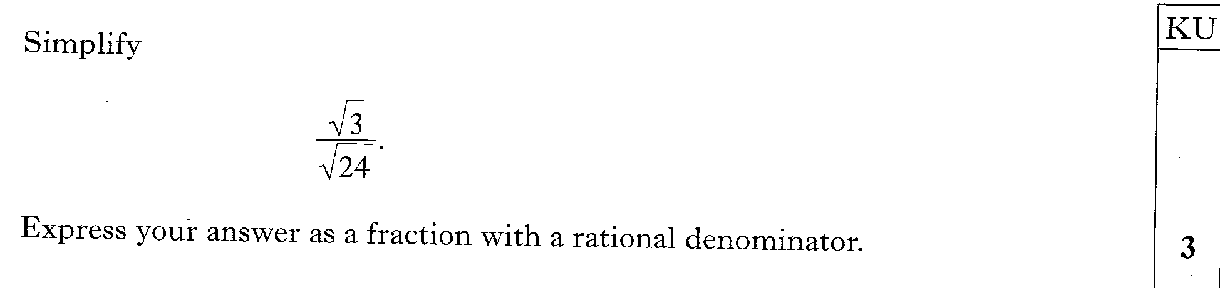
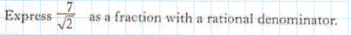
Past Paper Questions – National 5 Mathematics
Topic: Surds
08.19
08.20
08.21

Slide 7
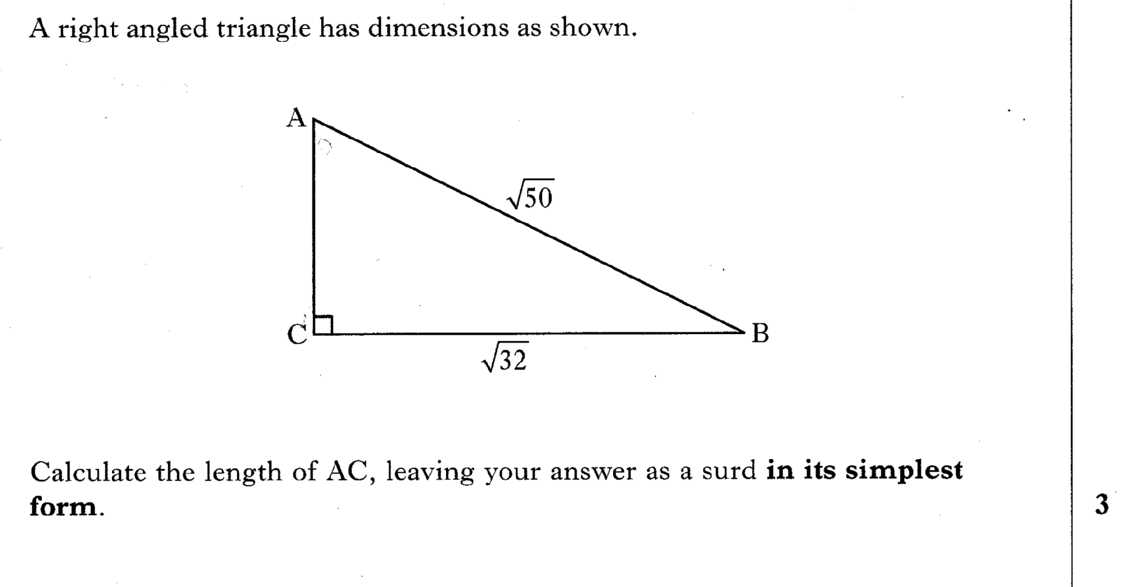
Past Paper Questions – National 5 Mathematics
Topic: Surds
08.22

Slide 8
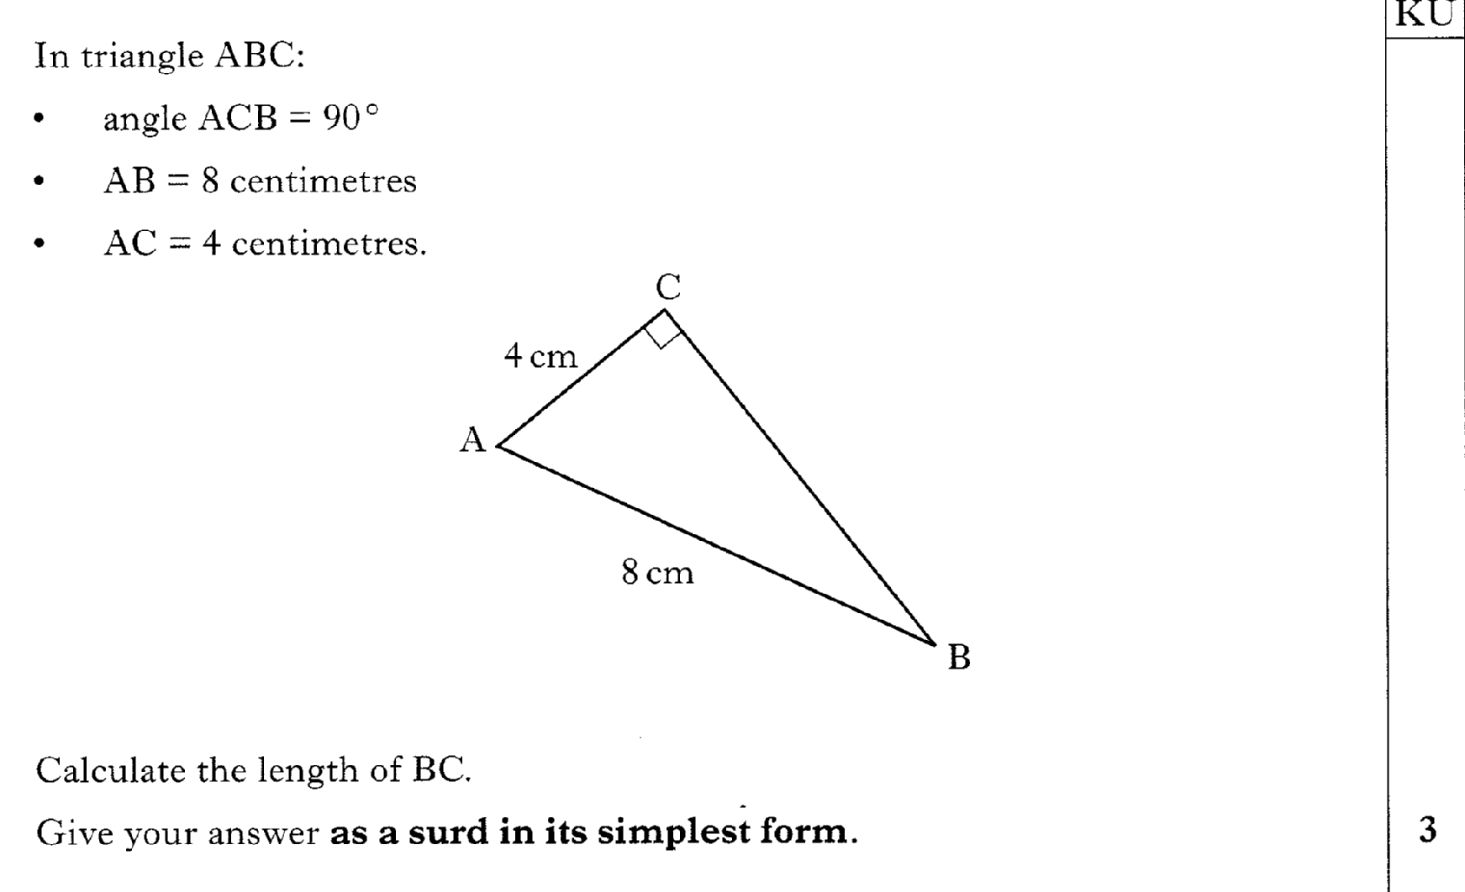
Past Paper Questions – National 5 Mathematics
Topic: Surds
08.23

Slide 9
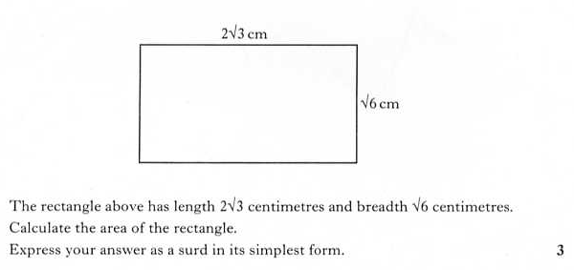
Past Paper Questions – National 5 Mathematics
Topic: Surds
08.24

Slide 10
Past Paper Questions – National 5 Mathematics
Topic: Surds
08.25

