Slide 1
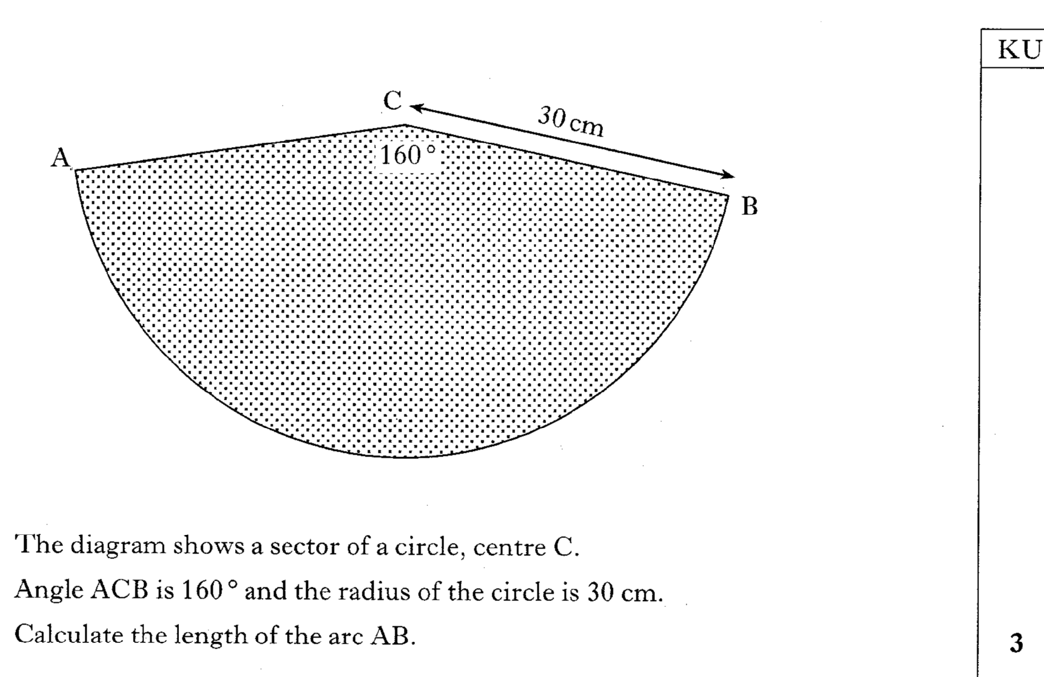
Past Paper Questions – National 5 Mathematics
Topic: Arc Length & Sector Area
22.01

Slide 2
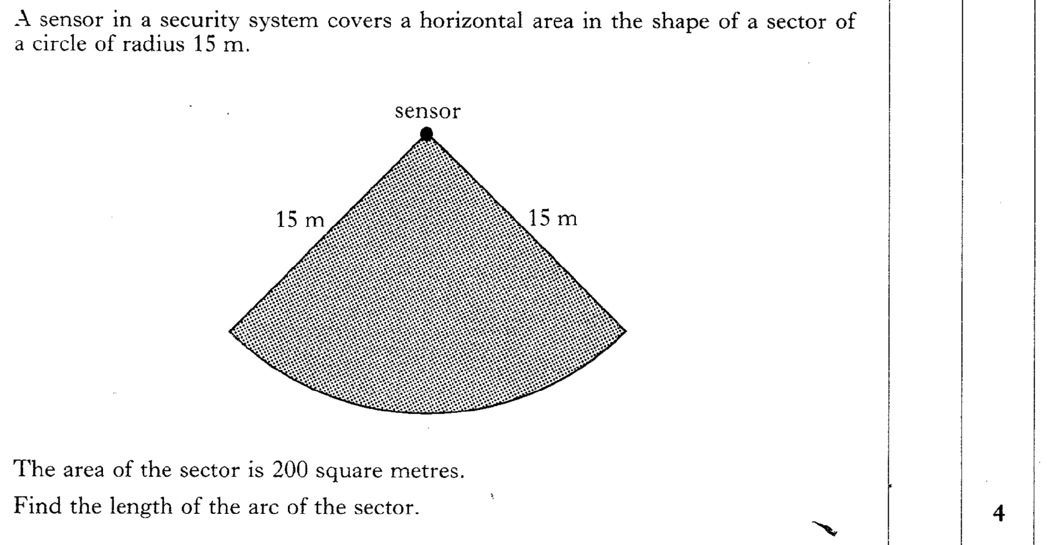
Past Paper Questions – National 5 Mathematics
Topic: Arc Length & Sector Area
22.02

Slide 3
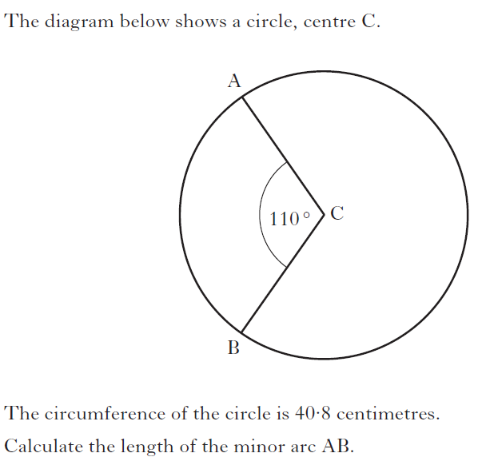
Past Paper Questions – National 5 Mathematics
Topic: Arc Length & Sector Area
22.03
Notes:
3

Slide 4
Past Paper Questions – National 5 Mathematics
Topic: Arc Length & Sector Area
22.04

Slide 5
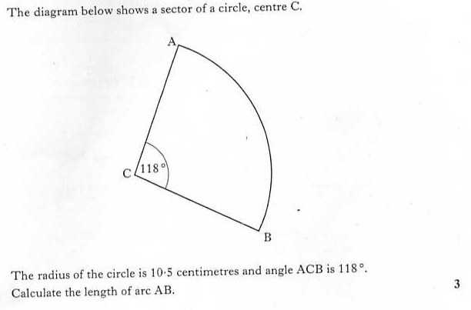
Past Paper Questions – National 5 Mathematics
Topic: Arc Length & Sector Area
22.05

Slide 6
Past Paper Questions – National 5 Mathematics
Topic: Arc Length & Sector Area
22.06

Slide 7
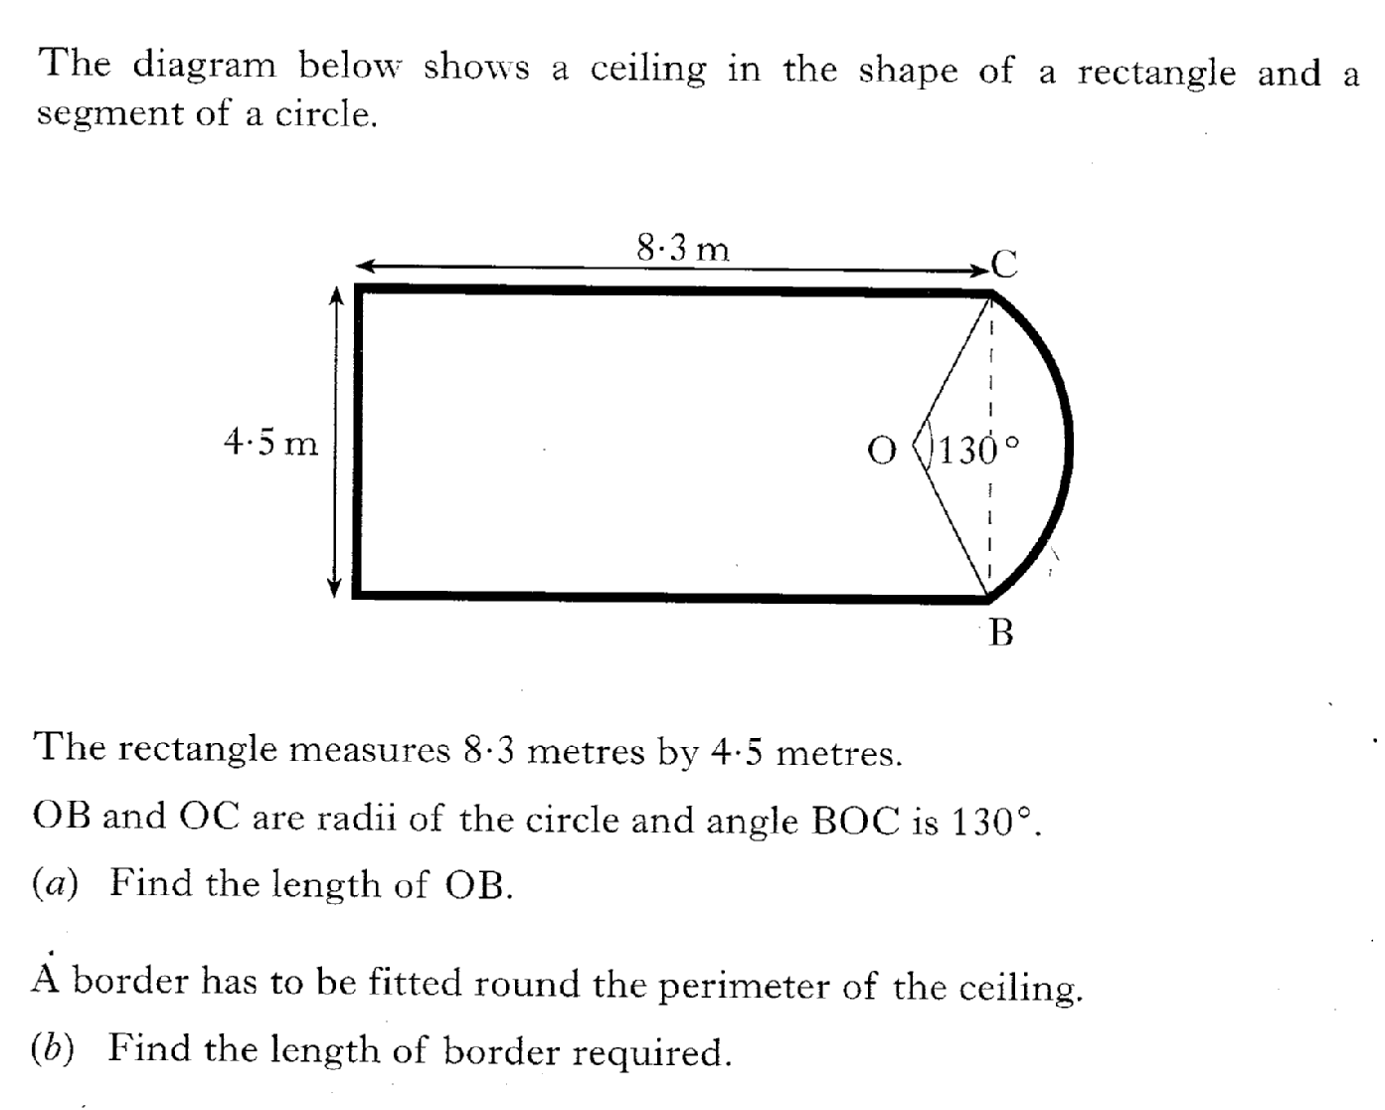
Past Paper Questions – National 5 Mathematics
Topic: Arc Length & Sector Area
22.07

Slide 8
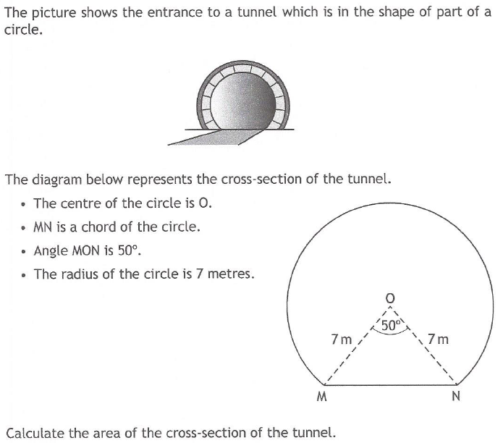
Past Paper Questions – National 5 Mathematics
Topic: Arc Length & Sector Area
22.08

Slide 9
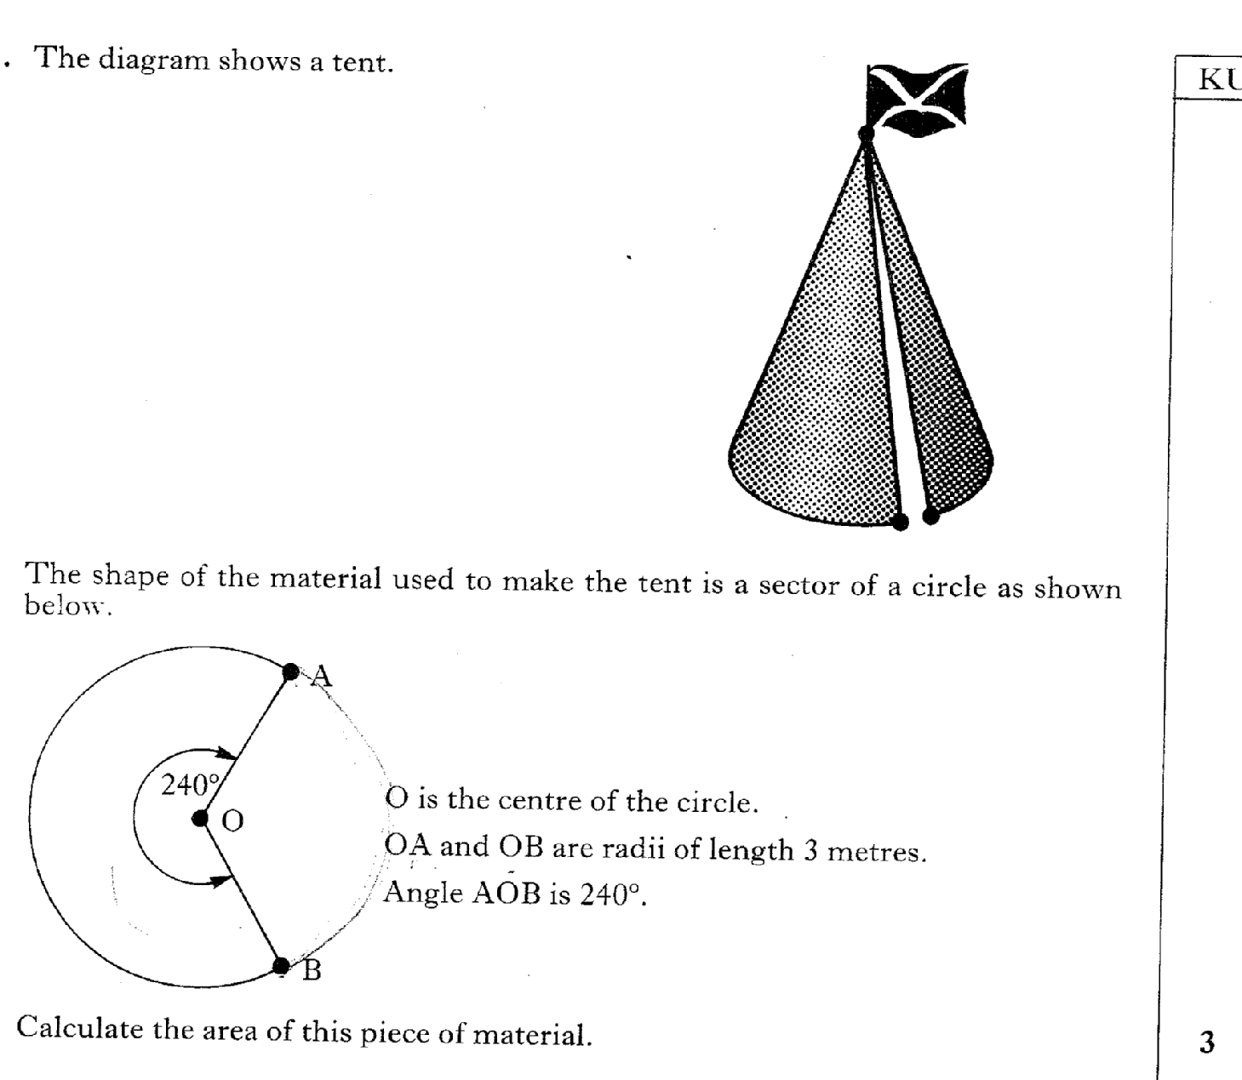
Past Paper Questions – National 5 Mathematics
Topic: Arc Length & Sector Area
22.09

Slide 10
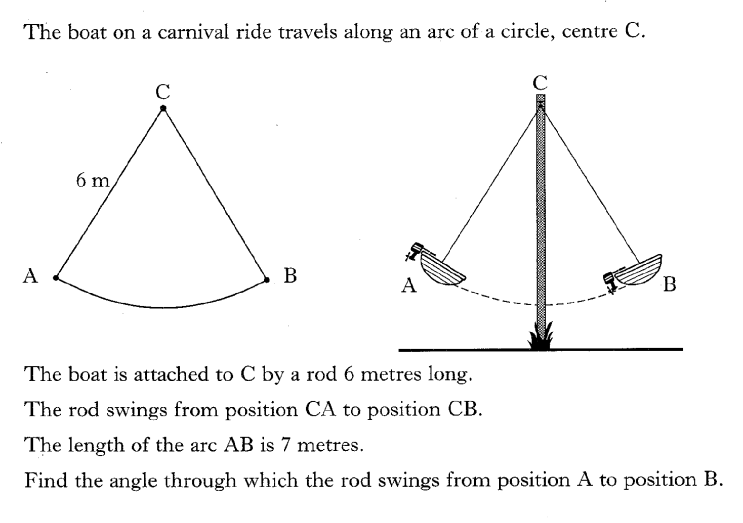
Past Paper Questions – National 5 Mathematics
Topic: Arc Length & Sector Area
22.10

Slide 11
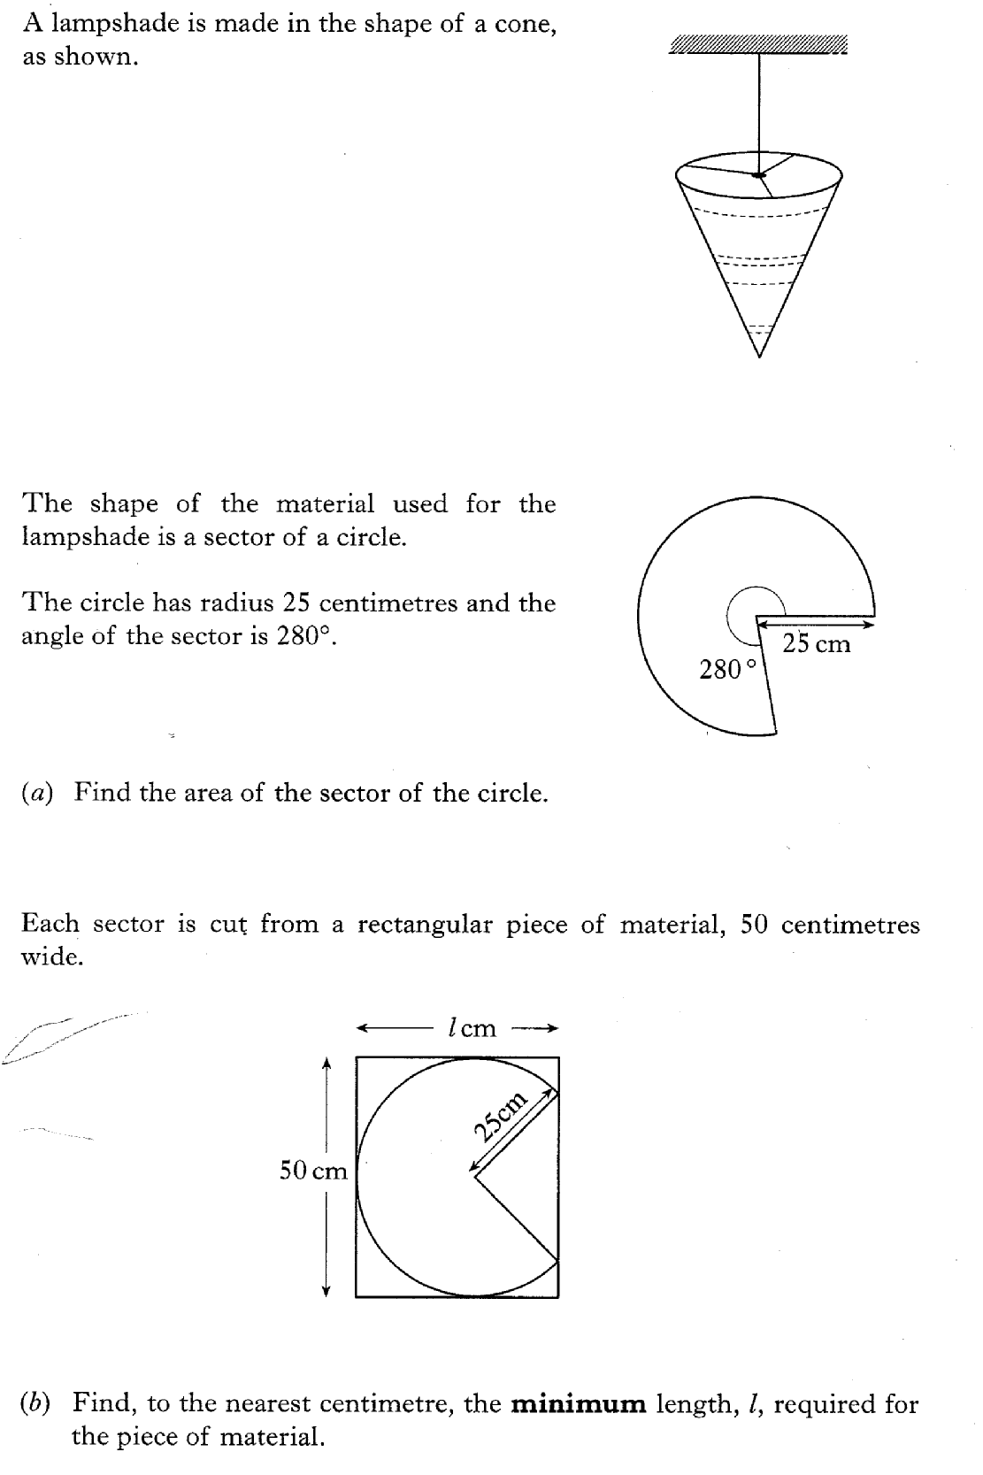
Past Paper Questions – National 5 Mathematics
Topic: Arc Length & Sector Area
22.11

Slide 12
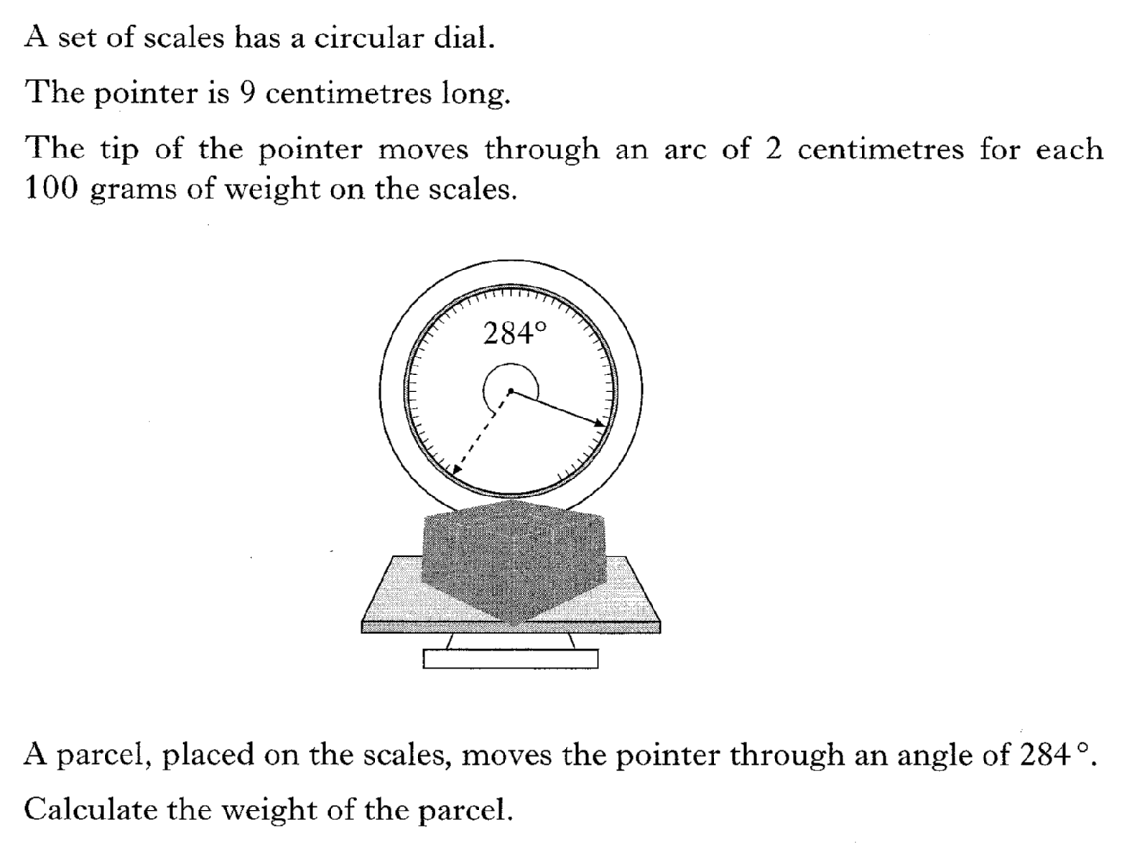
Past Paper Questions – National 5 Mathematics
Topic: Arc Length & Sector Area
22.12

Slide 13
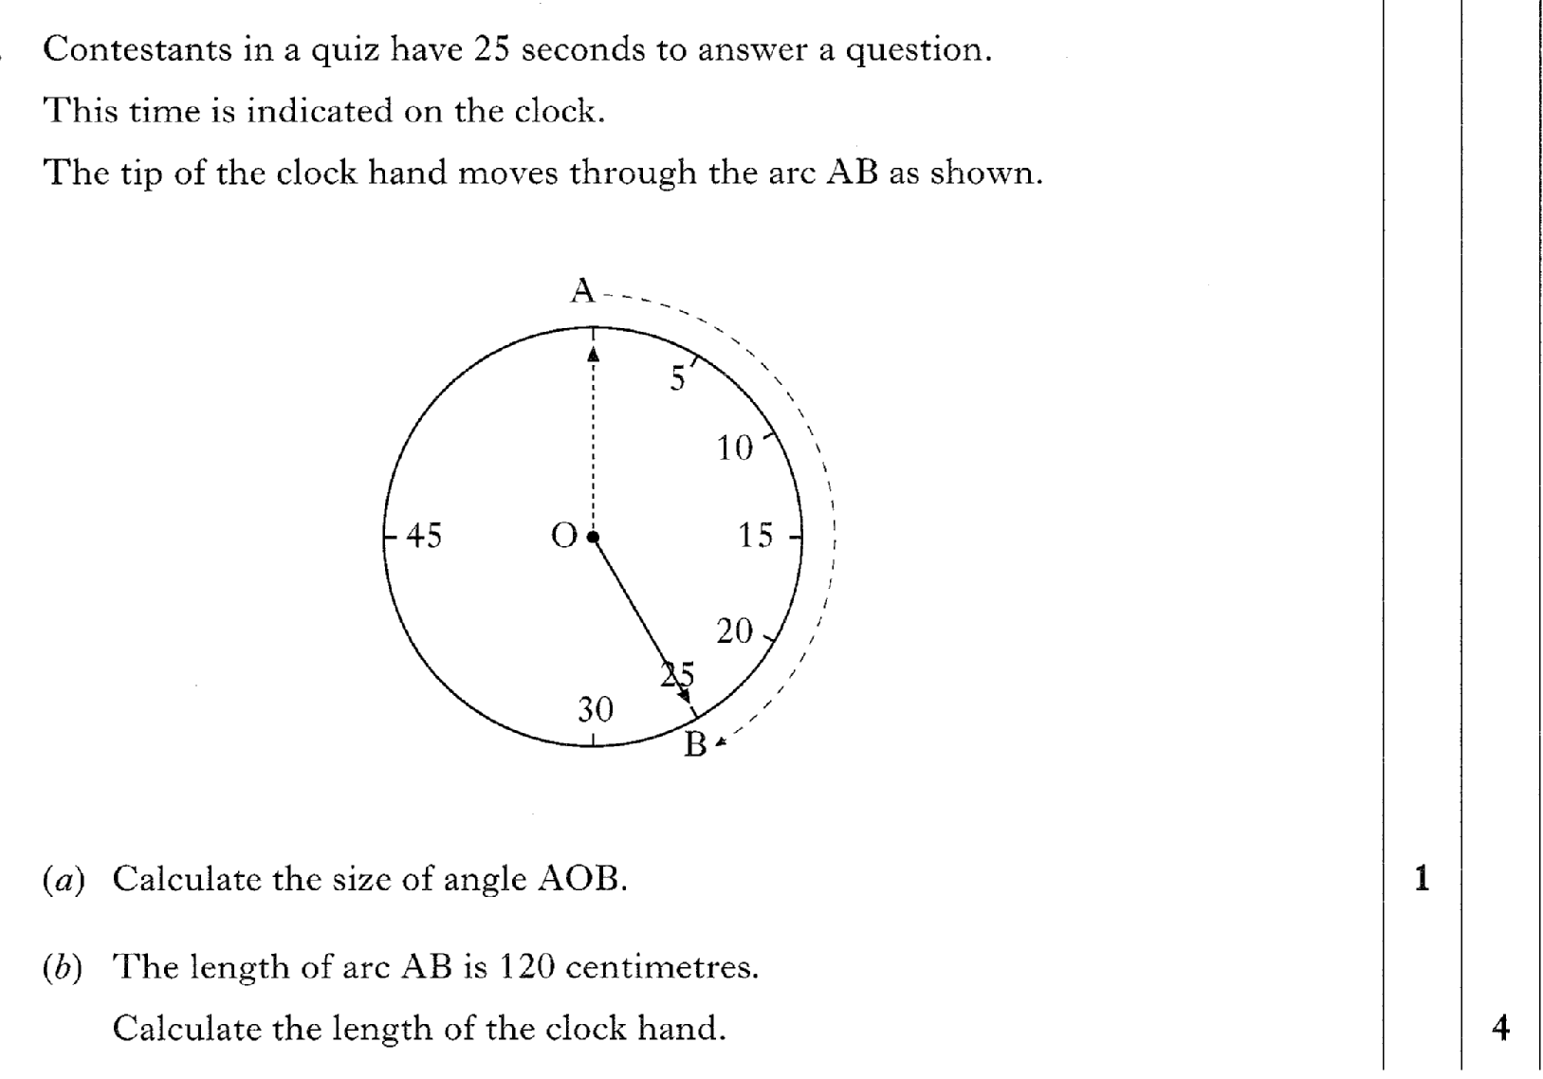
Past Paper Questions – National 5 Mathematics
Topic: Arc Length & Sector Area
22.13

Slide 14
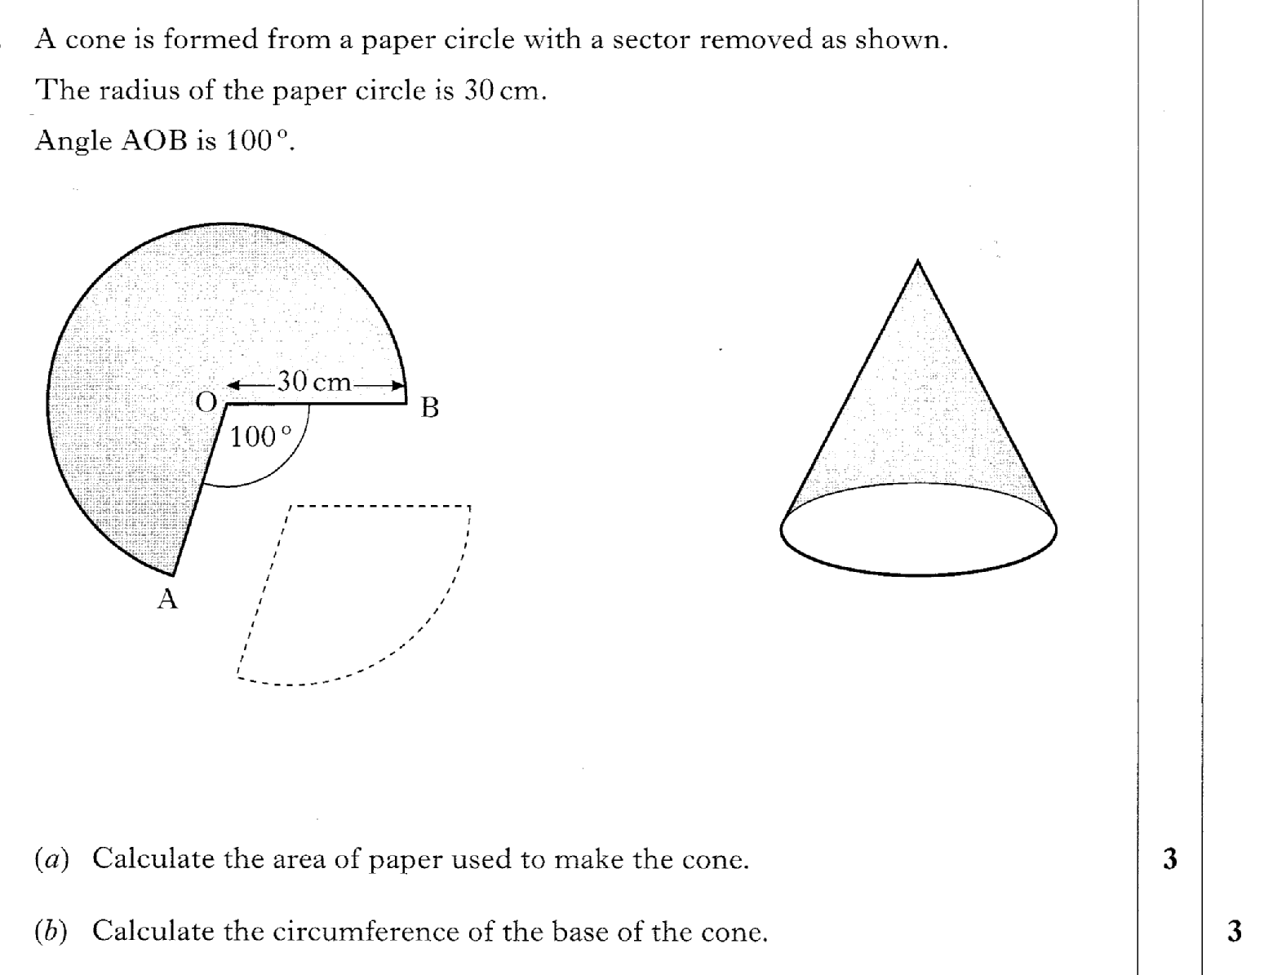
Past Paper Questions – National 5 Mathematics
Topic: Arc Length & Sector Area
22.14

Slide 15
Past Paper Questions – National 5 Mathematics
Topic: Arc Length & Sector Area
22.15

Slide 16
Past Paper Questions – National 5 Mathematics
Topic: Arc Length & Sector Area
22.16

Slide 17
Past Paper Questions – National 5 Mathematics
Topic: Arc Length & Sector Area
22.17

Slide 18
Past Paper Questions – National 5 Mathematics
Topic: Arc Length & Sector Area
22.18
Notes:
18

Slide 19
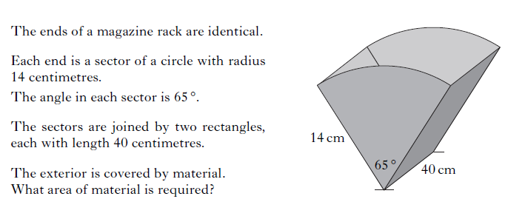
Past Paper Questions – National 5 Mathematics
Topic: Arc Length & Sector Area
22.19
Notes:
19

Slide 20
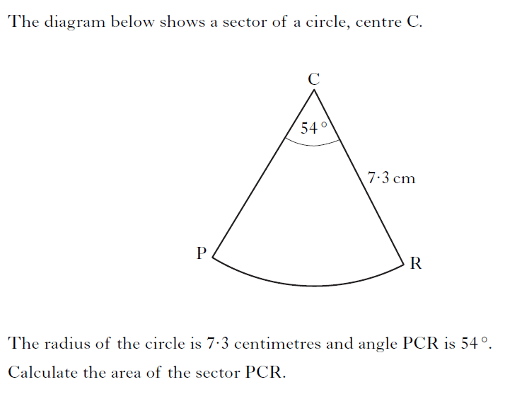
Past Paper Questions – National 5 Mathematics
Topic: Arc Length & Sector Area
22.20
Notes:
20

Slide 21
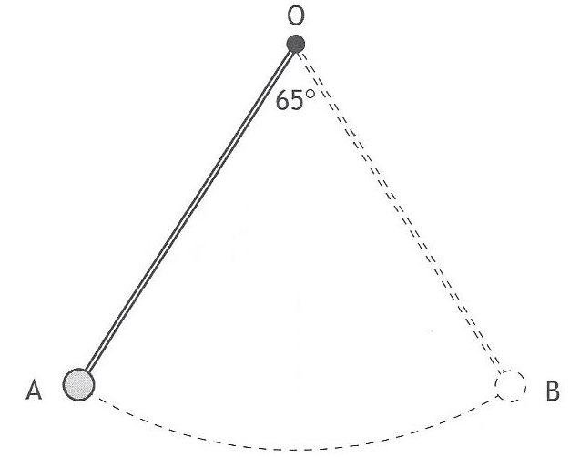
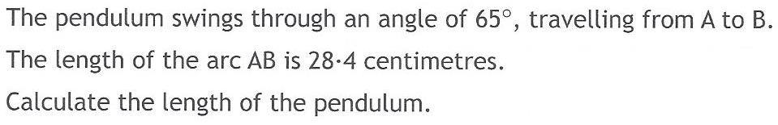
Past Paper Questions – National 5 Mathematics
Topic: Arc Length & Sector Area
22.21
Notes:
21

Slide 22
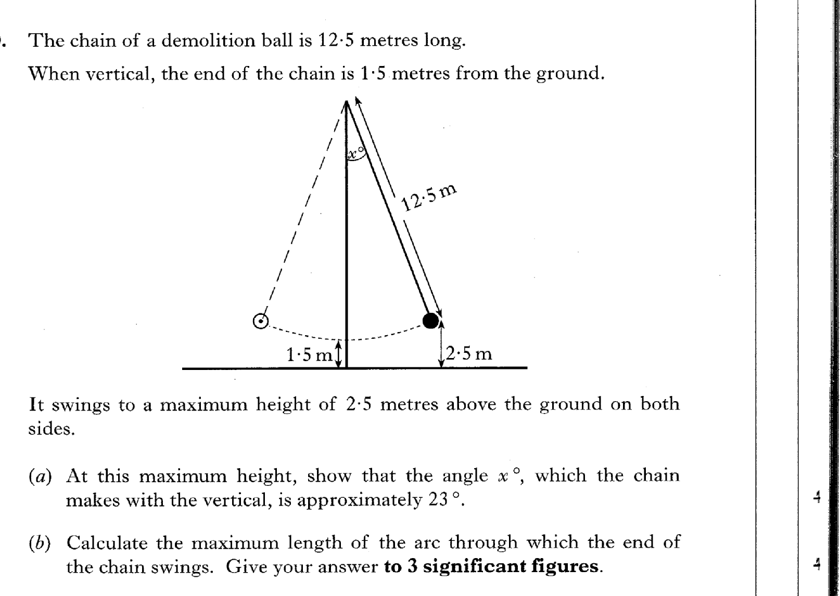
22.22
Past Paper Questions – National 5 Mathematics
Topic: Arc Length & Sector Area

