Slide 1
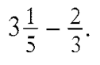
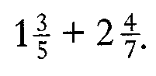
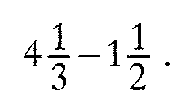
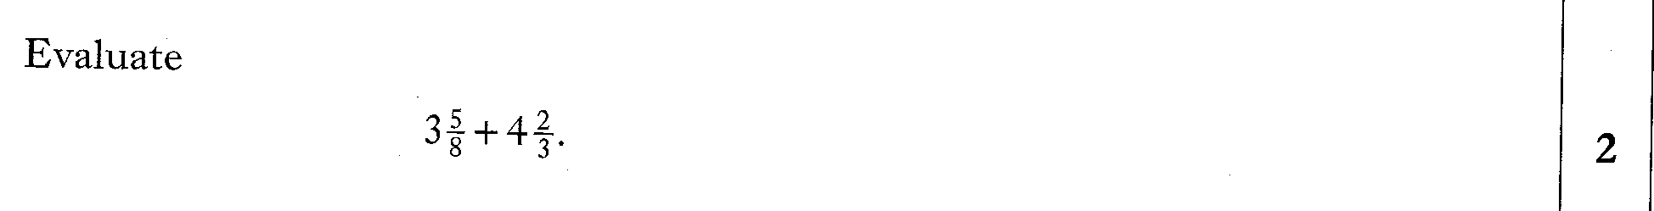
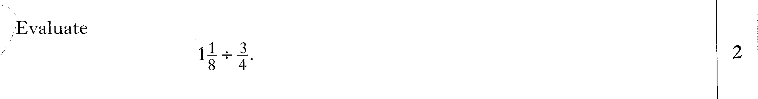
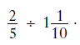

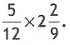
Past Paper Questions – National 5 Mathematics
Topic: Fractions
10.01
10.02
10.03
10.04
10.05
10.06
10.07
10.08

Slide 2
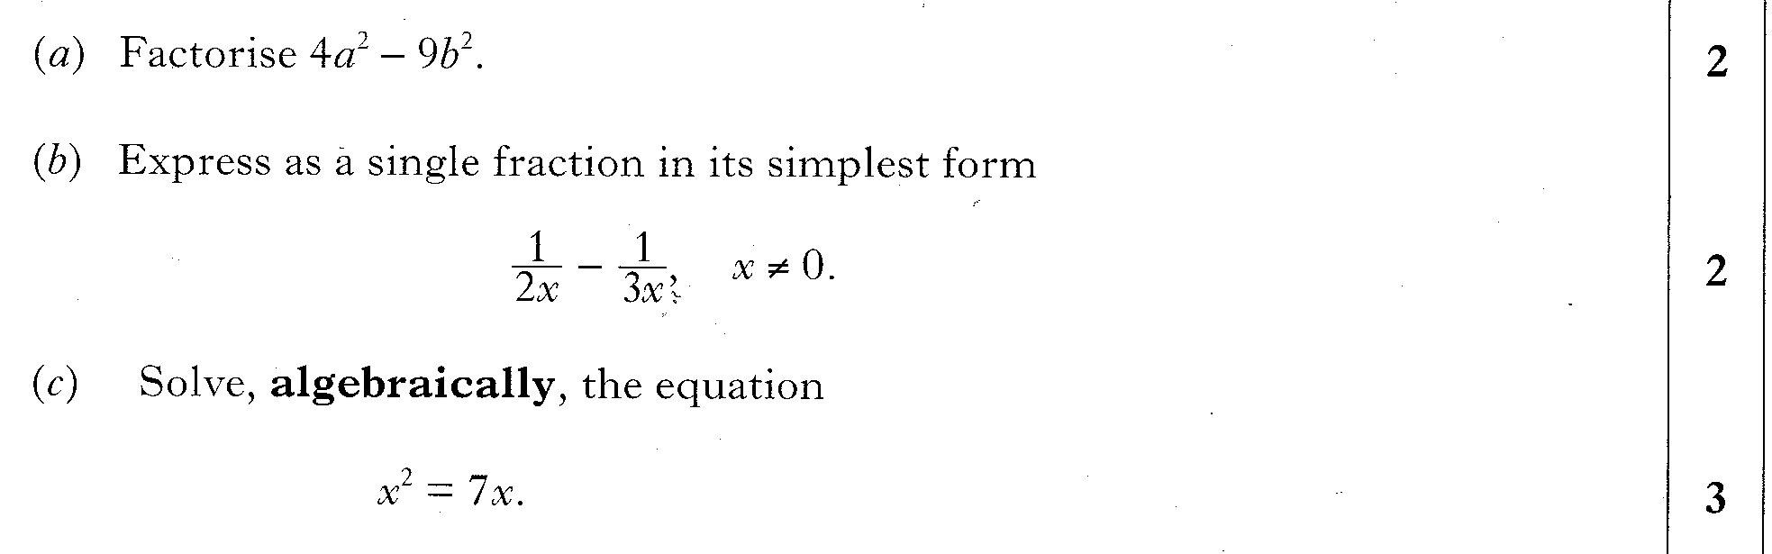
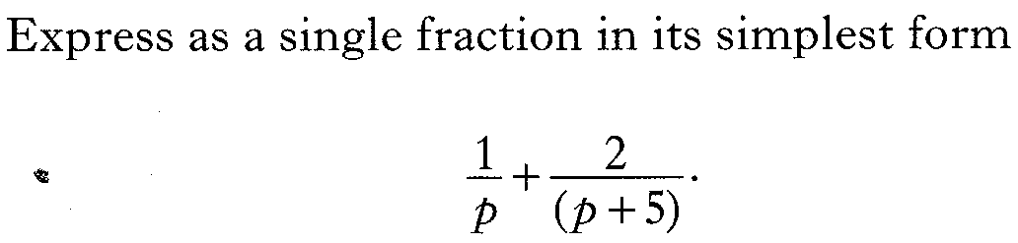
Past Paper Questions – National 5 Mathematics
Topic: Fractions
10.09
10.10
10.11

Slide 3
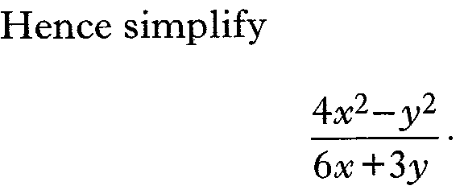
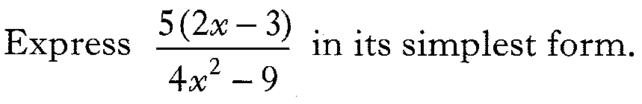
Past Paper Questions – National 5 Mathematics
Topic: Fractions
10.12
10.13
10.14

Slide 4
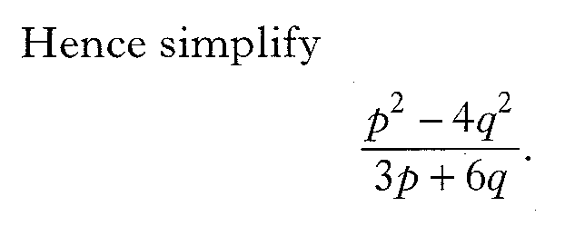
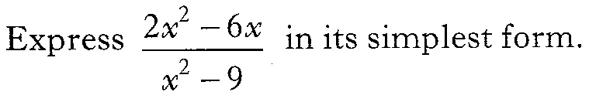
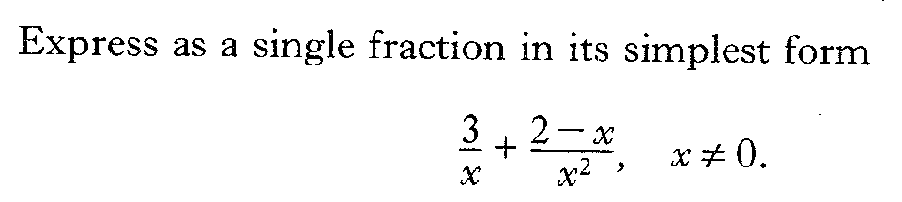
Past Paper Questions – National 5 Mathematics
Topic: Fractions
10.15
10.16
10.17

Slide 5
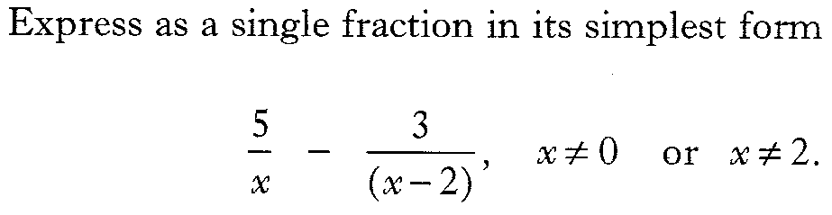
Past Paper Questions – National 5 Mathematics
Topic: Fractions
10.18
10.19
10.20

Slide 6
Past Paper Questions – National 5 Mathematics
Topic: Fractions
10.21
10.22

Slide 7
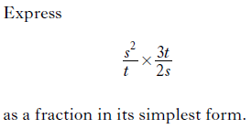
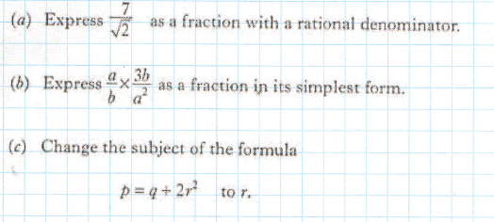
Past Paper Questions – National 5 Mathematics
Topic: Fractions
10.23
10.24
10.25

Slide 8
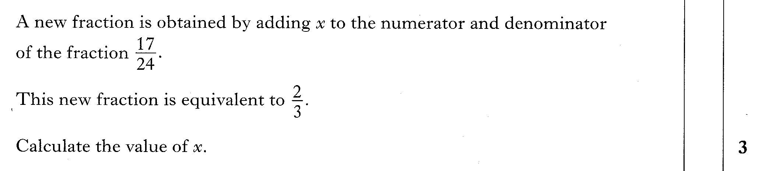
Past Paper Questions – National 5 Mathematics
Topic: Fractions
10.26
10.27

Slide 9
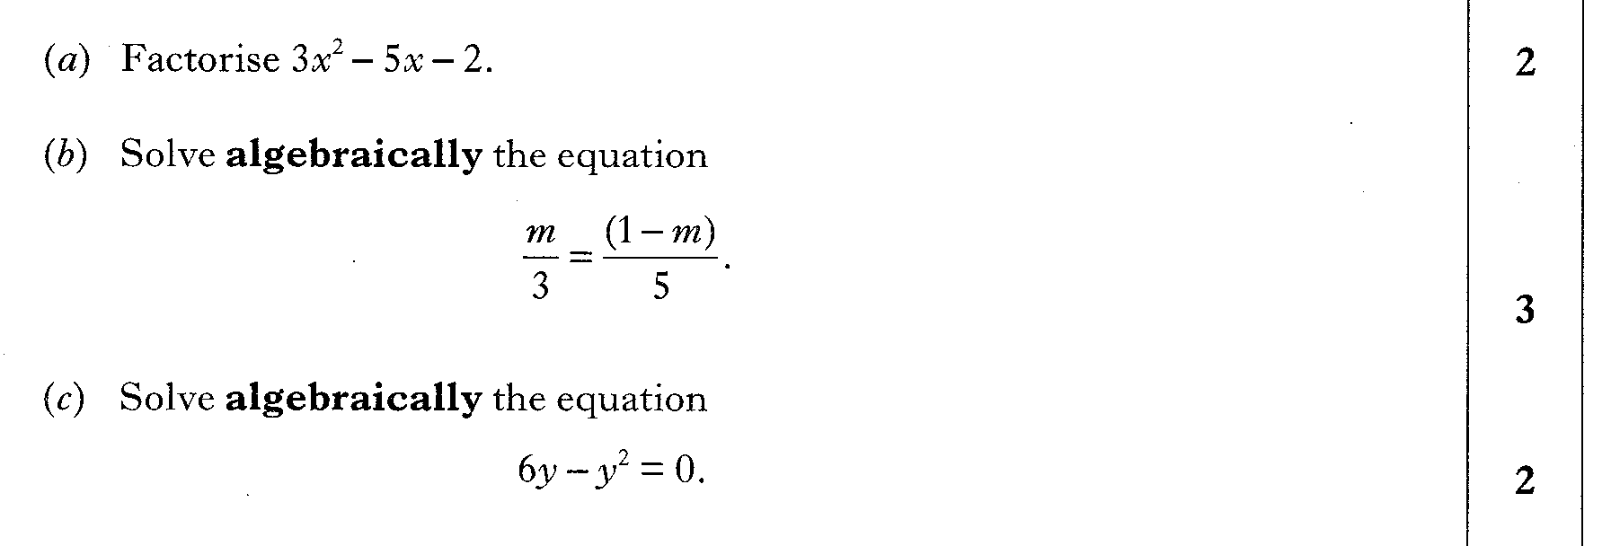
Past Paper Questions – National 5 Mathematics
Topic: Fractions
10.28
10.29
10.30

Slide 10
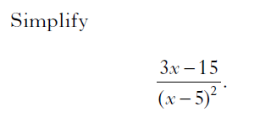
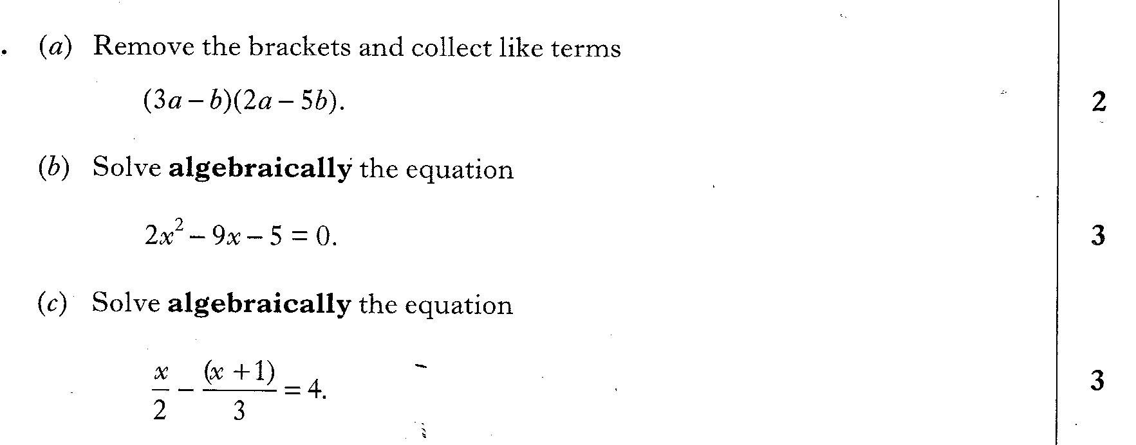
Past Paper Questions – National 5 Mathematics
Topic: Fractions
10.31
10.32
10.33

Slide 11
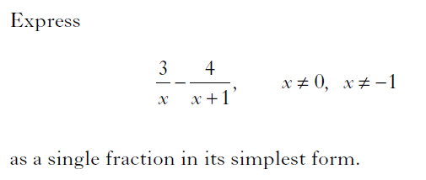
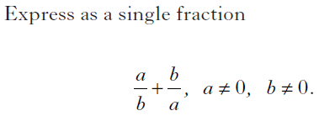
Past Paper Questions – National 5 Mathematics
Topic: Fractions
10.34
10.35

Slide 12


Past Paper Questions – National 5 Mathematics
Topic: Fractions
10.36
10.37
10.38
10.39

