Slide 1
P5/6

Slide 2
Health and Wellbeing

Slide 3
Physical Health

Slide 9
Mindful May and Yoga

Slide 10
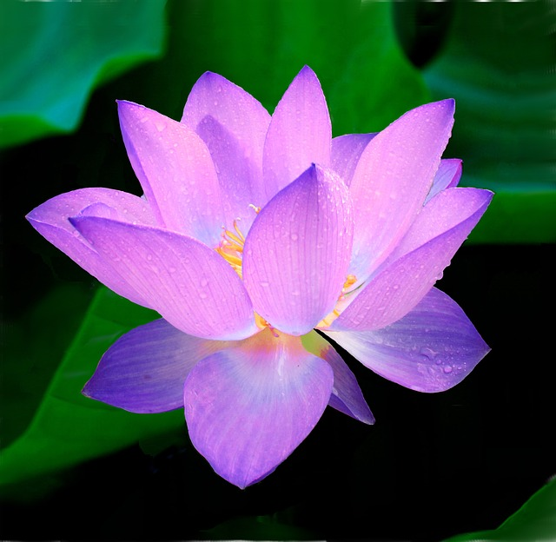
What is Mindfulness?
The lotus flower awakening, spiritual growth and enlightenment

Slide 11
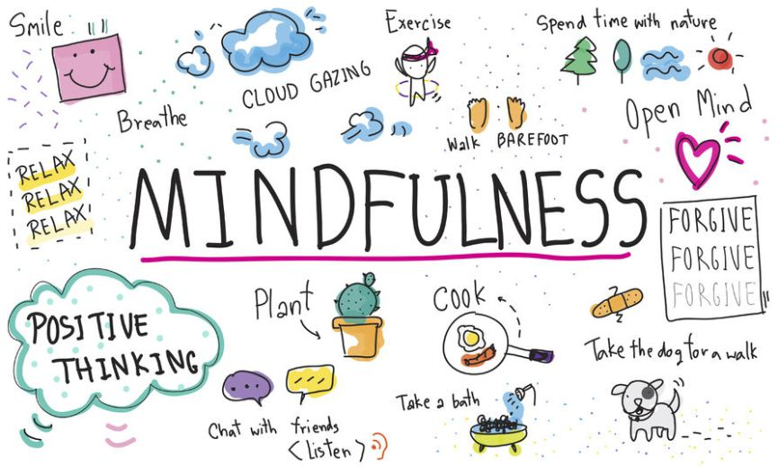

Slide 12
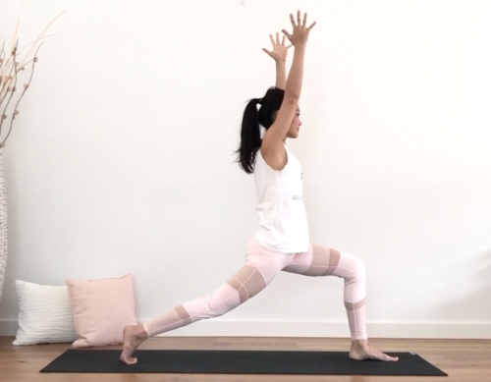
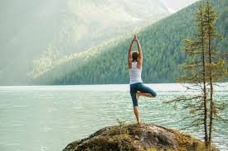
Yoga and its Benefits
We are going to show you some yoga poses

Slide 13
Keeping clean
Keeping your teeth clean
This Photo by Unknown author is licensed under CC BY.
This Photo by Unknown author is licensed under CC BY-NC.
This Photo by Unknown author is licensed under CC BY.
This Photo by Unknown author is licensed under CC BY-SA-NC.

Slide 14
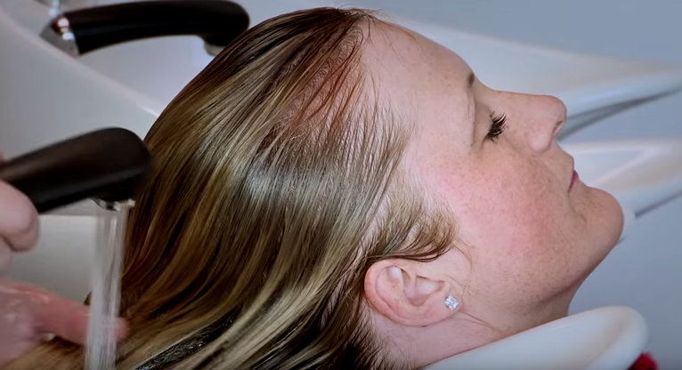
Keeping clean KEEPING YOUR HAIR CLEAN

Slide 15
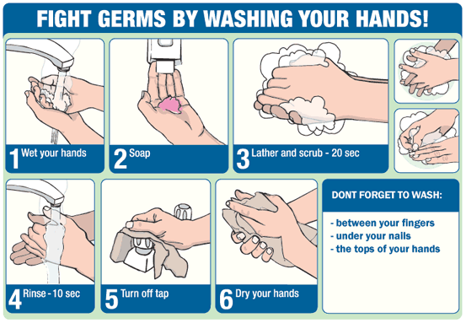
Keeping clean Keeping your body clean!
This Photo by Unknown author is licensed under CC BY-ND.
This Photo by Unknown author is licensed under CC BY-NC-ND.
This Photo by Unknown author is licensed under CC BY-NC.
This Photo by Unknown author is licensed under CC BY-NC.
This Photo by Unknown author is licensed under CC BY-NC-ND.

Slide 16
Keeping clean
Keeping your clothes, dishes and room clean
This Photo by Unknown author is licensed under CC BY-SA.

Slide 17
Water
safety
This Photo by Unknown author is licensed under CC BY-SA-NC.

Slide 18
Here are some things you might like to know
Road safety

Slide 19
Sun safety
This Photo by Unknown author is licensed under CC BY.
Here are some things you might like to know.

Slide 20
How to be a good friend

Slide 21
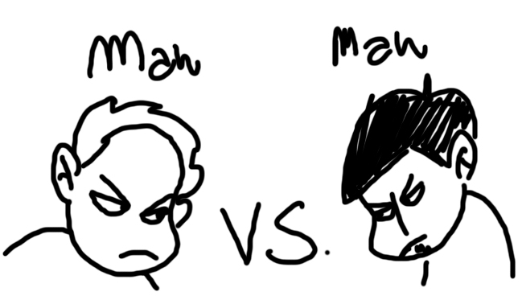
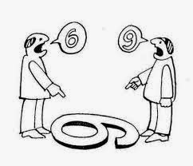
How to deal with conflict.

Slide 22
How to deal with bullying.

Slide 23
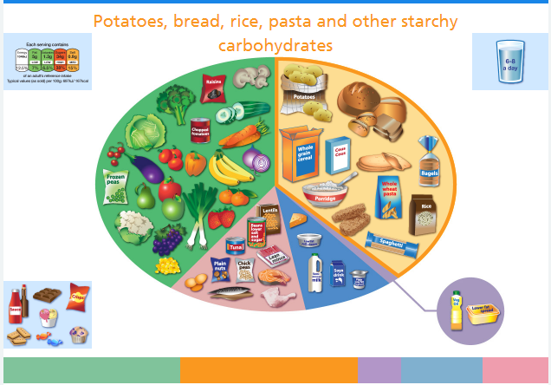
https://www.nhs.uk/live-well/eat-well/the-eatwell-guide/

Slide 24
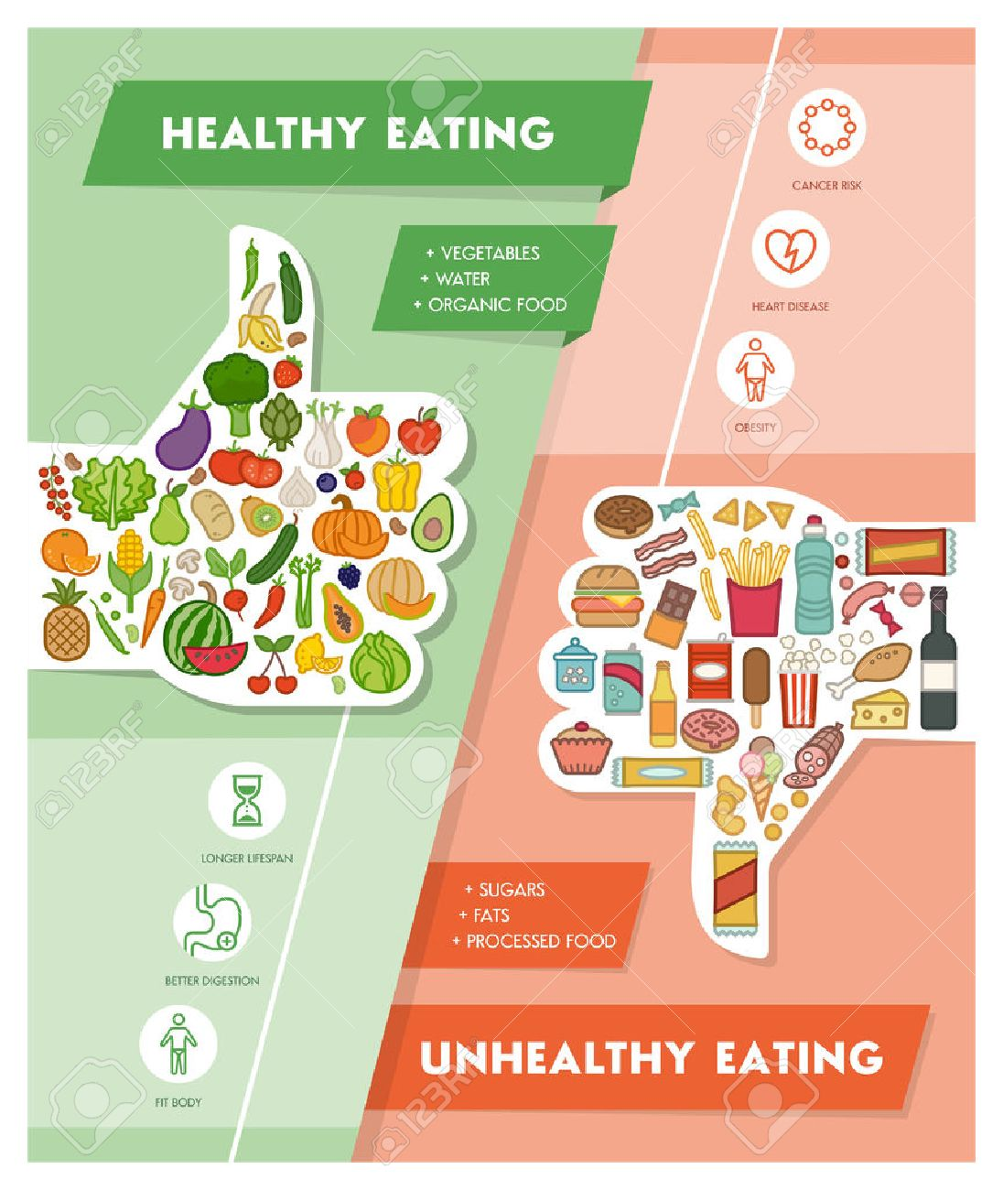
Healthy Diet
VS
Unhealthy Eating

Slide 26
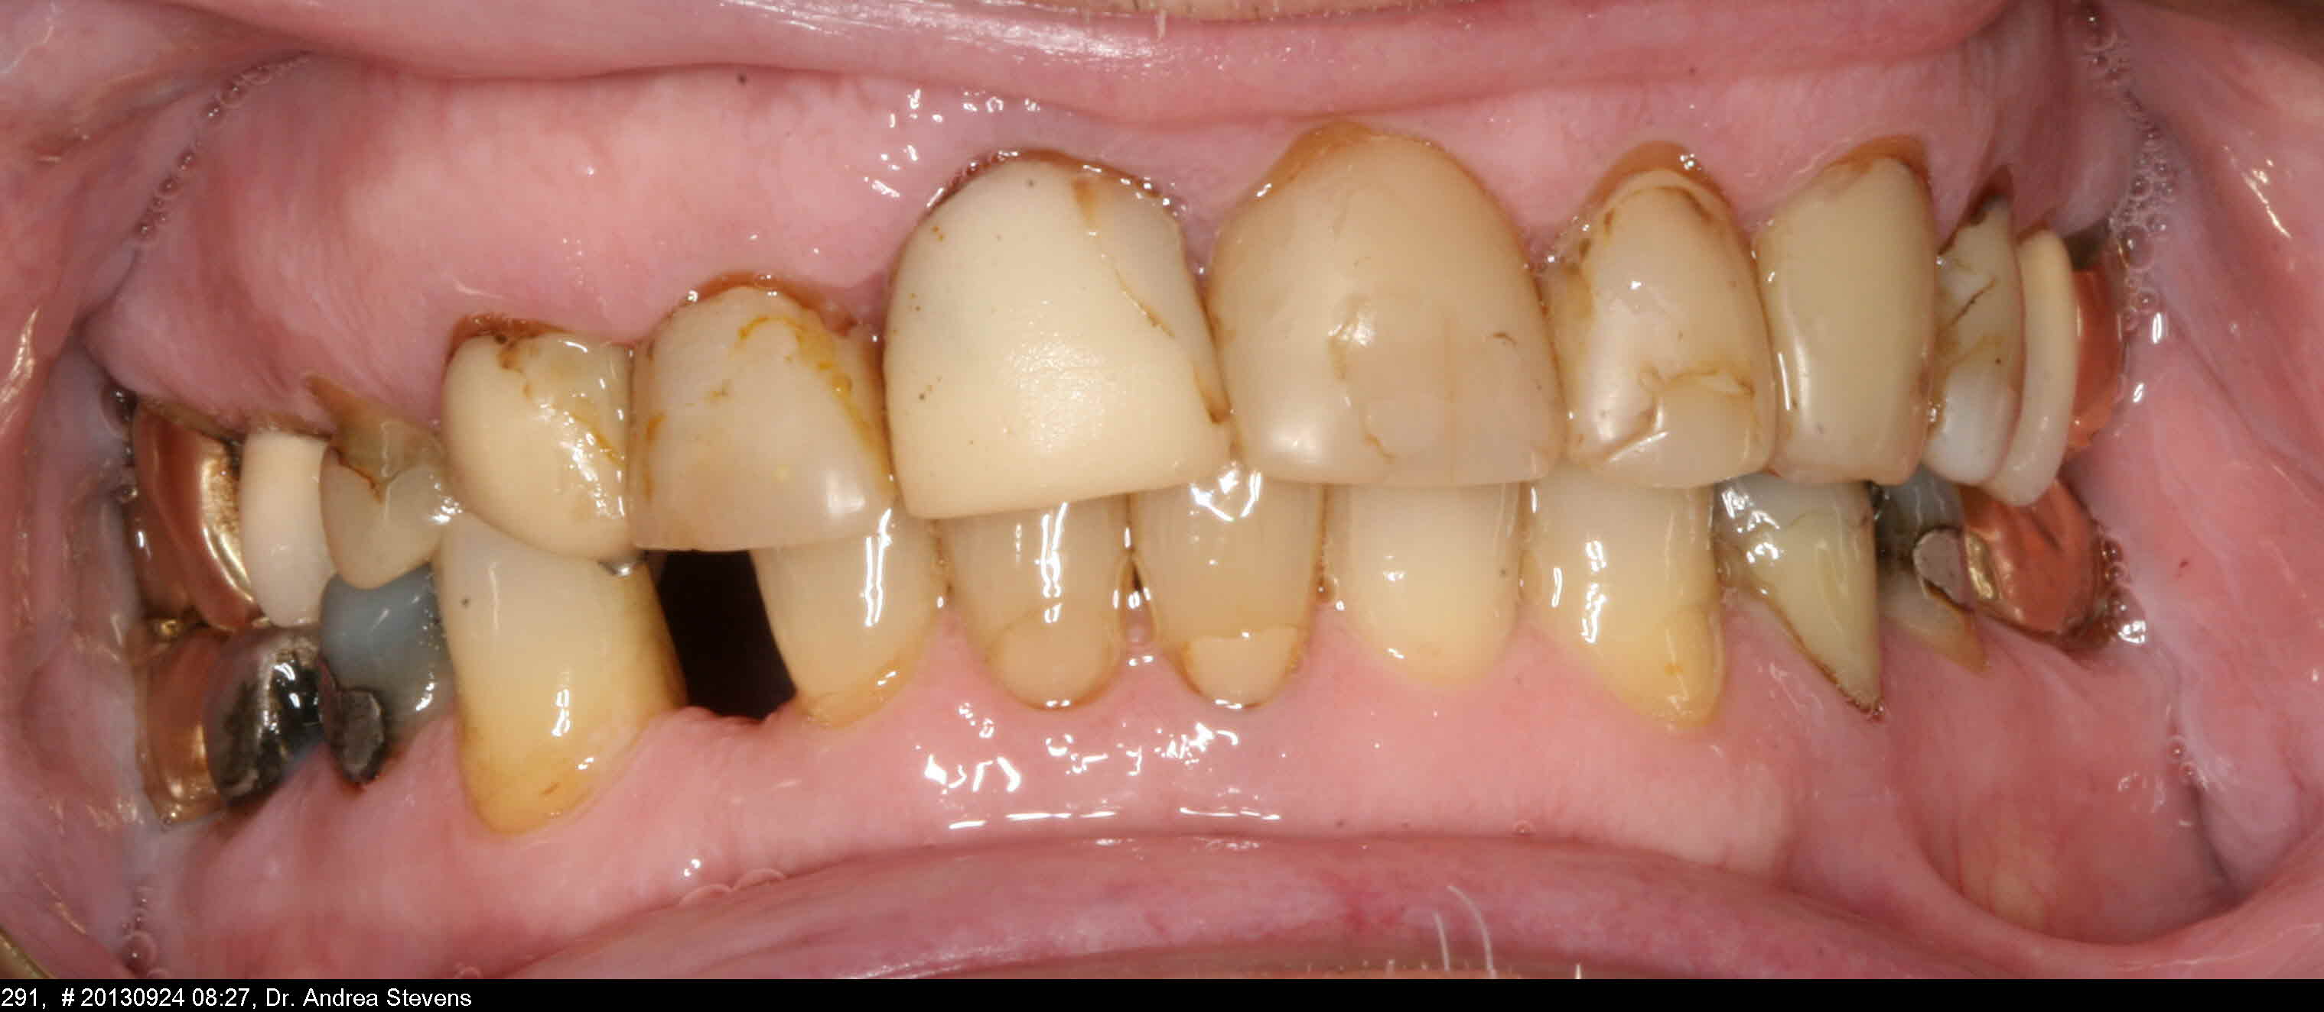
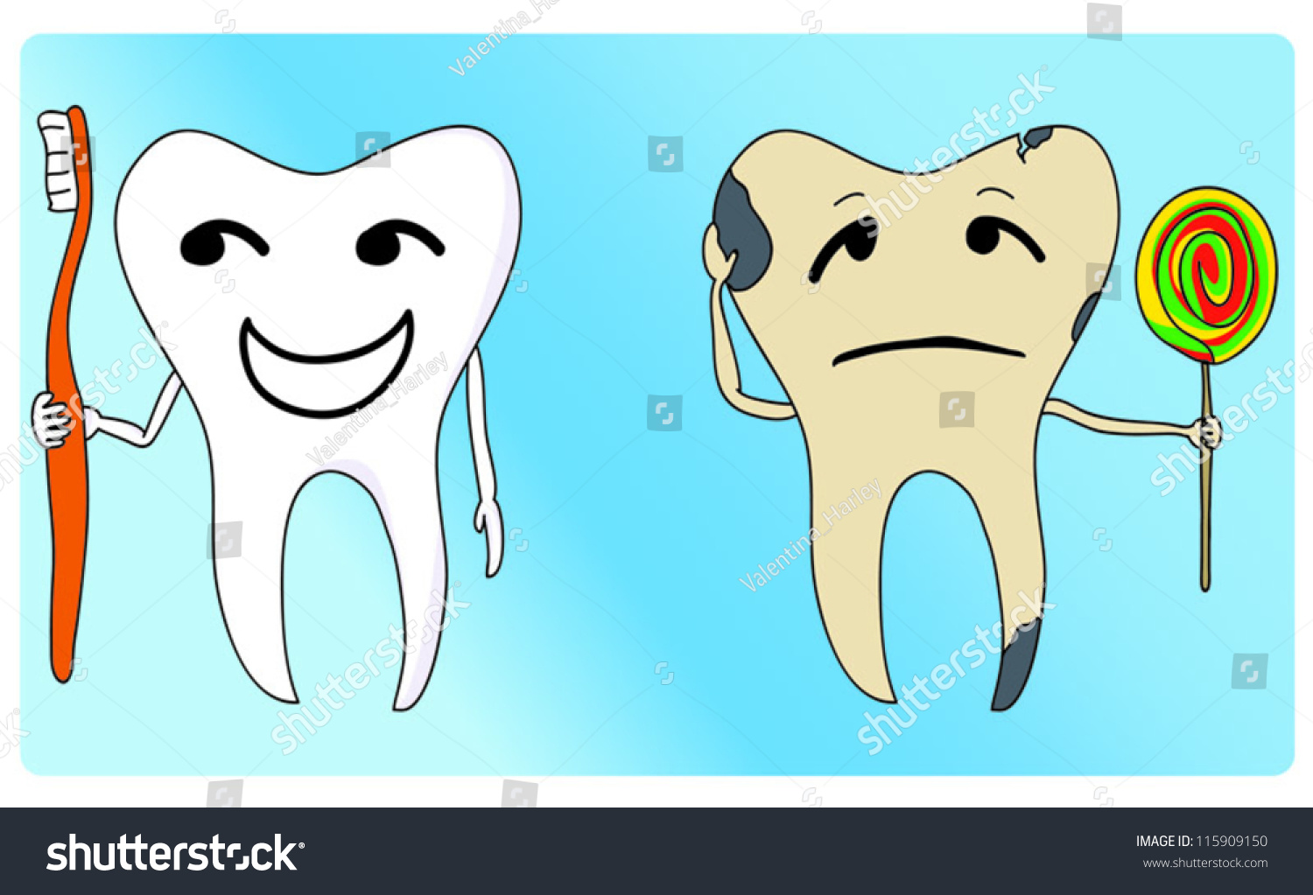

Slide 28
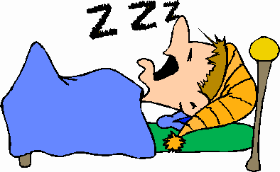
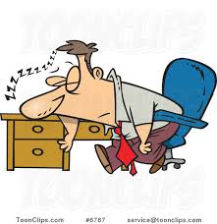

Slide 30
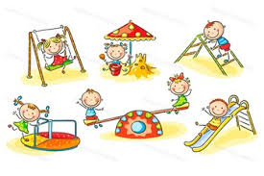

Slide 31
Skills for life

Slide 32
MATHS AND WRITING

Slide 33
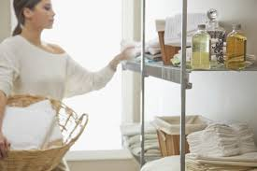
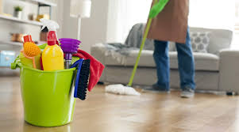
Home skills
These are some skills that you will need at home :
Cooking
Washing and drying
Cleaning
Organization
Tidying

Slide 34
Hopes for the future
We have these aspirations …

