Slide 1
Westfield & Torphichen Primary Schools
22nd – 26th May 2017

Slide 2
Photo Slideshow

Slide 3
Scripture Union Scotland
Worldwide Christian Organisation (Now in 120 countries)
School residential experiences for over 20 years (Alltnacriche and Lendrick Muir)
Schools – assemblies, classes, extra-curricular groups, in around 16% of Scotland’s schools
SU Holidays for 10 – 18 year olds

Slide 4
Lendrick Muir
120 acres of woodland and parkland
Central location near Kinross
150 beds
3 units
Opened in 1999
Over 30 onsite activities
Christian ethos

Slide 5
Safety
Participate in new activities and experiences
Risk benefit analysis
License to provide adventurous activities (www.hse.gov.uk/aala)
First Aid trained staff

Slide 6
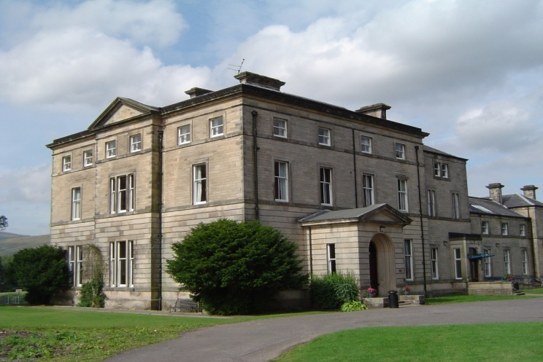
Typical Day
Get Up
8:30am Breakfast
9:30am Activity 1
11:00am Activity 2
12:30pm Lunch
1:30pm Activity 3
3:00pm Activity 4
4:30pm Time for Reflection
5:30pm Dinner
7:15pm Evening Activity
8:30pm Supper
9:00pm Bed Time

Slide 7
Map of Activities
High Ropes
Trail Bikes
Archery
Water Sports
Tree Climb
Low Ropes
Team Challenges
Bouldering
Bungee Trampolines
Adventure Park

Slide 8
Free Time
Adventure Park
Astro-turf Pitch
Football Pitch
Sports Hall
Beach Volley Ball (Easter Holidays– October Holidays)
Indoor Games

Slide 9
Accommodation
Centre can accommodate up to 150 people
Splits into 3 self-contained units
Bedrooms are dormitory style (2-12 beds)
Mix of bunks and single beds
Make their own beds on arrival
Toilets and showers near bedrooms

Slide 10
Food and Allergies
Allergen information posters are in each dining room
We ask for relevant dietary information before the group arrive

Slide 11
Curriculum for Excellence
We work within the Curriculum for Excellence
Programme tailored to your school
Activities chosen by the school

Slide 12
Your Programme
Westfield & Torphichen Primary Schools
8th – 10th February 2017
 | Monday |  |  |  |  |  | Tuesday |  |  |  |  |  | Wednesday |  |  |  |  |  | Thursday |  |  |  |  |  | Friday
 |  |  |  |  |  |  |  |  |  |  |  |  |  |  |  |  |  |  |  |  |  |  |  |  | Bags and Bedding
08:30 |  |  |  |  |  |  | Breakfast |  |  |  |  |  | Breakfast |  |  |  |  |  | Breakfast |  |  |  |  |  | Breakfast
09:30 |  |  |  |  |  |  | Jacobs Ladder | Nightline | Tree Climb | Search and Rescue | Search and Rescue | Search and Rescue | Adventure Park | Tree Climb | Mini-Survival | Orienteering | Archery | Trail Bikes | Team Challenges and Rocket Launch |  |  |  |  |  | Farewell Fun Leave LM 11:00
11:00 | Arrive 10:30 Settle in and Site Orientation |  |  |  |  |  | Nightline | Jacobs Ladder | Orienteering |  |  |  | Orienteering | Adventure Park | Jacobs Ladder | Mini-Survival | Trail Bikes | Archery
12:30 | Lunch |  |  |  |  |  | Lunch |  |  |  |  |  | Lunch |  |  |  |  |  | Lunch
13:30 | Search and Rescue | Search and Rescue | Search and Rescue | Archery | Mini-Survival | Tree Climb | Trail Bikes | Archery | Low Ropes | Jacobs Ladder | Adventure Park | Orienteering | Mini-Survival | Orienteering | Adventure Park | Tree Climb | Nightline | Low Ropes | Archery | Low Ropes | Trail Bikes | Nightline | Jacobs Ladder | Adventure Park
15:00 |  |  |  | Low Ropes | Tree Climb | Mini-Survival | Low Ropes | Trail Bikes | Archery | Adventure Park | Orienteering | Jacobs Ladder | Tree Climb | Mini-Survival | Nightline | Trail Bikes | Low Ropes | Nightline | Land Grab
16:30 | Time for Reflection HWB |  |  |  |  |  | Time for Reflection HWB |  |  |  |  |  | Time for Reflection |  |  |  |  |  | Time for Reflection HWB
17:00 | Free Time |  |  |  |  |  | Free Time |  |  |  |  |  | Dinner |  |  |  |  |  | Free Time
17:30 | Dinner |  |  |  |  |  | Dinner |  |  |  |  |  | Perth Swimming Pool - Teacher Led |  |  |  |  |  | Dinner
18:30 | Free Time |  |  |  |  |  | Free Time |  |  |  |  |  |  |  |  |  |  |  | Free Time
19:30 | Inflatables |  |  |  |  |  | Murder Mystery |  |  |  |  |  |  |  |  |  |  |  | Cheesy Disco
20:30 | Supper |  |  |  |  |  | Supper |  |  |  |  |  | Supper |  |  |  |  |  | Supper

Slide 13
Kit List
5 pairs of trousers
(denim jeans are not suitable)
4 long sleeved tops
5 t-shirts
4 warm jumpers
6 pairs of socks
5 sets of underwear
1 pair of shorts
Warm nightwear
Waterproof jacket
Waterproof trousers
Hat & gloves
Wash kit
Large towel
Training shoes for indoor use (not slippers)
2 pairs tough outdoor shoes/boots
(wellies suitable as one pair)
Water bottle
Slippers
Small backpack

Slide 14
We look forward to welcoming you soon!
Questions?
More Info:
www.classroomoutdoors.org.uk

