Slide 1
Click on the sound picture on each page to hear me read the page to you.

Slide 2
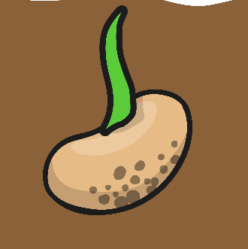
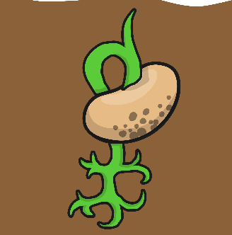
Shoots
Seeds
1
Roots
5
Bean
Plant
2
4
3
Flowers
Leaves

Slide 3
1. Shoots
The seed starts to grow when it is warm enough and it has had enough water.

Slide 4
2. Roots
Roots start to grow, usually underground, that helps the plant become strong in the ground.

Slide 5
3. Leaves
A stem grows from the ground and leaves start to grow. The leaves are important to the plant as they help the plant makes its own food from sunlight.

Slide 6
4. Flowers
Some plants will grow bright flowers. In the middle of the flowers are yellow parts covered in pollen. The pollen in the flowers is used to make seeds. Sometimes the pollen can make people sneeze!

Slide 7
5. Seeds
When the plant has finished growing seeds, they are dropped to the ground or the wind blows them away. This lets a new plant grow next year.

Slide 8
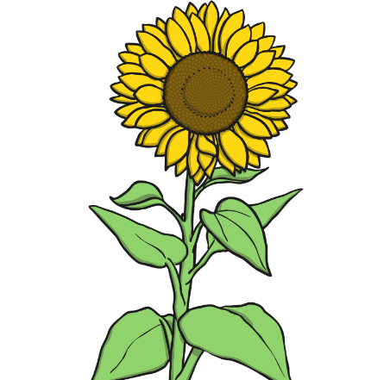
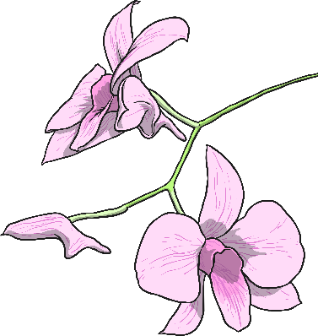
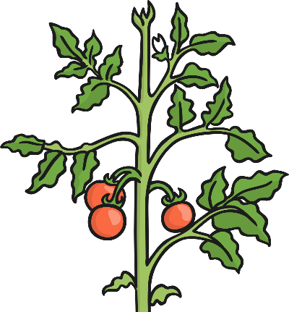
Other Flowering Plants
Sunflower
Orchid
Tomato plant

