Slide 1


Healthy Living
Click on the sound picture on each page to hear me read the page to you.

Slide 2
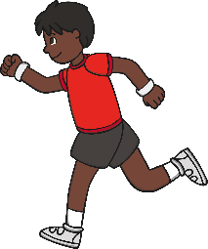
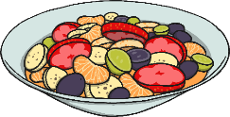
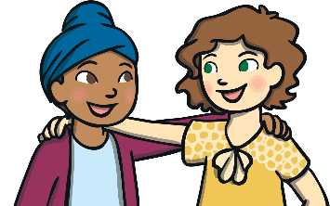
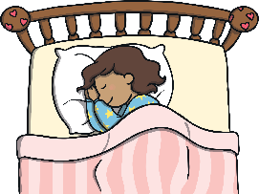

Staying Healthy
There are many ways to stay healthy.
Some of these ways are:
Exercising regularly
Eating healthily
Having a happy attitude
Getting enough sleep

Slide 3
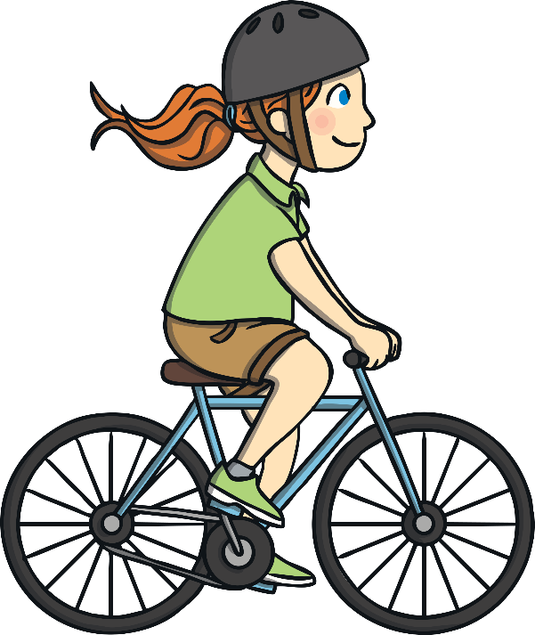
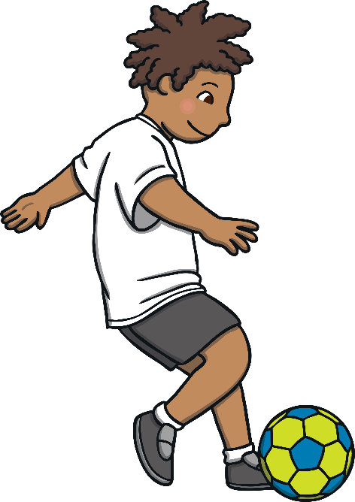
Exercising Is Fun!
Doing regular exercise will help us all feel great and keep our bodies strong!
Our hearts need to be kept
active. When you do exercise you might feel your heart beating in your chest quicker or stronger.

Slide 4
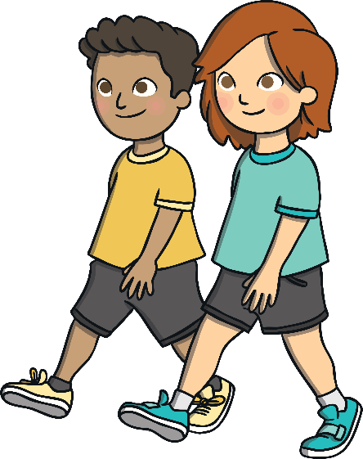
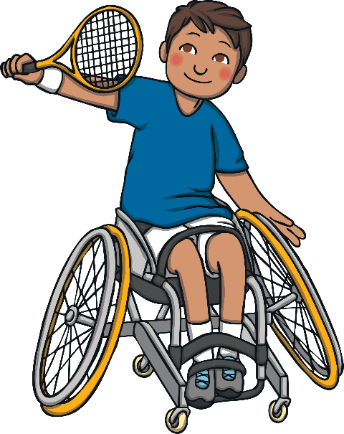
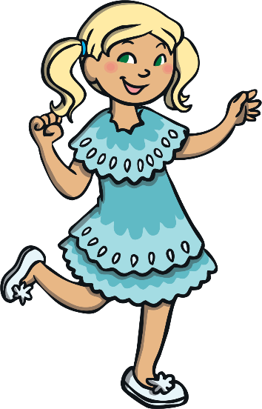
Ways to Stay Active:
Walking
Playing games
Dancing
What are your favourite ways to stay active?

Slide 5
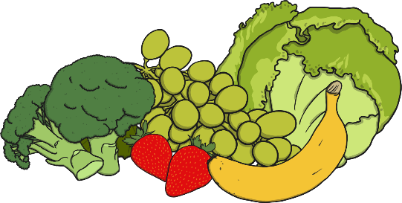

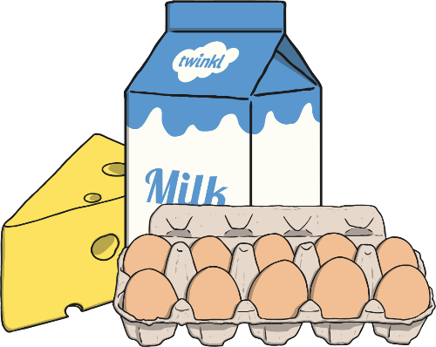
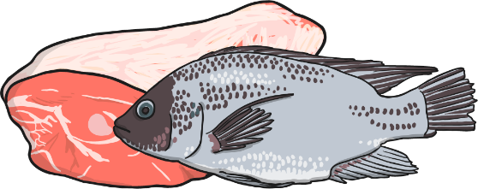
Healthy Foods
Food gives us the energy we need to do all our daily activities. We need to eat lots of different types of food so we get the right types of energy in our bodies.
Fruit and vegetables
Rice, Pasta, Potatoes, Bread and Cereals
Eggs, milk and cheese
Fish and meat or alternatives

Slide 6
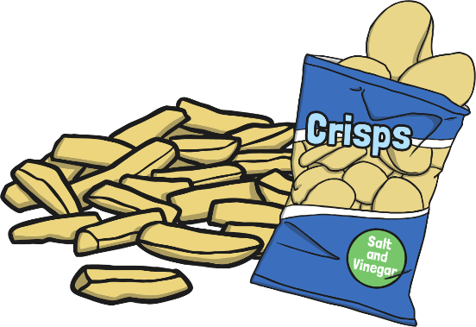
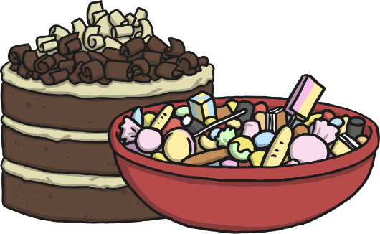

Unhealthy Foods
Some foods can be unhealthy for us if we eat them too much and can make our bodies unwell. We should keep these foods for a treat.
Cakes and sweets
Chocolate
Chips and crisps

Slide 7
Having a happy attitude
Doing things that make us feel good about ourselves can really help to keep our bodies and minds healthy. There are lots of ways to find happiness. You could:
Play with your family or friends
Spend time with your pets
Read a book
Draw a picture
Watch your favourite film
Get a hug from someone in your
family
Think about what you can do that
makes you happy.

Slide 8
Getting enough sleep
You need sleep to let your body rest, to help your body grow and to let your brain understand everything it has seen or listened to during the day.
If you don’t get enough sleep, you might be too tired to enjoy the next day and it might make you grumpy.
Children need to get more sleep
that adults.

