Slide 1

Click on the sound picture on each page to hear me read the page to you.

Slide 2


The Sun
The sun gives off different types of energy.
It gives us light that we can see and gives
us heat which makes our skin feel warm.
The sun is very important to us but it can damage our skin if we get too much of it. This damage can be caused by Ultraviolet light, sometimes called UV rays.

Slide 3
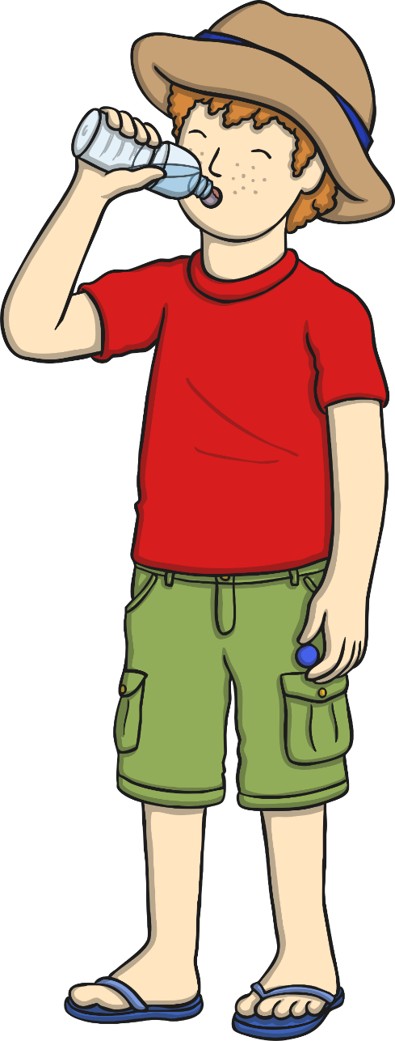
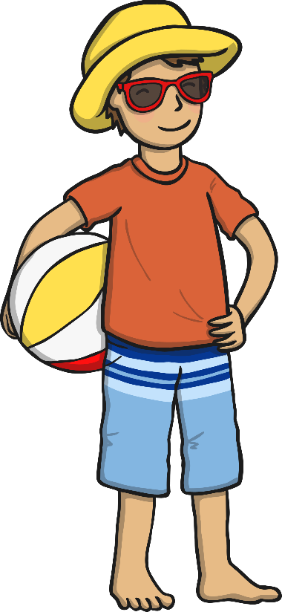
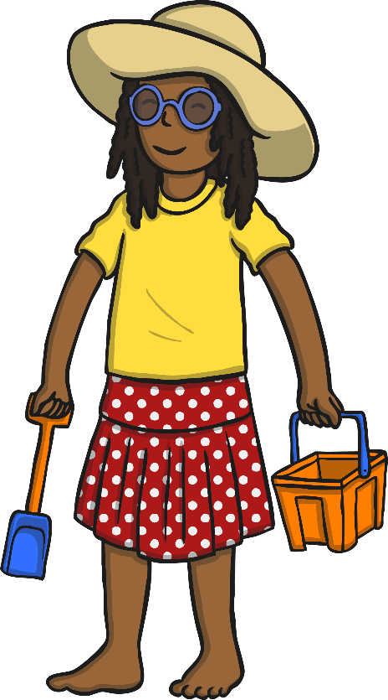
Your Skin and UV Rays
Being outside in the sunshine can be great fun, but we need to make sure that we protect our skin from the UV rays.
Everyone needs to look after their skin.
If you’ve got fair skin, or moles and freckles,
you’ll need to take extra care to protect
your skin.

Slide 4

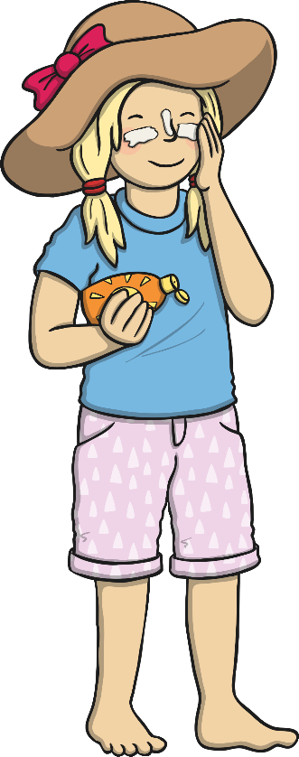
Sun Safety Code
Be SMART!
We should all follow a special code
which reminds us how to enjoy the
sun safely.
There are five things to remember…

Slide 5

Shade
You should spend time in the shade when the sun is at its strongest - between 11am and 3pm.
You can find shade under:
- trees
canopies
umbrellas
indoors

Slide 6
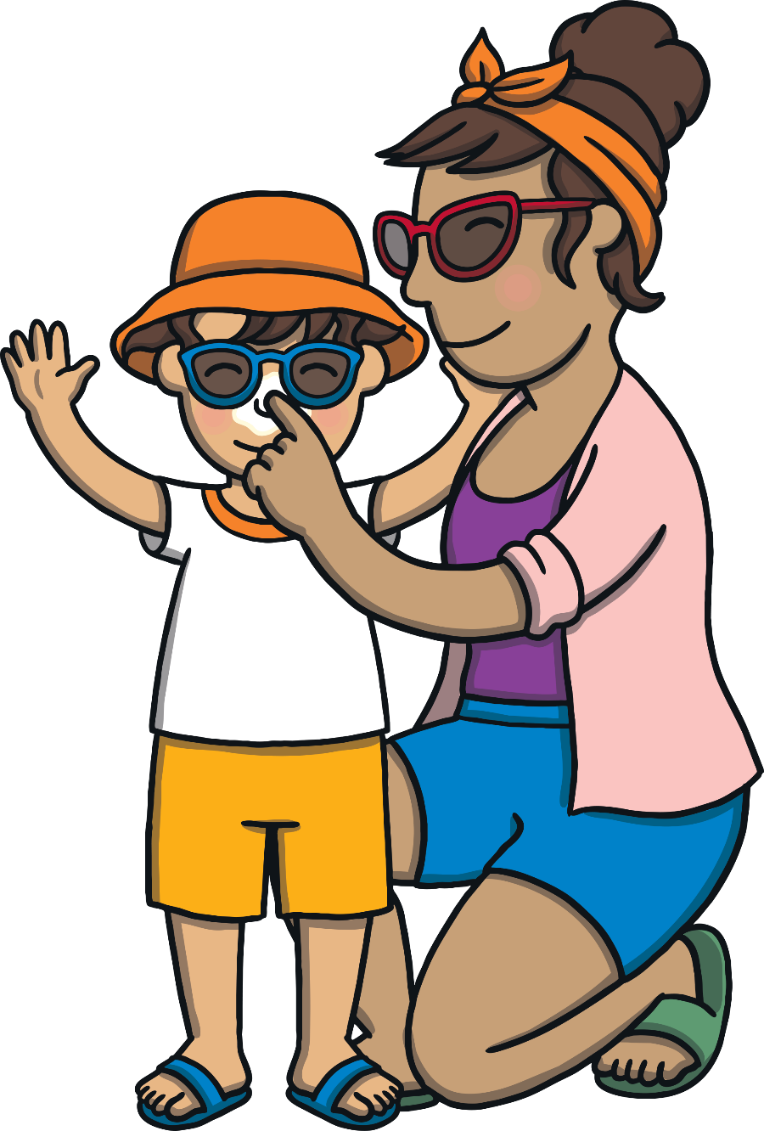
Never Burn
It’s easy to get sunburnt, even when you’re
not expecting to because we cannot
see UV rays.
It’s very important to avoid
burning your skin.
Remember
You can still burn on a cloudy day.

Slide 7
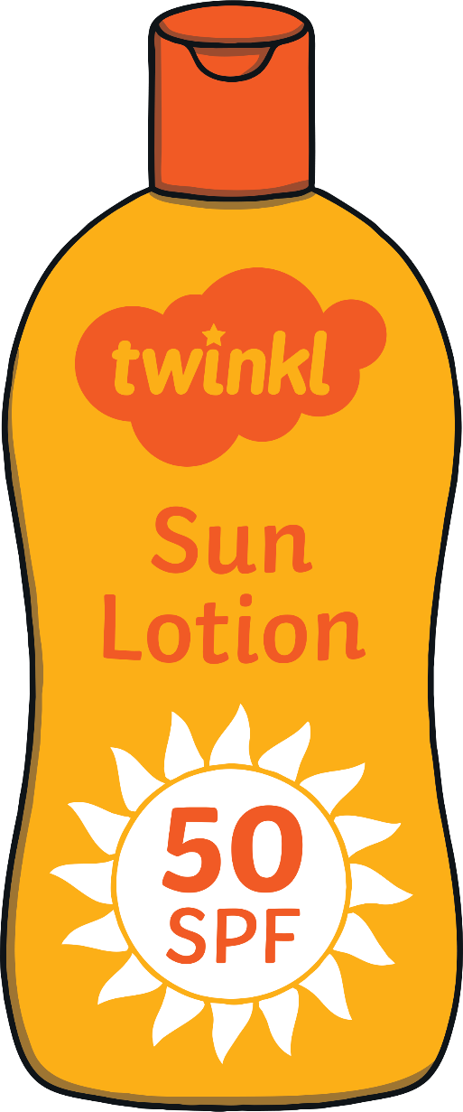
Use Sunscreen or Suntan Lotion
When we are outside a lot, we should wear
some sunscreen or suntan lotion to help
protect our skin from the UV rays and
stop us from getting burned.
We should put suntan lotion on any
parts of our body that the sun might see.
Suntan Lotion bottles have a number on
them. The bigger the number, the more
protection it gives our skin. Look for
bottles with a number 30 or bigger.
3

Slide 8


Cover up
A hat with a wide brim will shade your face and neck.
Sunglasses can help to protect your eyes from UV rays.
Covering up with a T-shirt is a good way to protect your shoulders and upper arms.

Slide 9
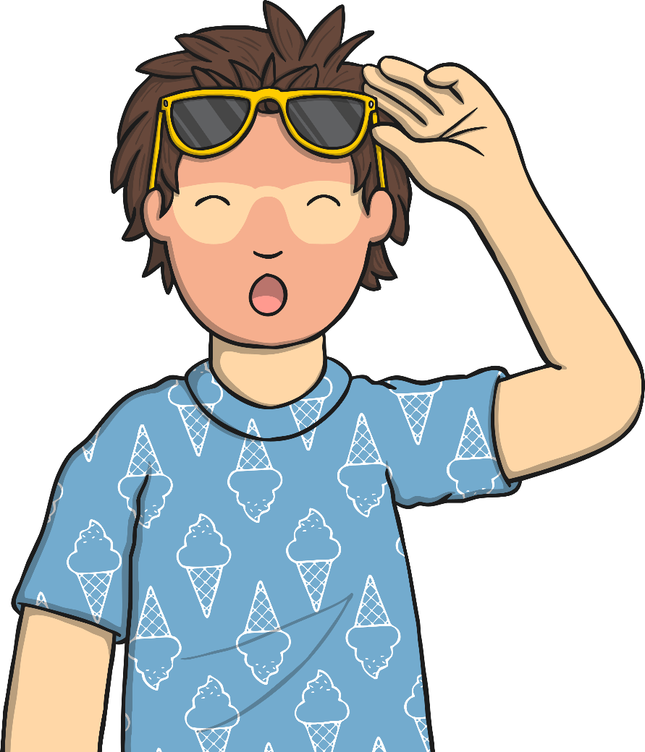
Children Need to Take Extra Care
Young skin is very delicate and easily damaged by the sun.
Make sure you take extra care to
protect yourself when playing
outside.
If you have any young brothers
or sisters, make sure that they
are protected from the sun too!

