Slide 1
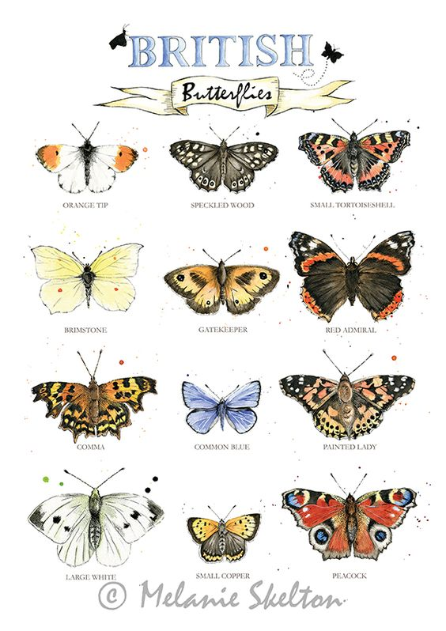
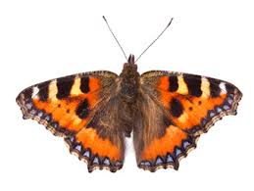
I am learning to use symmetry in my art work
Have you spotted any butterflies yet?
Which butterflies have you seen?
What do you notice about butterflies?
Think about lines, shapes, colours and space.

Slide 2
I am learning to use symmetry in my art work
Butterflies wings are symmetrical.
If I drew a line through the middle of the butterfly, we can see each wing is the same, a mirror image.
The wings are the same shape.
The lines, shapes, patterns and colours on each wing are also the same.

Slide 3
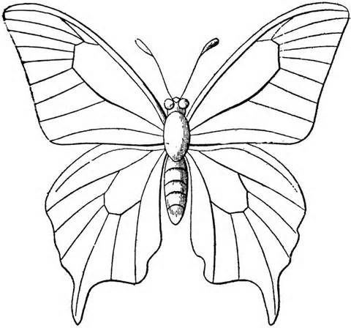
I am learning to use symmetry in my art work
This week we are going to explore and create some symmetrical art.
The next slides have ideas for you to explore.
If you have a printer:
print slide 5: draw and colour your own symmetrical butterfly
print slide 6: design your own symmetrical butterfly wings with lines, shapes and colour
Click the link for free printable symmetry sheets
https://www.artforkidshub.com/5-free-symmetry-art-activity/
If you don’t have a printer ask an adult to draw the outline of a butterfly for you.

Slide 4
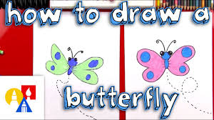
I am learning to use symmetry in my art work
Click the link and have a go at the guided drawing:
Art for kids hub: How To Draw A Cartoon Butterfly + SYA!
https://www.youtube.com/watch?v=pDxtH-OkFxU

Slide 5
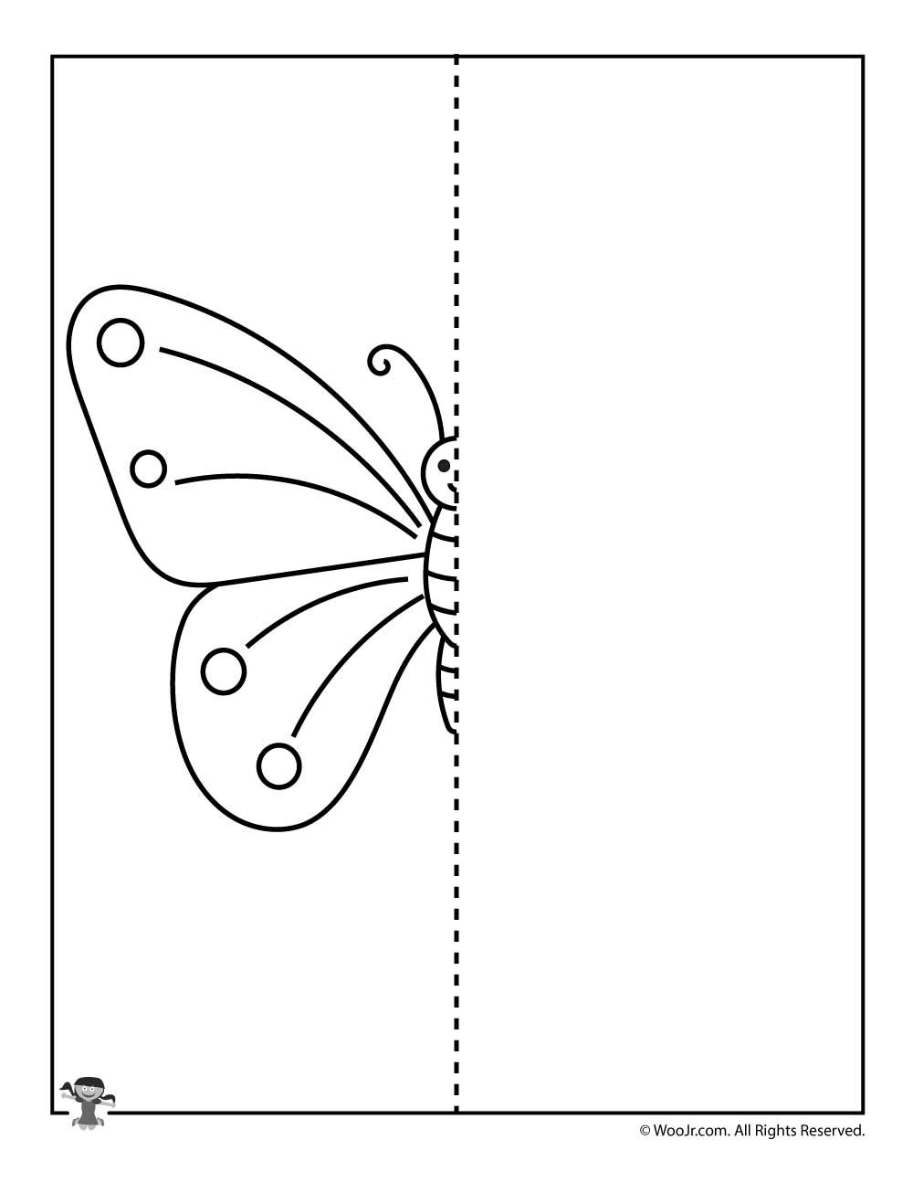

Slide 6
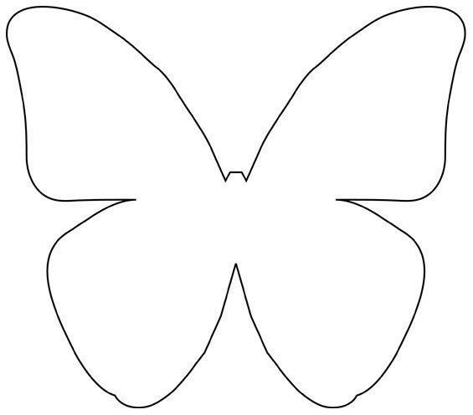

Slide 7
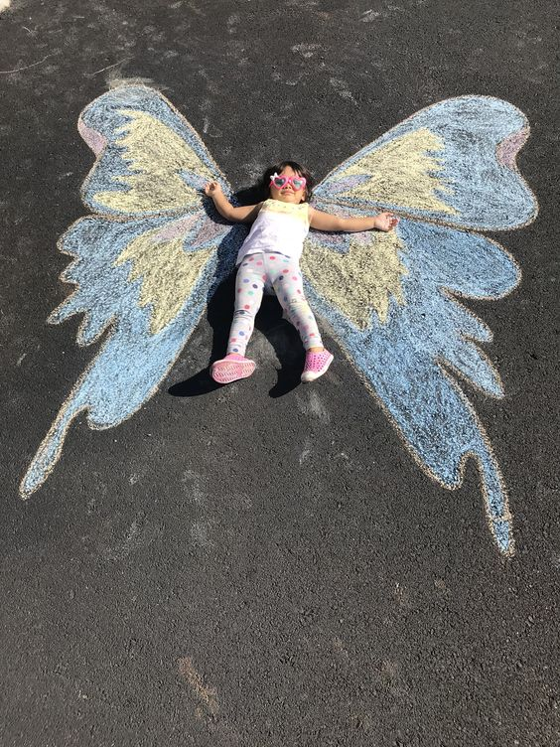
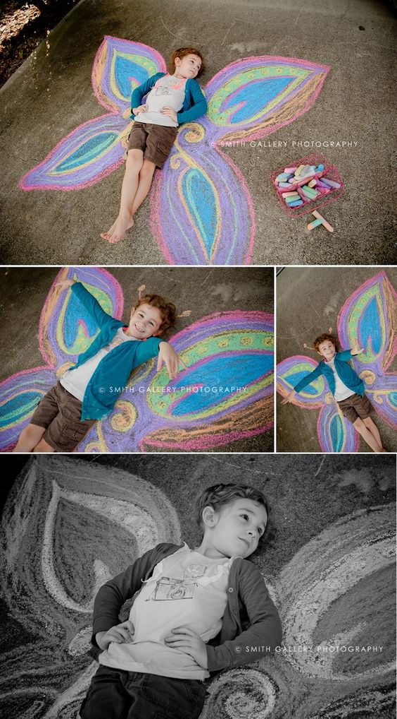
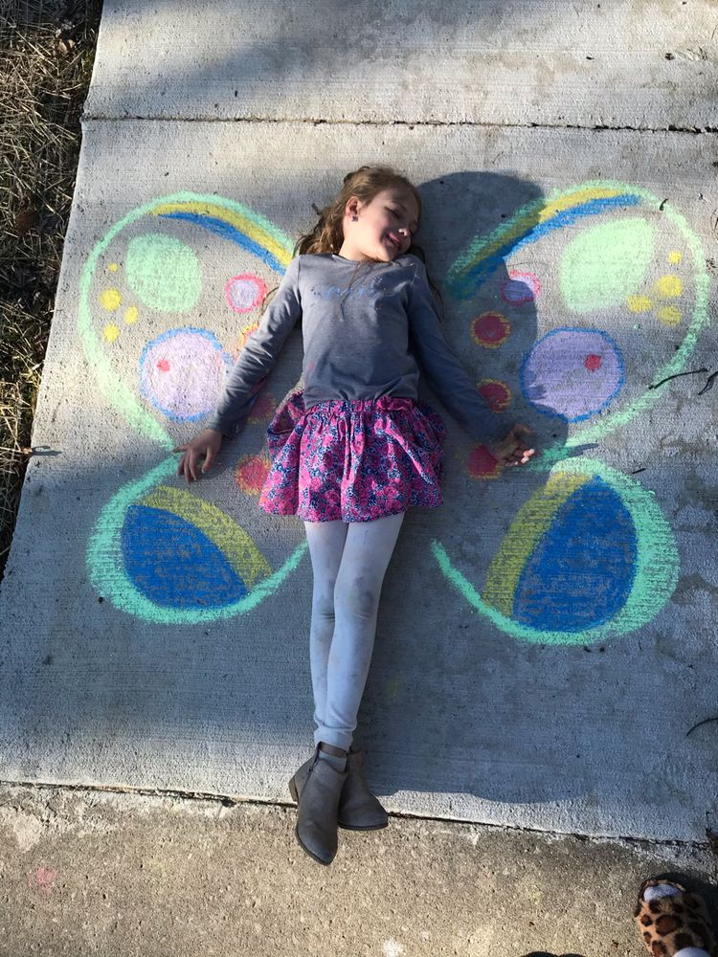
I am learning to use symmetry in my art work
If you have chalk draw your own giant symmetrical butterfly wings

Slide 8
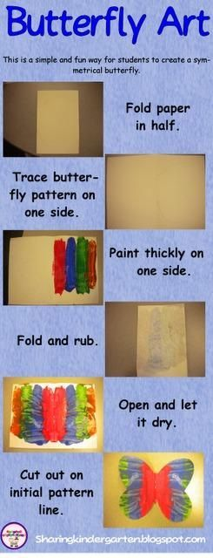
I am learning to use symmetry in my art work
If you have paint have a go at creating this symmetrical butterfly.

