Slide 1
Click on the sound picture on each page to hear me read the page to you.

Slide 2
Click on a picture to learn more about the pirate.
William Kidd
Anne Bonney
Blackbeard
Black Bart
Click on this button to come back to this page.

Slide 3
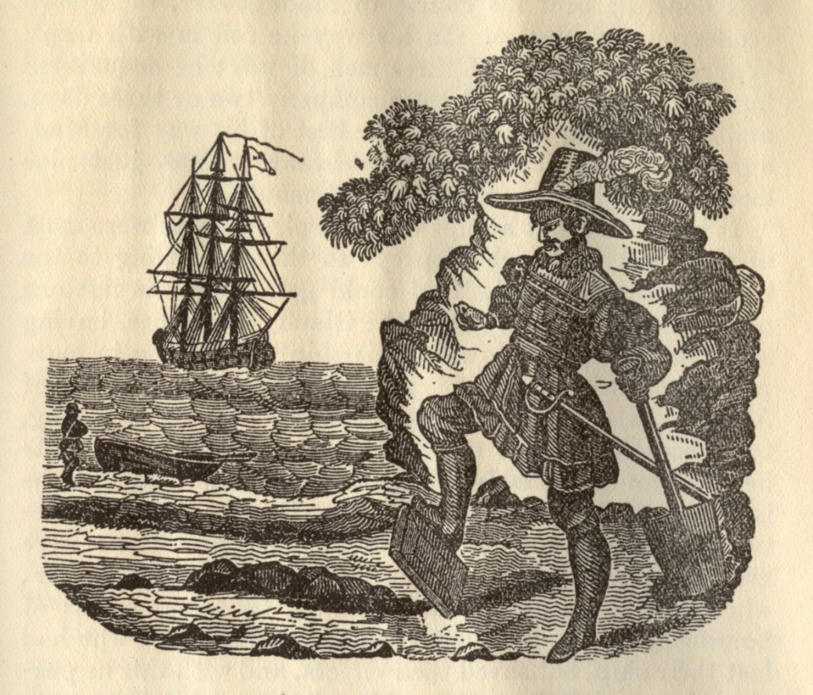
Captain William Kidd
Born:
1645, Dundee, Scotland
Died:
23rd May 1701

Slide 4
Interesting Facts
William Kidd was actually a wealthy and well respected sailor, protecting the British and American trade routes from French warships before he became a pirate.
Kidd was very unlucky as he was forced into becoming a pirate by his crew whilst on duty. It was also at this time that the American people became very fed up with all pirates. This led to him being sentenced to death when caught.
Kidd was the only pirate known to have ever buried any treasure on Long Island, New York. It was thought that he did this in the hope of buying his way out of capture!

Slide 5
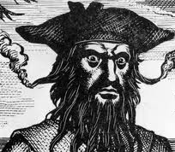
Captain Blackbeard
Born: 1680
Died: 22nd November 1718.
He was shot.

Slide 6
Interesting Facts

Slide 7
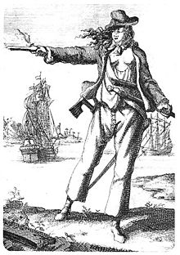
Anne Bonny
Born:
8th March 1698
Died:
22nd April 1782

Slide 8
Interesting Facts
Anne acted and dressed just like a male pirate and was excellent at fighting.

Slide 9
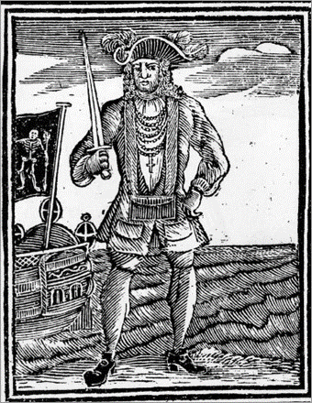
Black Bart
Born:
17th May 1682
Died:
10th February 1722

Slide 10
Interesting Facts
He was born in South Wales as John Roberts and later adopted the name 'Bartholomew', or Black Bart, when he became a pirate.
He was known to love expensive clothes and jewellery and was always well-dressed, even in battles!
He was eventually killed by the British Government, and his crew were put on trial in the biggest pirate trial in history!

Slide 11
Pirate Questions
What did William Kidd do before he became a pirate?
Who was Anne Bonny the girlfriend of?
How many times did Blackbeard marry?
Who killed Black Bart?

