Slide 1
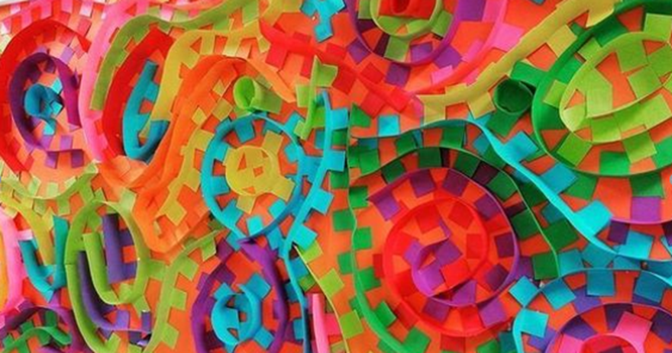
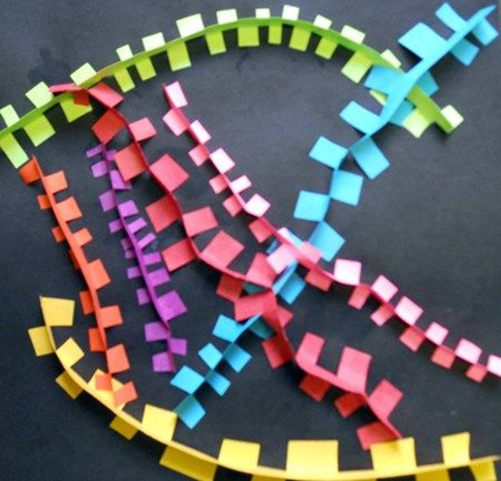
Paper sculptures
We are learning to form paper to make 3d sculptures.

Slide 2
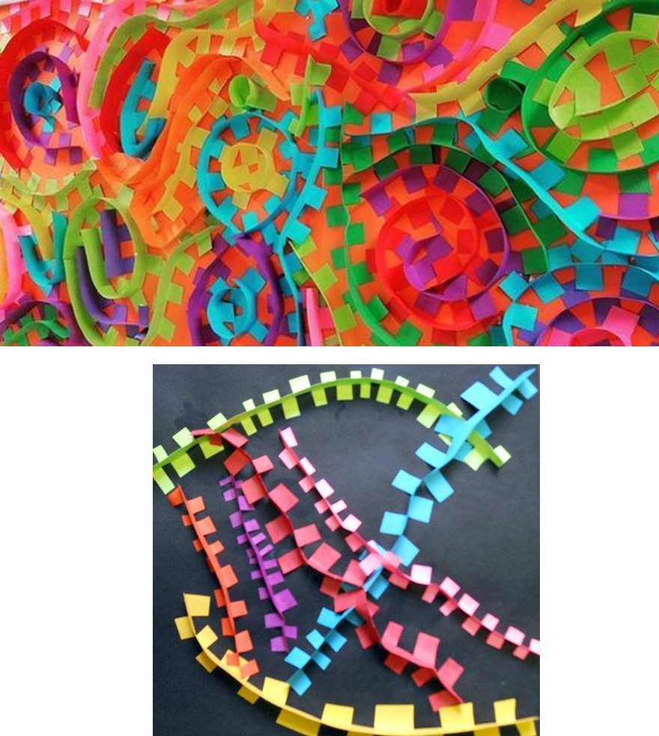
Paper sculptures
You will need:
A grown up
Strips of paper (coloured/white paper, wrapping paper, newspaper, old comics, anything will do, be creative!)
A4 sheet of paper for your background or a bigger sheet if you want
Scissors
Glue stick

Slide 3
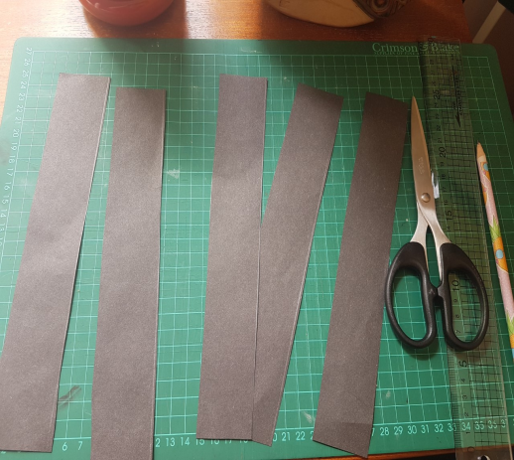
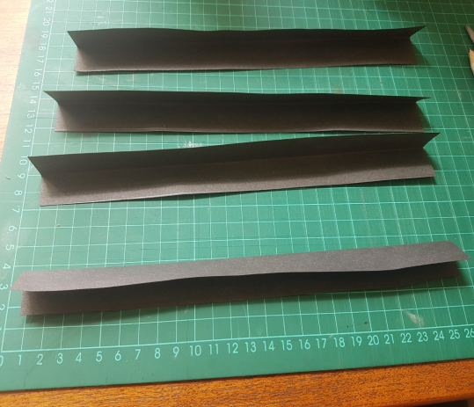
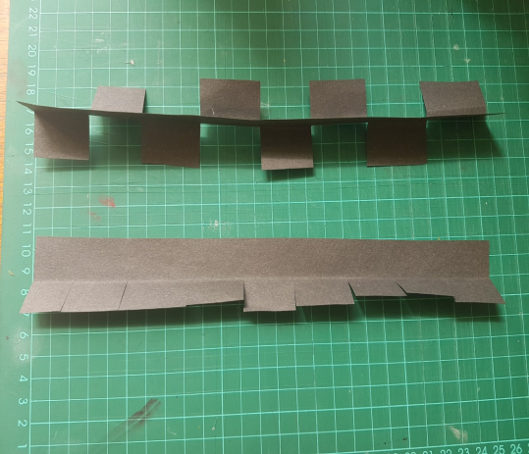
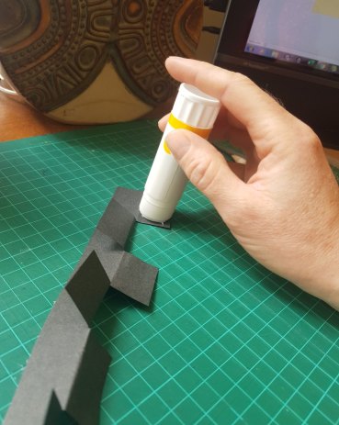
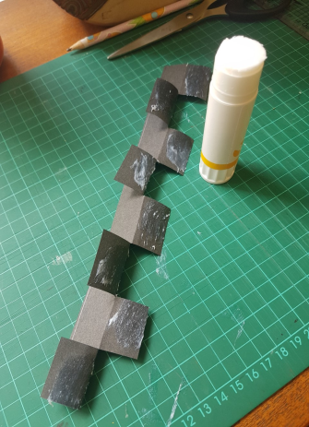
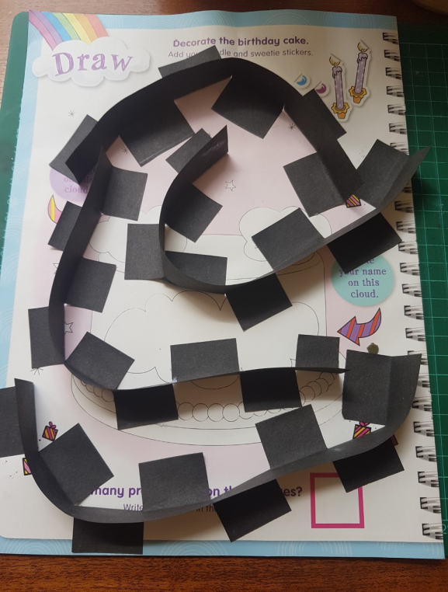
Paper sculptures
1. Cut strips of paper
You will need a grown up to help.
They can be different sizes or you could keep them the same size, experiment!
2. Fold your strips in half
You might need a grown up for this bit too.
3. Cut tabs up to the fold and along the strip of paper.
Now fold your tabs so they go in opposite directions.
I think you can do this with a grown up watching you.
4. Carefully apply glue to the back of the tabs.
I know you can do this part on your own.
Watch the tabs don’t rip off.
5. Arrange the tabs so your paper has a 3D curve and press onto your background paper.
Enjoy doing this part on your own.
You can make your own design.

