Slide 1
Click on the sound picture on each page to hear me read the page to you.

Slide 2
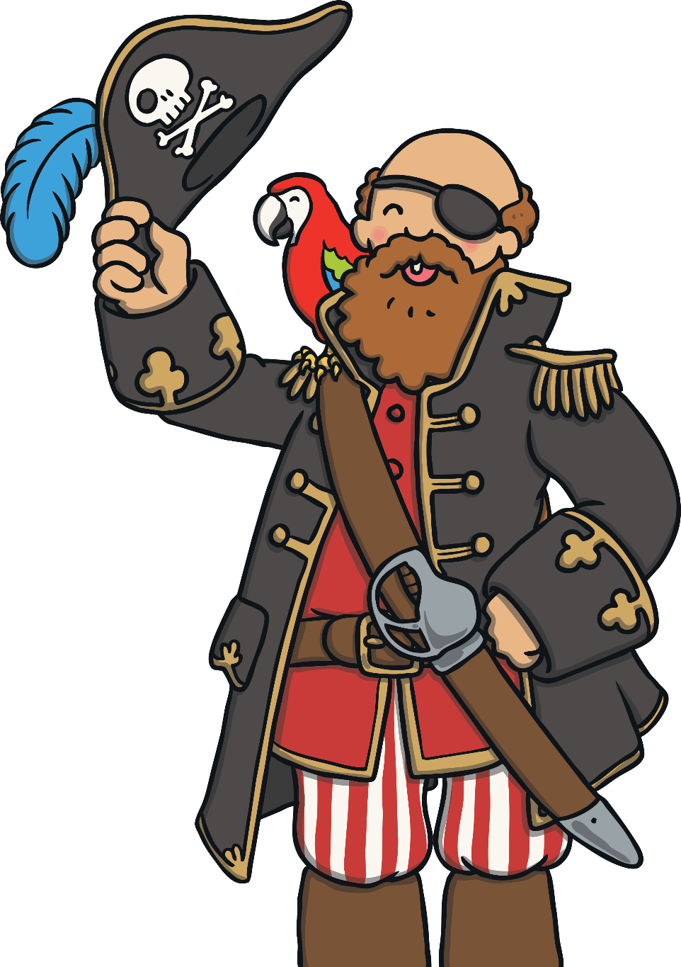
Pirates
Pirates were people who sailed ships around the world looking for other ships to attack. When they attacked ships, they would try to steal whatever the other ship had, especially treasure.
Some pirates had unusual nicknames, such as Blackbeard, Calico Jack and Redbeard.

Slide 3
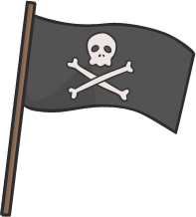
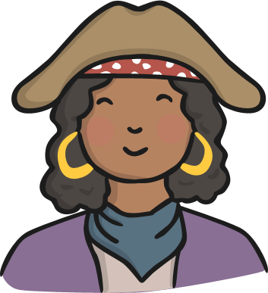
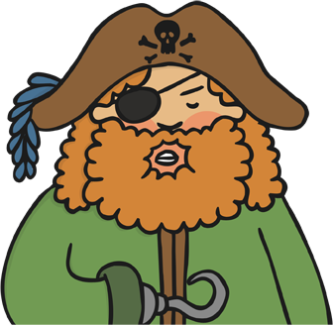
All about Pirates
This flag is called the Jolly Roger. Lots of pirate ships flew this flag. When other ships saw the Jolly Roger, they knew there was trouble ahead.
Lots of pirates wore gold and silver jewellery because they believed it gave them good eyesight.
Some pirates wore an eyepatch. It is believed that they did this to make each eye stronger so they could see in the dark.

Slide 4
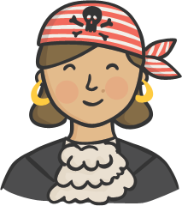
No Girls Allowed
pardon - to forgive
Most pirates believed that it was unlucky to have women on board. However, that didn’t stop these women!
Grace O’Malley
Grace lived nearly 500 years ago and was a leader of the Ó Máille clan in Ireland. Although she had lots of land and people to rule, Grace loved sailing and became known as a fearsome pirate.
Anne Bonny
Over 300 years ago, while sailing to the Caribbean, Anne met a pirate called Jack Rackham. They got married and became a feared pirate couple.
Cheng I Sao
After Cheng I Sao’s pirate husband died, she took over leading his pirate crew. After years of ruling her fearsome fleet, the government stated that, if she stopped being a pirate, they would offer her a . Cheng I Sao agreed and even got to keep most of her treasure!
pardon

Slide 5
What Is Your Pirate Name?
Use this pirate name generator to make yourself a pirate name.
First Name
Your Favourite Colour | Your Pirate First Name
Blue | Matey
Red | Captain
Pink | Pegleg
Purple | One-eyed
Green | Scallywag
Orange | Buccaneer
Yellow | Master
Black | Skipper
White | Shipmate
Second Name
Your Favourite Animal | Your Pirate Second Name
Cat | Blackbeard
Dog | Sparrow
Bird | Hornswoggle
Hamster | Swashbuckler
Horse | Lubber
Something else | McBoatface

Slide 6
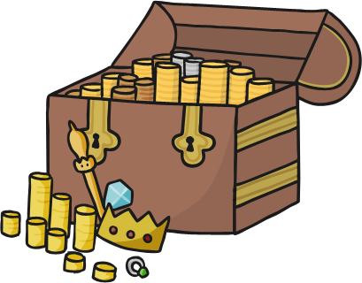
Talk like a Pirate
Pirates had special words for lots of different things. Can you guess what these words and phrases mean?
Ahoy!
Avast ye!
landlubber
doubloons
Hello!
Pay attention!
a non-pirate
gold coins
matey
booty
sea shanty
friend
treasure
yo ho ho
song
aye
Something you say when you’re happy.
Land ahoy!
yes
Shiver me timbers!
I can see land up ahead.
Oh my goodness!

Slide 7
Talk like a Pirate
Here are some tips for talking like a pirate.
Have a go at making your voice sound like a growl.
Try to emphasise the ‘r’ sound in all of your words.
Don’t say the letter ‘h’ in any words, for example ‘me hearties’ would be ‘me arties’.
Don’t say the letter ‘g’ at the end of words, for example ‘sailing’ would be ‘sailin’.

Slide 8
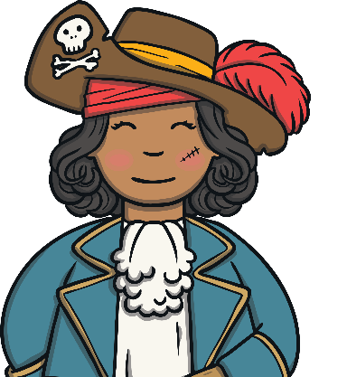
Talk like a Pirate
‘Shiver me timbers, land ahoy!’
‘Yo ho ho, there be lots of doubloons for us.’
‘Arrgh, me matey, lets go sailin’ and get some booty!’
‘Avast, ye scurvy dog!’

