Slide 1
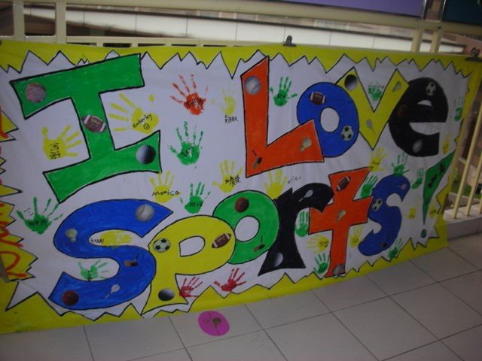
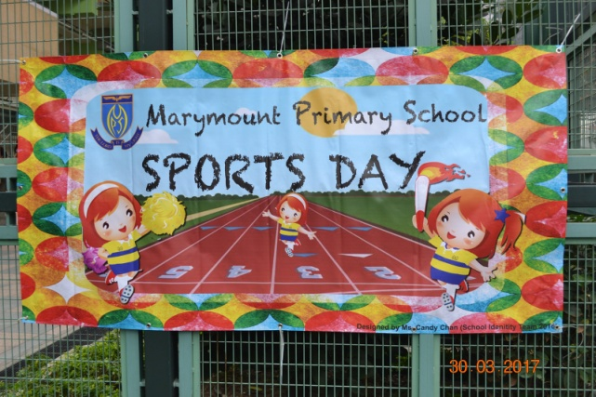
Mrs Brown’s Weekly Challenge – 26th May
Make a banner for our virtual sports day.
Take part in virtual sports day on
Friday 29th May
Send your photos to
eileen.brown@westlothian.org.uk

