Slide 1
Creative
Faces
In art this week we are going to use our creativity to make some different kind of faces.
We are going to learn about the artist Giuseppe Arcimboldo and look very closely at his unusual work.

Slide 2
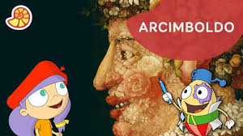
Click the link to watch ‘Art with Mati and Dada’
https://www.youtube.com/watch?v=hrHZL8pp--M
Or google search
Art with Mati and Dada - Arcimboldo | Kids Animated Short Stories in English youtube

Slide 3
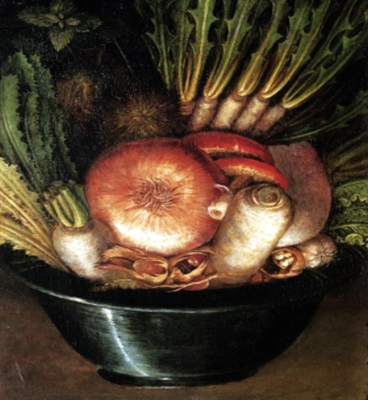
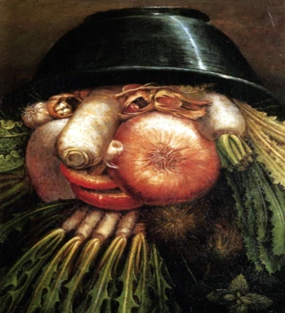
Giuseppe Arcimboldo
Italian Artist (1527-1593)
What do you see in Arcimboldo's artwork?
Turn the first artwork upside down, what do you see?

Slide 4
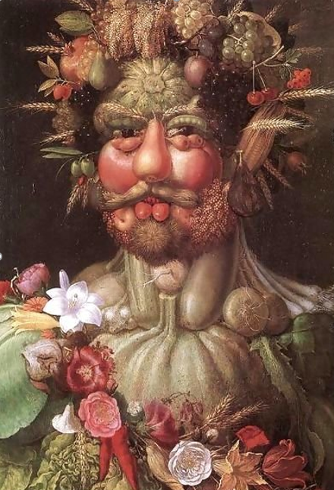
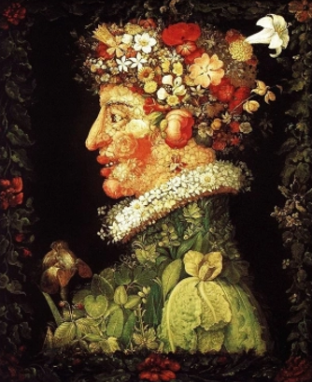
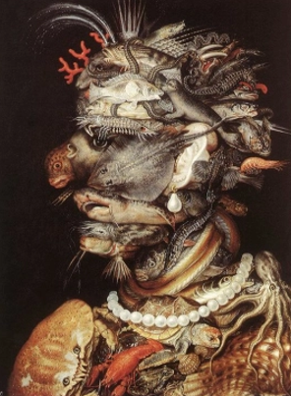
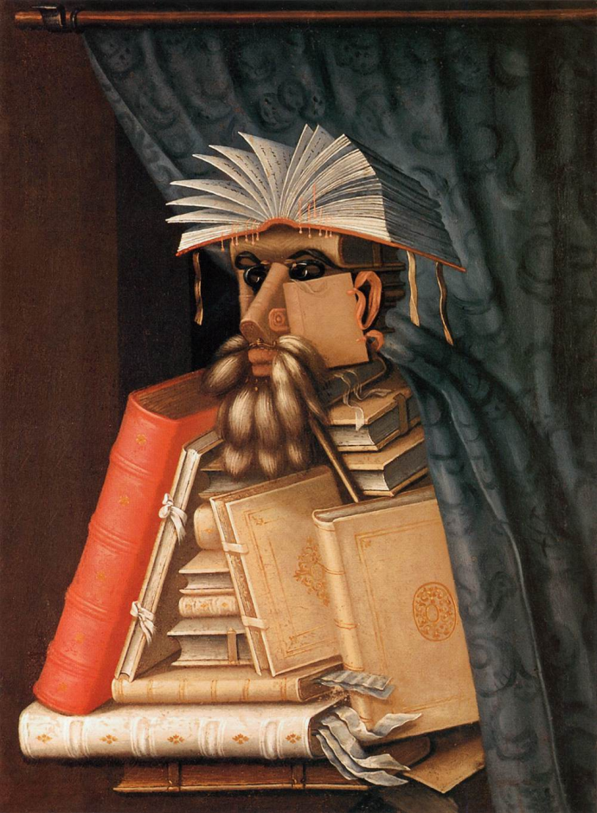
Here is some more artwork by Giuseppe Arcimboldo
Can you list 10 different things that you see?
What do you think of Arcimboldo’s work?
Share your opinions with your grown ups.

Slide 5
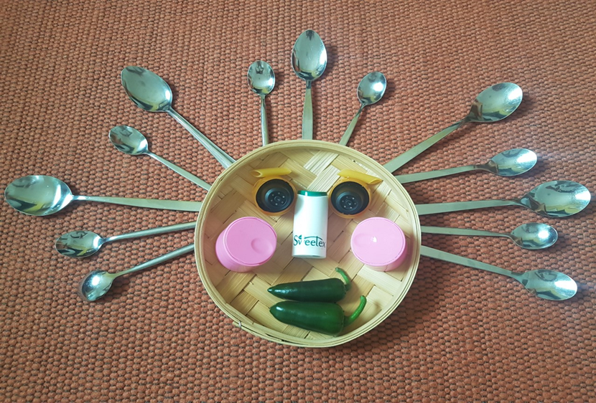
Creative faces
Now it’s your turn to make your own creative face, use your imagination.
Check with your grown up for permission before using anything
You could use:
things from nature- leaves, daisies, twigs etc
Food - fruit, vegetables, dried pasta etc
Stationary – rubbers, pencils, scissors etc
Packaging – plastic lids, egg boxes, milk cartons etc
Kitchen items – cutlery, tins, lids etc
Small toys
If you can, take a photo and share your creative faces. I’d love to see them.
What will you use for hair?

Slide 6
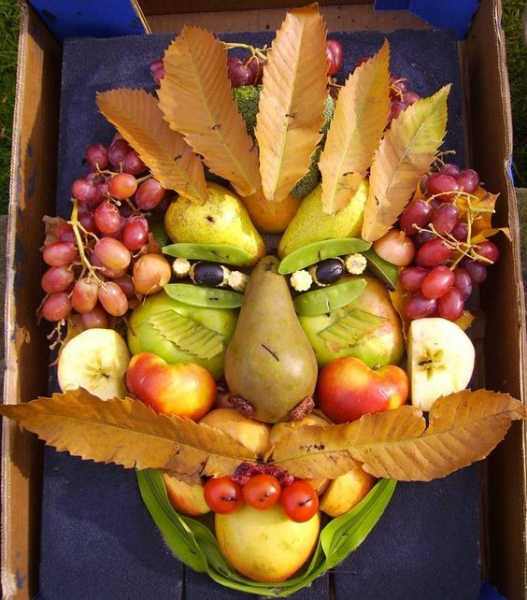
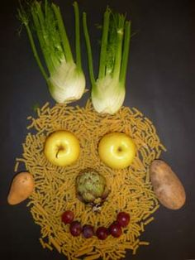
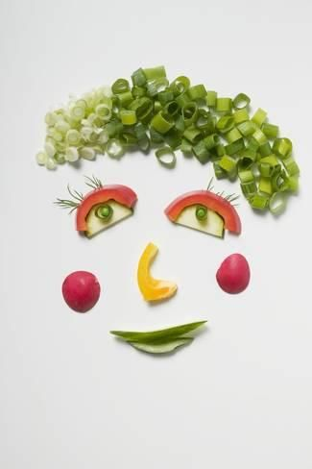

Slide 7
