Slide 2
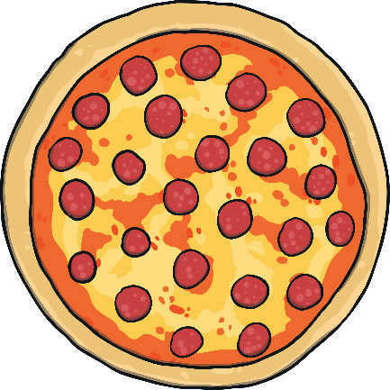
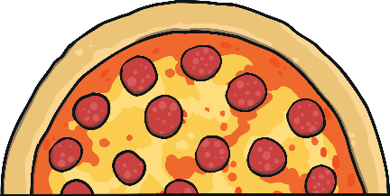
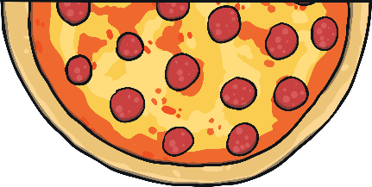
What Is Halving?
This is the whole pizza.
The pizza has been cut into 2 halves.
Each piece is the same size.
This is one half of the pizza.

Slide 3
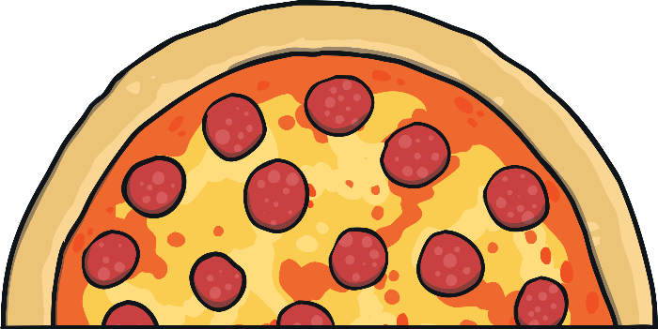
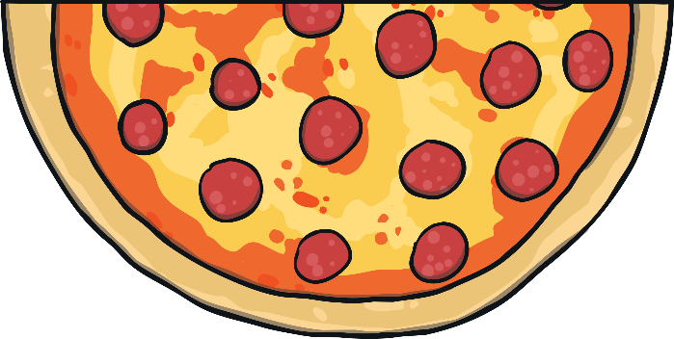
Making Halves
This is a whole pizza.
Can you click on the knife to cut it into two halves?
You have made two halves. Each piece is a half.

Slide 4
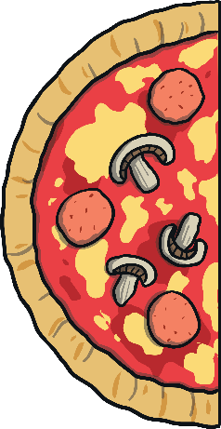
Finding Halves
Half of this cake is missing. Can you find the other half?
The two halves make a whole.

Slide 5
Finding Halves
Half of this ice cream is missing. Can you find the other half?
Each half is the same size.

Slide 6
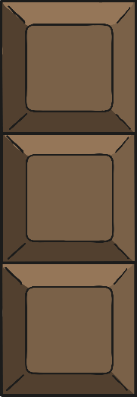
Finding Halves
Half of this chocolate is missing. Can you find the other half?
The two halves of chocolate are equal.

Slide 7
Finding Halves
Half of this melon is missing. Can you find the other half?
How many people can share the melon when it is in halves?

Slide 8
Finding Halves
Half of this pineapple is missing. Can you find the other half?
This is the whole pineapple.

