Slide 1
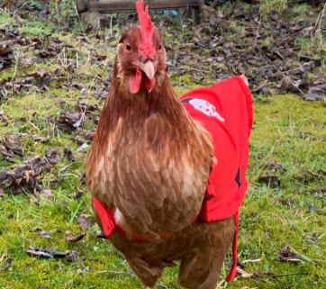
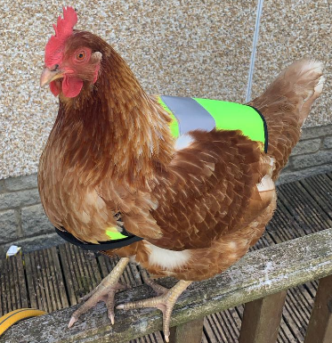
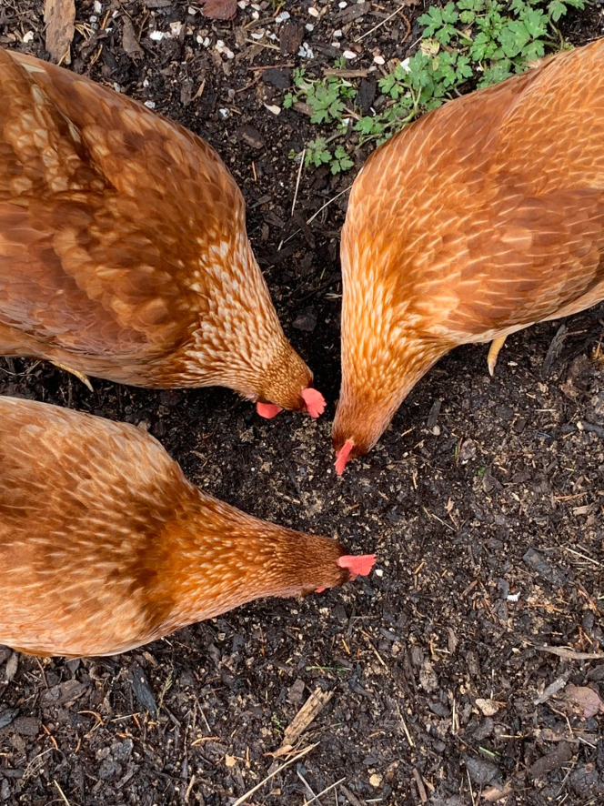
Mrs Brown’s Spring Challenge – 18th May 2020
I have three chickens at home. Katniss, Clove and Rue. They love new things to play with and new coats.
Can you design a new toy or jacket for the girls.
Take a picture of your items and send it to eileen.brown@westlothian.org.uk

