Slide 1
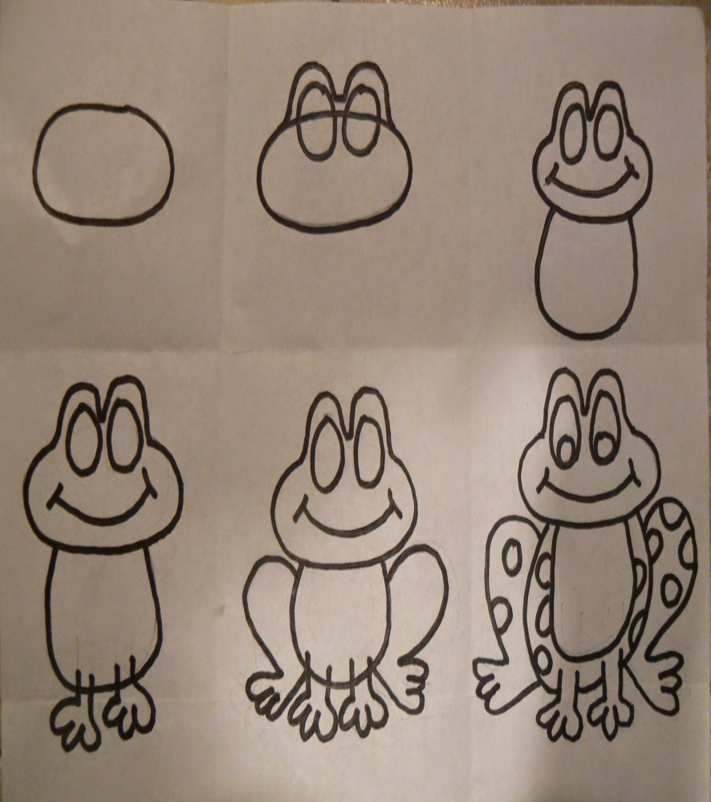
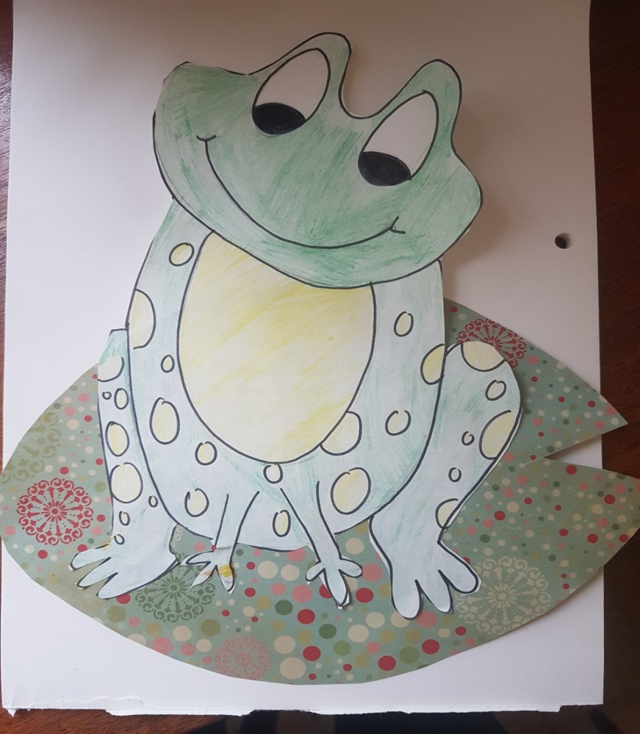
Spring Art Activities
Have you spotted any frogspawn or tadpoles on your walks?
I’ve seen lots of tadpoles and even some frogs.
I can draw a frog using lines and shapes
I can draw curved lines
I can draw oval shapes and circles
What colours will you choose to colour your frog?
Can you add a background?

Slide 2
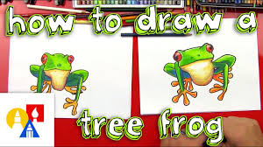
Now for something trickier.
Follow the you tube video to draw this tree frog
Google search: art for kids hub how to draw a tree frog
https://www.youtube.com/watch?v=9vm9N1c_eIg

Slide 3
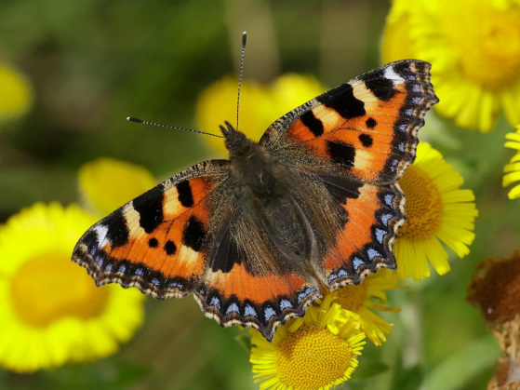
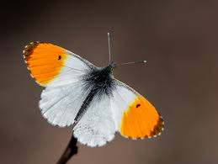
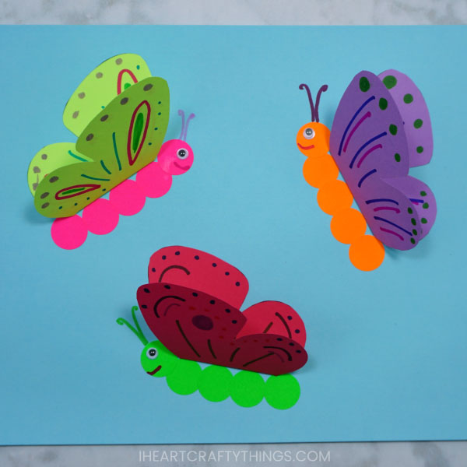
Spring Art Activities
Have you spotted any butterflies on your walks?
I’ve seen lots of butterflies, tortoise shells and orange tips.
I can make a paper butterfly
I can draw, cut and fold the wing shape
I can add line and shape patterns to the wings
I can draw and cut a butterfly body

Slide 4
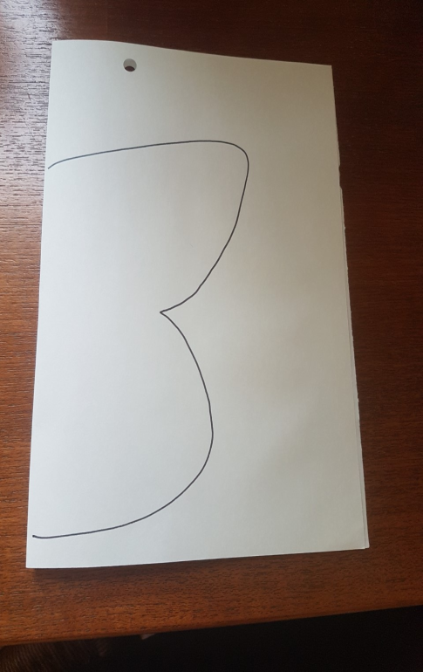
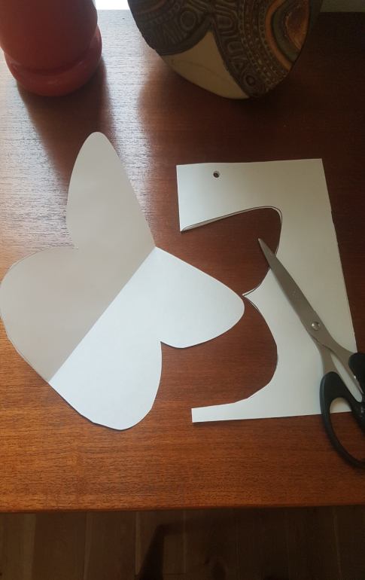
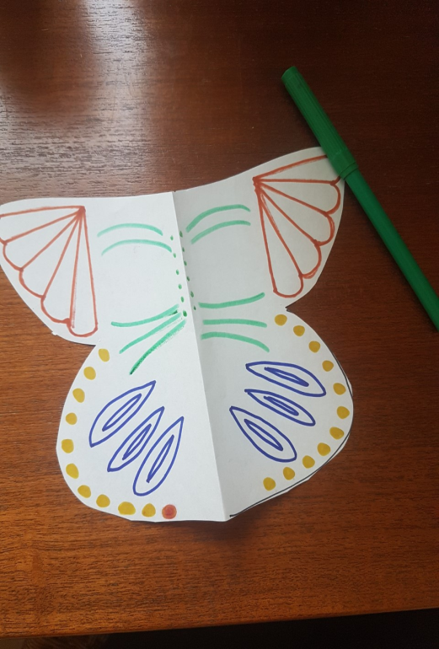
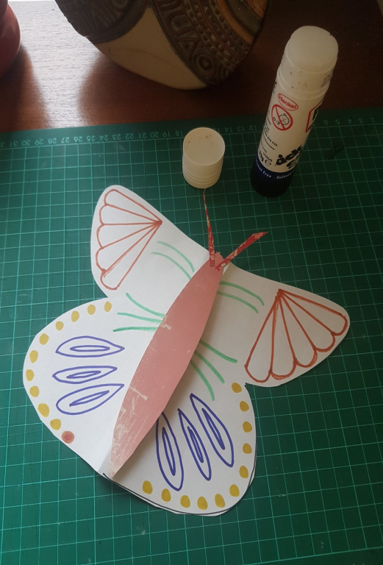
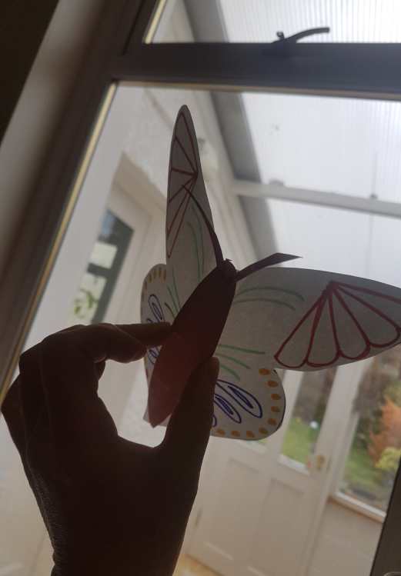
Spring Art Activities
Have you spotted any butterflies on your walks?
I’ve seen lots of butterflies, tortoise shells and orange tips.
I folded a piece of paper
in half. Then drew half a
butterfly shape on the fold.
I cut my shape out.
I drew the same symmetrical
patterns on each wing.
I found some scrap paper
and cut out a body and
antennae.
I glued the body to the
fold on my butterfly.
I played with my butterfly!
Well, just for a wee while.

Slide 5
Now for something trickier.
Follow the you tube video to draw this butterfly
Google search: art for kids hub how to draw a monarch butterfly
https://www.youtube.com/watch?v=NLWNOafqfh0

