Slide 1
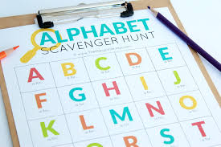
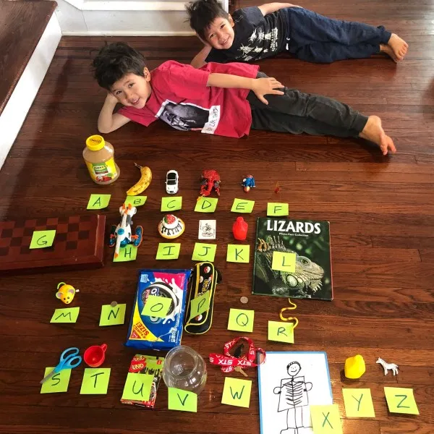
Mrs Brown’s Weekly Challenge – 11th May 2020
Have a scavenger hunt around your house and garden! Can you find an item for every letter of the alphabet?
Take a picture of your items and send it to eileen.brown@westlothian.org.uk

