Slide 1
Mindful doodle art
Doodling is an important way for everyone to:
Relax
Stay focused
Grasp new concepts
Retain information
Think amazing creative thoughts
The following slides have different doodling options for you to choose

Slide 2
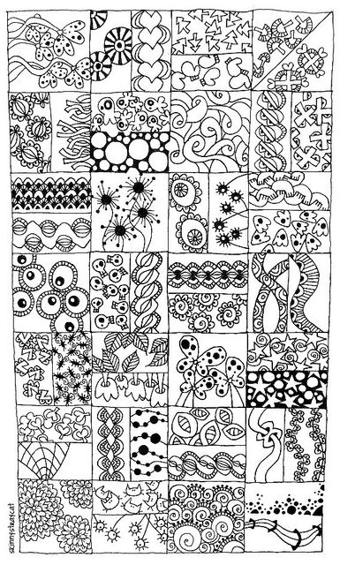
Mindful doodle art
Relax and enjoy some mindful doodling
All you need is some paper and a pencil or pen
Find a comfy space, get settled in
Nothing to think about for the next wee while except doodles
Here are some doodle ideas to explore
Be creative and invent your own doodles
My favourite part of doodling is colouring my doodles in

Slide 3
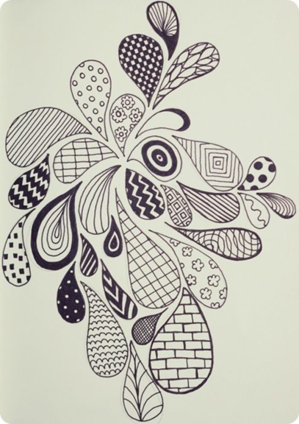
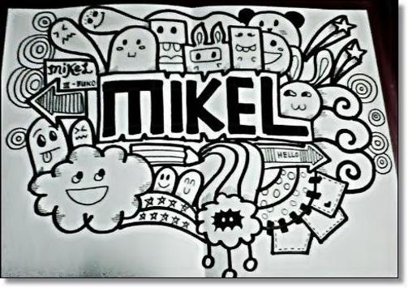
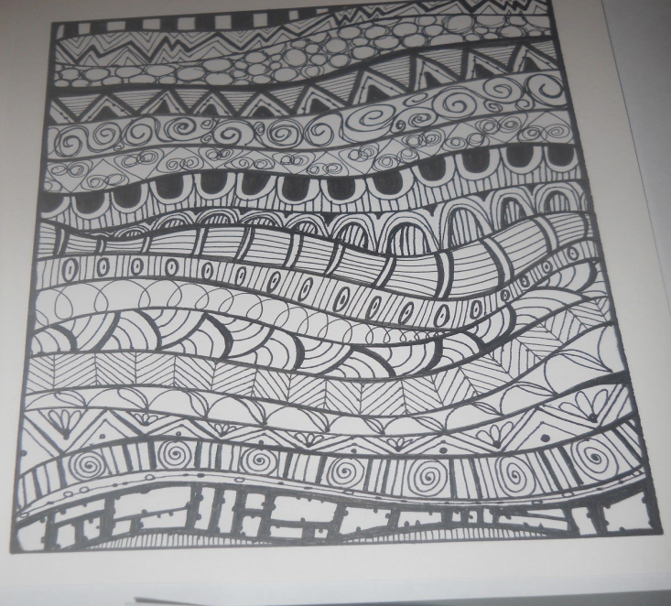
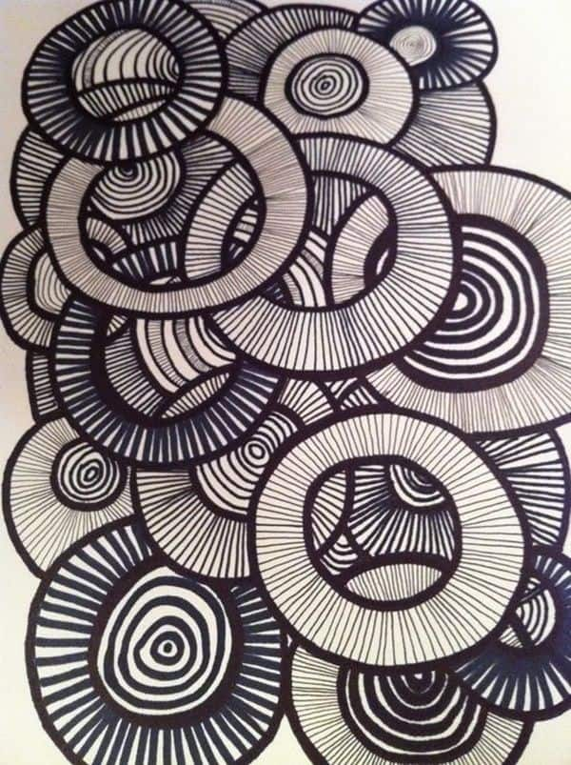
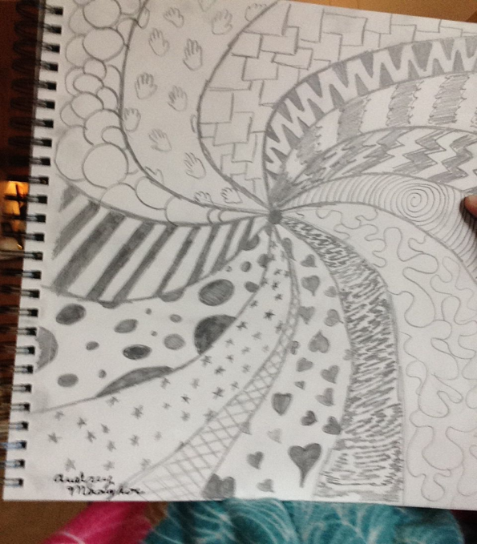
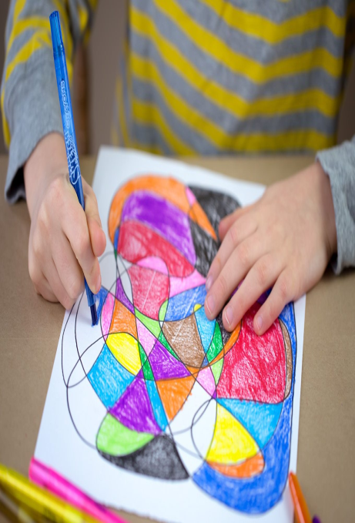
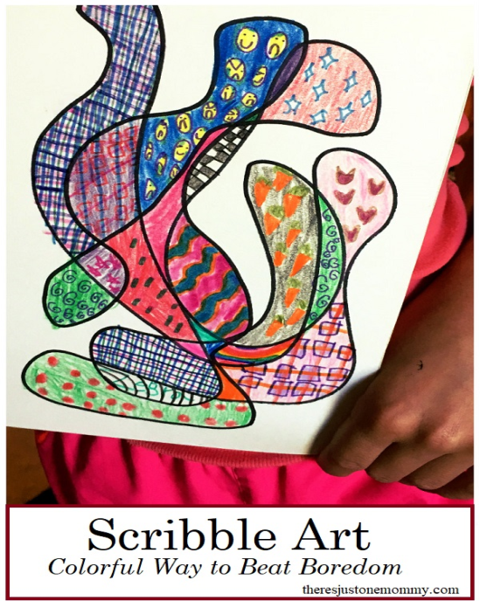
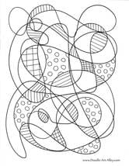
Mindful doodle art ideas

Slide 4
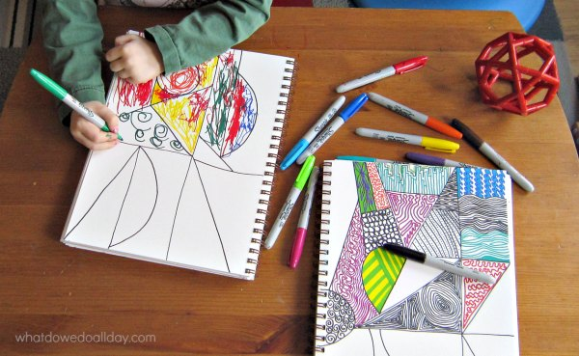
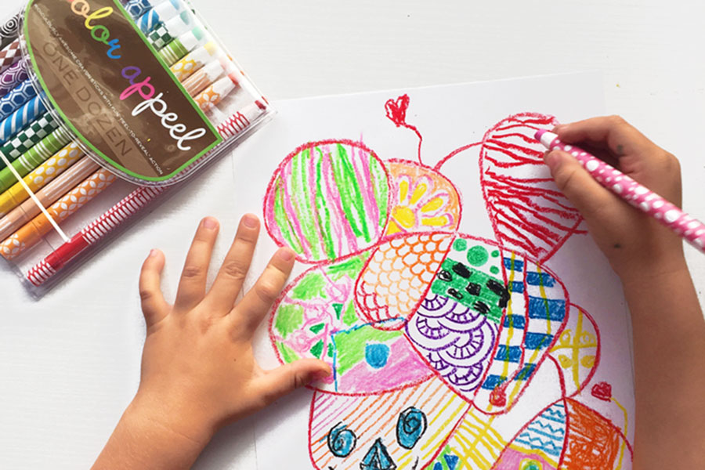
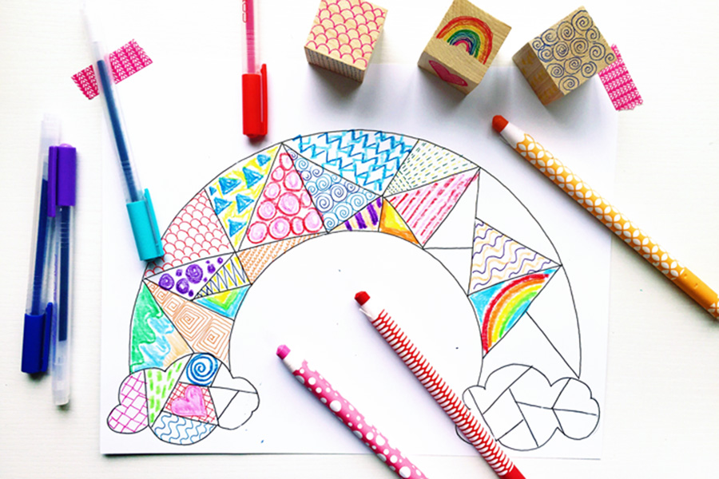
Mindful doodle art ideas
Always have some paper and a pen/pencil handy, you can doodle anywhere.
Are things getting tough?…………..have a doodle break
Struggling to stay focussed?…………….have a doodle break
Feeling bored?………………..have a doodle break
Want to relax and forget about the world?……………….have a doodle
The more you practise the more creative you will become.
Enjoy doodling.

Slide 5
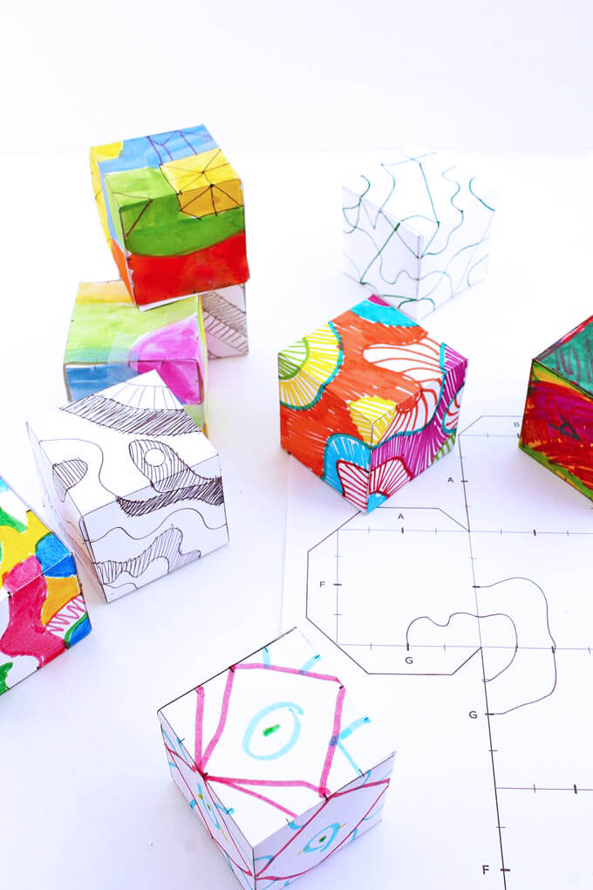
Mindful doodle art
If you have access to a computer and printer you might like to try and create a ‘doodle cube’
You can download the template for the cube on ‘The Artful parent’ website
Google search: The Artful Parent Doodle cubes
or click the link below
https://artfulparent.com/doodle-cubes-art-activity-kids/

Slide 6
Mindful doodle art
You could try and make your own
cube at home.
You’ll need an A4 sheet of paper or card, a ruler or square shapes to draw around, pencil, scissors, glue or sellotape
You will need some help for this.
Look at the cube template opposite.
A cube is made up of 6 squares all the same size.
Draw your squares in the same position as the template. Draw them around the same size or bigger. Remember to draw on the flaps,
this will help you join cube.
Go to the next slide.

Slide 7
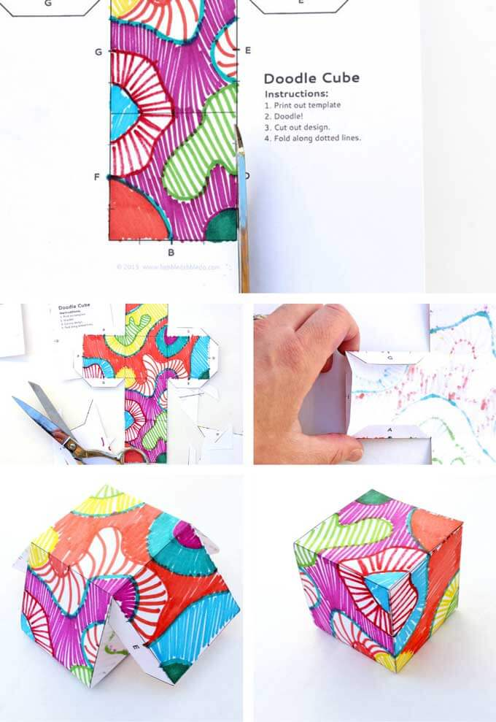
Mindful doodle art
This is the fun part.
Choose your art materials, pencils, pens, crayons anything you want.
Find a comfy space to work.
Get settled in.
Begin doodling.
Choose you favourite lines and shapes to draw.
Layer them with more lines and shapes.
Enjoy taking your time to colour them in.
Now you can cut out your cube template, fold the flaps and join in together.

Slide 8
Remember to send photos of your doodles to Mrs Brown. Eileen.brown@westlothian.org.uk

