Slide 1
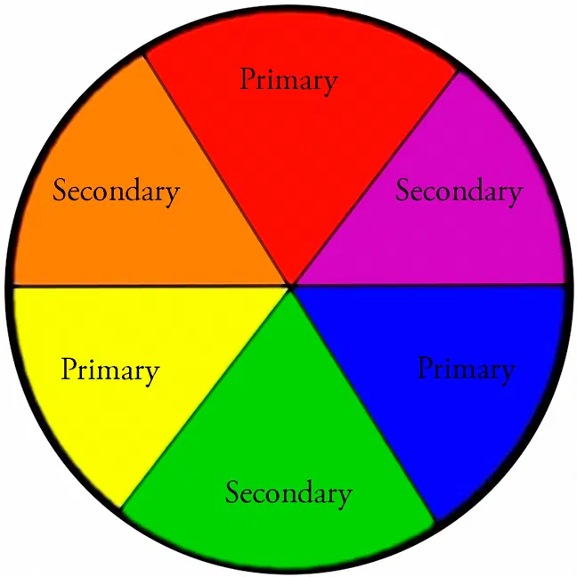
I am learning to explore colour
I can create a colour wheel
with primary and secondary colours.
Be creative you can use any material.
Look at the next slides for ideas.
If you can, share your artwork with. I’d love to see it.

Slide 2
I am learning to explore colour
What are the primary colours?
What are the secondary colours?
What primary colours would you mix together to make:
Green
Orange
Purple

Slide 3
I am learning to explore colour
Make your own colour wheel
Have a look at the next slide for ideas on the materials you could use
Have a go at collecting and naming warm colours
and cool colours.

Slide 4
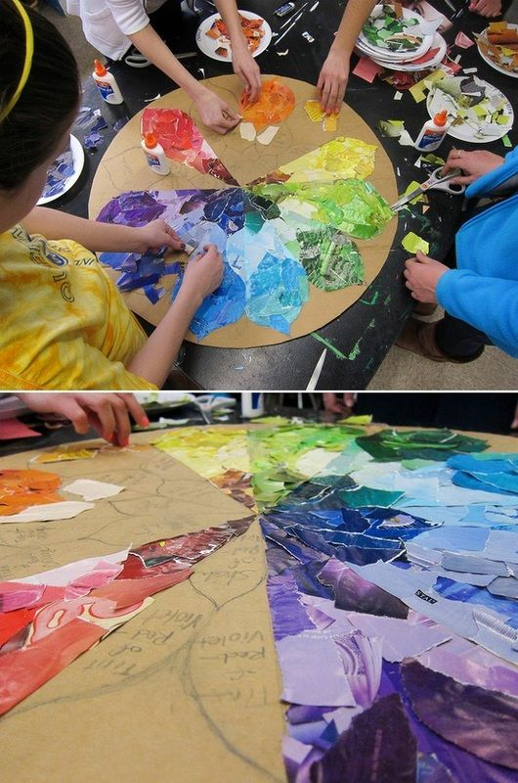
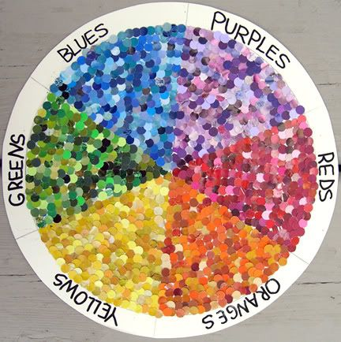
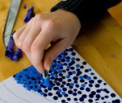
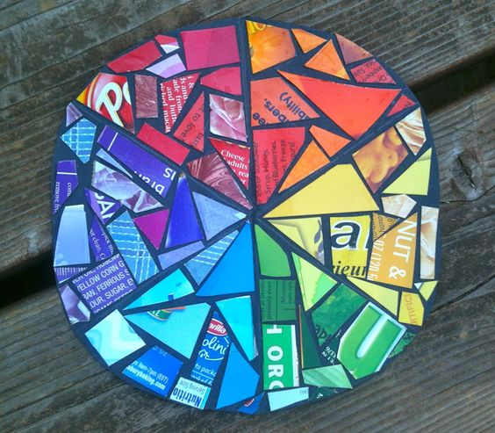
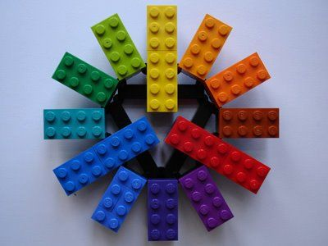
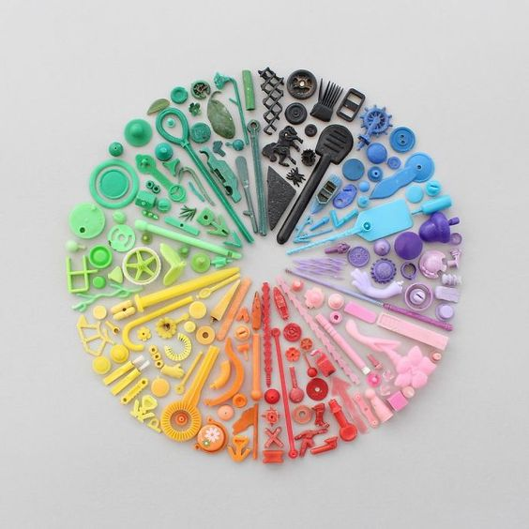
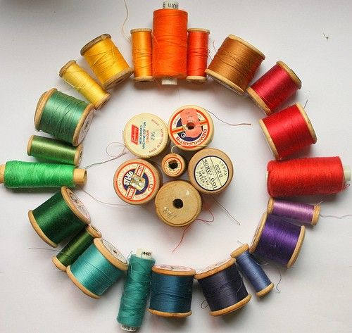
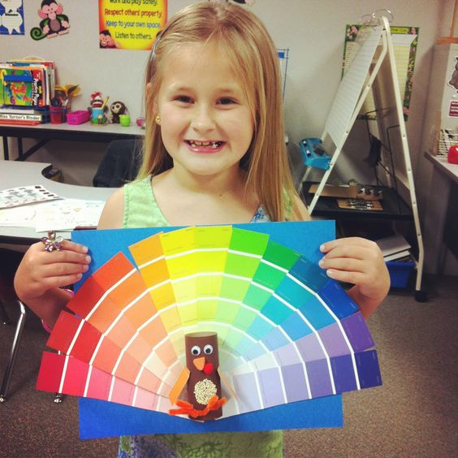
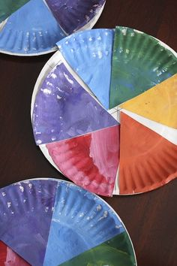
Make your own colour wheel
Colour wheel ideas
Email your colour wheels to
Eileen.brown@westlothian.org.uk
crayons
lego
Paper/magazines
Paint samples
paint
pencils
Objects from around the house
thread

Slide 5
Things to watch/sing/play to help learn colour theory
If you have red, yellow and blue paint this is a good one to watch
BBC Art – the colour wheel – The afternoon club
https://www.youtube.com/watch?v=hdq0OclL4vE
Youtube sesame street:ok go – three primary colours song
https://www.youtube.com/watch?v=yu44JRTIxSQ
Youtube primary colours song (sesame studios)
https://www.youtube.com/watch?v=v9gIj0j7Ba0
Youtube sesame street: colours Elmo’s world
https://www.youtube.com/watch?v=MeO8VIx-jXA
Google search: Topmarks colours
Select warm and cold colours
https://www.topmarks.co.uk/Search.aspx?q=colour

