Slide 1
space
By Layla and Jada

Slide 2
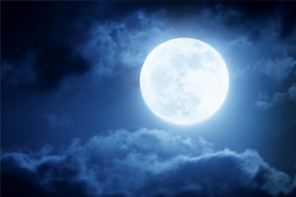
moon
The moon is made of rock
Tim peeck was the seckind pepull on the moon

Slide 3
SUN
The sun is a boll off gas.

