Slide 1
space
By Billie and Lexi

Slide 2
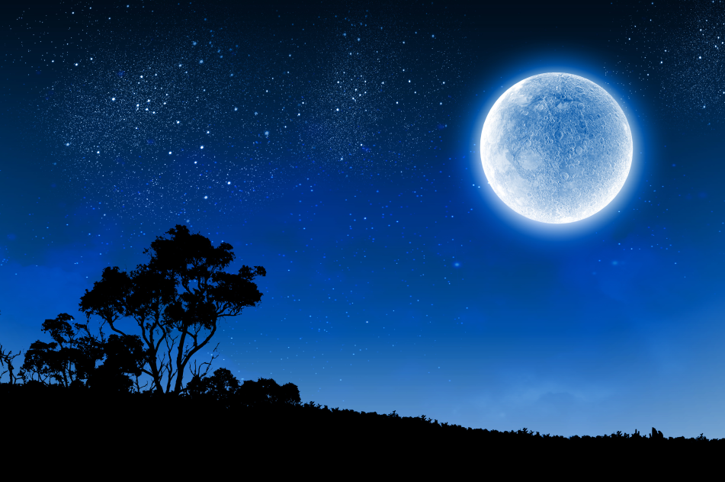
moon
The moon is made out of rock.
The moon shines bright light.

Slide 3
Sun
The sun is a hot
Ball of gas.
The sun can fit
100 Erths around
The sun.

