Slide 1
space
By Kaseylee and Amelia

Slide 2
moon
The moon is the earth’s only satellite.
The moon sometimes looks like a banana shape.
It shines brightly.

Slide 3
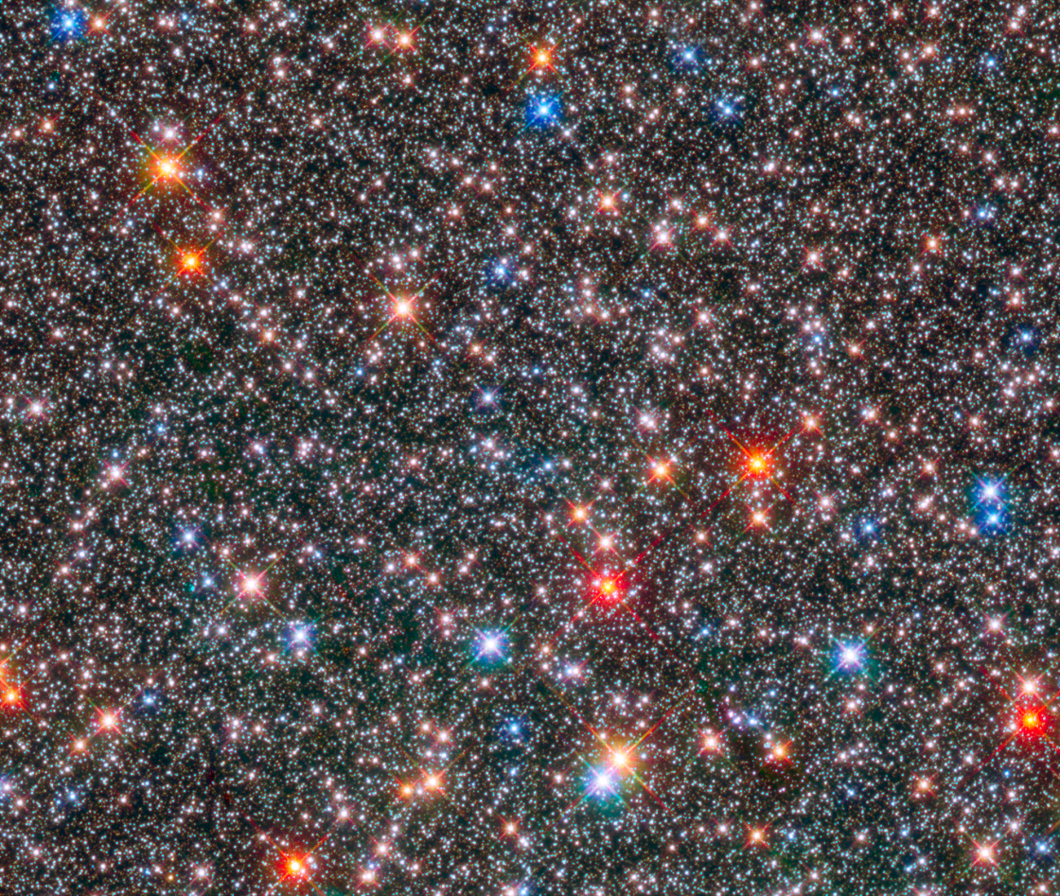
Stars
The stars is a ball of gas.
The stars ra to mene to count.

