Slide 1
Space
By teejay and lucas

Slide 2
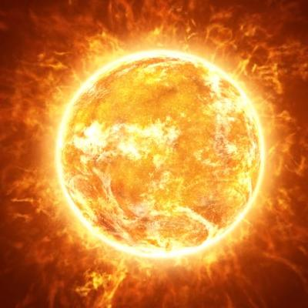
sun
the sun is a ball of gas
The sun is a big star
The sun looks like a banana shape sometimes.

Slide 3
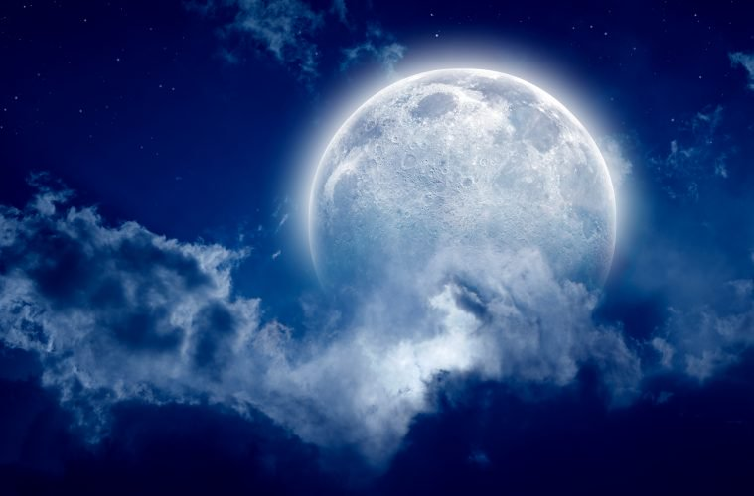
Moon
The moon is big and shines brightly.

