Slide 1
Space
By Shay and Corey

Slide 2
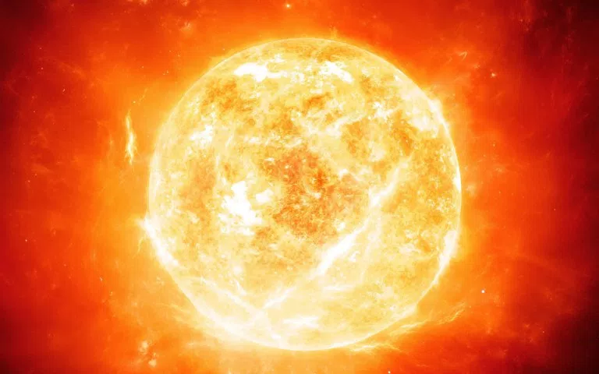
sun
The sun is a ball of gas.
It is very hot.
Nobody can land on it.
Heat travels from the sun to us.

Slide 3
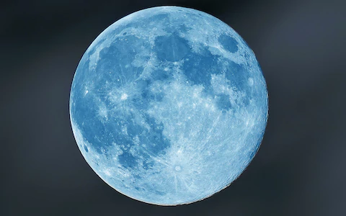
moon
The moon is rock.
The moon look lec a boll.

