Slide 1
Space
By owen and jordan

Slide 2
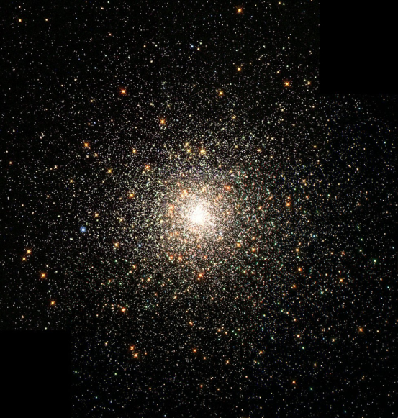
stars
Stars are burning balls of gas
Stars can turn in to star constellations
A star constellatins can turn in a picture of lyra and the big dipper
And leo and saggita
A star has a gas that there
temperter is 10000 degareas

Slide 3
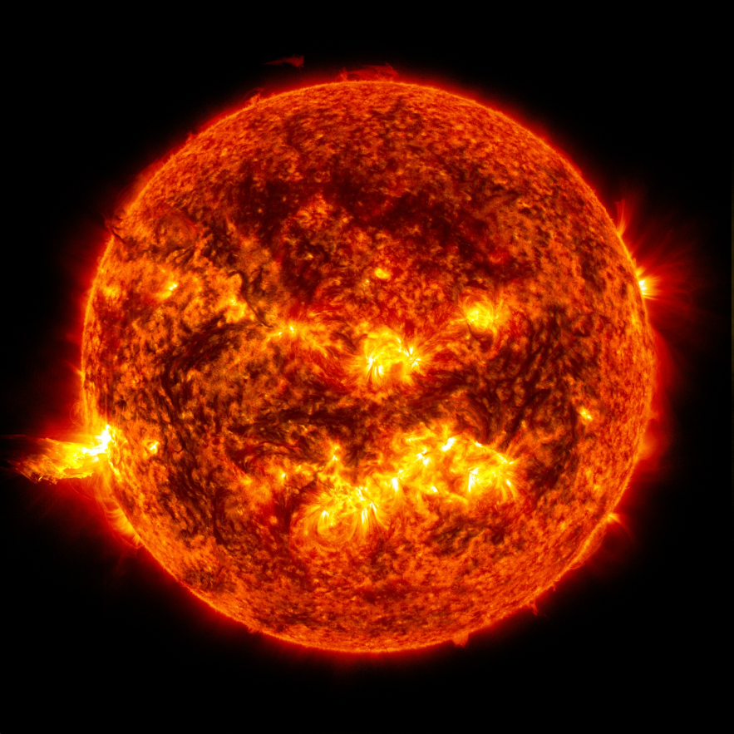
sun
The sun is super hot in the summer because the sun gets super hot because the sun is relly hot.
It is a burning ball of gas.
The sun gives us day time.

