Slide 1
By Lillie RiIey
SPACE

Slide 2
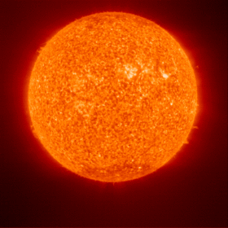
Sun
THE SUN IS A BOL OV GAS.
The sun is the closest star to the earth.
The sun is really warm and no one can land on it.

Slide 3
Moon
The moon is not made of cheese it is made of rock.
It looks like the moon changes shape but it doesn’t.

