Slide 1
By leon and bayliss
Space

Slide 2
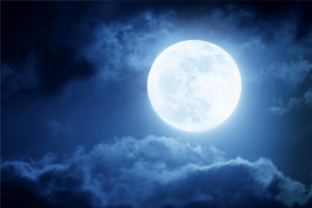
moon
The moon is not made of cheese!
It is made of rock.
The moon looks like it changes shape but it doesn’t.

Slide 3
sun

