Slide 1
Space
By calum alexander

Slide 2
Sun
the sun is a buring ball of gas
The is red yellwel and oring
The sun can fit 100 eriths allon sihgd it

Slide 3
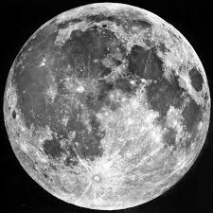
moon
Astranots can land on the moon
The moon can dosenot
change shape the sun reefelcc to the moon

