Slide 1
Space
By Adam and Lewis

Slide 2
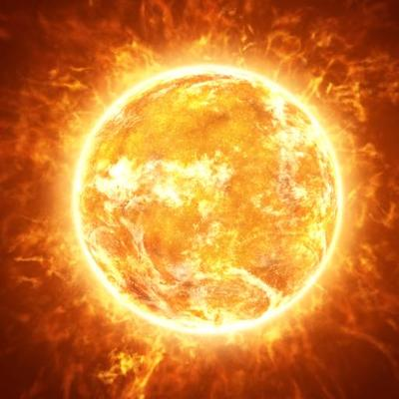
sun
The sun is a big star
The sun gives light to the moon
The sun gives heat and light to Earth

Slide 3
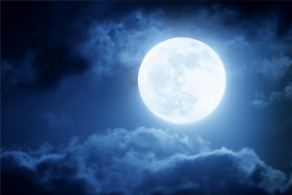
moon
Peeple have landed on the moon

