Slide 1
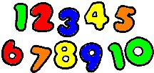
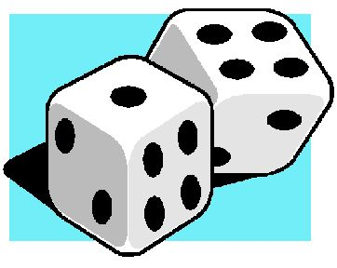
Maths and Numeracy at Stoneyburn P.S
P1/2 Parent Workshop

Slide 2
Overview
Numeracy and Maths in P1/2 – What does this look like?
What is the school doing to help your child achieve?
How can you help at home?

Slide 3
Numeracy and Maths in P1/2
Smartstarts
Purposeful play – situations and tasks to support their numeracy knowledge and life skills ( sharing, turn –taking, co-operation)
Maths focus – once a week – Time/ Information Handling/ Shapes
Numeracy focus – 3 times a week
Mix of whole class work, paired work & and group work
Support and Challenge for all pupils
Mrs Sibbald – Class Teacher
Mrs Lind – Nursery Nurse from Murrayfield P.S
Mrs Gardinier – Acting PT/Support for Learning Teacher
Notes:
Smart starts - Numeracy based- Monday, Wednesday and Friday mornings. 25 min session – engages learners in tasks at the beginning of the day.

Slide 4
What might a lesson look like?
Mental agility (warm up) Daily
Numeracy lesson / Maths lesson
Learning Intentions & Success Criteria shared
Rotations
Accessible variety of resources for pupils to use
Opportunities for children to practise the skills they have learned
Plenary session to round off(What have we learned?)
Wall displays that children can refer to and that reflect their current learning

Slide 5
How is the school helping your child achieve their potential?
Up-to-date training for staff on most effective ways to teach numeracy.
Experienced support in class
Building purposeful play into the school day
Situations for children to apply their numeracy skills
Work on different areas of numeracy:
Numerals (number names)
Number Structure – how numbers are built up (e.g. 5 is 3 and 2, or 4 and 1)
Counting Strategies – Counting accurately, developing counting on/back strategies,
Notes:
Support from NDT & NN

Slide 6
How can I best support my child?
Be positive about Maths.
Take opportunities to talk about numbers everywhere. (Home, shops, car etc)
Identifying and recognising numbers- Asking children to read numbed in the home and in the environment
Counting out loud – counting steps, how long someone can hold their breath, counting how long it takes to run around the garden.
Use finger patterns – “How do we make 5? Show me on your fingers. Show me another way!”

Slide 7
Things to do at home
Dominoes
Snakes & Ladders
Card games
Counting songs
Helping with DIY-measuring, counting out screws
Helping with the washing- pairing up socks, counting out pegs to hang up clothes
Cooking/Baking- measuring ingredients/counting biscuits baked
Counting tins in cupboard
Making a shopping list.

Slide 8
Homework
Remove distractions. (Screens, phones etc)
Try to do homework at a regular time.
Have high expectations.
If homework is too hard- speak to the class teacher and let them know.

Slide 9
Where to go for info.
Twitter @ReadWriteCount
@StoneyburnPS
@WLNumeracy
@PlayTalkRead
http://www.familymathstoolkit.org.uk/
www.readwritecount.scot
http://www.educationscotland.gov.uk/parentzone/

Slide 10
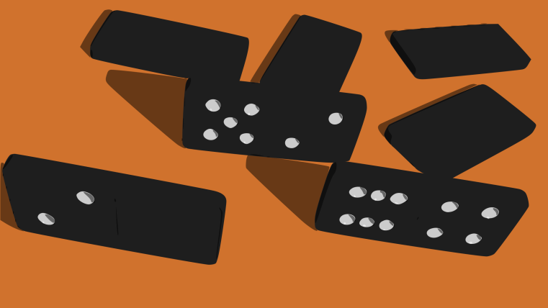
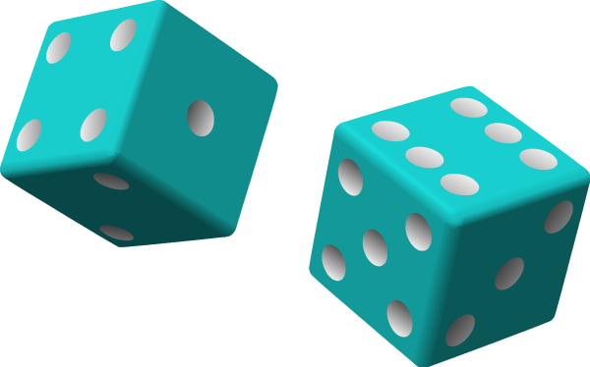
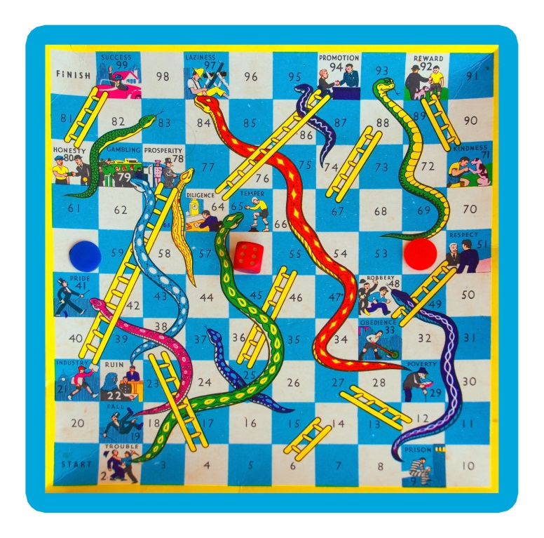
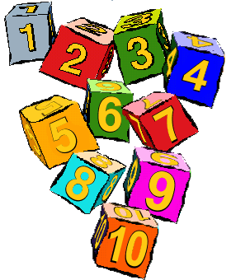
Time to play!

Slide 11
Suggested websites
http://www.smartygames.com/
https://illuminations.nctm.org/
http://www.topmarks.co.uk/
http://www.snappymaths.com/
http://www.oswego.org/ocsd-web/games/Mathmagician/cathymath.html (search Math magician)
http://nrich.maths.org/frontpage
http://www.primarygames.co.uk/
http://www.multiplication.com/
http://www.communication4all.co.uk

