Slide 1
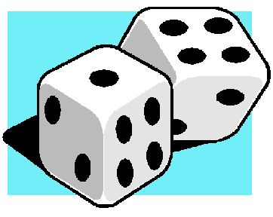
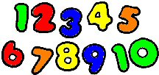
Numeracy at Stoneyburn
Parent Workshop

Slide 2
https://www.youtube.com/watch?v=MS2aEfbEi7s

Slide 3
Overview
What the research says.
How do we teach number at school?
What might a lesson look like?
How can we help at home?

Slide 4
Research
Parental involvement has particularly positive outcomes in pre-school and early years.
Mums, particularly, have a huge influence on girls achievement in Maths – Jo Boaler

Slide 5
How children learn numeracy at school
Counting forwards and backwards (all stages)
Base 5 / Base 10 (moving on to 100s,1000s,10 000s+)
Concrete
Visual
Abstract

Slide 6
What might a lesson look like?
Mental agility (warm up) Daily
Numeracy lesson / Maths lesson
Learning Intentions & Success Criteria shared
Accessible variety of resources for pupils to use
Wall displays that children can refer to and that reflect their current learning
Opportunities for children to practice the skills they have learned
Plenary session to round off(What have we learned?)

Slide 7
Progression in learning
How we help your children to move forwards
(Addition)

Slide 8
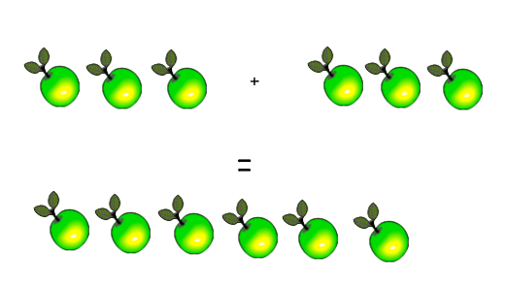
Concrete

Slide 9
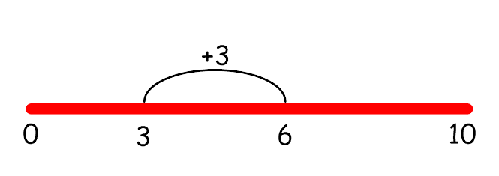
Visual

Slide 10
Abstract
3 + 3 = 6

Slide 11
Progression in learning
How we help your children to move forwards
(Multiplication)

Slide 12
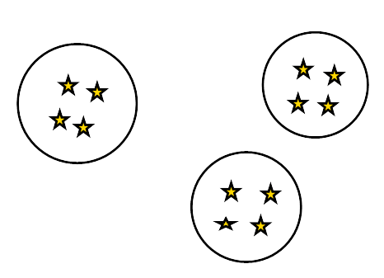
Concrete

Slide 13
Visual

Slide 14
Abstract
3 x 4 =12

Slide 15
Other key areas of learning

Slide 16
Instant recognition of regular patterns
Regular Dot Patterns

Slide 17
Irregular patterns

Slide 18
Finger Patterns

Slide 19
Instant recognition
What do you see, how do you see it?
https://www.youtube.com/watch?v=Ya1MWNo9dQw

Slide 20
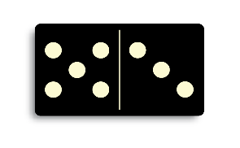
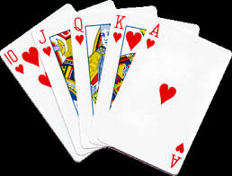
Games to play at home
Dominoes or Cards

Slide 21
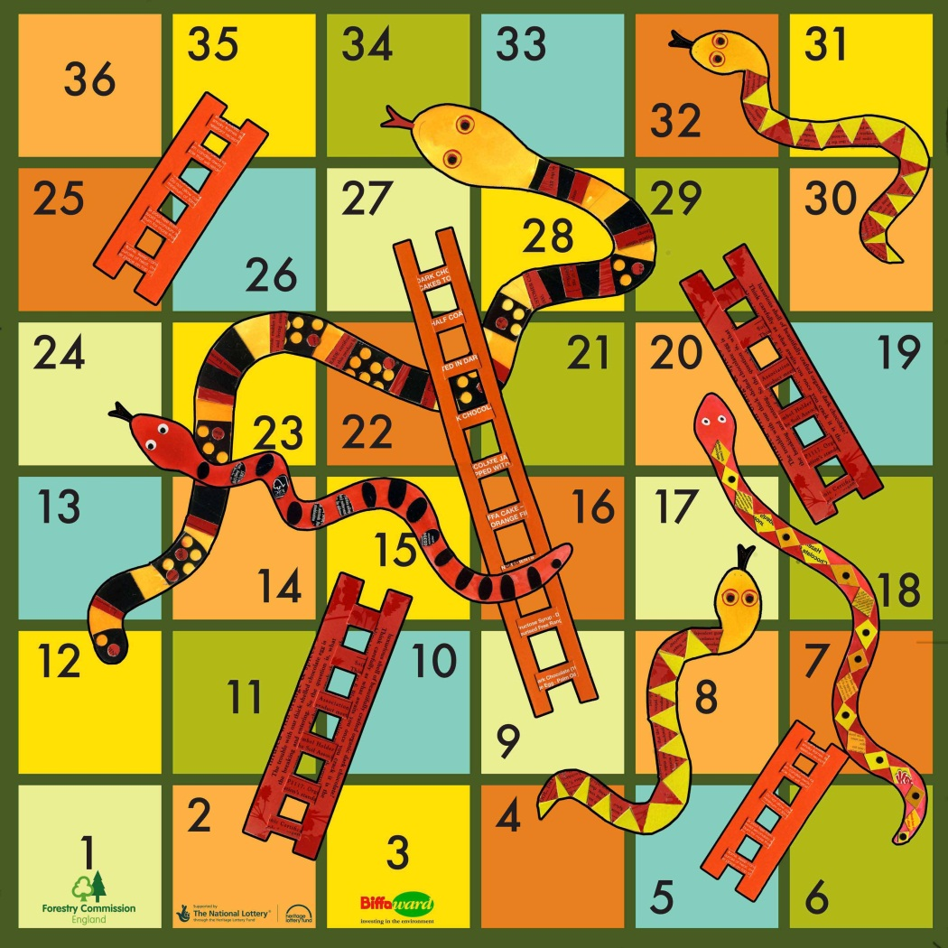
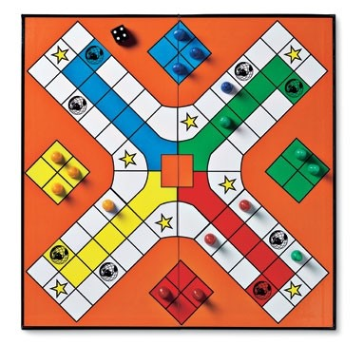
Board games

Slide 22
Homework
Remove distractions. (Screens, phones etc)
Try to do homework at a regular time.
Have high expectations.
Speak to class teacher about homework if you have questions.

Slide 23
Suggested websites
http://www.smartygames.com/
https://illuminations.nctm.org/
http://www.topmarks.co.uk/
http://www.snappymaths.com/
http://www.oswego.org/ocsd-web/games/Mathmagician/cathymath.html (search Math magician)
http://nrich.maths.org/frontpage
http://www.primarygames.co.uk/
http://www.multiplication.com/
http://www.communication4all.co.uk

Slide 24
What other things could you do at home?
Go for a walk and count how many steps/jumps you take
When tidying up encourage children to organise toys/books in size order
Baking- what do you need to do to change a recipe for 6 cupcakes to make 12?
Give your child some money to buy things while shopping
When wrapping presents encourage your child to estimate how much paper they need to wrap the gift.
Calculate the cost of a takeaway/home delivery and how much change is due

Slide 25
Top Tips
Be positive about maths! Avoid saying things like ‘I can’t do maths’ or ‘I hated maths at school’ or “I was never any good at Maths at school”... your child might start to think like that themselves…..especially girls!
Point out the maths in everyday life. Include your child in activities involving maths such as using money, cooking and travelling.
Praise your child for effort rather than talent - this shows them that by working hard they can always improve.
http://www.educationscotland.gov.uk/parentzone/

Slide 26
Any Questions?

Slide 27
Time to visit classrooms and see what your children are up to!

