Slide 1
Primary 7 young leaders

Slide 2

Organising the big spring clean
All primary 7 pupils will be organising a big spring clean in March 2017.
We hope to have a very clean and tidy environment for our fellow pupils to play in.
We will know we are successful when we have a tidy environment.

Slide 3

Monitoring Lunch Queue Duties
The lunch monitors will lead you to your correct queue.
It will be done daily to make sure our pupils are in the correct place.
We use class sheets to make sure that everyone is having the correct lunch.
We will know we are successful when everyone gets their lunch on time.

Slide 4

Messengers
The messengers will make sure that everyone get’s the correct mail.
This job is done daily so that everyone get their letters and mail on time.
We will know were are successful when the messages will be passed to the right people.

Slide 5
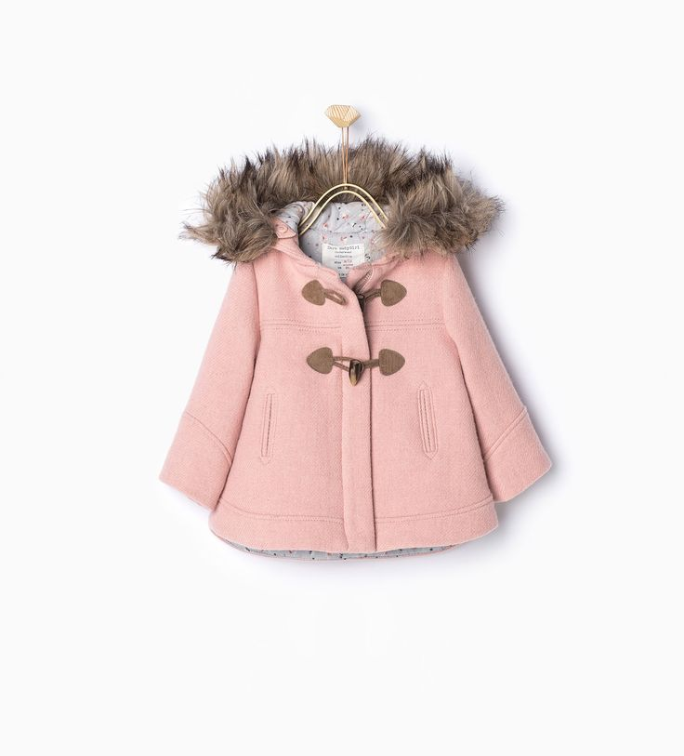
Cloakroom duties
There will be monitors each week to make sure that our cloakroom is clean and tidy.
The monitors will check the cloak room after Break, Lunch and at the end of the day.
We will know we are successful when our cloakroom is clean and tidy.

Slide 6

Library duties
We will have primary 7 monitors to keep the library clean and tidy.
We will clean the library weekly and check it daily.
We will know we are successful when our shelves are tidy and we can find books easily.

Slide 7

ICT Duties
We will make sure everyday that our netbooks are charged and tidy.
We will check the cart 3 times a day to make sure our cart is always tidy.
We will know we are successful when netbooks are charged and ready to use at all times.

Slide 8

Assembly duties
There will be IT monitors to set up assemblies.
We will do it as required for assemblies.
we will know we are successful because the assemblies will be organised and ready.

Slide 9

Wet Play Monitors
There will be one Primary 7 in each class to make sure nobody is messing around and not misbehaving.
We will do it as required every wet play.
We are doing it to encourage safety and good behaviour.
We will know we are successful if we have successful playtimes with no incidents.

Slide 10

Reading with younger children
Primary 7 will read to their primary 1 buddies throughout the year
We hope to read to them throughout the year with traditional stories and stories of our own.
We hope to create better relationships with younger pupils.

