Slide 1
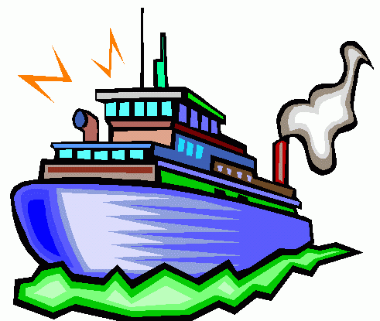
Union Canal
By Sophie Reid, Ben Wilson,
Piotr Kmita
Hope you enjoy

Slide 2
Wildlife
Look out for Sparrow hawk , Skylar , Kingfisher , Swift , Linnet , Reed Bunting , Spotted Flycatcher , Tree Sparrow , Grey Partridge , Great Crested Grebe , Bull Finch , Song Thrush and bats.

Slide 3
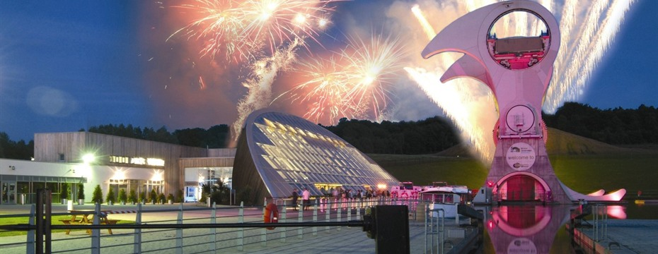
Falkirk Wheel
The Millennium link was an ambitious £84.5 project with the objective of restoring navigability across Scotland on the historic forth and Clyde and union canals providing a corridor of regeneration activity through central Scotland.

Slide 4
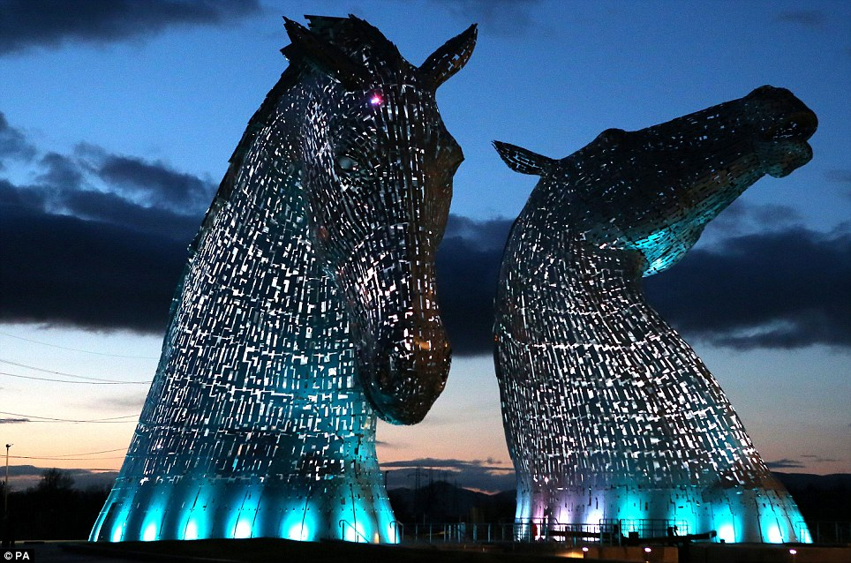
Kelpies
The sculptures opened to the public in April 2014. As part of the project, they will have their own visitor centre, and sit beside a newly developed canal turning pool and extension.

Slide 5
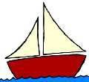
Trips
Boat trips these are
Fishing something's to do
Cycling at The union Canoeing
Falkirk wheel
Kelpies
Walking
Dog walks
Shows

Slide 6
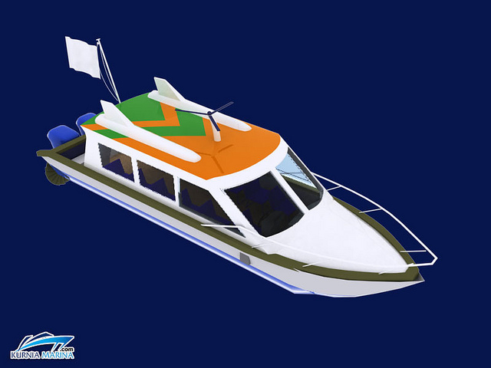
History
The horses used to pull the boats across the Union Canal. The canal was closed for 40 years and then opened in 2001.

Slide 7
Thank you for watching our fabulous slideshow. Bye

