Slide 1
the Union canal
BY SAOIRS,HANA,COLE !

Slide 2
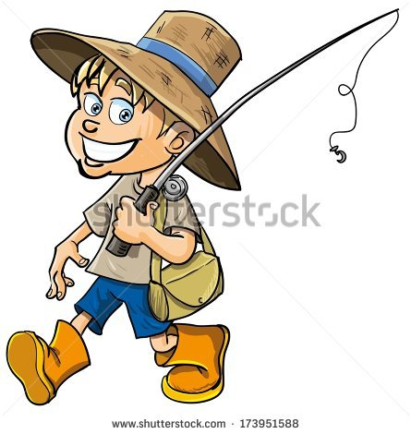
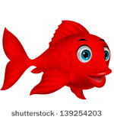
You can fish on the canal

Slide 3
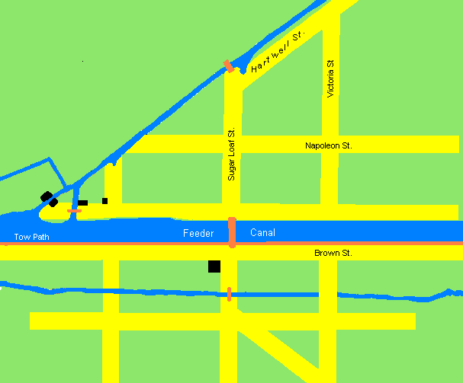
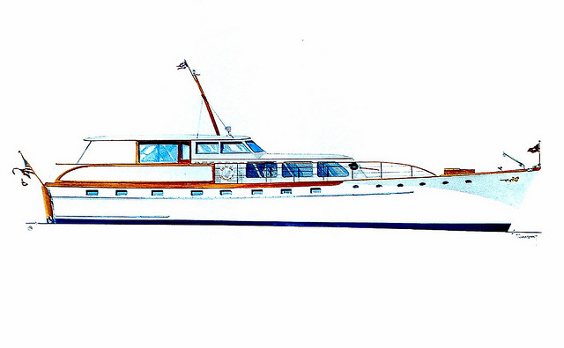
About the union canal
Horses us to pull the canal.

Slide 4
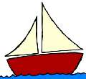
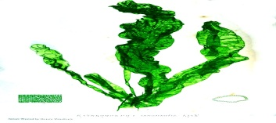
Boats there are lots of different kinds of boats

Slide 5
You can go on different tips of stuff on water
Trips!

Slide 6
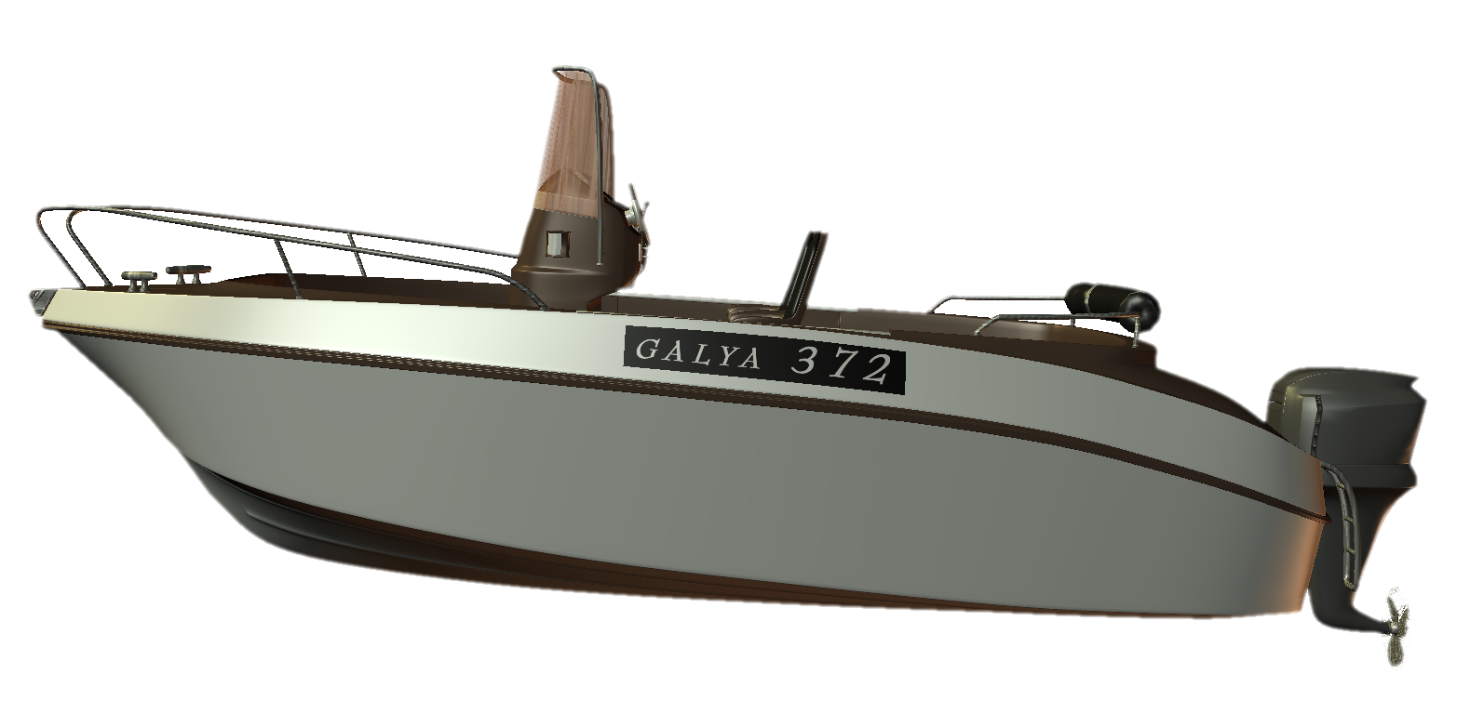
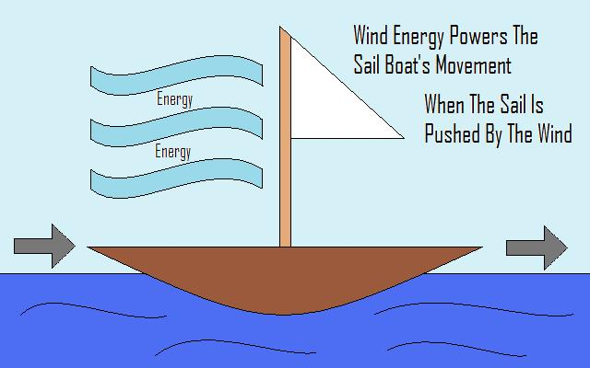

Slide 7
The Falkirk wheel is when the boat stops and go’s on to the forth and Clyde it looks amazing
FALKIRK WHEEL

Slide 8
when you go fishing be carful you and that you don’t fall in
Watch were you are fishing it mite have a sign that says do not fish in this area it will have a yellow line were you cant and. can fish

Slide 9
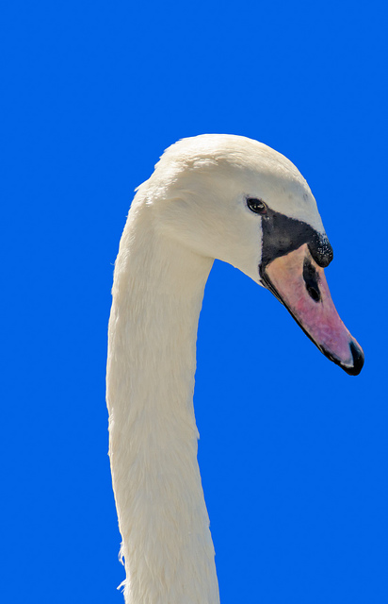
THERE ARE LOTS OF ANIMALS LIKE DUKS,SWAN,FROGS,TOADS, MUTE SWAN, MINKS, MALARDS MALES FEMALE,FISH AND BIRDS.
wildlife

Slide 10
Thank you for watching

