Slide 1
Union Canal
By
Ollie Megan Finaly

Slide 2
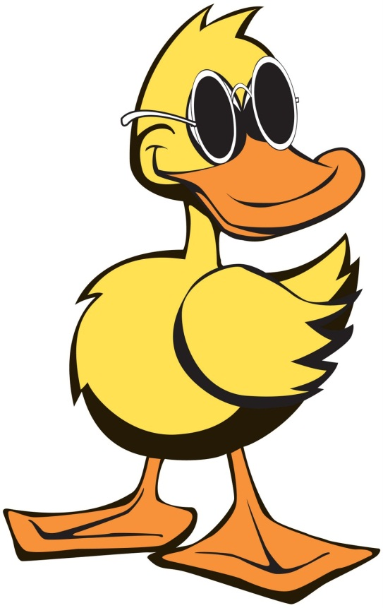
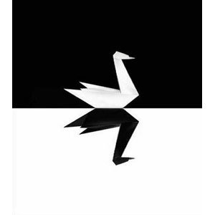
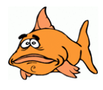
Wildlife If you feed the swans white bread please stop DUCKS ARE VERY FUSSY ABOUT FOOD THERE ARE NOT MANY FISH IN THE CANAL BECAUSE RUBISH

Slide 3
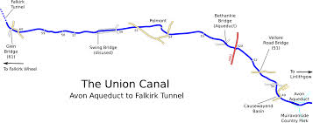

Slide 4
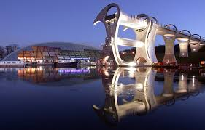
FALKIRK WHEEL
The Falkirk wheel
Is the end of the
Union Canal
After the end your boat lifts up and goes through the wheel..that’s why its called the Falkirk wheel

Slide 5
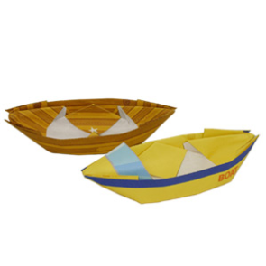
HISTORY
The Union Canal was made by hand in 1818 for coal for people in Edinburgh. The horses pulled 100 tons a day

Slide 6
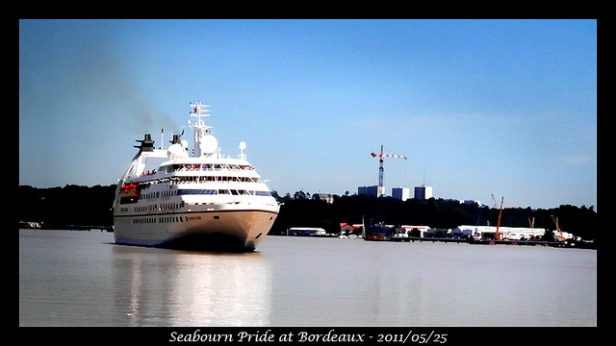
Boat adventures
People love going on boat trips but in 2014 they stopped for safety reasons.

Slide 7
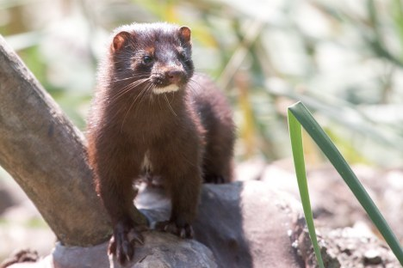
Watch out for minks
Minks are very deadly so don’t go near them

Slide 8
End
Thank you for watching

