Slide 1
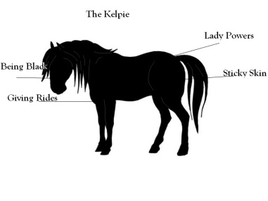
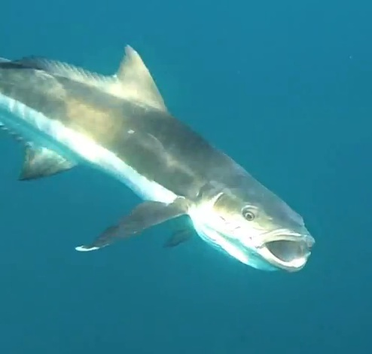
Union Canal
By Natasha, Jazib and Fraser

Slide 2
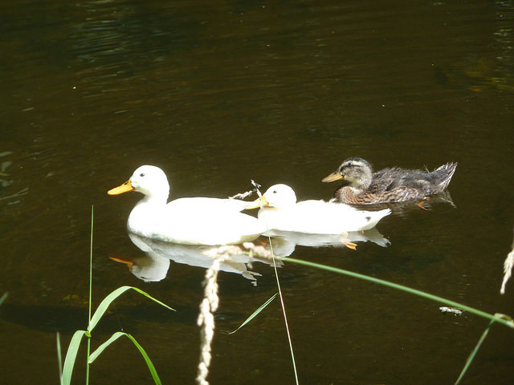
Life at the union canal is great.
It was built over 200 years ago.
The union canal goes to the kelpies.

Slide 3
These are what you pass by on the way,kelpes, and the falkurk wheel

Slide 4
What you can do
One of many activeates many is biking you can fish but only in the place were is not two yellow signs or you will get hurt . And you can go on the Falkirk wheel.

Slide 5
history
How it was built
It was built by hand and it was not filled by a hose .

Slide 6
Thank you

