Slide 1
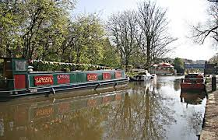
Union canal
By Maria Victoria, Karolina and Reyan

Slide 2
The union canal
The canal was dug by hand.
Horses pulled the boat across the canal.
The union canal goes from Edinburgh to the Falkirk wheel.
The canal was built 200 years ago.
The canal joins the forth and Clyde canal.
There are bridges witch have numbers along the canal bridges.

Slide 3
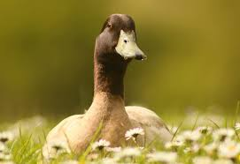
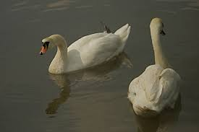
wildlife
There are lots of minks around the union canal.
There are lots of birds around the canal.
You can fish in the canal.
You can catch lots of pike in the union canal.
You can see lots of swans and ducks.
There are lots of minks at the canal
These are beautiful swans

Slide 4
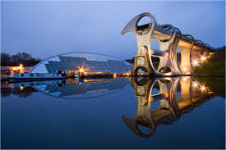
Falkirk wheel

Slide 5
Falkirk wheel
The Falkirk wheel is 35 meters tall.
The Falkirk cost £17.5 million to build.
The Falkirk wheel is big it goes round and carries boat.
1,200 tonnes of steel was used to build the wheel.
The Falkirk wheel contains over 14,000 bolts and 45000 bolt holes.

Slide 6
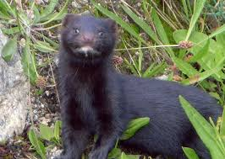
minks

Slide 7
minks
Minks are dangerous.
Minks can attack humans.
Minks aren't scared of anything.
Minks live in the water to.

