Slide 1
Union Canal
Hope you enjoy our presentation

Slide 2
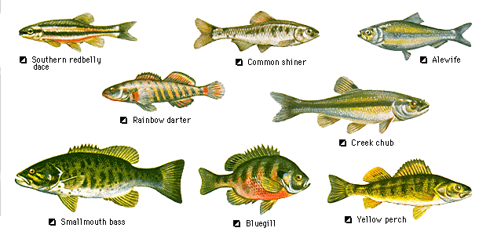
there are lots of wild life
mink are deadly they will bite

Slide 3
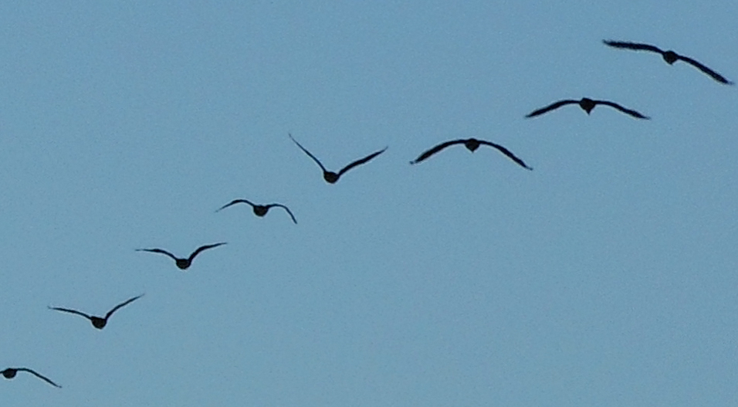
There are birds near the canal

Slide 4
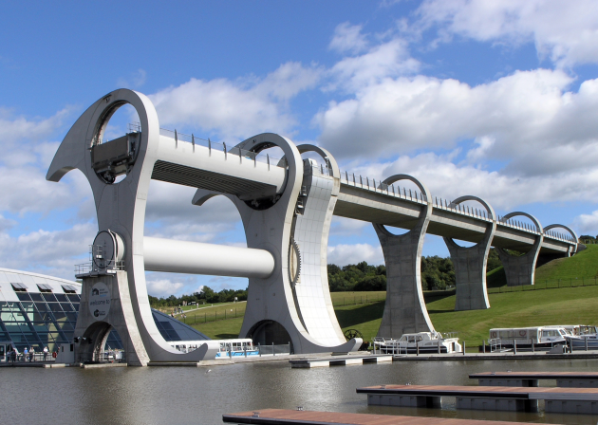
Hope you enjoy our facts
The Union Canal is almost 22 miles long
THE CANAL ENDS AT THE FALKIRK wheel

Slide 5
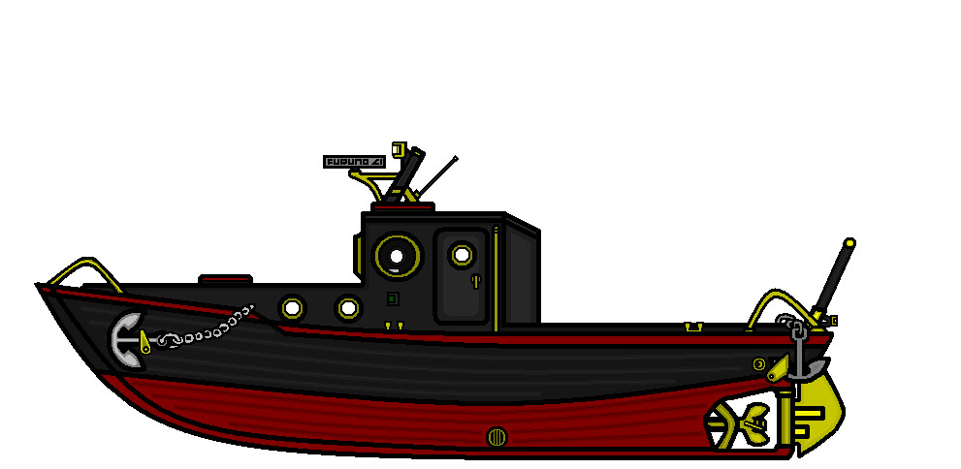
the Falkirk wheel
Is about 36 meters tall
After the Falkirk wheel is the fourth and Clyde canal
Don’t swim in the canal because there is sea weed and you might drown you
You can hire a boats for treat if you are good

Slide 6
bye

Slide 7
The end

