Slide 1
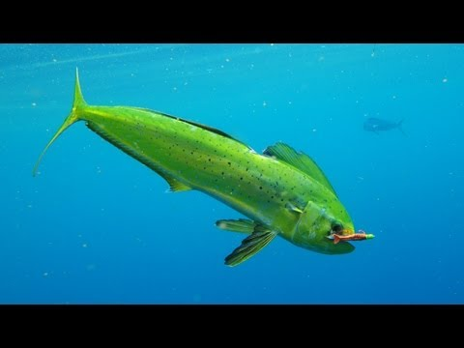
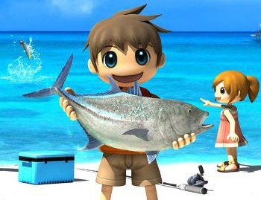
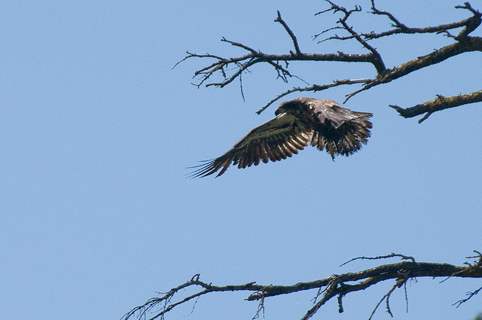
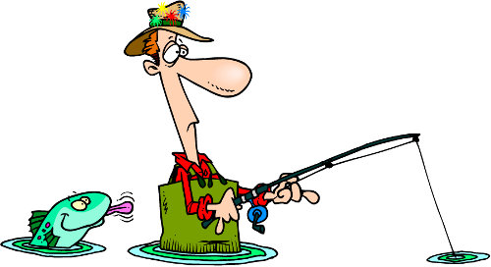
The Union Canal

Slide 2
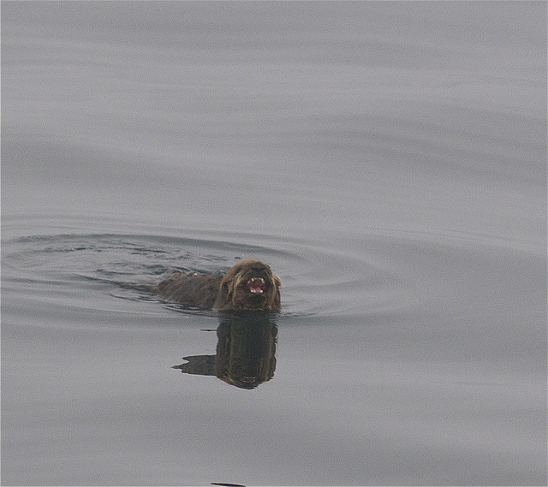
Mink
Mink are like otters the only differences is that mink have no fear whatsoever and otters are bigger than mink . Otters only eat fish and mink are carnivores .

Slide 3
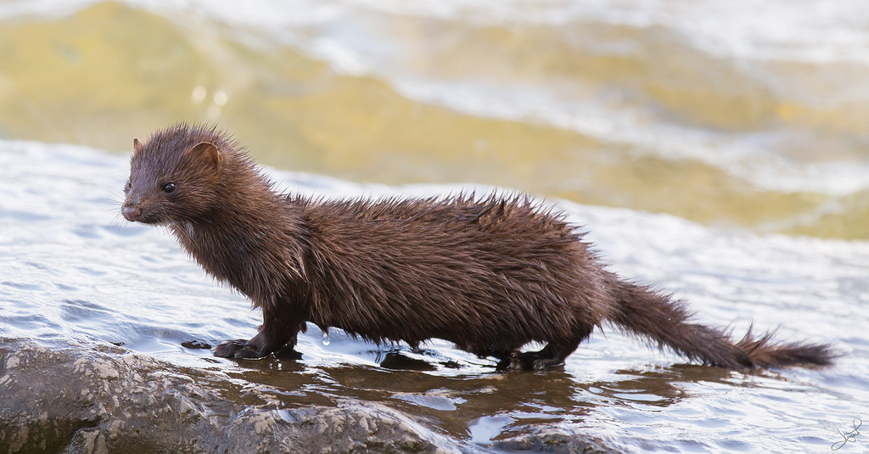

Slide 4
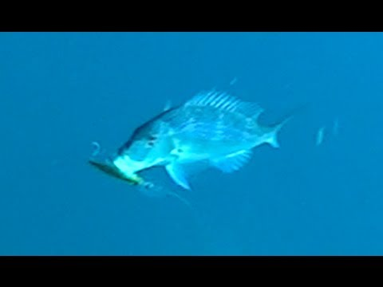

Slide 5
Pike are pretty dangerous they may ferocious but that doesn’t mean they are invincible.
pike

