Slide 1
Union canal facts
The Union Canal goes to the Falkirk wheel.
The Union Canal is 6 feet tall.
The Union Canal has 21 miles .
The Union Canal has geese and more included.
The Union Canal has dangerous wild animals called minks.Warning stay away from them.
The Union Canal was diged by the builders hands.
The Union Canal is 200 years old.

Slide 2
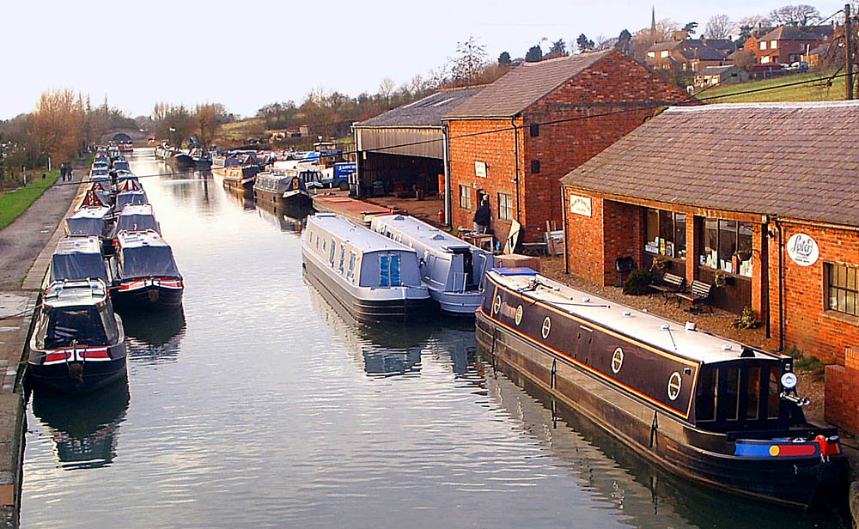
THE UNION CANAL in the oldendays

Slide 3
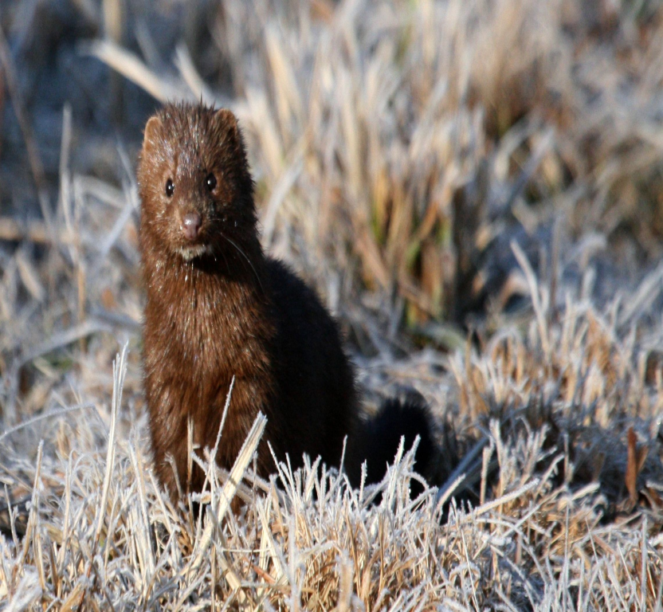
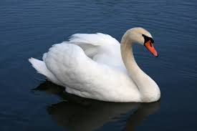
wild animal
minks
swans

Slide 4
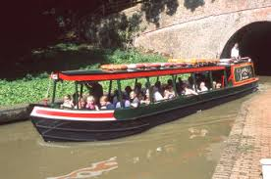
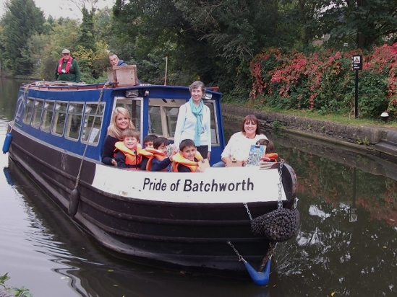
trips for schools

Slide 5
Goodbye
By CHARLEE MARIE OSCAR and FINN

